Slide 1

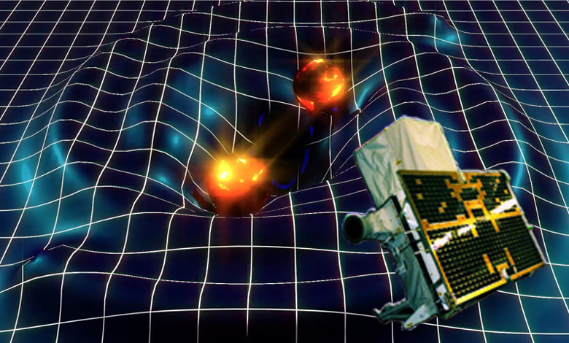
AGILE Data Center Activities
C. Pittori (coord), F. Lucarelli, F. Verrecchia (INAF), G. Fanari (TPZ/Serco)
14th AGILE WS, June 20-21, 2016

Slide 2


AGILE GS Architecture
S-Band
Kenya
ASI Malindi
Ground Station
Fucino, Italy
Fucino, Italy
ASINet
Fucino Gateway
Command, HK, Sci raw data
ASINet
Fucino Gateway
Calibration,
SW for data analysis, ...
Fucino, Italy
Command, HK, Sci raw data
Frascati, Italy
Satellite
Control
Center
TM L0 &
Aux Data
AGILE
DATA
CENTER
@ASDC
internet
Agile
Team
AGILE Data Center as SOC
Data
Mission
Control
Center
Mission Planning
Quick Look Analysis
Scientific Software
Data processing
Calibration Archive
Scientific Archive
Long Term Plan
Obs Planning File
AGILE Team Processing Group
Agile Pointing Program
APPC
AGILE Science Support Center at ASDC
Flight
Dynamics
Center
Products
and SW
ASINet
internet
Scientific
Community
AGILE Operation Control Center
AGILE Data Center
AO/GOP
Notes:
2

Slide 3
The ADC, based at ASDC, is in charge of all the scientific oriented activities related to the analysis and archiving of AGILE data:
Different kinds of users:
Internal ADC operators
AGILE Team scientists
AGILE Guest Observers
Scientific Community
From scientific telemetry (TM) Level–0:
Preprocessing → Level-1 data
Quick-Look Analysis (transient detection)
Standard analysis → Level-2 data (photon list)
Scientific analysis (source detection, diffuse gamma-ray background)
Archiving and distributing all scientific AGILE data
Notes:
3

Slide 4
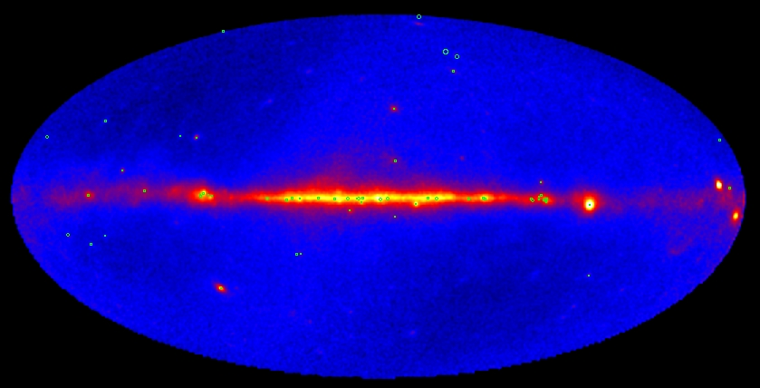
AGILE Total Intensity Map (E > 100 MeV)
Pointing + Spinning (up to April 2015)
(green circles: AGILE sources, first year of operations)
“The First AGILE-GRID Catalog of High Confidence Gamma-Ray Sources”, C. Pittori et al., A&A 506, 2009 and
“An updated list of AGILE bright γ-ray sources and their variability in pointing mode”, F. Verrecchia et al., A&A 558, 2013

Slide 5
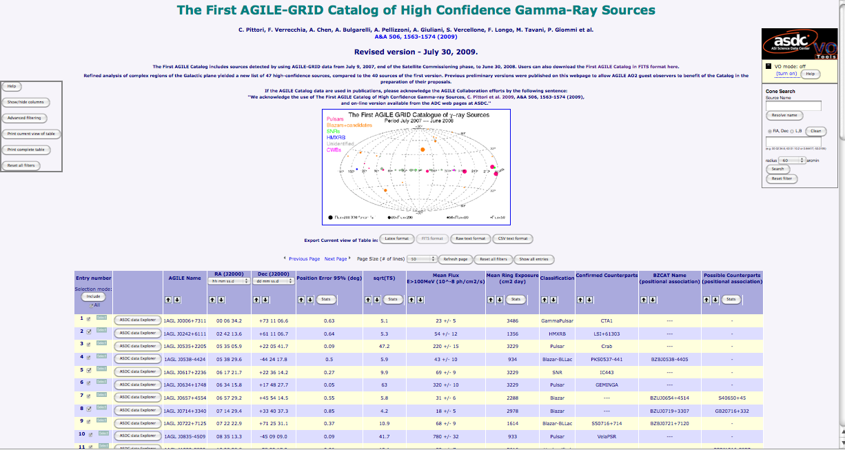
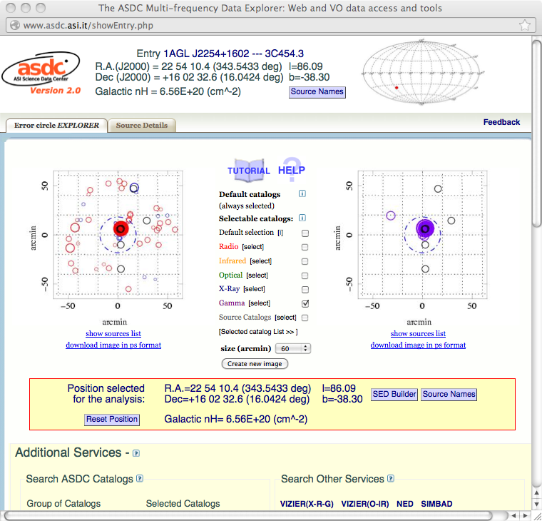
ASDC interactive catalogs webpages
ASDC Data Explorer Tool

Slide 6
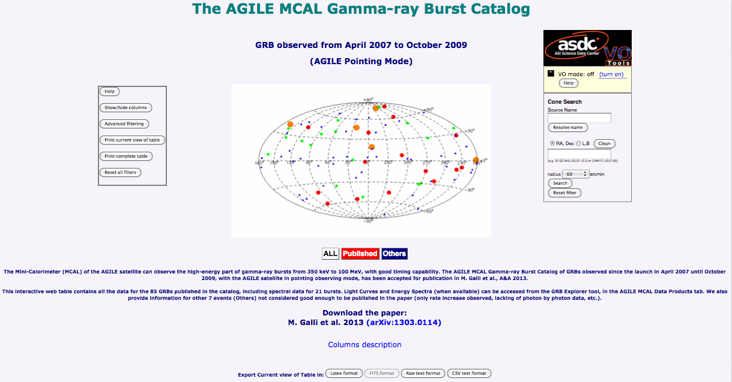
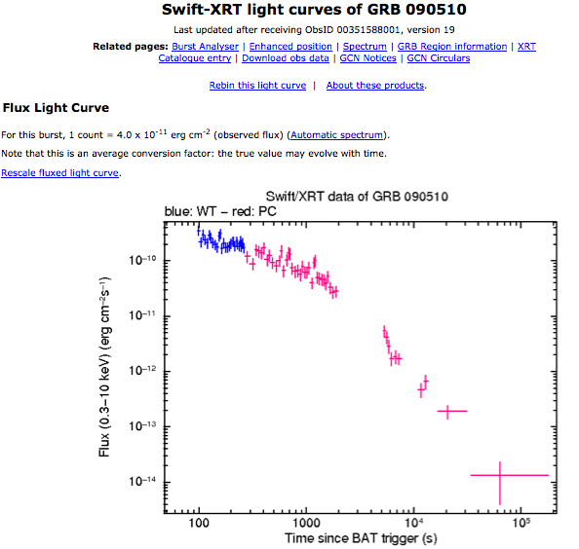
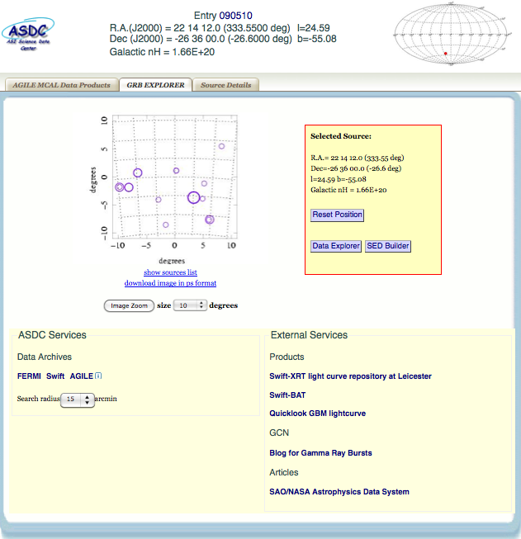
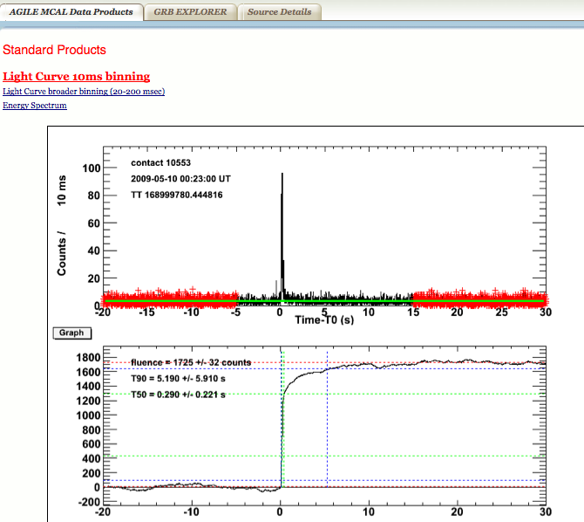
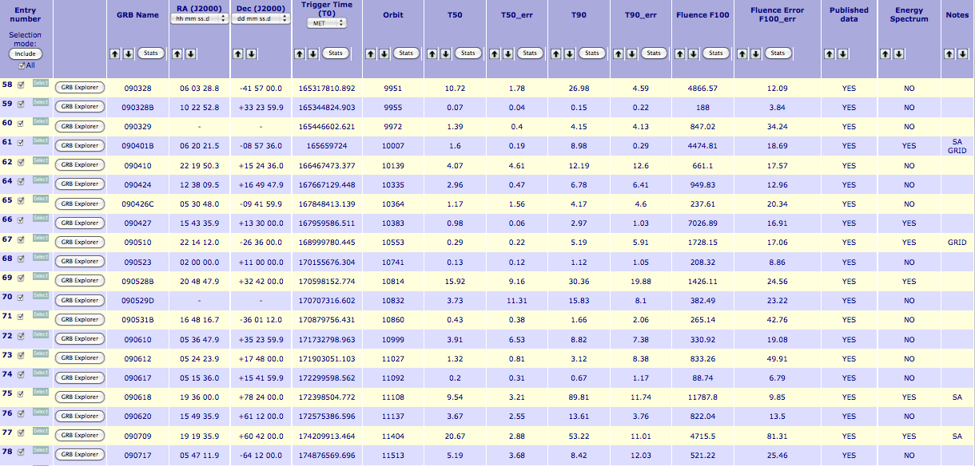
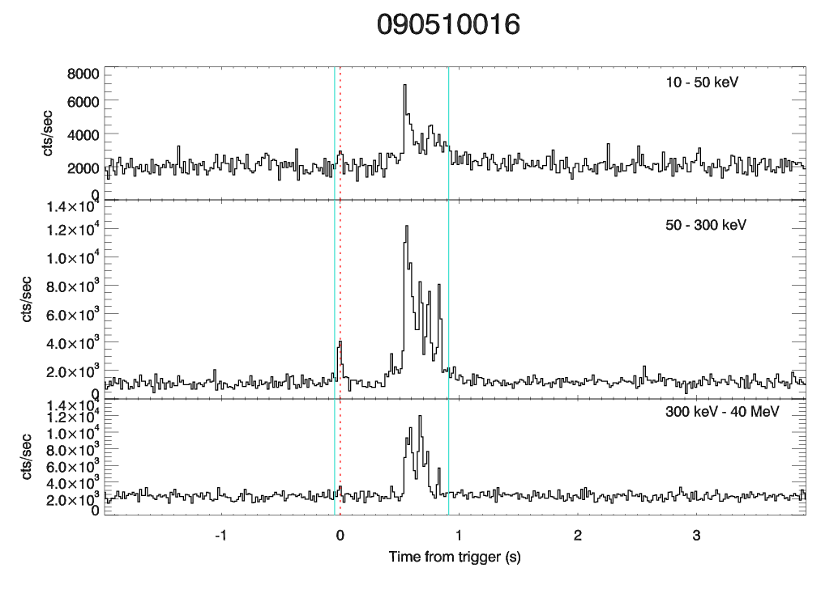
MCAL GRB Catalog (M. Galli et al., 2013) Interactive webpage

Slide 7
Variable sources and transients:
the AGILE Science Alert System
The system is distributed among the ADC @ ASDC and the AGILE Team Institutes (see Bulgarelli talk for details).
Automatic Alerts to the AGILE Team are generated within T₀ + 45 min (SA) and T₀ + 100 min (GRID)
GRID Alerts are sent via email (and sms) both on a contact-by-contact basis and on a daily timescale
Refined manual analysis on most interesting alerts performed every day (daily monitoring)
142 ATel (48 in pointing + 94 in spinning) and 44 GCN published up to June, 2016: recently several transient sources, new record gamma-ray flare from 3C 279, and a new Cyg X-3 flare.

Slide 8

AGILE: “very fast” Ground Segment
(with contained costs)
^{Satellite}
^{Malindi Ground Station}
^{~1 hr}
^{Fucino TZP MOC}
^{~0.5 hr}
^{ASDC}
^{Automatic}
^{data processing}
^{~0.5-1 hr}
^{AGILE Team}
^{~(2-2.5) hr}
^{Guest Observers}
Public data access
Record for a gamma-ray mission!
APP (iPhone, Android): AGILEScience

Slide 9
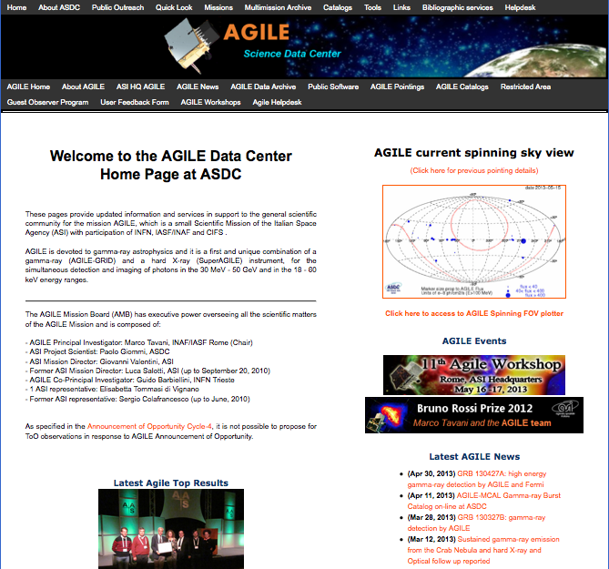

Slide 10
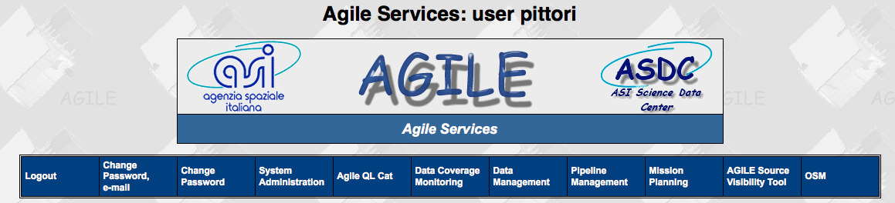
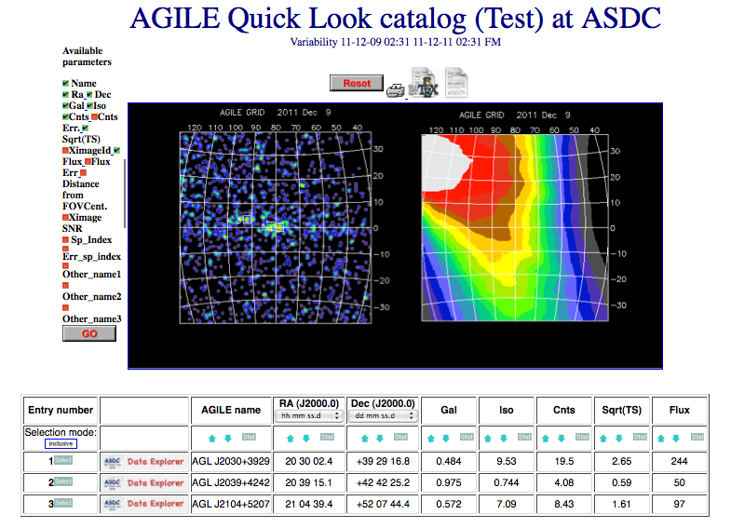
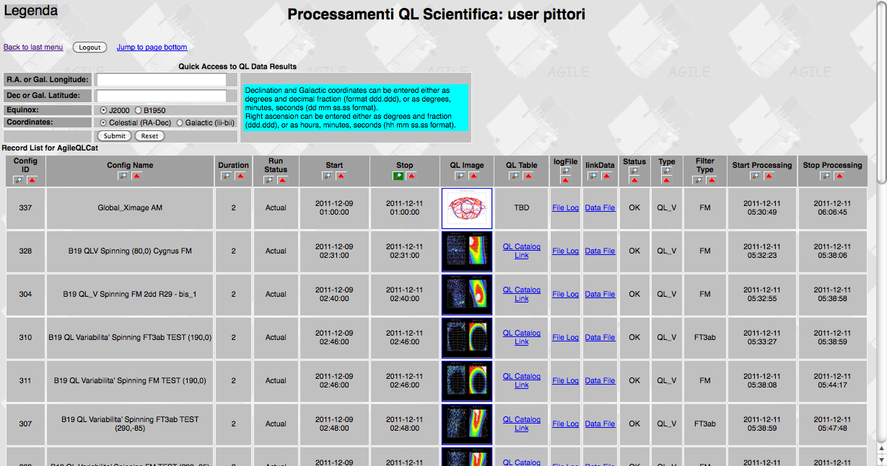
ADC Quick-Look Interface
(from AGILE Services restricted area)

Slide 11
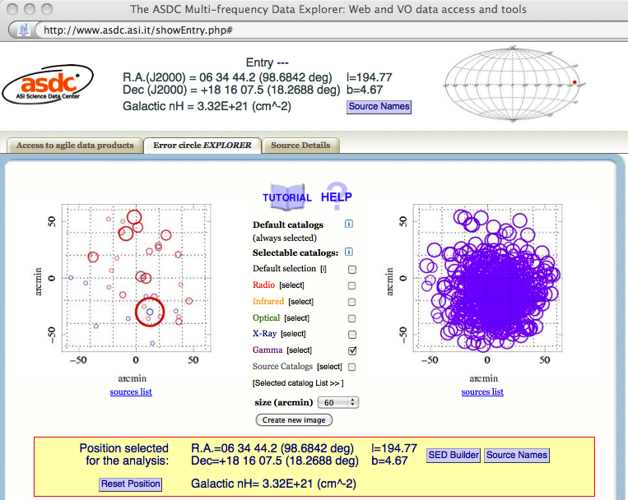
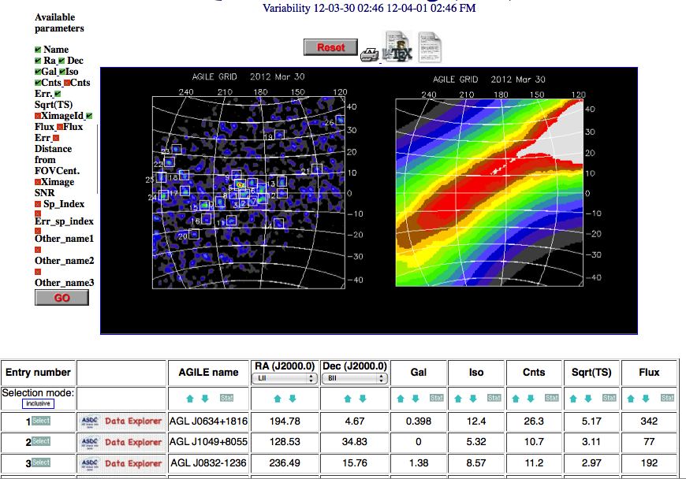
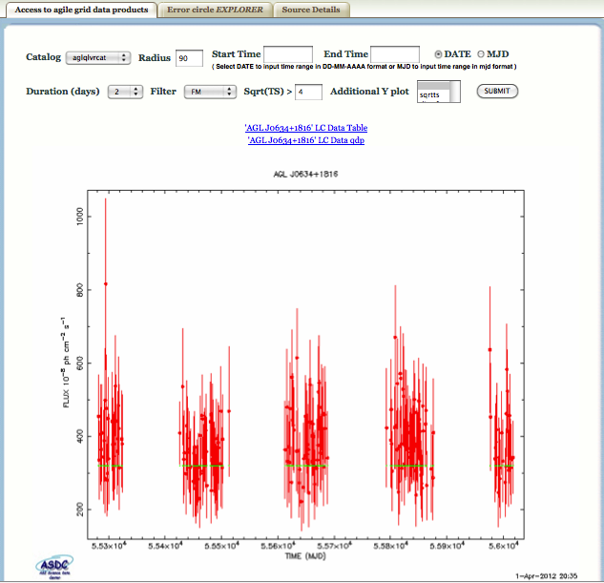
ASDC Data Explorer Tool
Quick Look AGILE database and automatic light curves

Slide 12
AGILE: 9th year in orbit
Pointing observation mode up to October 18, 2009 and spinning observation mode since October 2009, surveying a large fraction (~80%) of the whole sky each day.
All AGILE functions are NOMINAL. Mission operations funded by ASI at least till 2017.
Guest Observer Program open to the scientific community up to 2011: 4 ASI Announcements of Opportunity from Cycle-1 to Cycle-4 (Dec. 1, 2007– Nov 30, 2011).
.
Cycle-5, 6, 7 and 8: completed (Dec.1, 2011 – Dec. 31 2015) Cycle-9: on-going data taking.
Notes:
12

Slide 13
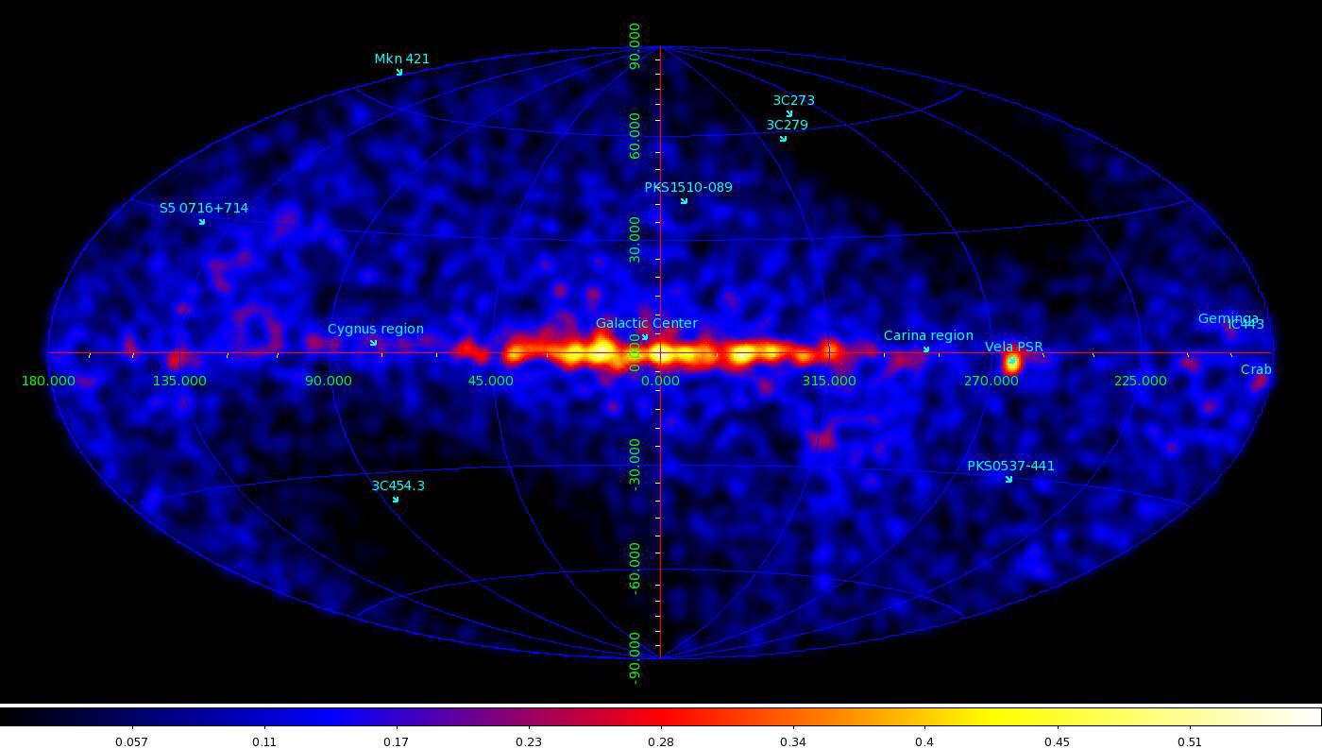
AGILE, gamma-ray sky, 8 March, 2016, 00:30 UT
AGILE in “spinninng” with its large FoV of about 60 degrees
covers 80% of the sky every 7 min (except the Sun/antiSun direction)

Slide 14
Activities in view of the new GW-pipeline
New software builds, new calibrations, new GRID pipelines optimized for timing.
Latency in QL data processing further reduced in 2016.
Reprocessed archive from July 1st 2015, (after the leap second of June 30, 2015) to December 2015 under validation.

Slide 15
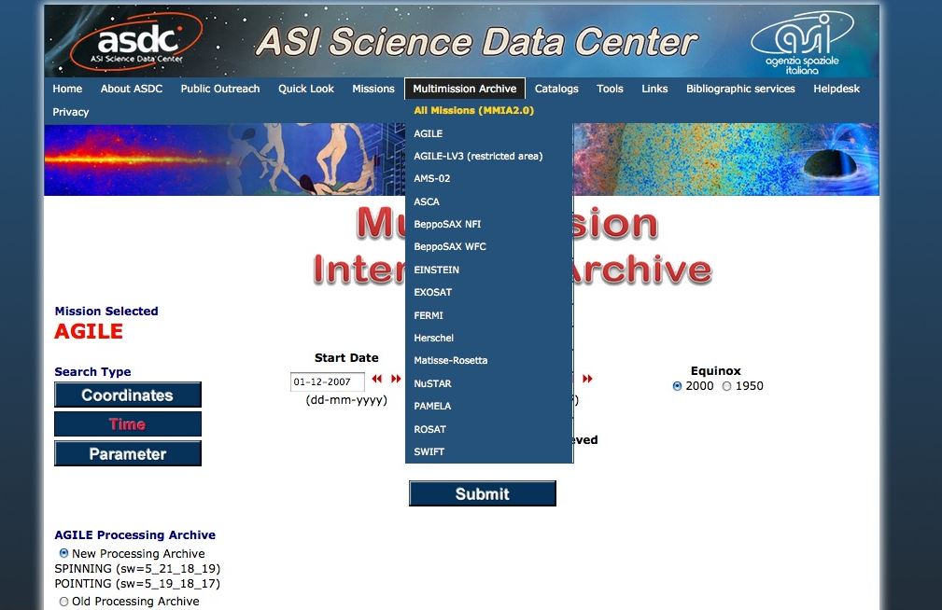
  NEW AGILE Data Publication Policy:
  The AGILE Mission Board suggested in 2015 to eliminate the one year proprietary period.
The public AGILE archive now contains
all data from Dec 2007 up to June 2015
(from Cycle-1 to Cycle-8)
New Cycle-9 data will become public
in early September.

Slide 16
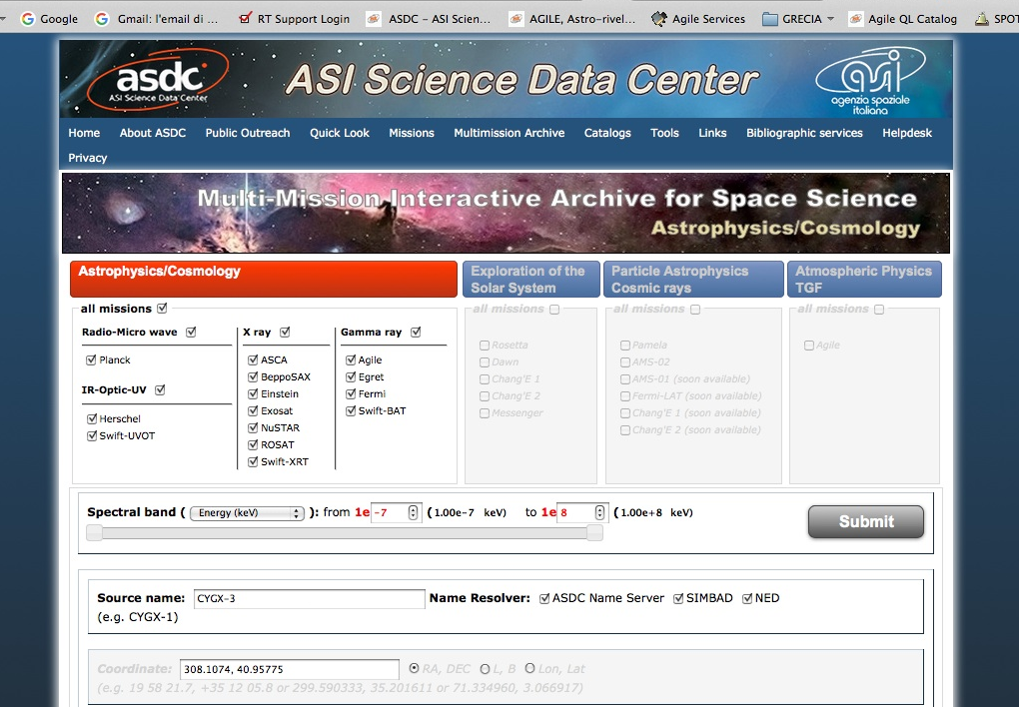
  NEW ASDC/SSDC MMIA 2.0:
  Not only Astrophysics, but also Terrestrial Physics (Note AGILE unifying role!)

Slide 17
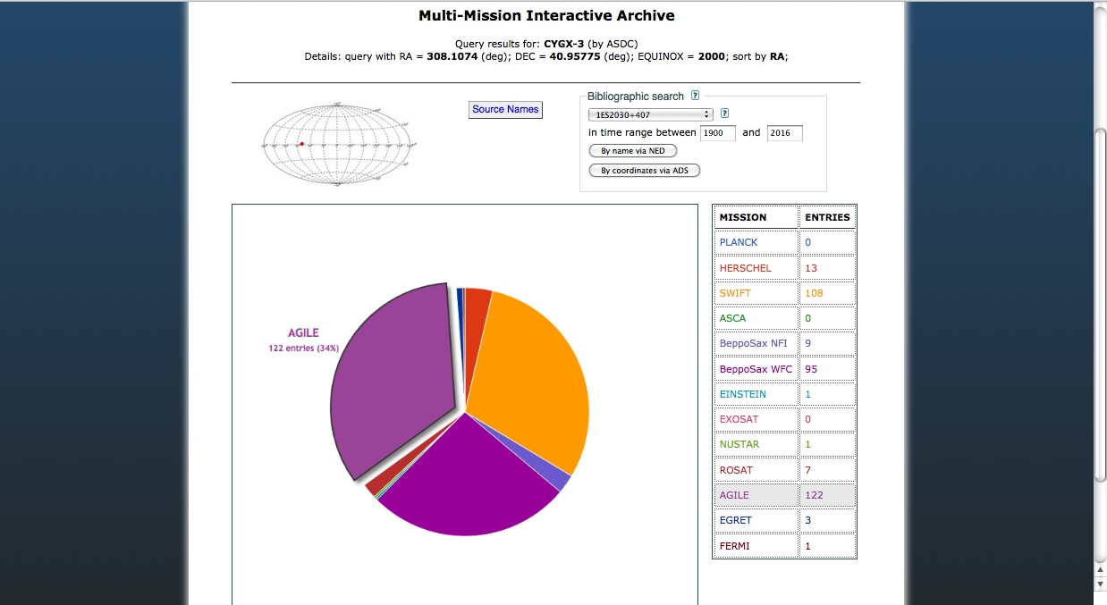

Slide 18
Non only gamma-rays from cosmic origin
but also: surprises from the EARTH atmosphere!

Slide 19
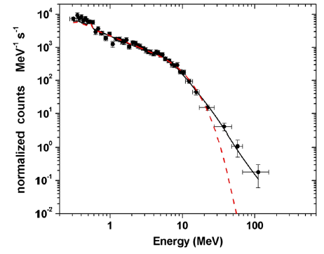
TGF Cumulative spectrum
In 2011: 110 TGFs 1806 photons 142 γ E> 10 MeV 26 γ E> 20 MeV
Broken powerlaw model β = -2.7
Significant detection of γ
>40 MeV!! Uneplained by standard RREA model: challenge for emission models
RREA cutoff powerlaw model
AGILE-MCAL crucial spectral contribution up to 100 MeV!!
Tavani et al., Phys. Rev. Letters 106, 018501 (2011)
Notes:
19
19

Slide 20
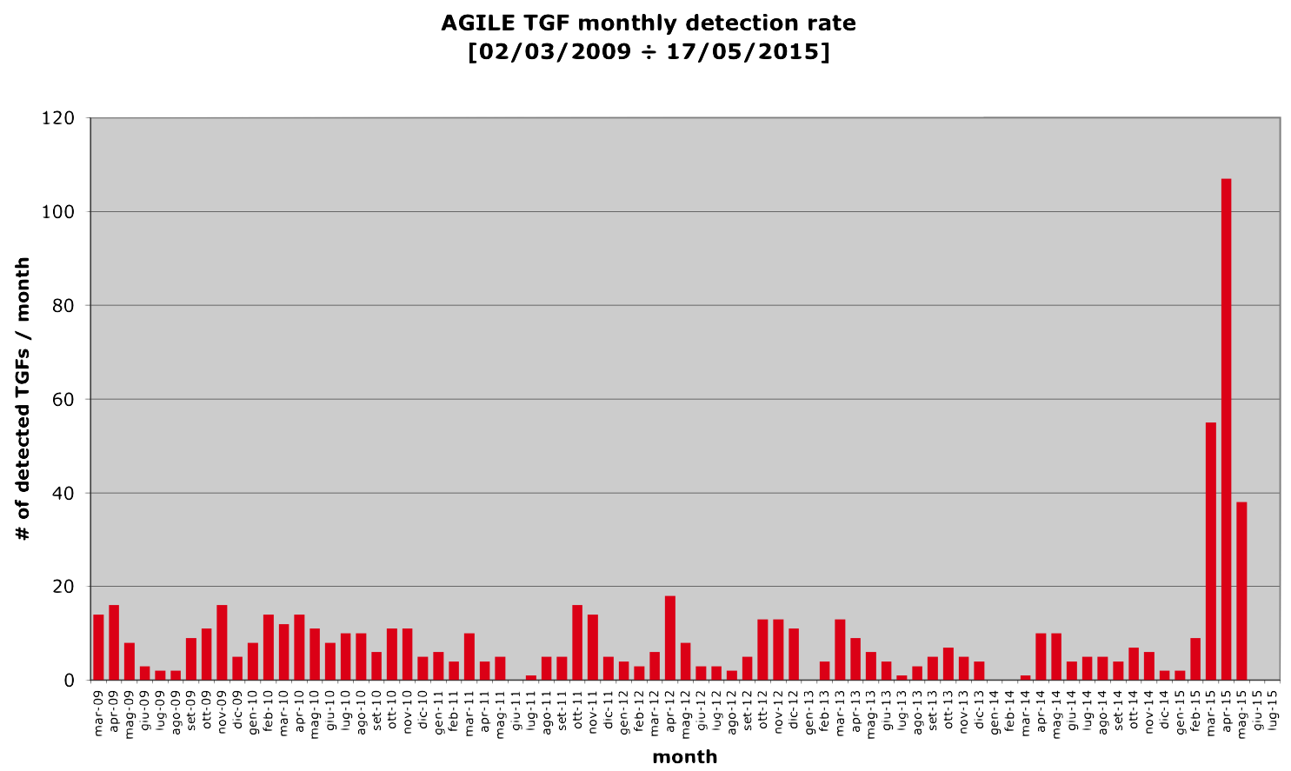
Recent change on the on-board configuration to
reduce MCAL dead time: submillisecond timescales
factor > 10
increase in
TGF detection rate!

Slide 21
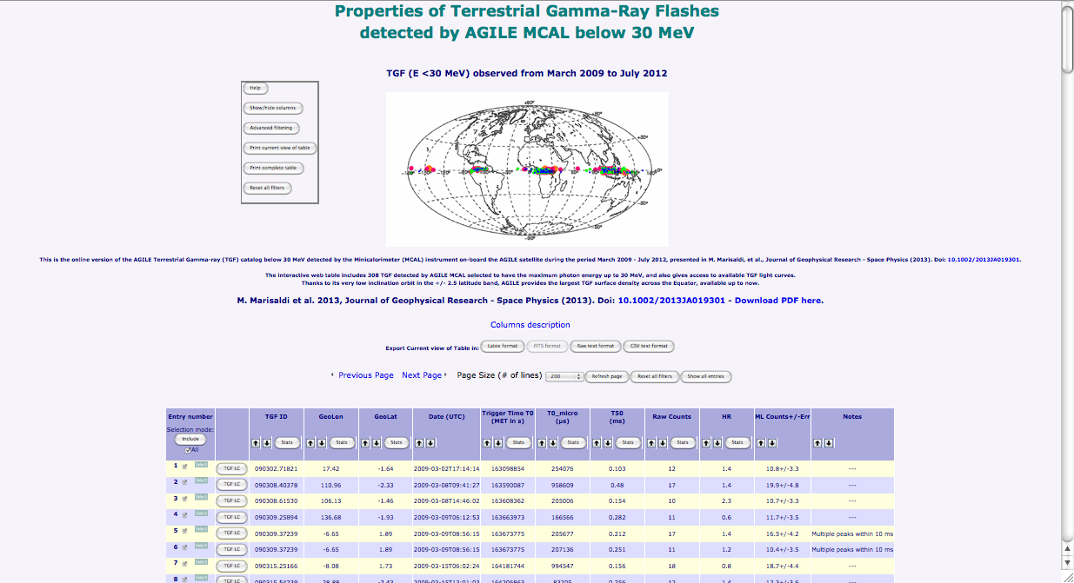
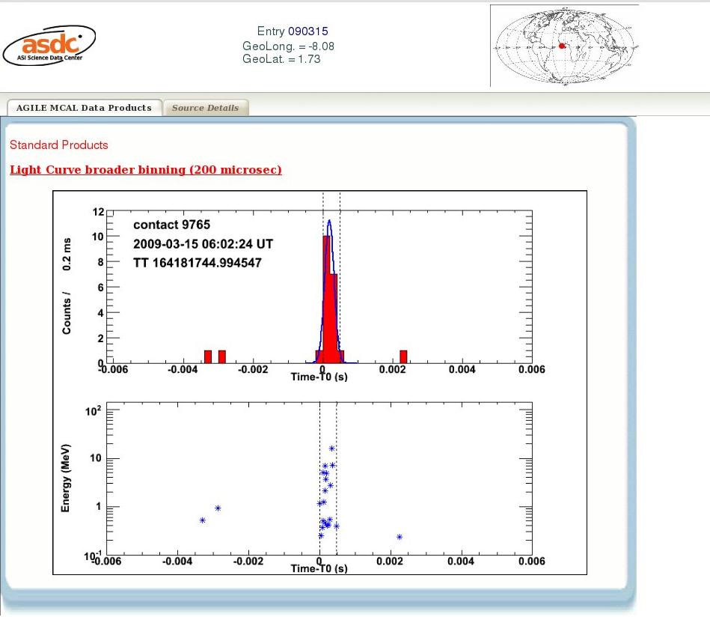
MCAL TGF Catalogs
ASDC interactive webpages:
www.asdc.asi.it/mcaltgfcat

Slide 22
FUTURE: A NEW Real Time Pipeline to
Link Meteorological Information
and TGFs Detected by AGILE
^{Satellite}
^{Malindi Ground Station}
^{~1 hr}
^{Fucino TZP MOC}
^{~0.5 hr}
^{ASDC}
^{Automatic}
^{data processing}
^{~0.5-1 hr}
^{AGILE Team}
^{~(2-2.5) hr}
Extend also to Terrestrial data
the ASDC expertise on web based
interactive tools and cross-correlations
among different DBs and archives
^{Guest Observers}
Public data access

Slide 23
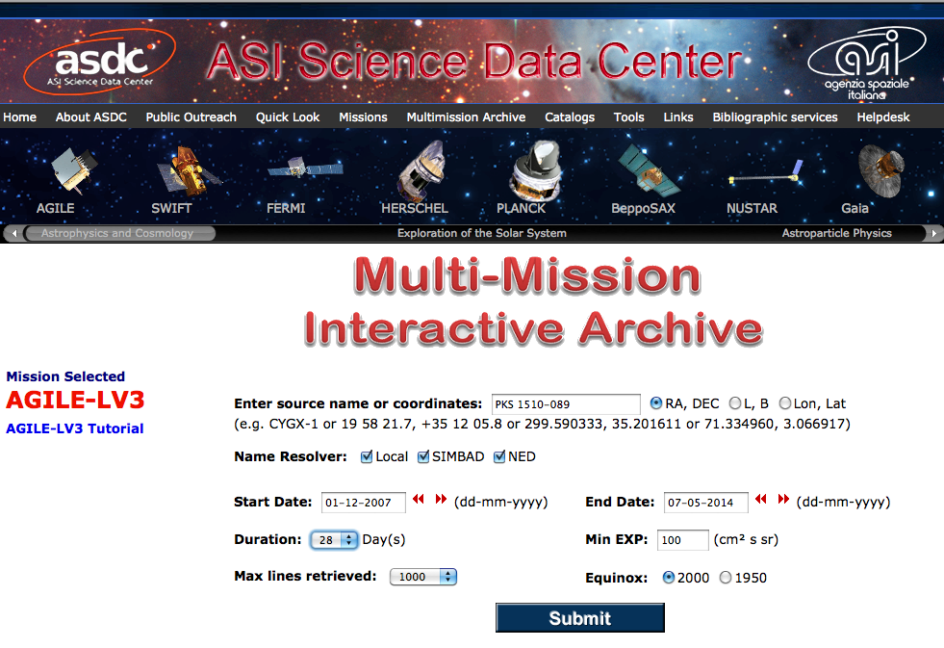
Working prototype
interfaced with other ASDC tools
(password restricted access)
NEW TOOL: web interface for official interactive on-line ML analysis on AGILE data.
Tested also with students, will be open access in early September!
Duration:
1, 2, 7, 28 days

