Slide 1


The detection of Gravitational Waves
Fulvio Ricci
Virgo Spokesperson
INFN Rome
&
University of Roma Sapienza

Slide 2
LIGO & VIRGO
In 2004 LIGO and Virgo started a first exercise to test the data exchange and compare the software performance developed in the two collaborations.
In 2007 a formal Memorandum of Understanding (MoU) between the two collaborations was signed: “”We intend to carry out the search for gravitational waves in a spirit of teamwork, not competition. “”
“”The terms governing work on data analysis are exclusive; that is, the parties agree that all of the data analysis work that they do will be carried out under the framework of this agreement…omissis…, all subsequent observational data will be open to both collaborations, to be used in the framework of Joint Data Analysis Groups on all gravitational wave analysis topics. All gravitational wave data analysis will be carried out under the umbrella of this agreement between LIGO and VIRGO; there will be no LSC-only or Virgo-only gravitational wave data analyses while this agreement remains in force. “”

Slide 3

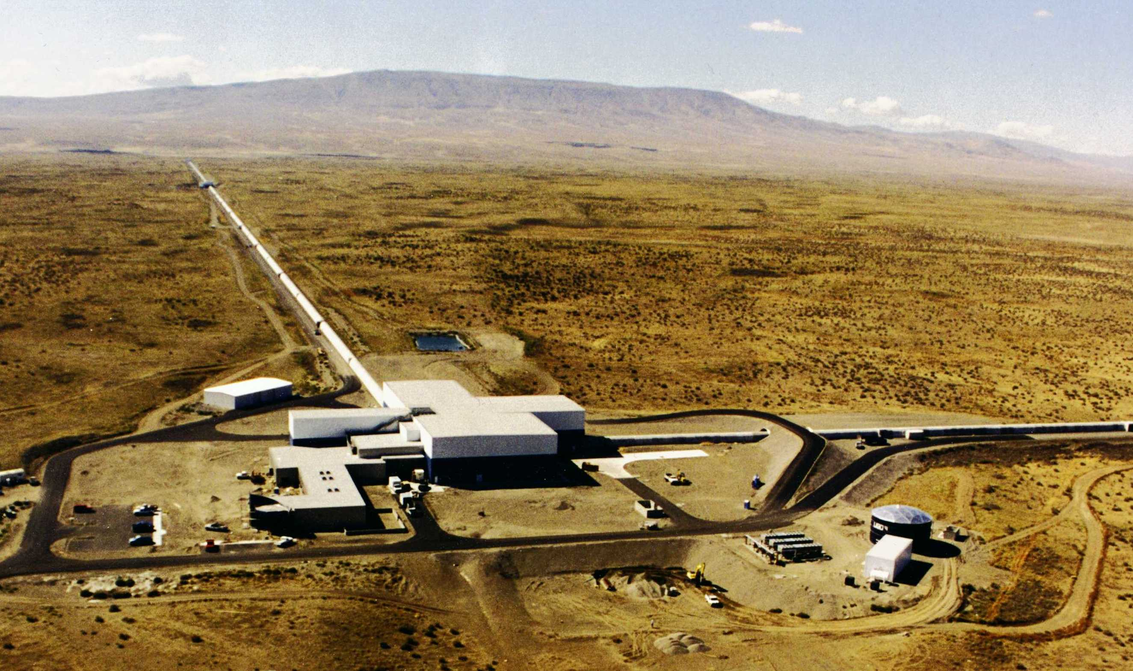

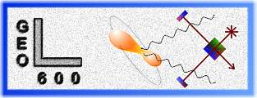
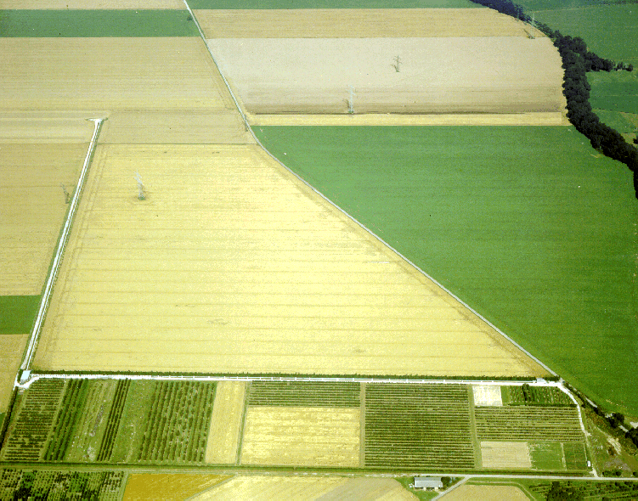
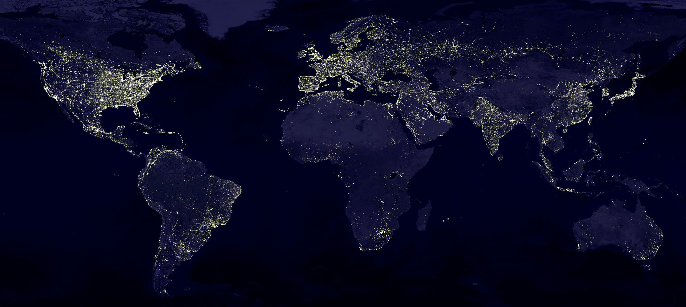
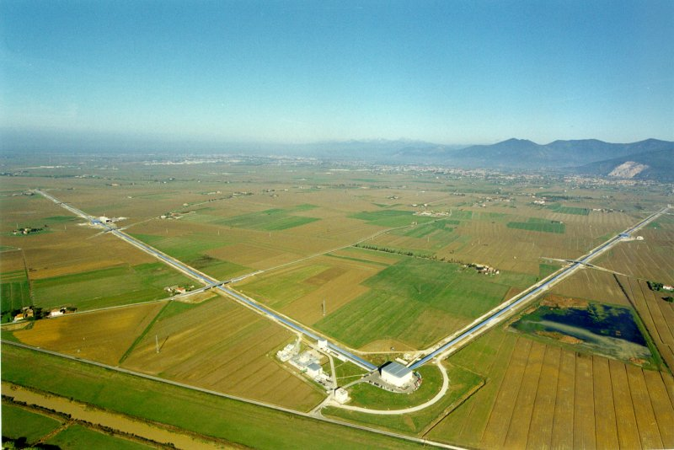
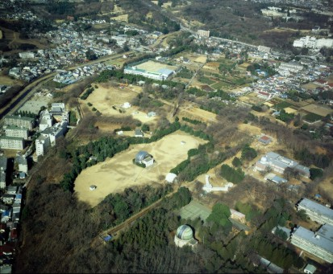
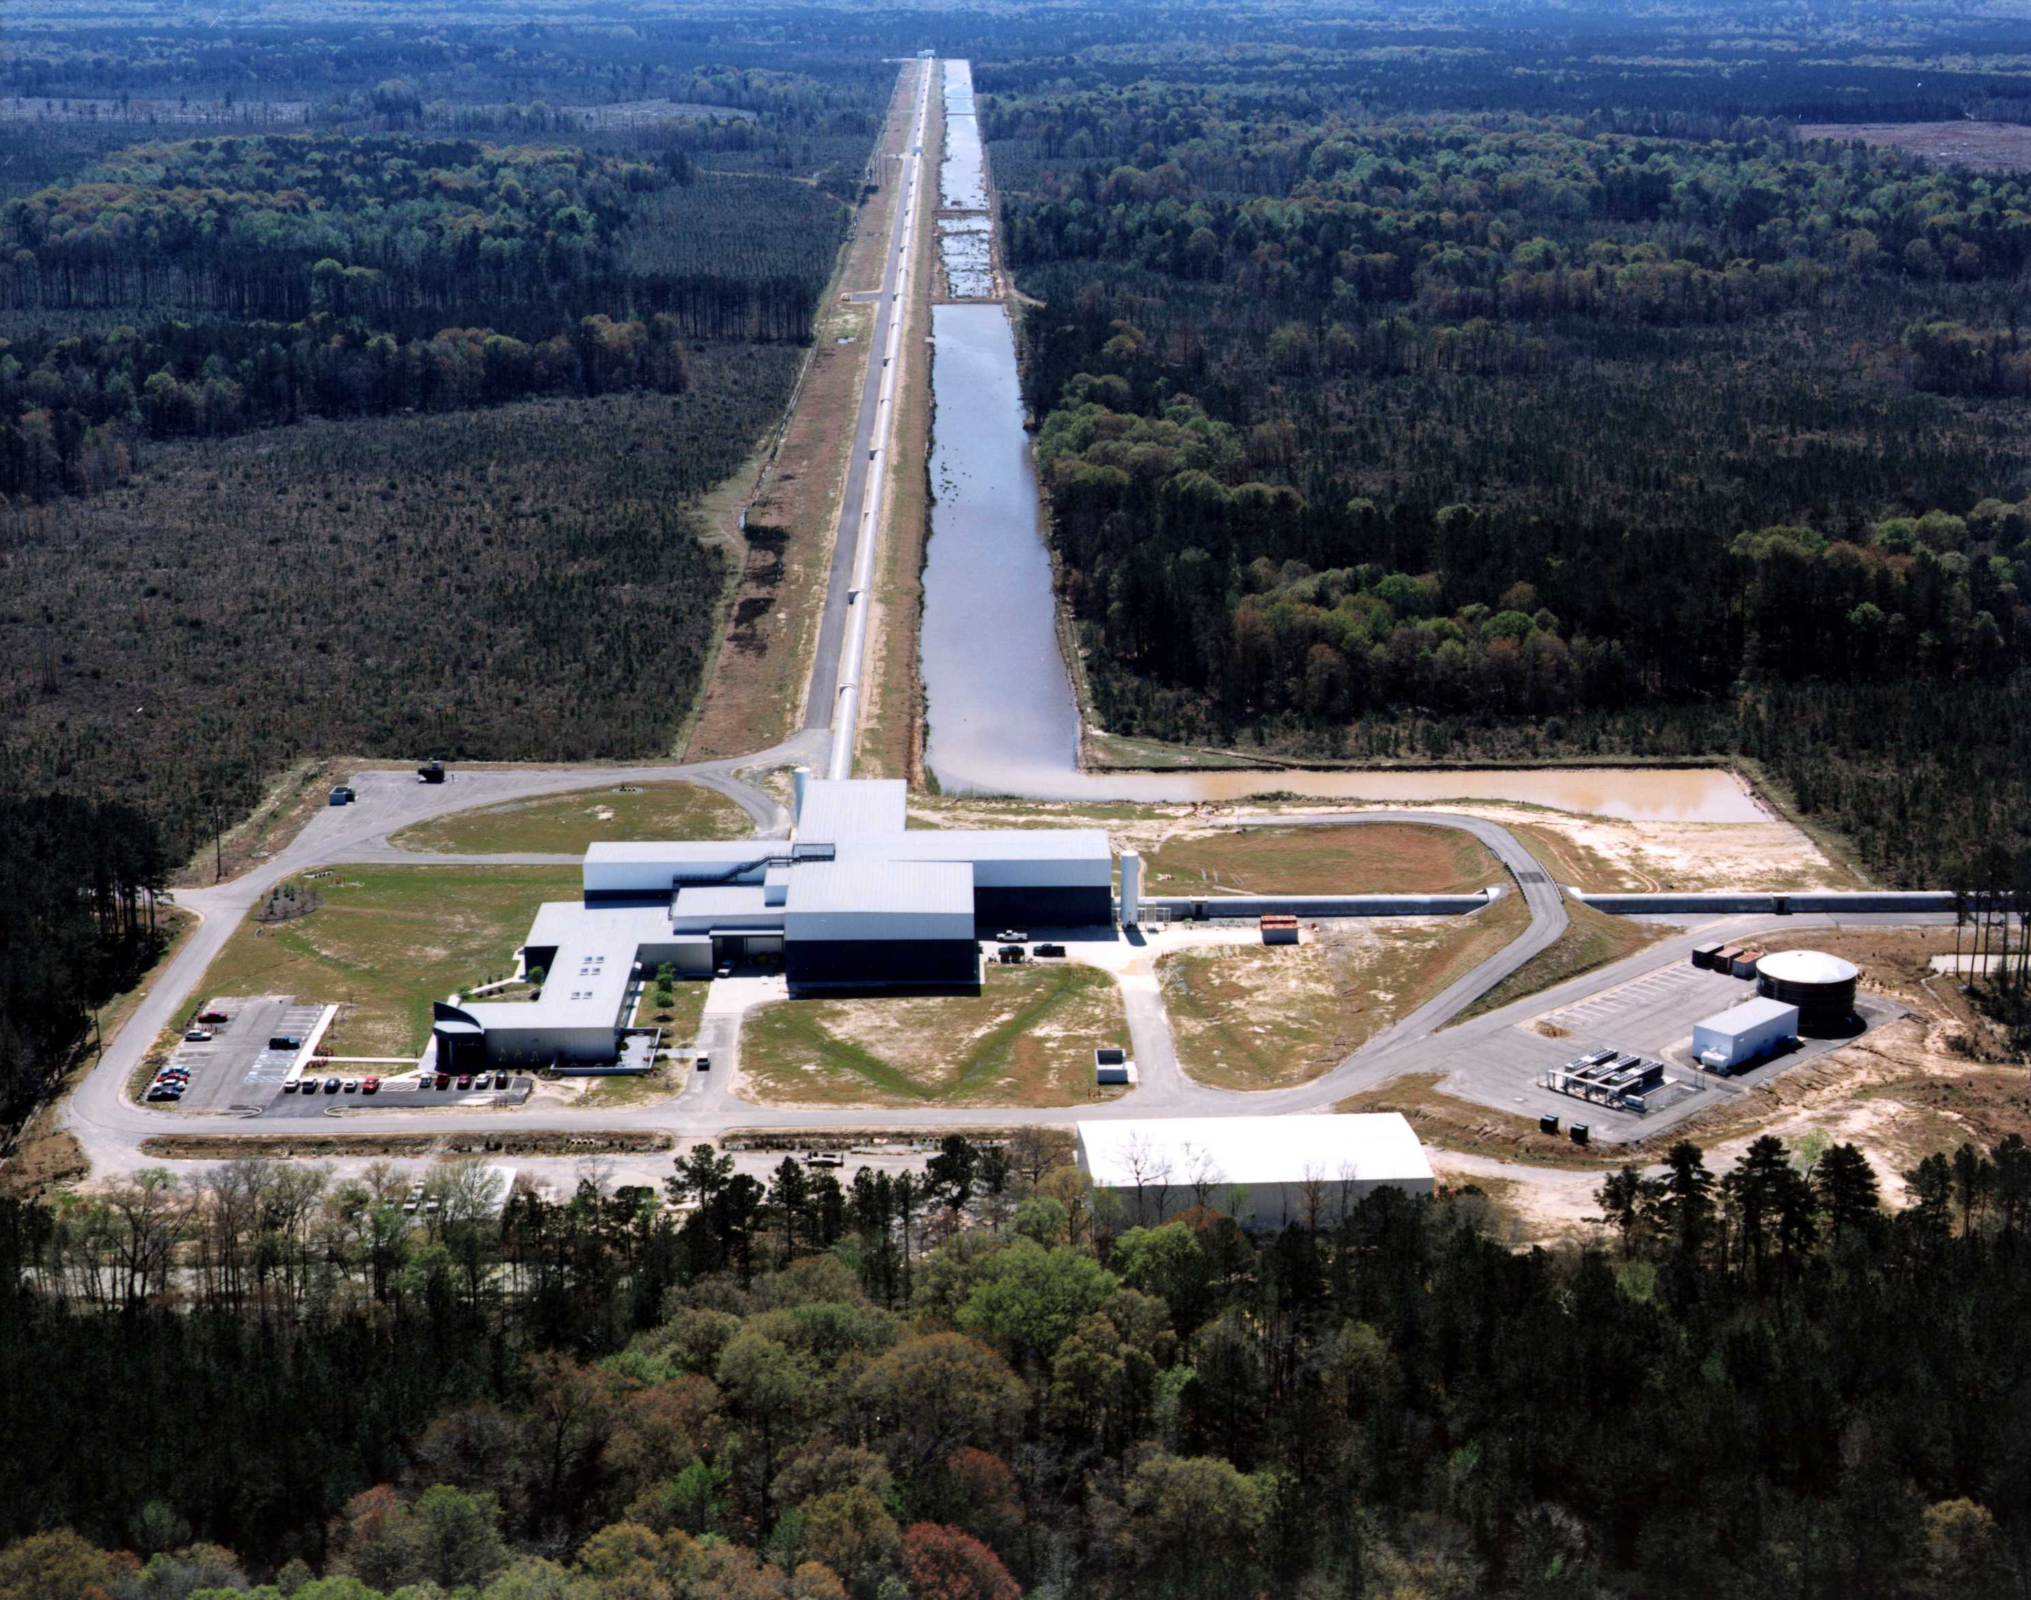

The network since 2007
MOU to be signed between LIGO Scientific Collaboration and Virgo:
  Full exchange of data, joint analysis
  Coordinate science runs, commissioning and shutdowns
  Joint publications
4 detectors to operate as a SINGLE MACHINE
Great scientific value added

Slide 4
GW Science From First Generation(2007-2011)
PRD 85 (2012) 08202
- Mpc
250
H1
L1 V1 H2
S6 L1
Excluded
Livingston Hanford
200
S6 H1
Rate - events / year / Mpc³
₁₀--4
Inspiral Horizon Distance
150
S5 L1
S5 H1
₁₀--6
Plausible Rate Estimates
100
VSR2
S5 H2
50
Virgo
₁₀--8
VSR3
VSR1
0
₁₀-10
0
5
10 15
Total mass - M0
20
25
NS-NS
NS-BH
BH-BH

Slide 5
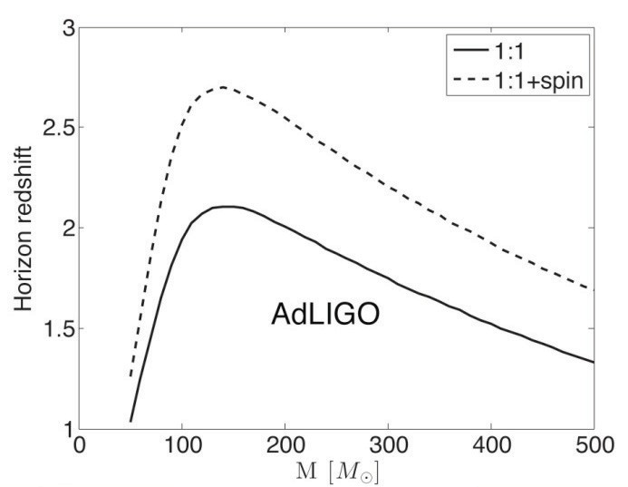
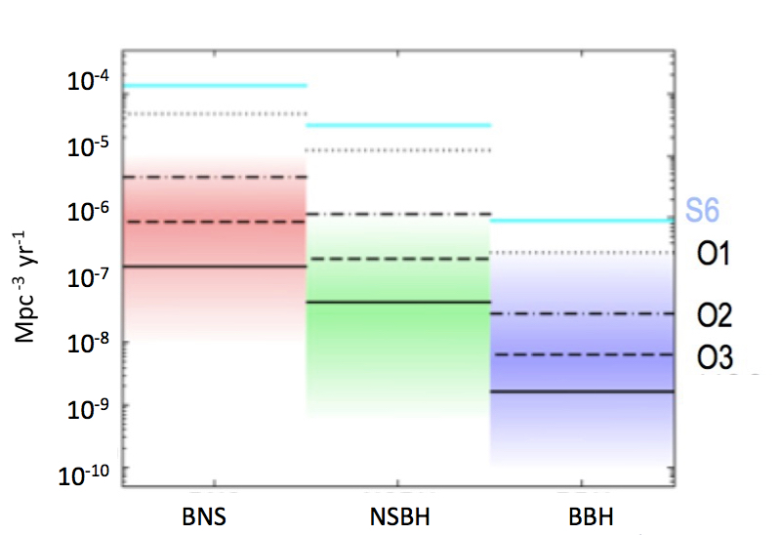
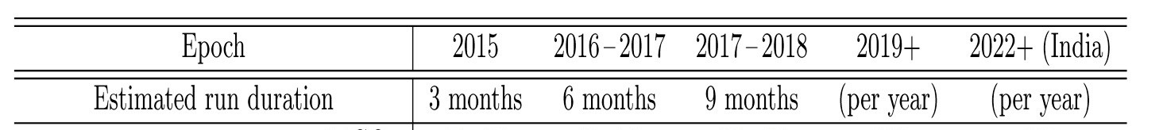
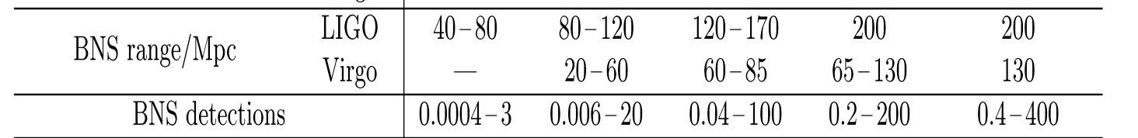
Compact Coalescing Binaries
Detection perspectives with advanced detectors Phys. Rev D85 (2012) 082002GW
Mandel 2015
Models
Probe beyond local universe 100 M⊙ + 100 M⊙ BBH visible out to ~16 Gpc at design sensitivity (~5 Gpc in O1), even further if the source is spinning

Slide 6
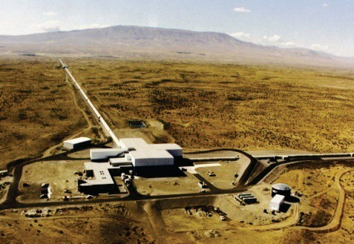
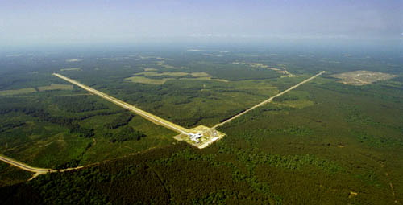
The first observing run of LIGO in the advanced configuration took place from September 12, 2015 to January 19, 2016
Total coincident time:
51.5 days
The data quality checks reduce the hunting time to: 48.6 days

Slide 7
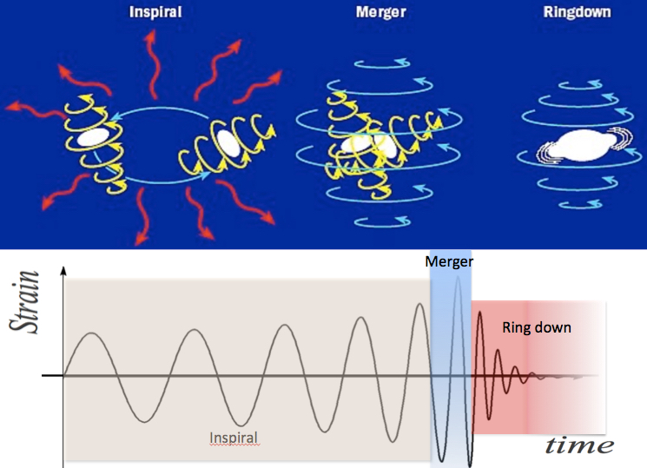
The search for black hole signals is performed over a range of frequencies from 30 Hz to several kHz.
These are the typical frequencies of the gravitational waves emitted during the late inspiral, merger and ringdown of stellar mass black hole binaries.

Slide 8
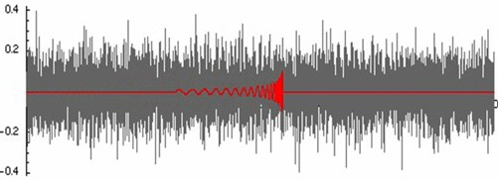
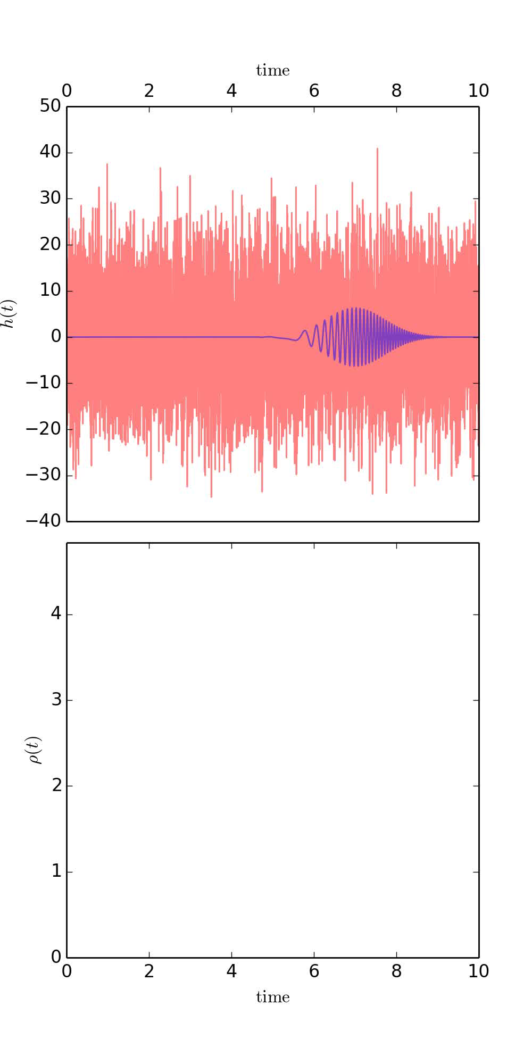
THE SEARCH METHOD: MATCHED FILTER
The matched filter, commonly used in radar, is obtained by correlating the hypothetical signal with the interferometer output signal to infer the presence of the gravitational wave signal hidden in the data.
Notes:
A

Slide 9
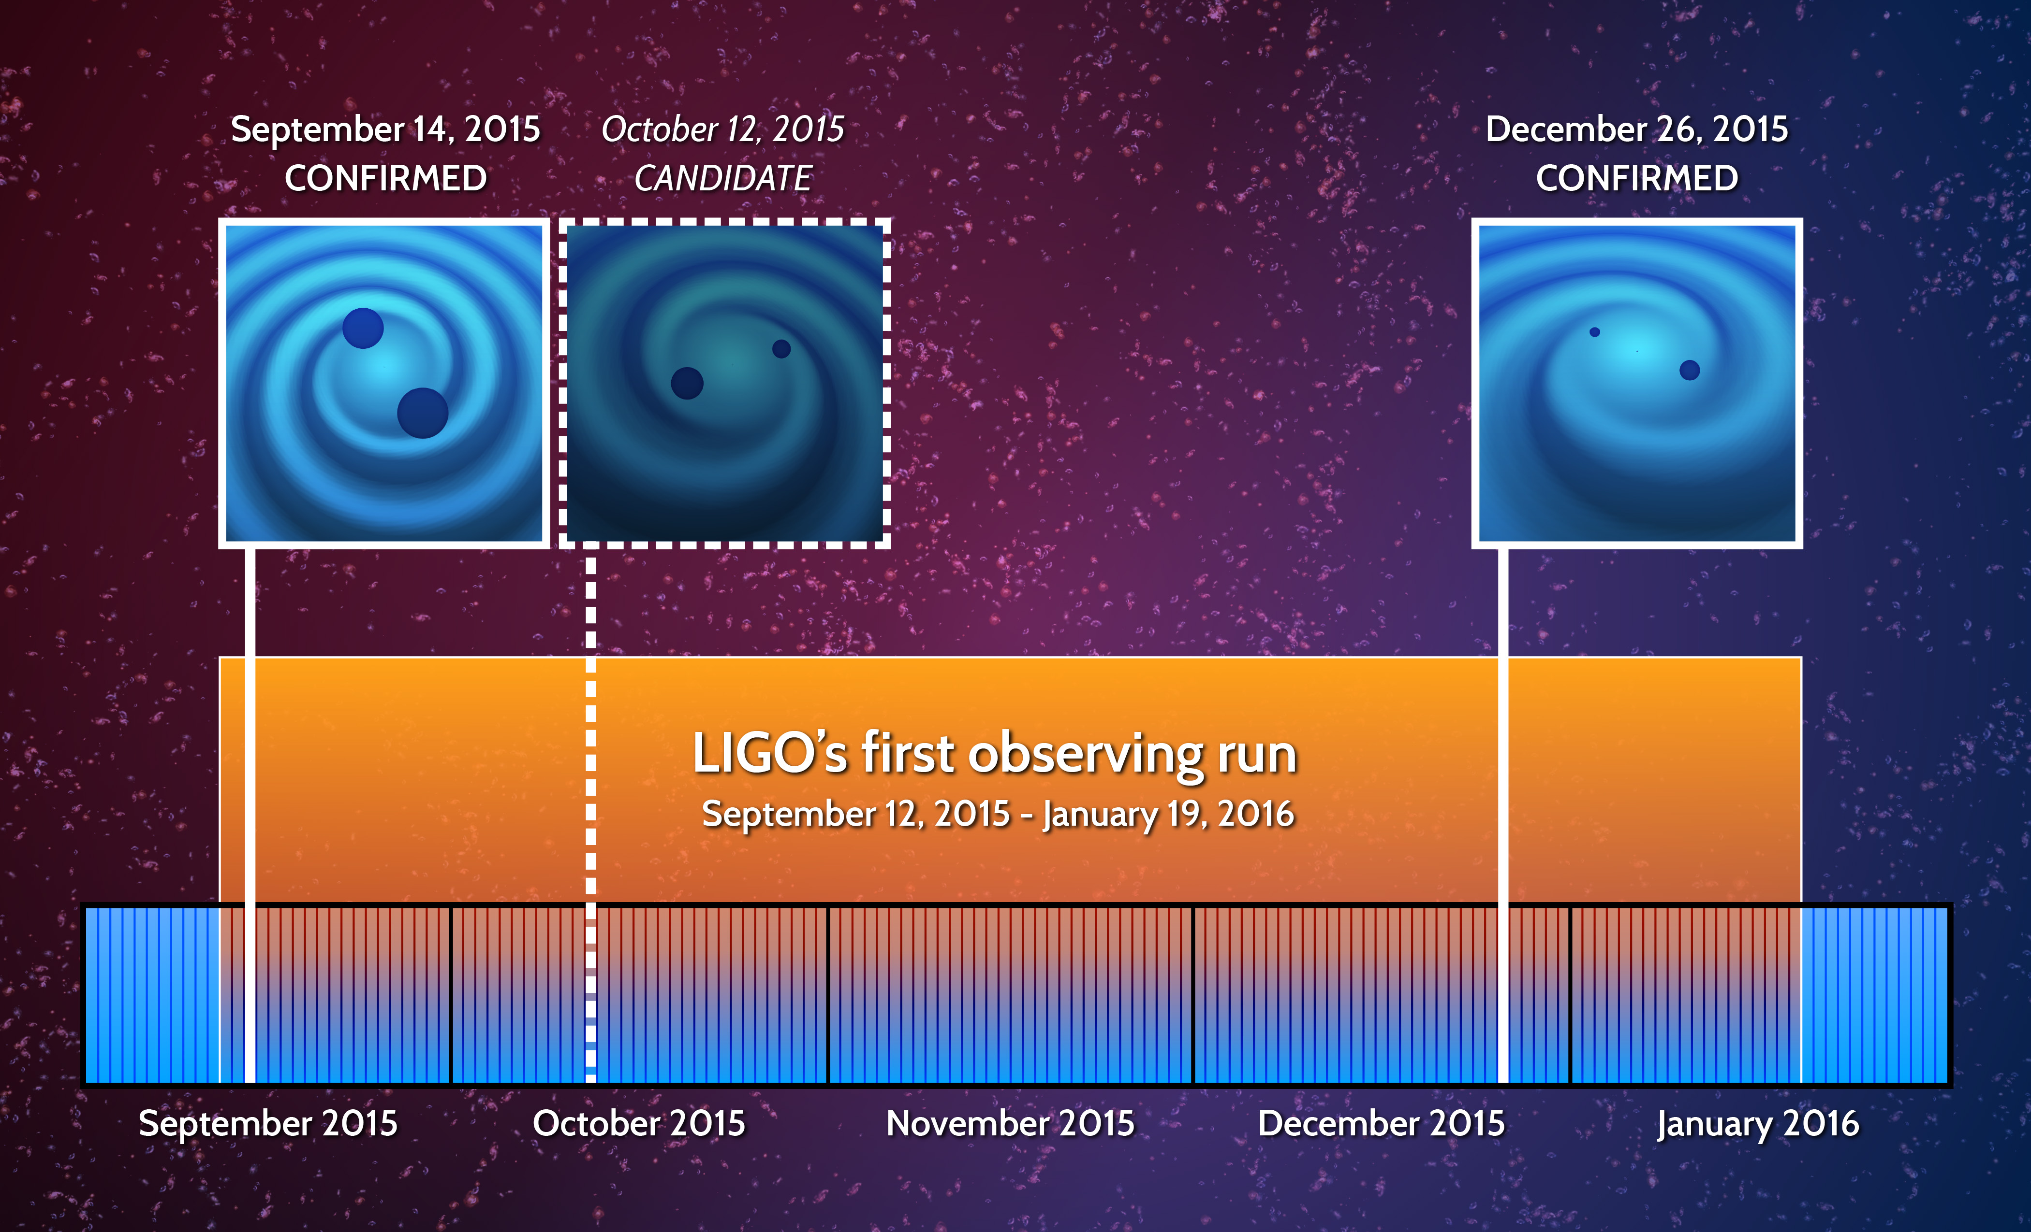

Slide 10
The search identified two black hole mergers:
GW150914 ➔ Signal/Noise =24
GW151226 ➔ Signal/Noise = 13
+
LVT151012 ➔Signal/Noise =9.7
While we are not so confident to tag this as a detection, it is more likely to be a gravitational wave signal than not

Slide 11
Significance of the three signals

Slide 12
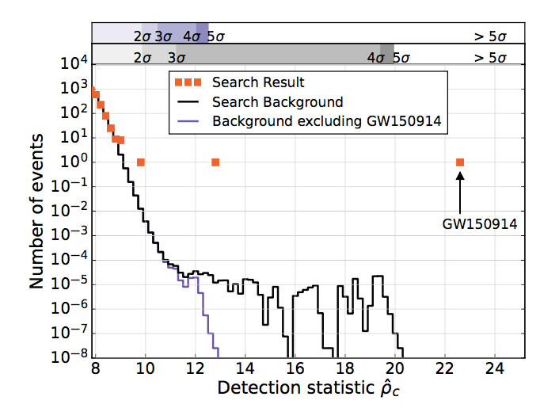
GW151226
LVT151012

Slide 13
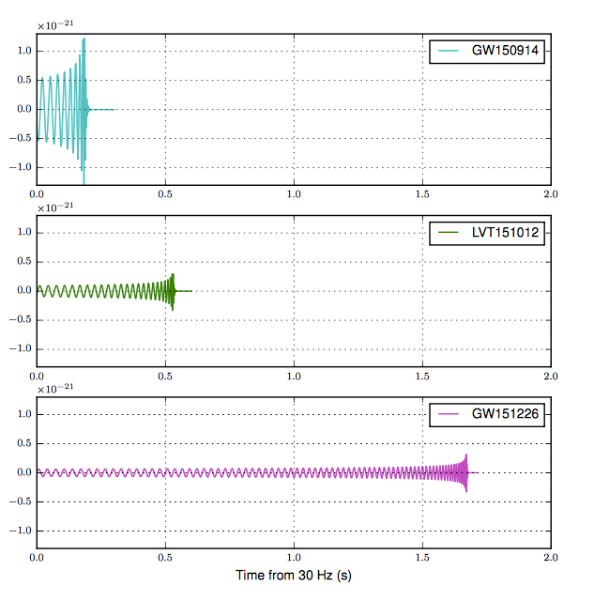
Comparison of the three signals in the time domain
Final mass 62 times that of the sun
Final mass 35 times that of the sun
Final mass 21 times that of the sun

Slide 14
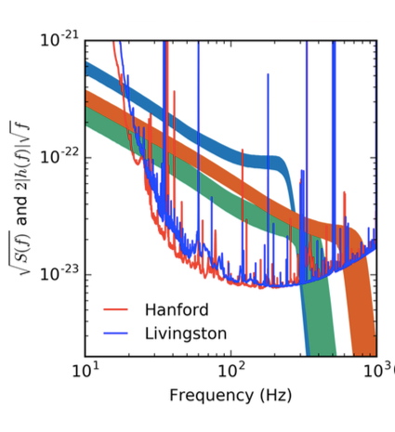
Spectral components of the triggers
GW150914
GW151226
LVT151012

Slide 15
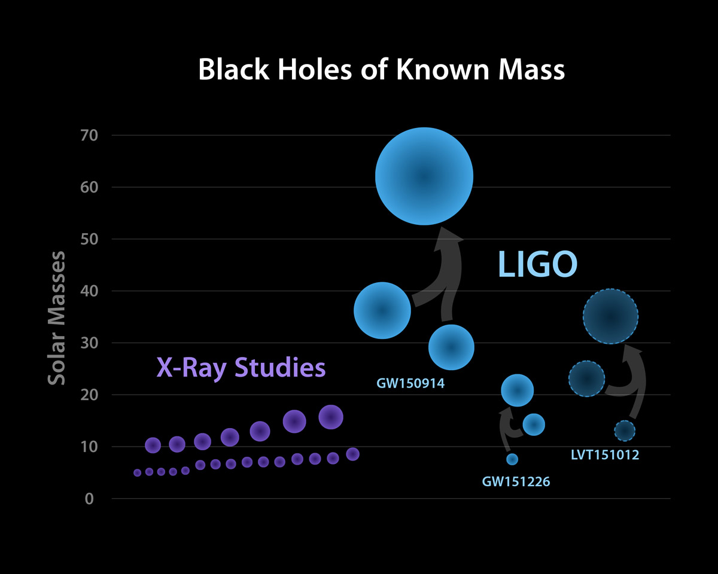

Slide 16
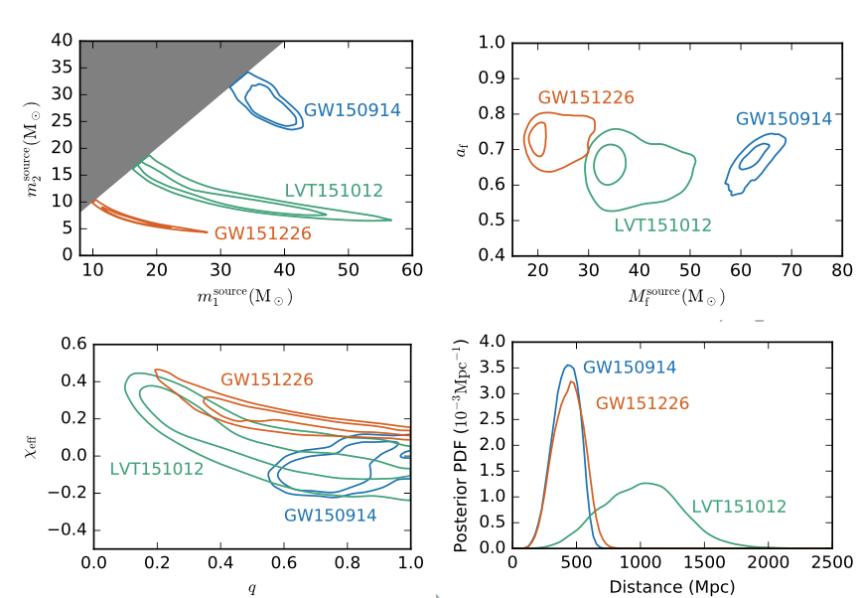
90% contour plots of the BBH perameters

Slide 17
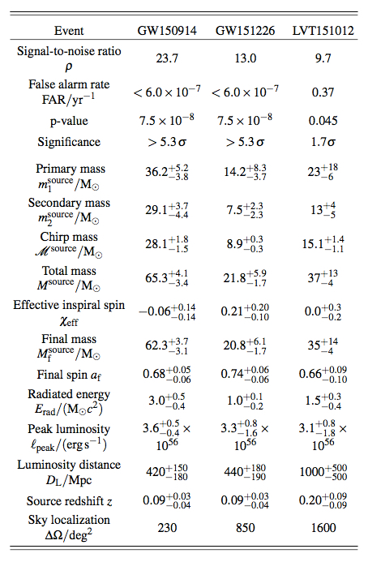

Slide 18
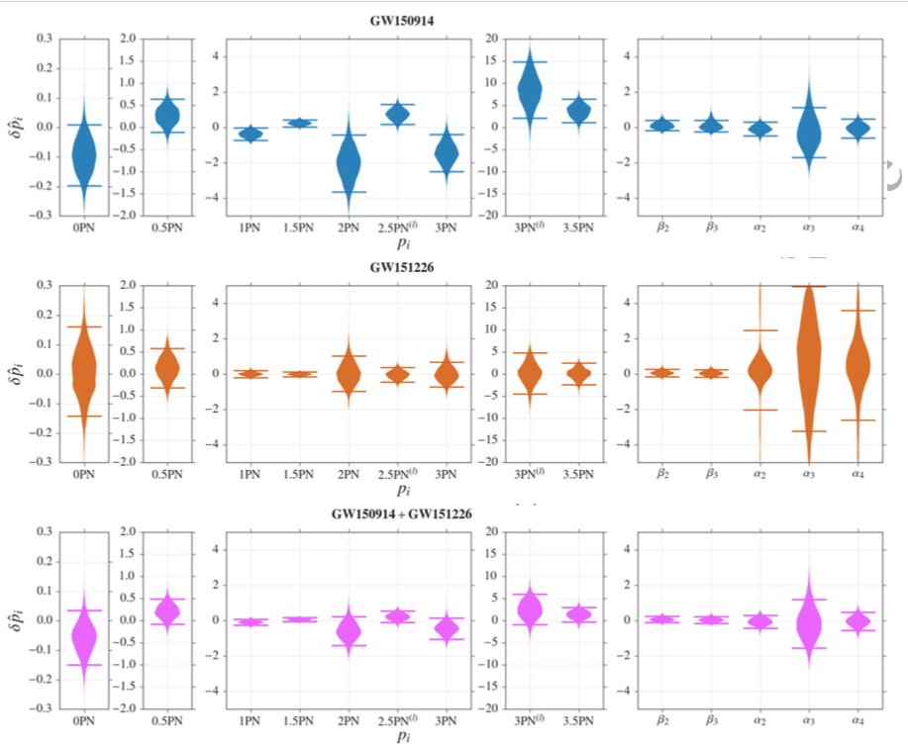
General Relativity tests in the strong interaction regime -I

Slide 19
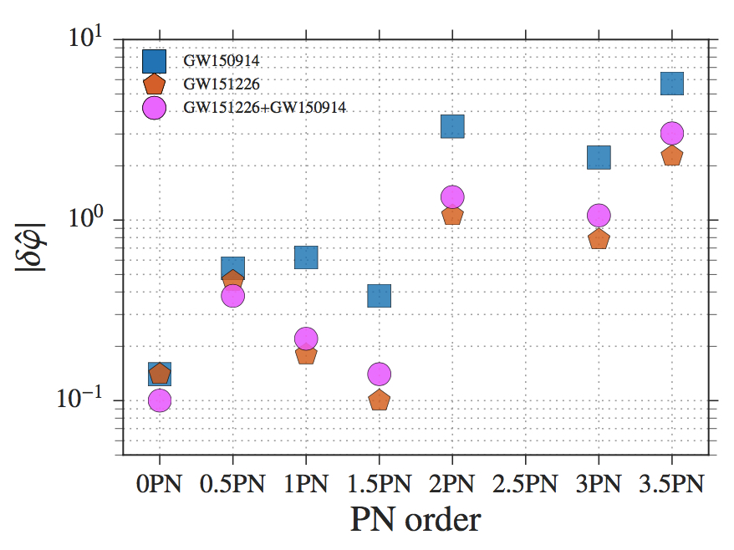
General Relativity tests in the strong interaction regime – II

Slide 20
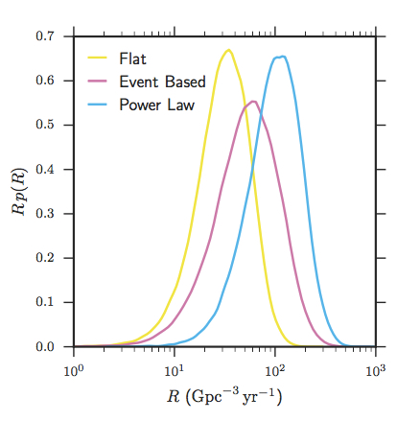
Estimated Event Rate of BBH
It depends the assumption done on the mass distribution
Rate Range
9 - 240 Gpc ⁻³ yr ⁻¹

Slide 21
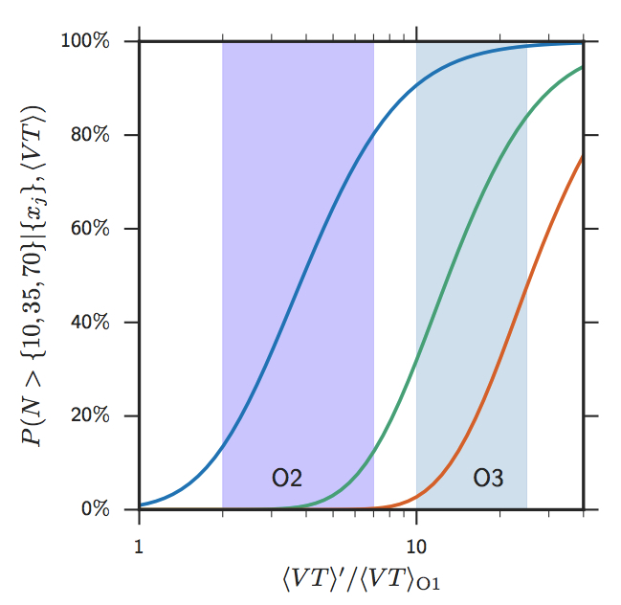
Probability to detect BBH events
The probability of observing N > 10, N > 35, and N > 70 highly significant events, as a function of surveyed time-volume.

Slide 22
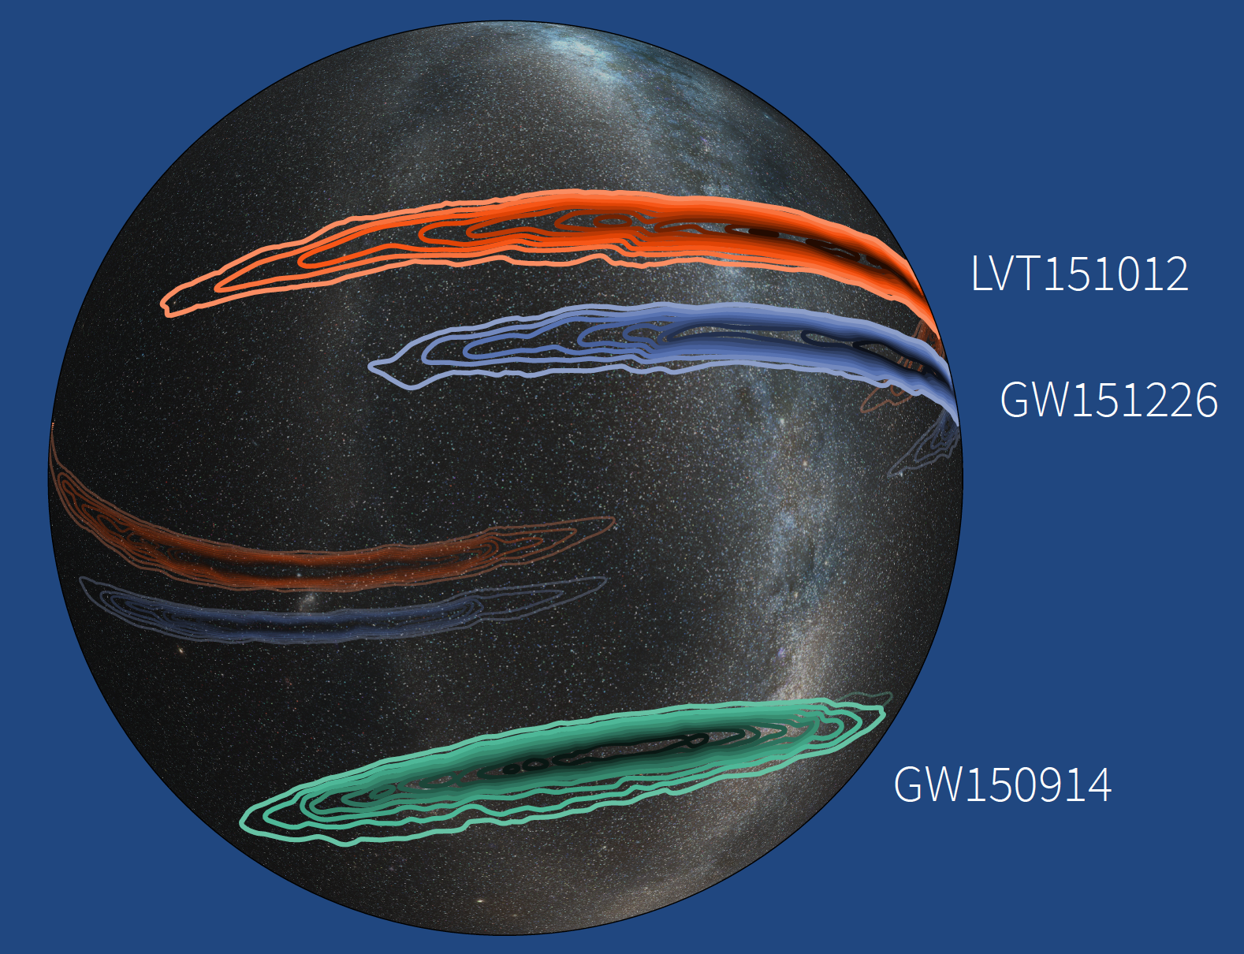
Sky Locations of Gravitational-wave Events GW150914, GW151226 and Candidate LVT151012

Slide 23
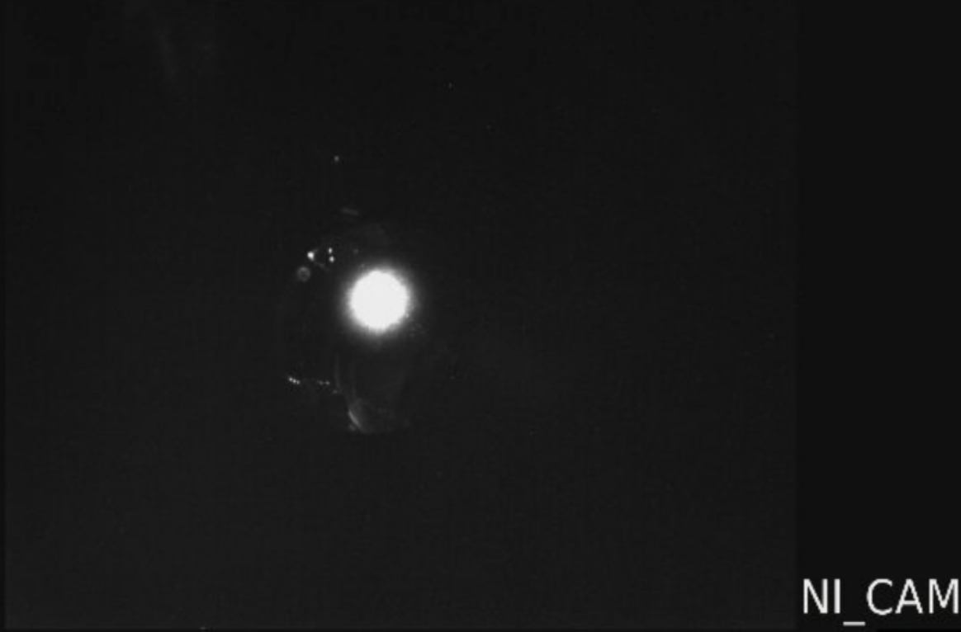
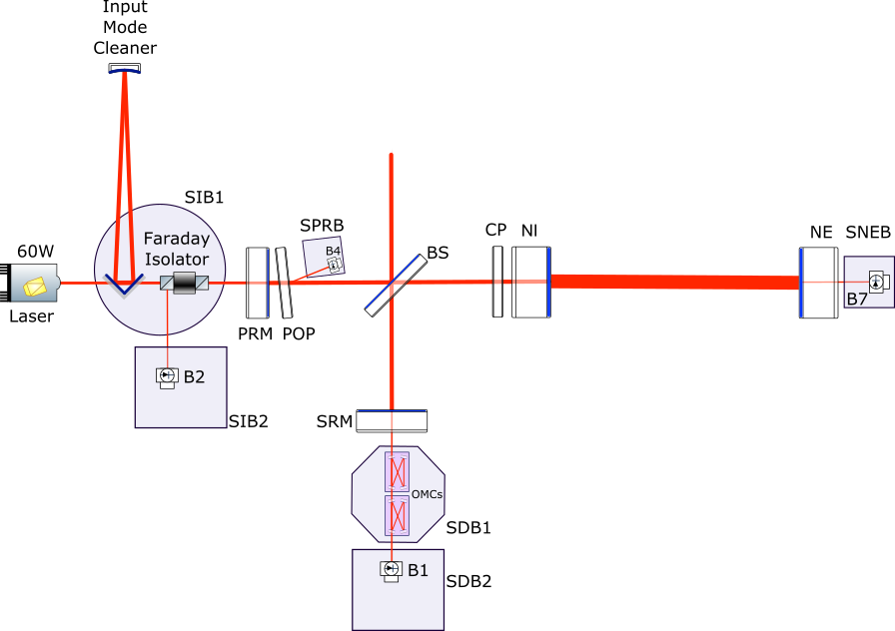
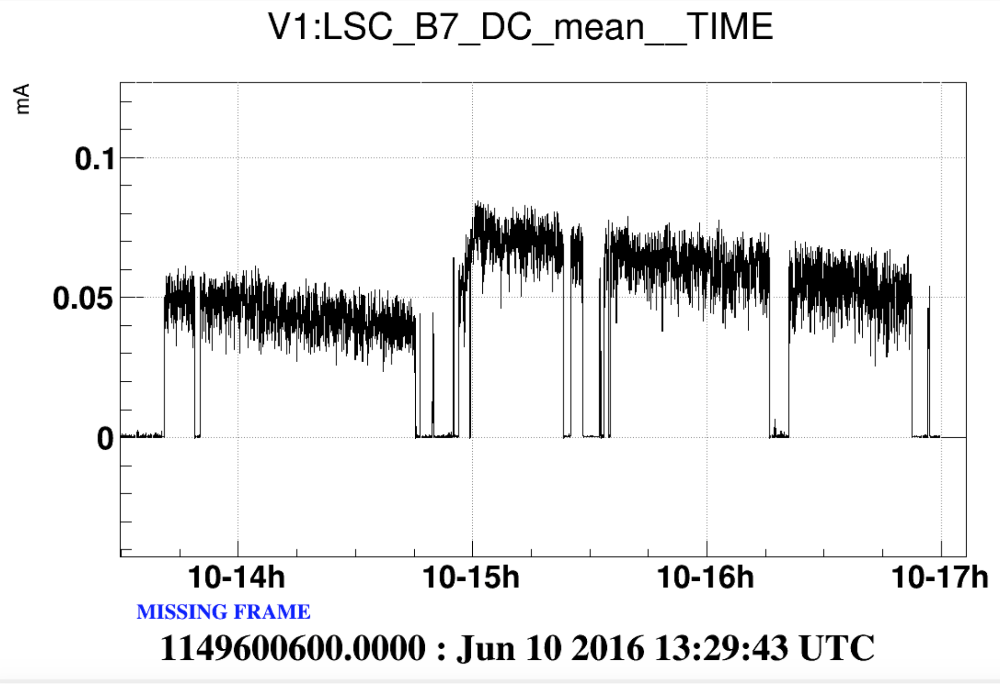
Advanced Virgo is progressing to join aLIGO in O₂
3km FP cavity locked
  Important integrated test with a high finesse cavity
  Lock stable and reproducible

Slide 24
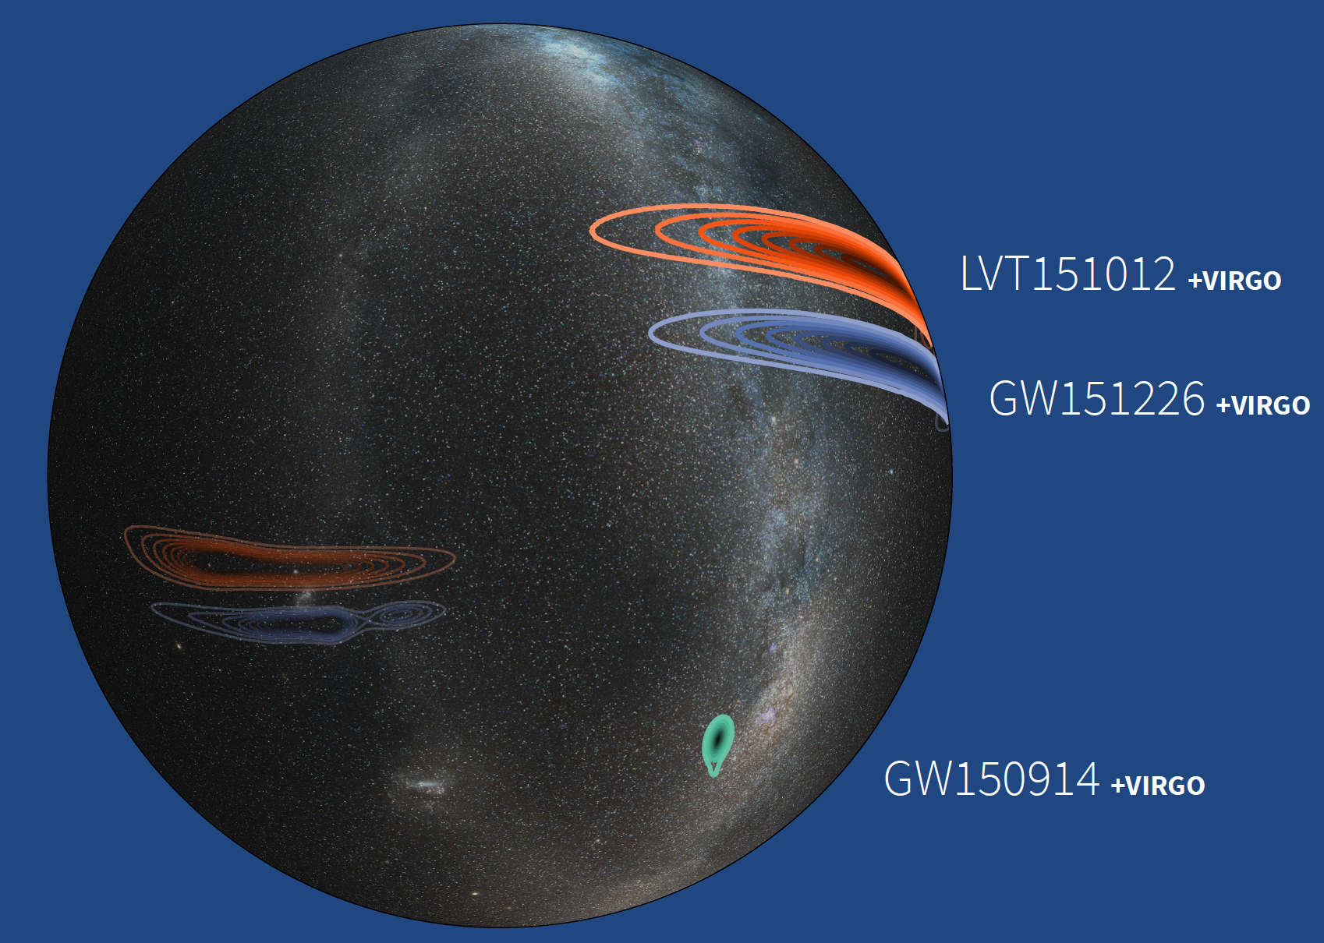
Simulated Sky Locations of O1 Events and Candidate Including the Virgo Interferometer

Slide 25
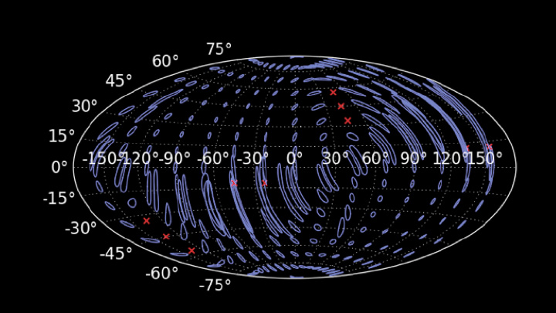
Simulation of Localization of a Gravitational Wave Event
by the US LIGO and European Virgo Detectors

Slide 26
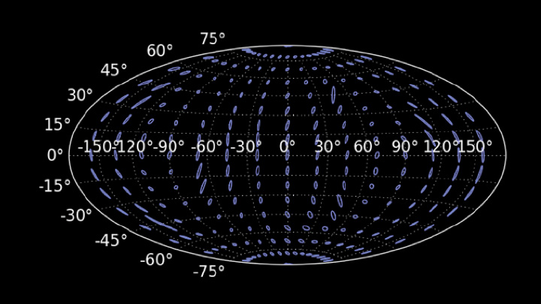
Simulation of Localization of a Gravitational Wave Event
by the US LIGO, European Virgo, and LIGO-India Detectors

Slide 27
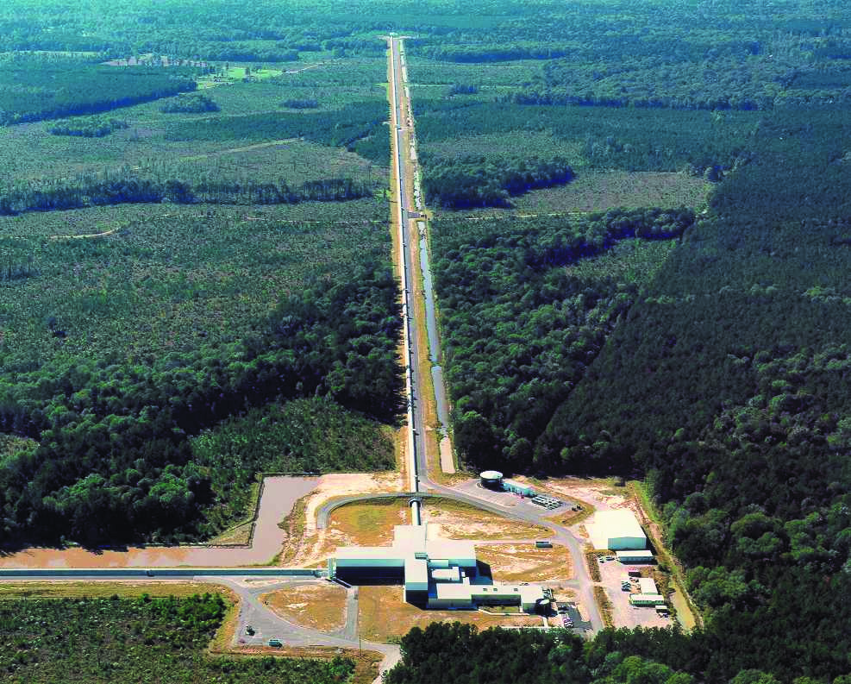
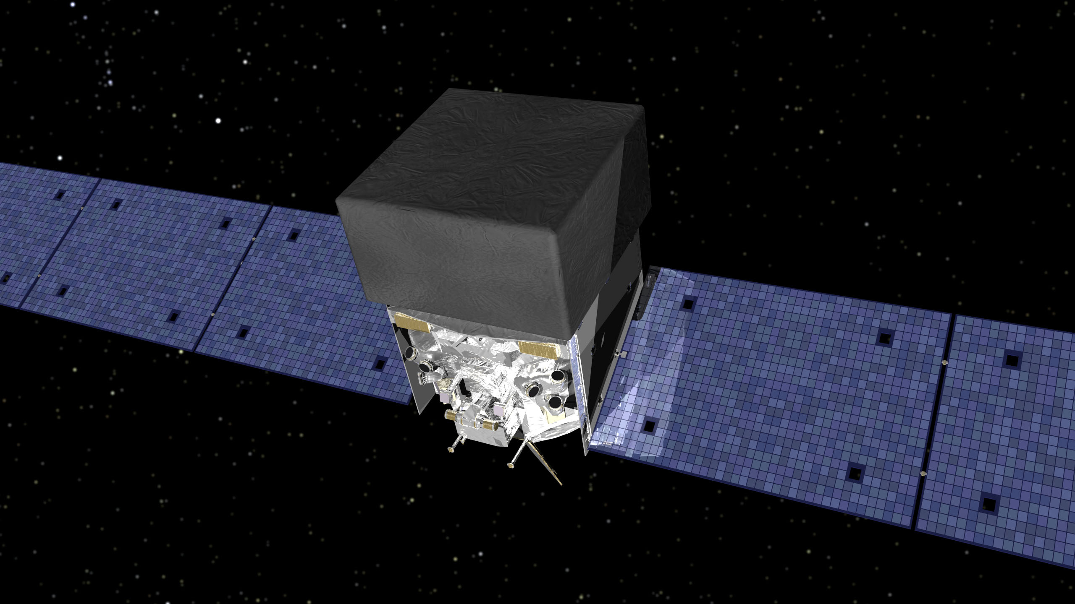
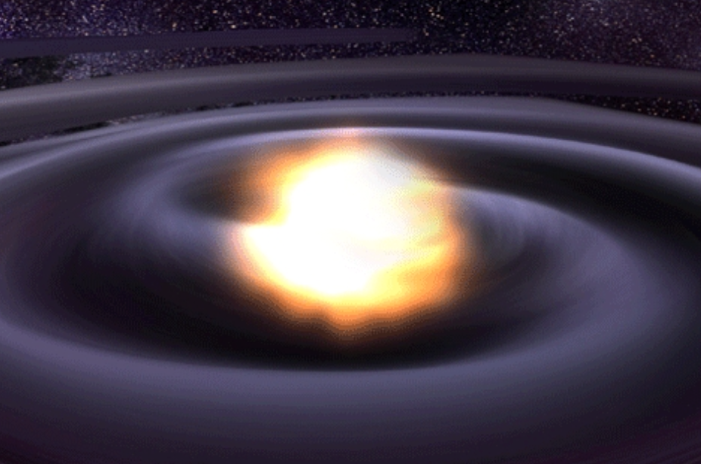
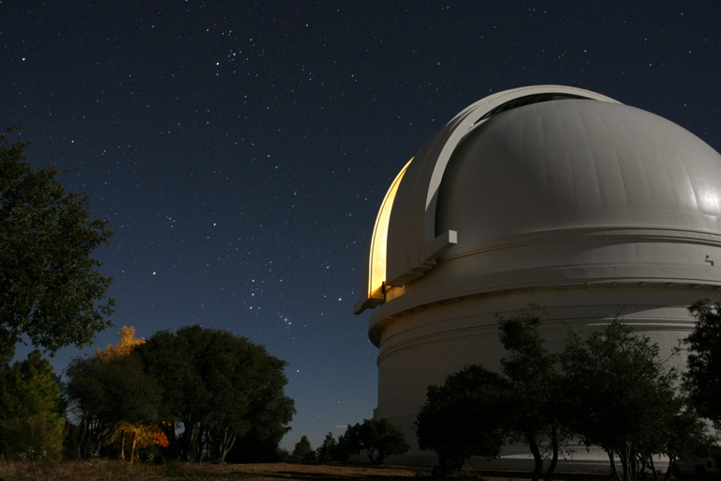
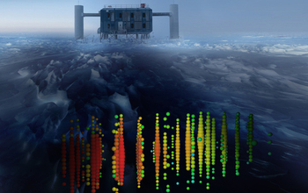
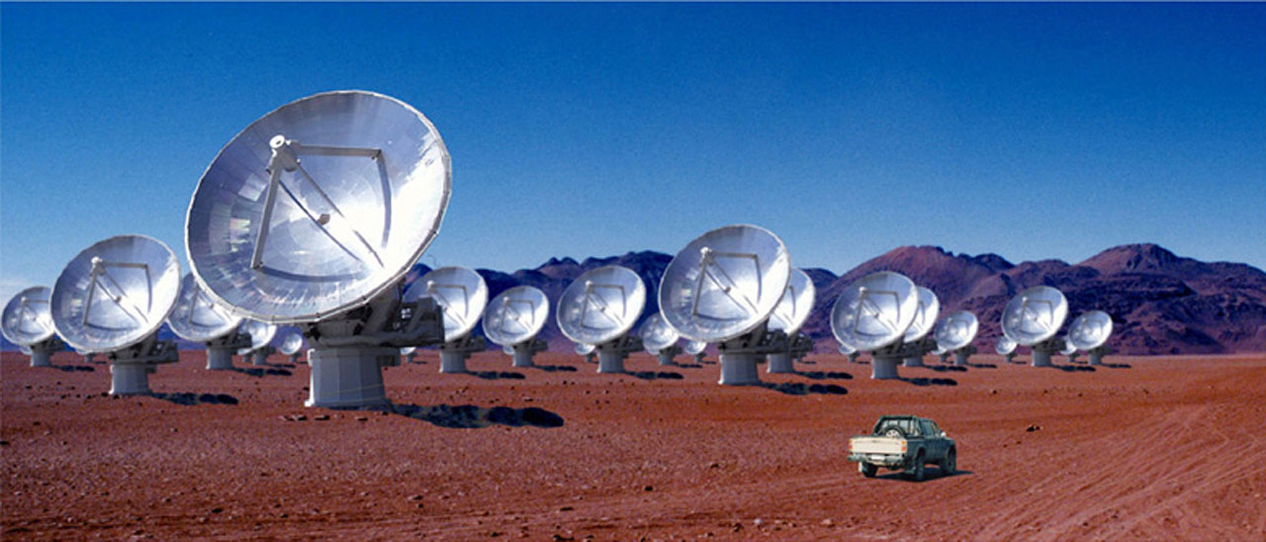
Multi-messenger Astronomy with Gravitational Waves
Multi-Messenger Astronomy:
Gravitational Wave + Electromagnetic +Neutrinos
Binary Neutron Star Merger
X-rays/Gamma-rays
Gravitational Waves
Visible/Infrared Light
Neutrinos
Radio Waves

Slide 28
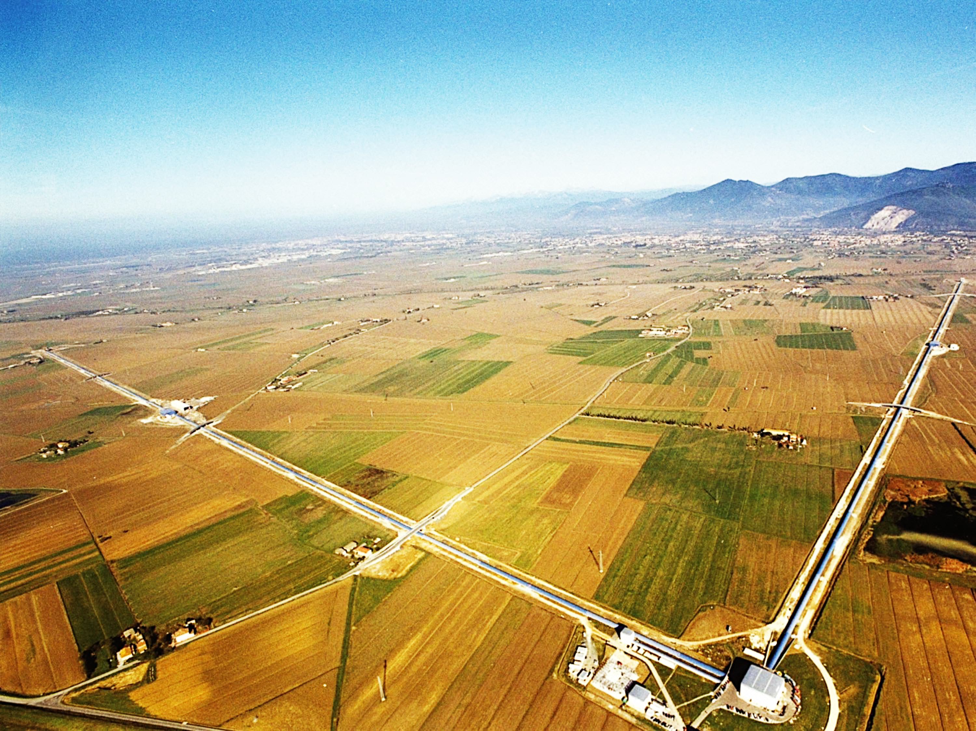
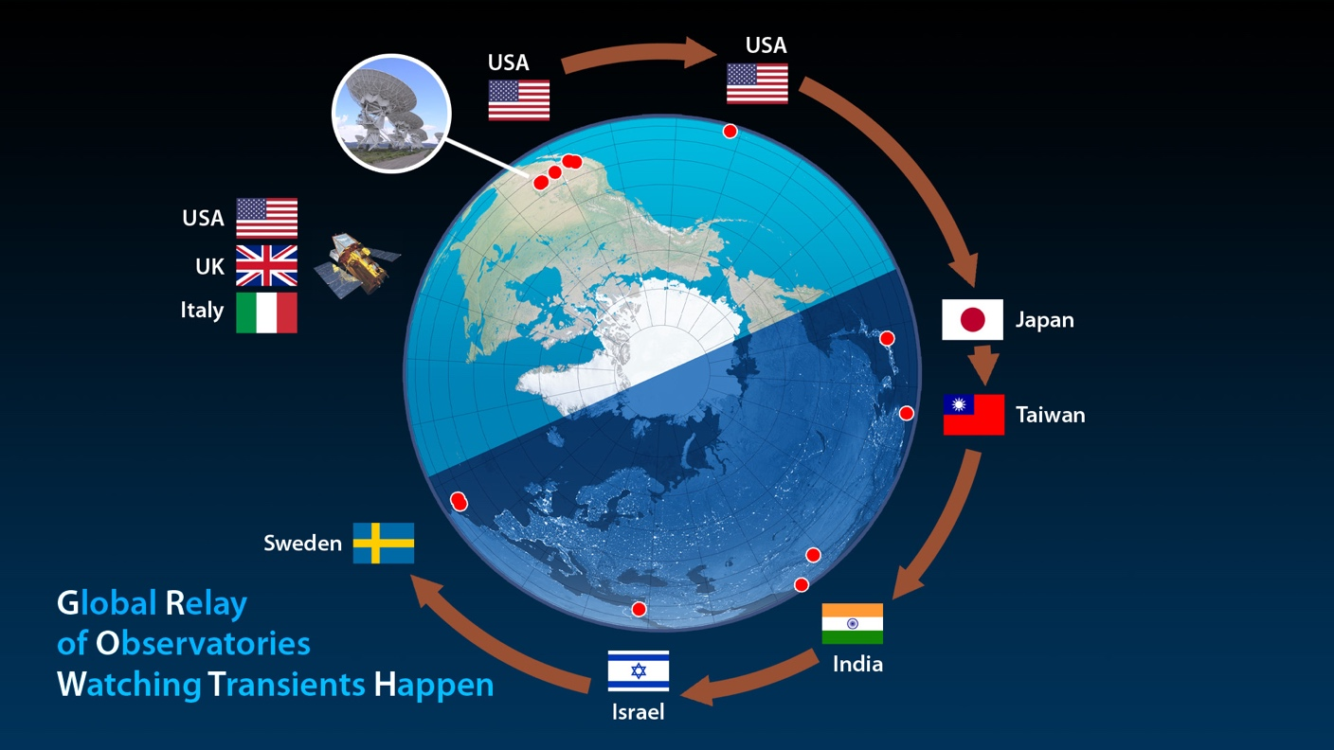
Multi-Messenger Astronomy:
Gravitational Wave + Electromagnetic +Neutrinos

Slide 29
Conclusion
During its first observing run we have observed gravitational waves from the coalescence of two stellar-mass BBHs:
  GW150914
  GW151226
  and the third candidate
  LVT151012 also likely to be a BBH system
The inferred rate of BBH mergers based on our observations is 9–240 Gpc⁻³ yr⁻¹
We are confident that in the future observing runs will observe many more BBHs.

