Slide 1
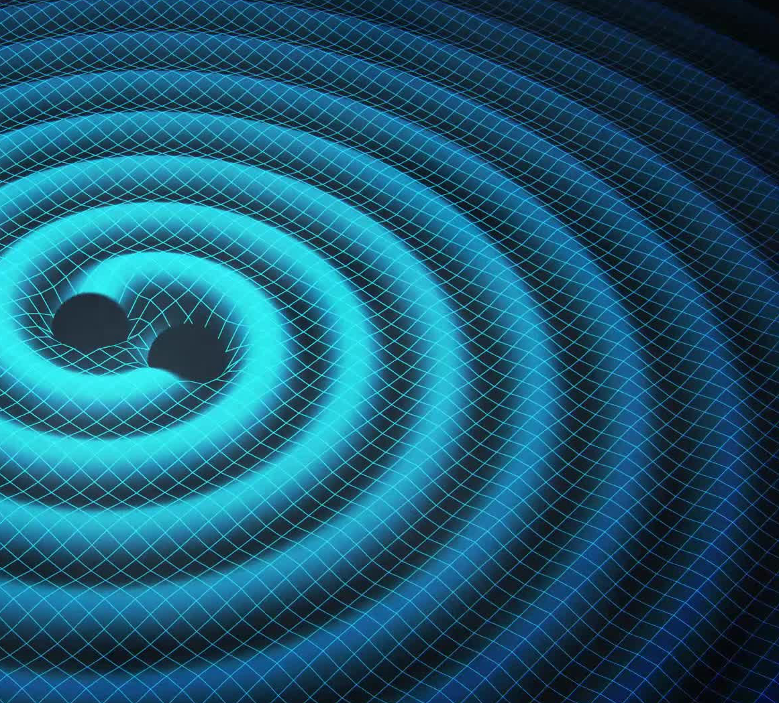
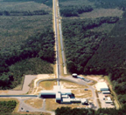
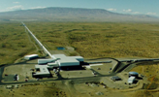
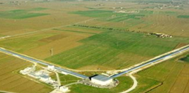




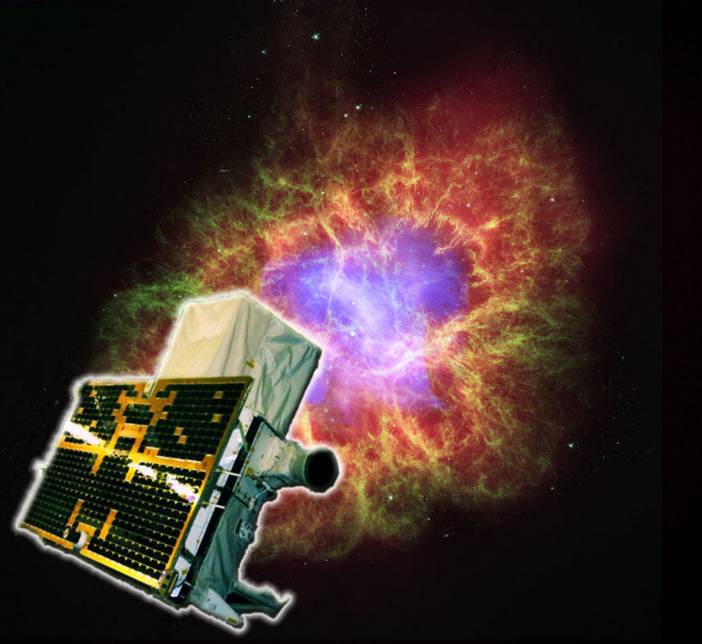
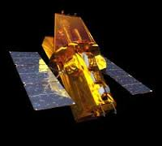
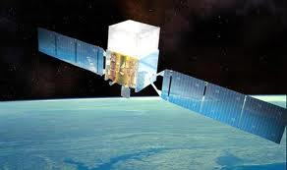
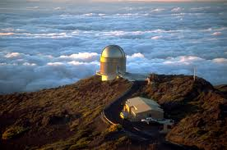
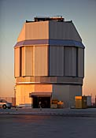
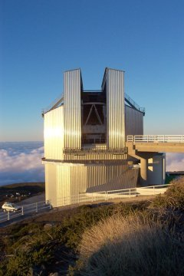
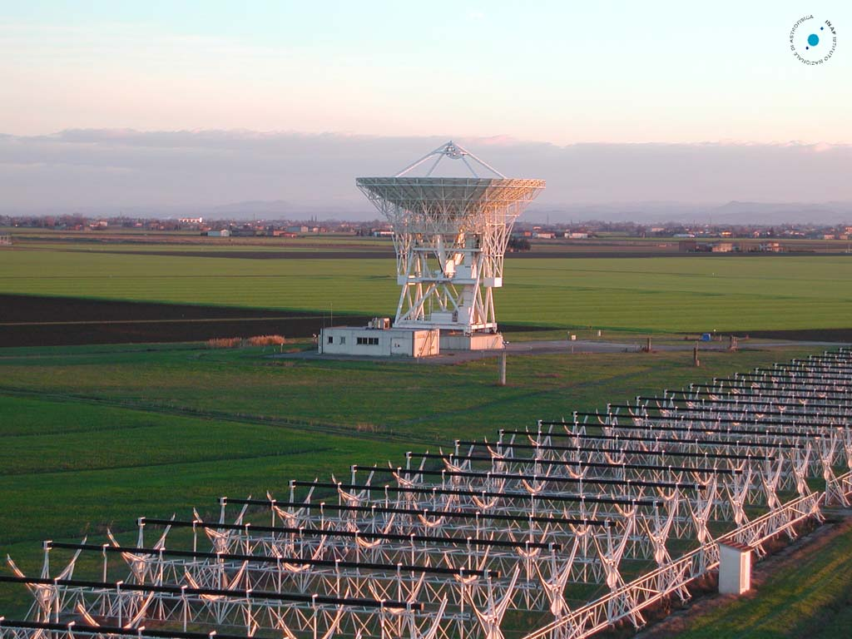
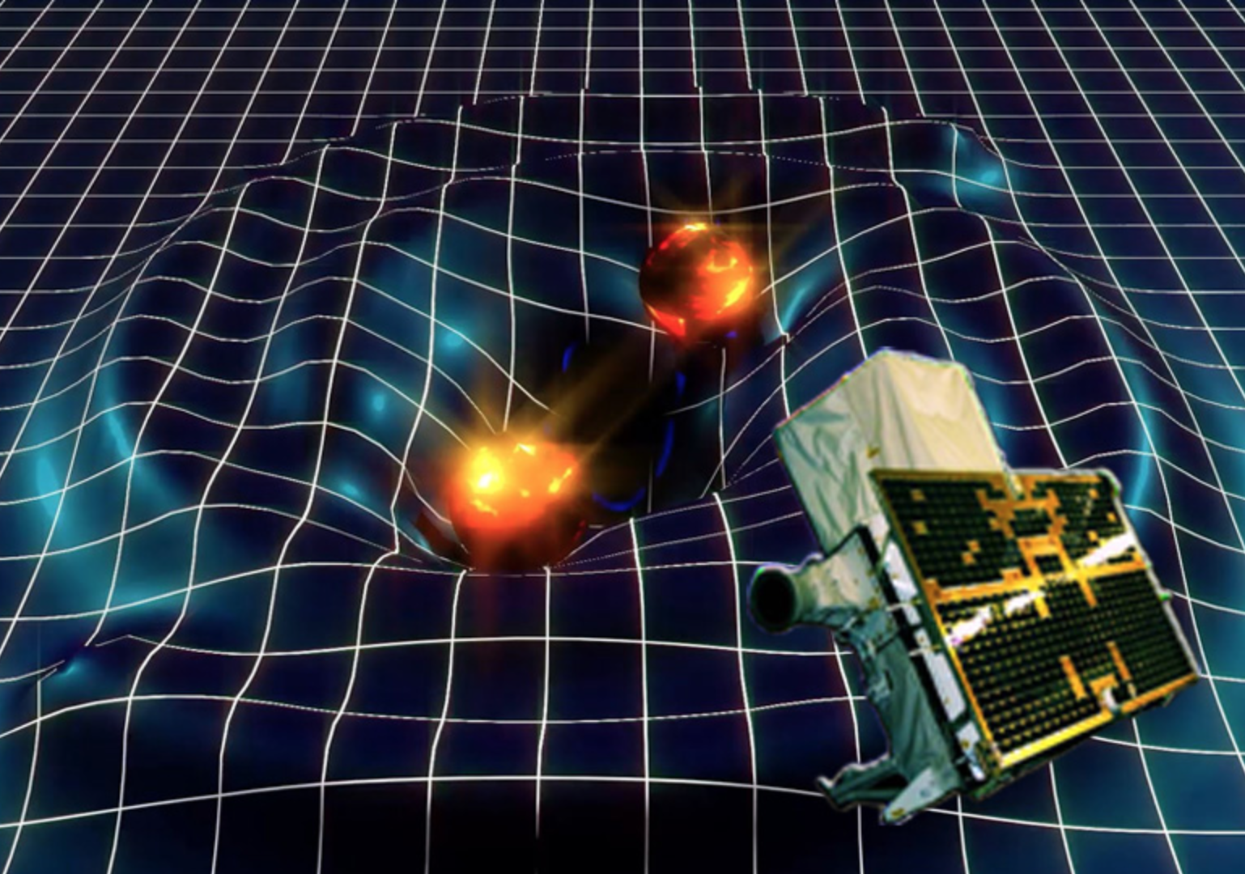


Multi-wavelength observational campaign of GW events
M.Branchesi
(Università di Urbino/INFN Sezione di Firenze)

Slide 2
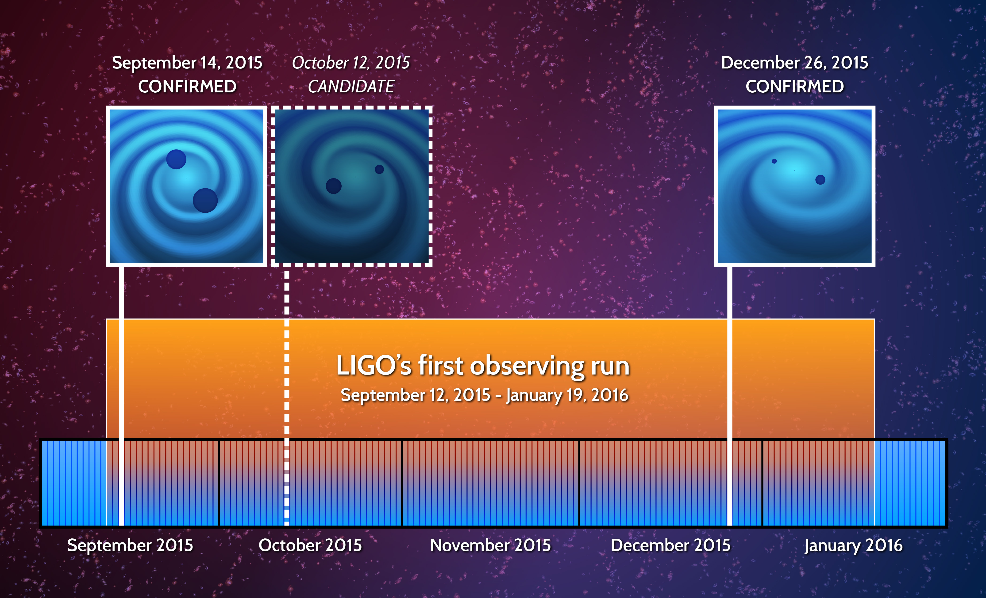

Low-latency search
Off-line search
Low-latency search
SNR=24
FAR < 6 x 10⁻⁷ yr⁻¹
Significance > 5.3 σ
SNR=9
FAR 0.37 yr⁻¹
Significance = 1.7 σ
SNR=13
FAR < 6 x 10⁻⁷
Significance > 5.3 σ

Slide 3
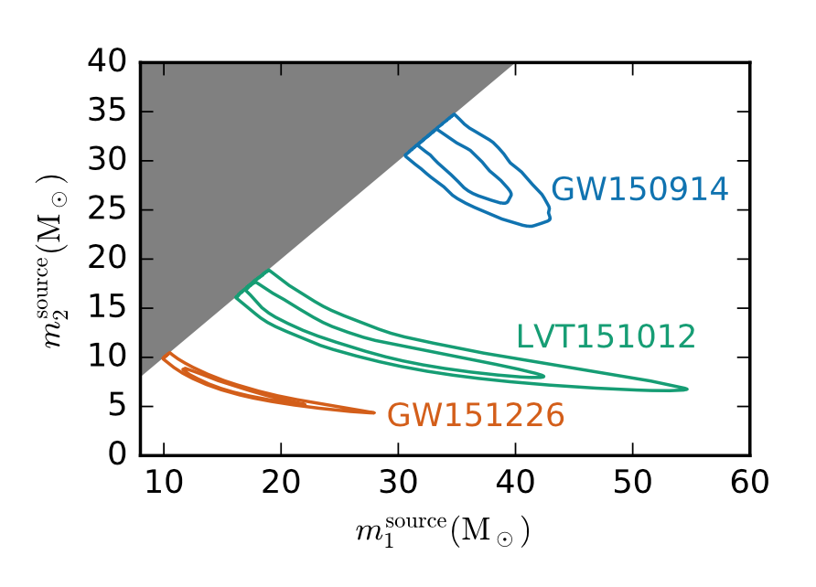
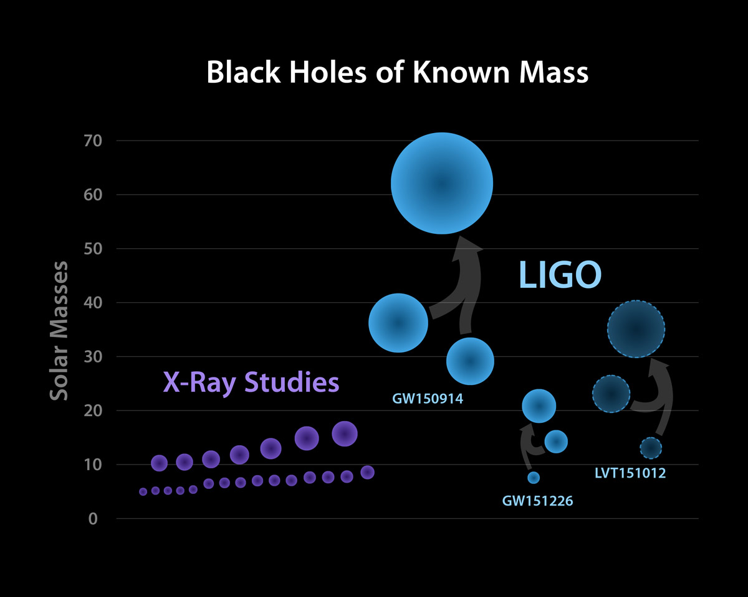
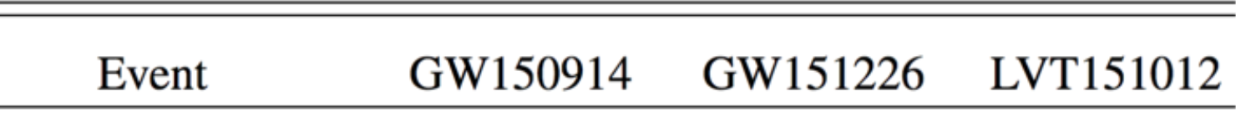
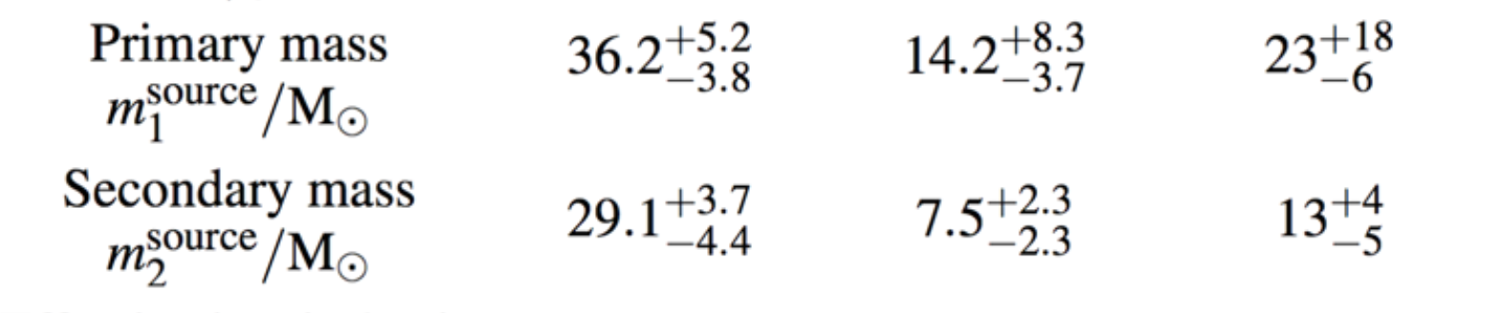
Parameters of the BBH systems
Component masses
dcc.ligo.org/LIGO-P1600088/public

Slide 4
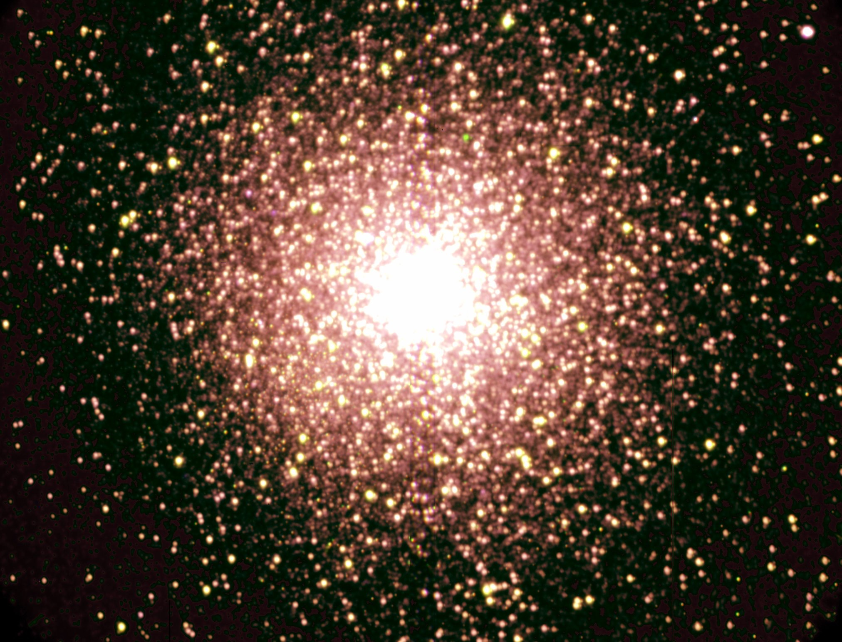
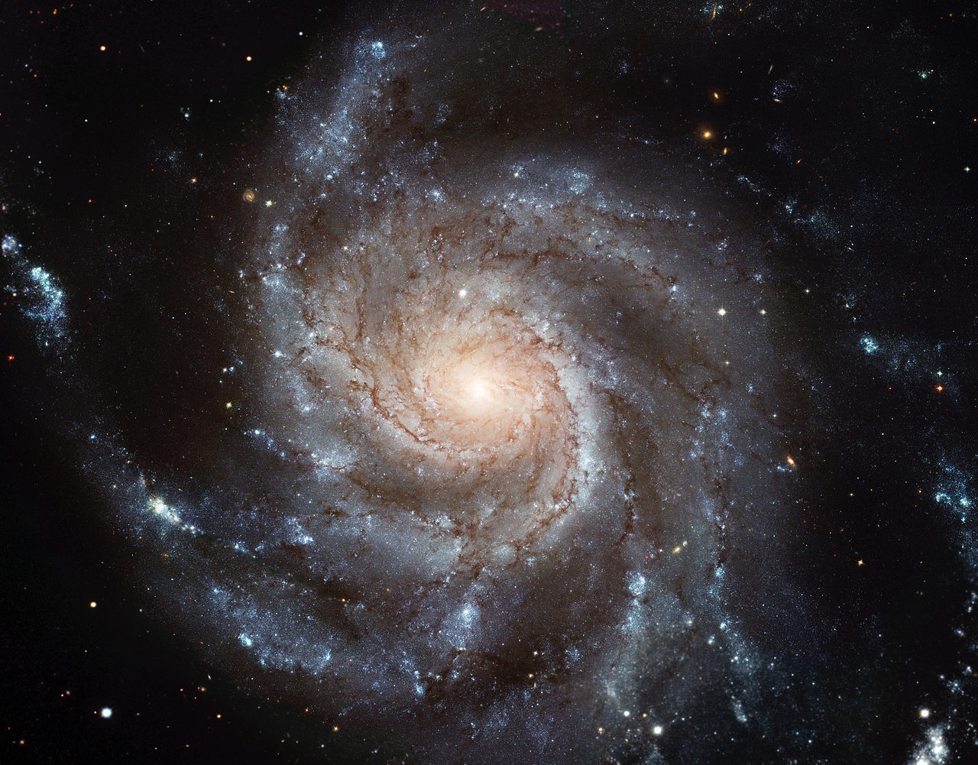
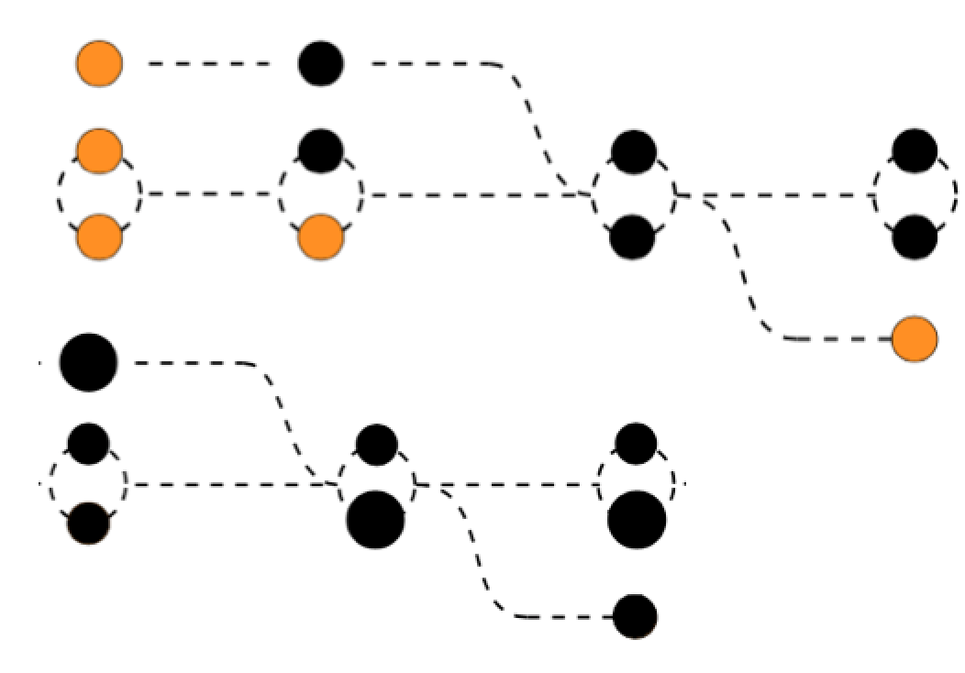
Where black holes form?
Galaxy field
R~10 kpc,
N ~ 10¹⁰ stars
Dense enviroment
star clusters
R~1-10 pc,
N ~ 10³⁻⁷ stars
How do they form binary system?
Isolated binary
Dynamical interactions
Both formation paths are consistent with
GW150914 and GW151226
For GW150914, low metallicities are necessary
See e.g. Belczynsky arXiv:1602.04531
See e.g. Ziosi et al. 2014
Notes:
- Progenitors stars form in binary → Mass transfer, supernovae, common-envelope
- Dynamical interaction: black holes form binaries, three body interactions harden and (sometimes) eject binaries

Slide 5
Where black holes form?
Galaxy field
R~10 kpc,
N ~ 10¹⁰ stars
Dense enviroment
star clusters
R~1-10 pc,
N ~ 10³⁻⁷ stars
How do they form binary system?
Isolated binary
Dynamical interactions
Crucial: identify the host galaxy and
study the GW source environment
See e.g. Belczynsky arXiv:1602.04531
See e.g. Ziosi et al. 2014
Notes:
- Progenitors stars form in binary → Mass transfer, supernovae, common-envelope
- Dynamical interaction: black holes form binaries, three body interactions harden and (sometimes) eject binaries

Slide 6
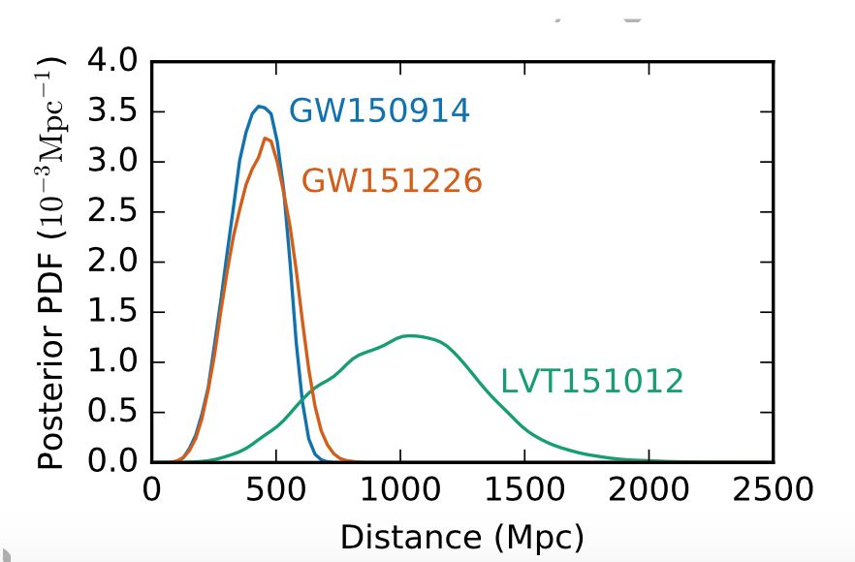
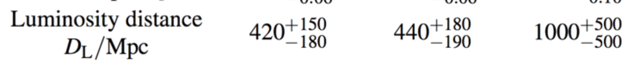
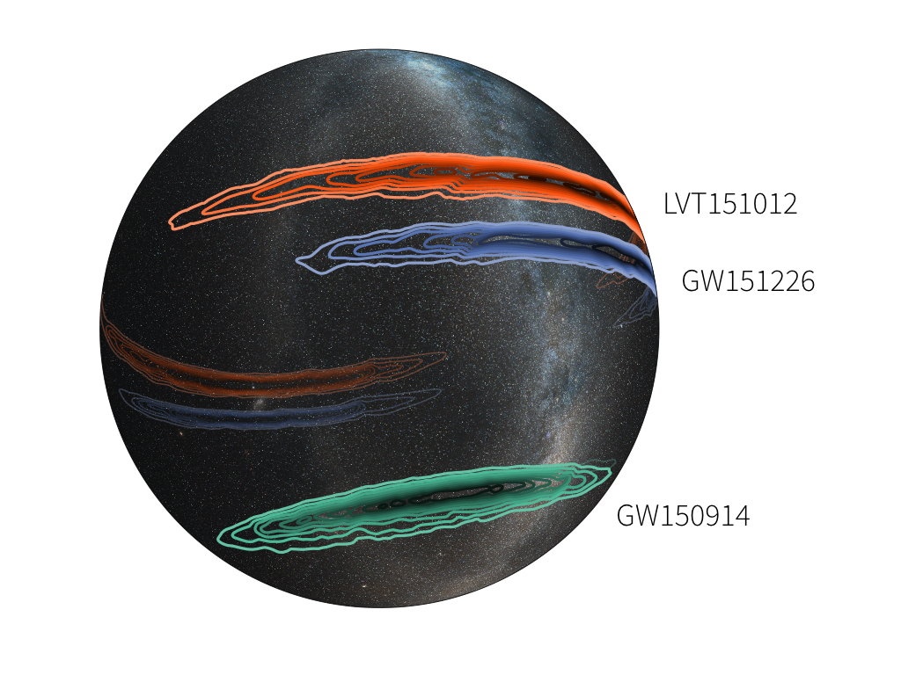
Challenges to identify the host galaxy
Distances
Sky localizations
90% credible areas of about
600 deg² GW150914
1600 deg² LVT15012
1000 deg² GW151226
Image credit: LIGO/L. Singer/A. Mellinger
Notes:
hundred of thousand of galaxies

Slide 7
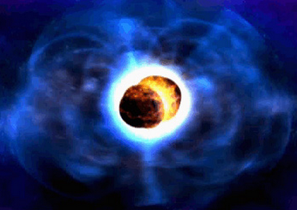
LVC GW-EM follow-up program
80 MoUs involving
170 instruments
(satellites/ground-based telescopes)
Worldwide astronomical institutions,
agencies and large/small teams of astronomers
8%
8%
11%
covering the full spectrum from radio to very high-energy gamma-rays!
73%
65 teams of astronomers were ready to observe during O1 (September 2015 – January 2016)!

Slide 8
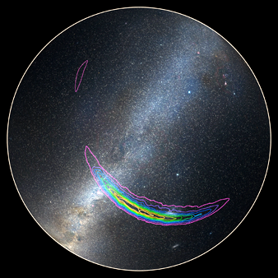
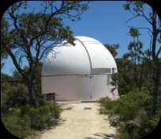
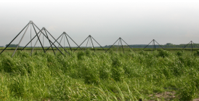


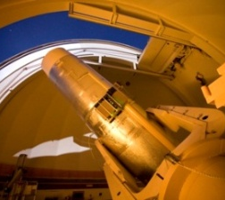
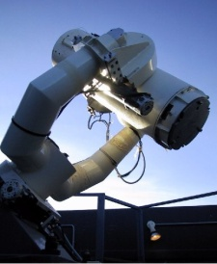
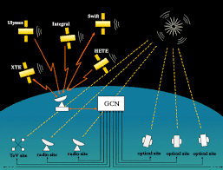
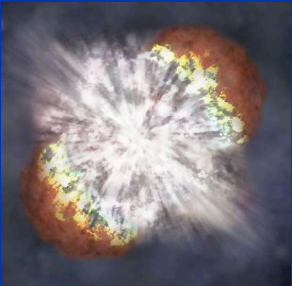
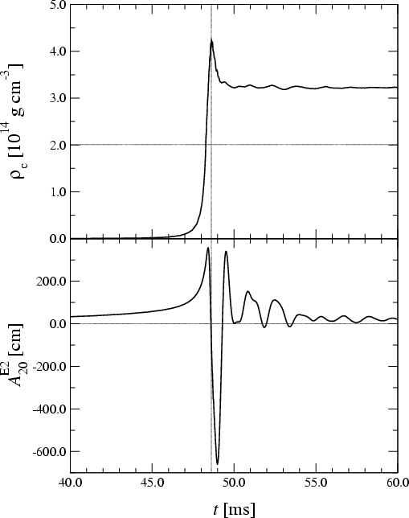
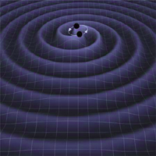
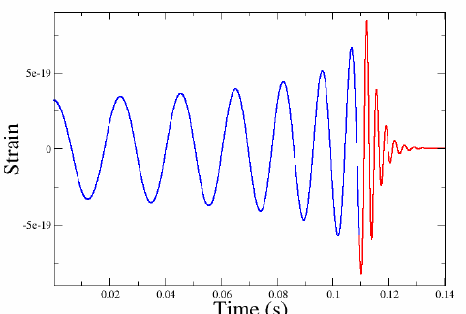

Low-latency GW data analysis pipelines to promptly identify GW candidates and send GW alert to obtain EM observations
GW candidates
Sky Localization
EM facilities
LIGO-H
LIGO-L
ESO
Virgo
Event validation
NASA
Low-latency Search
to identify the GW-candidates
Software to
select statistically significant
triggers wrt background
check detector sanity and
data quality
determine source localization
Unmodeled GW
burst search
Matched filter with waveforms of compact binary coalescence
a few min
15/30 min
GW candidate updates
Parameter estimation codes
Hours,days
Notes:
search for transient signals that are coincident in the two detectors within the 10ms light travel time separating them.
search specifically for NS binary mergers using matched fil- tering. Since CBC waveforms can be precisely computed from general relativity, GSTLAL and MBTA are more sen- sitive to CBC signals than the burst search pipelines are. Candidates few minutes of data acquisition
begin on September 18 1 ogni 3 anni
estimate satisfied our planned alert threshold of 1 month−1
BAYESTAR produces sky maps by triangulating the times, amplitudes, and phases on arrival supplied by the CBC pipelines
performs full forward modeling of the data using a parameterized CBC waveform which allows for BH spins and detector calibra- tion uncertainties
BYASTAR can estimate the position of CBC triggers, using timing, phase, and amplitude consistency, with only a short latency, typically . Full Markov Chain Monte Carlo exploration of the parameter space
CHECK what fixed

Slide 9
EM follow-up program - O1 run
Three alerts sent to 65 groups of astronomers with observational capabilities
About 40 groups followed-up at least one alert giving a broadband coverage of the sky maps and the rapid characterization of the candidate counterparts
GW150914
Update
BBH nature
Updates:
Final FAR and sky map
Alert!
Initial sky maps
2 days
19 days
4 months
G194575
Update
Noise event
Alert!
Initial sky maps
6.5 hrs
29 days
Retraction
GW151226
Updates:
Redshift
Final FAR
Updates:
Final sky map
Alert!
Initial sky maps
1.6 days
15/17 days
23 days

Slide 10
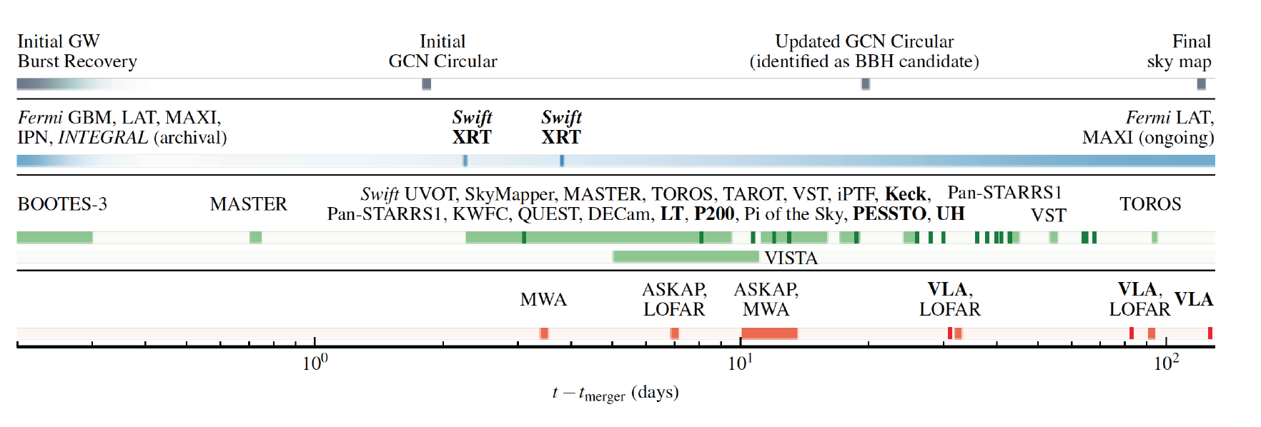
GW150914
EM follow up observations and archival searches
Twenty-five teams of observers responded to the GW alert
The EM observations involved satellites and ground-based telescopes around the globe spanning 19 orders of magnitude in frequency across the EM spectrum
High-energy
Optical/NIR
Radio
Smartt et al. arXiv160204156S
Evans et al. MNRAS 460, L40
Annis et al. arXiv:1602.04199
Kasliwal et al. arXiv:1602.08764
Morokuma et al. arXiv:1605.03216
Fermi-LAT collaboration APJL, 823,2
Lipunov et al. arXiv:1605.01607
Soares-Santos et al. arXiv:1602.04198
LVC+astronomers arXiv1602.08492
LVC+astronomers arXiv1604.07864
Connaughton et al. arXiv:1602.03920
Savchenko et al. 2016 ApJL 820, 36

Slide 11
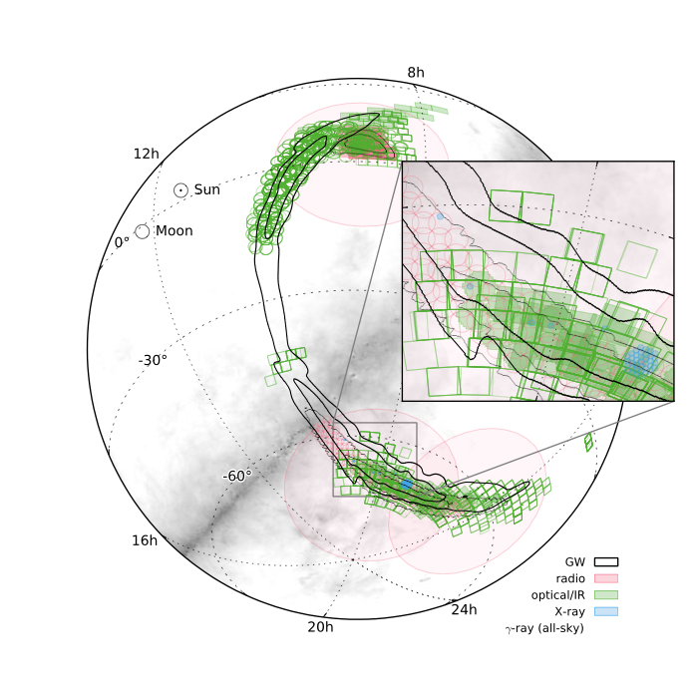
Sky map coverage

Slide 12
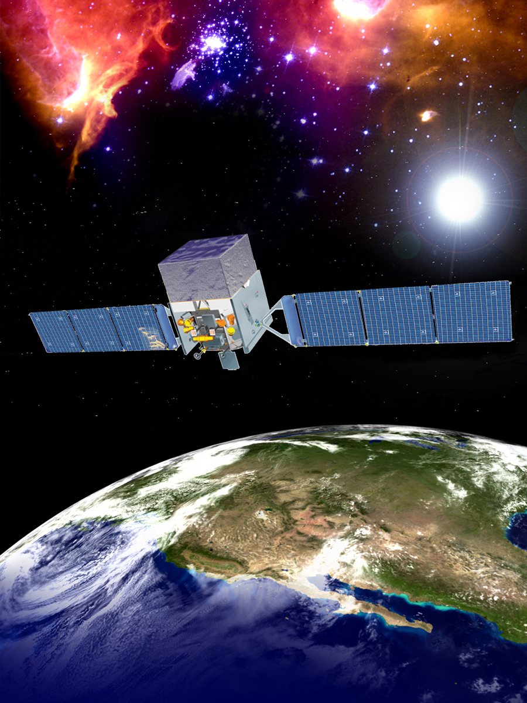
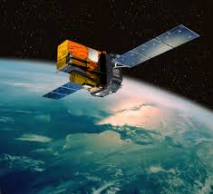
Skymap coverage/Depth and Results Summary
Most complete coverage in the gamma-ray down to 10⁻⁷ erg cm⁻² s⁻¹
X-rays coverage complete down to 10⁻⁹ erg cm⁻² s⁻¹ (MAXI),
relatively sparse at fainter flux with the Swift XRT
Fermi-GBM sub-threshold search → weak signal of 1 sec 0.4 s after the event
fluence (1 keV - 10 MeV) = 2.4 × 10⁻⁷ erg cm⁻²
FAR 4.79 × 10⁻⁴ Hz, FAP 0.0022
INTEGRAL → no signal but stringent upper limit
No signal detected by AGILE (Tavani et al. arXiv:1604.00955) and MAXI
(Connaughton et al. arXiv:1602.03920 )
(Savchenko et al. 2016 ApJL, 820)
Optical facilities together tiled about 900 deg² with a contained probability of over 50% of the initial sky map and slightly less of the refined sky map
The depth varies widely among these facilities, DES and VST deepest surveys 22.5
Deep photometry, broadband observations and spectroscopy → candidates to be normal population type Ia and type II SNe, dwarf novae and active galactic nuclei, all very likely unrelated to GW150914
The radio coverage is also extensive, with the contained probability of 86%, dominated by MWA down to 200 mJy

Slide 13
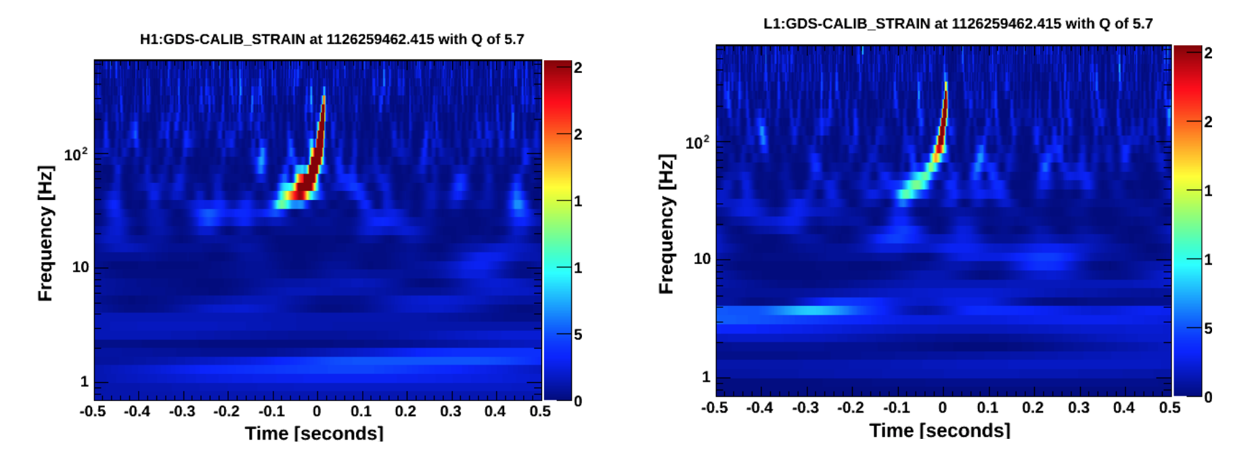
GW151226
Thirty-one groups responded to the GW alert:
High-energy and Very high-energy→ Swift, XMM-Slew, MAXI, AGILE, Fermi, CALET, CZTI, IPN, MAGIC, HAWC
Optical-NIR → MASTER, GRAWITA, GOTO, Pan-STARRS1, J-GEM, DES, La Silla–QUEST, iPTF, Mini-GWAC SVOM, LBT-Garnavich, Liverpool Telescope, PESSTO, VISTA-Leicester, Pi of the Sky observations, LCOGT/UCSB, CSS/CRTS, GTC
Radio → VLA-Corsi, LOFAR, MWA
To
1.6 days
Alert sent!
Gamma
hard X-ray
10 days
1 hrs
X-ray
˜
0.5 hrs
Optical/Near-IR
˜
3 months
3.5 days
˜
Radio
3 months
Racusin et al. arXiv:1606.04901
Smartt et al. arXiv:1606.04795
Copperwheat et al. arXiv:1606.04574
Cowperthwaite et al. arXiv:1606.04538
Evans et al. arXiv:1606.05001

Slide 14
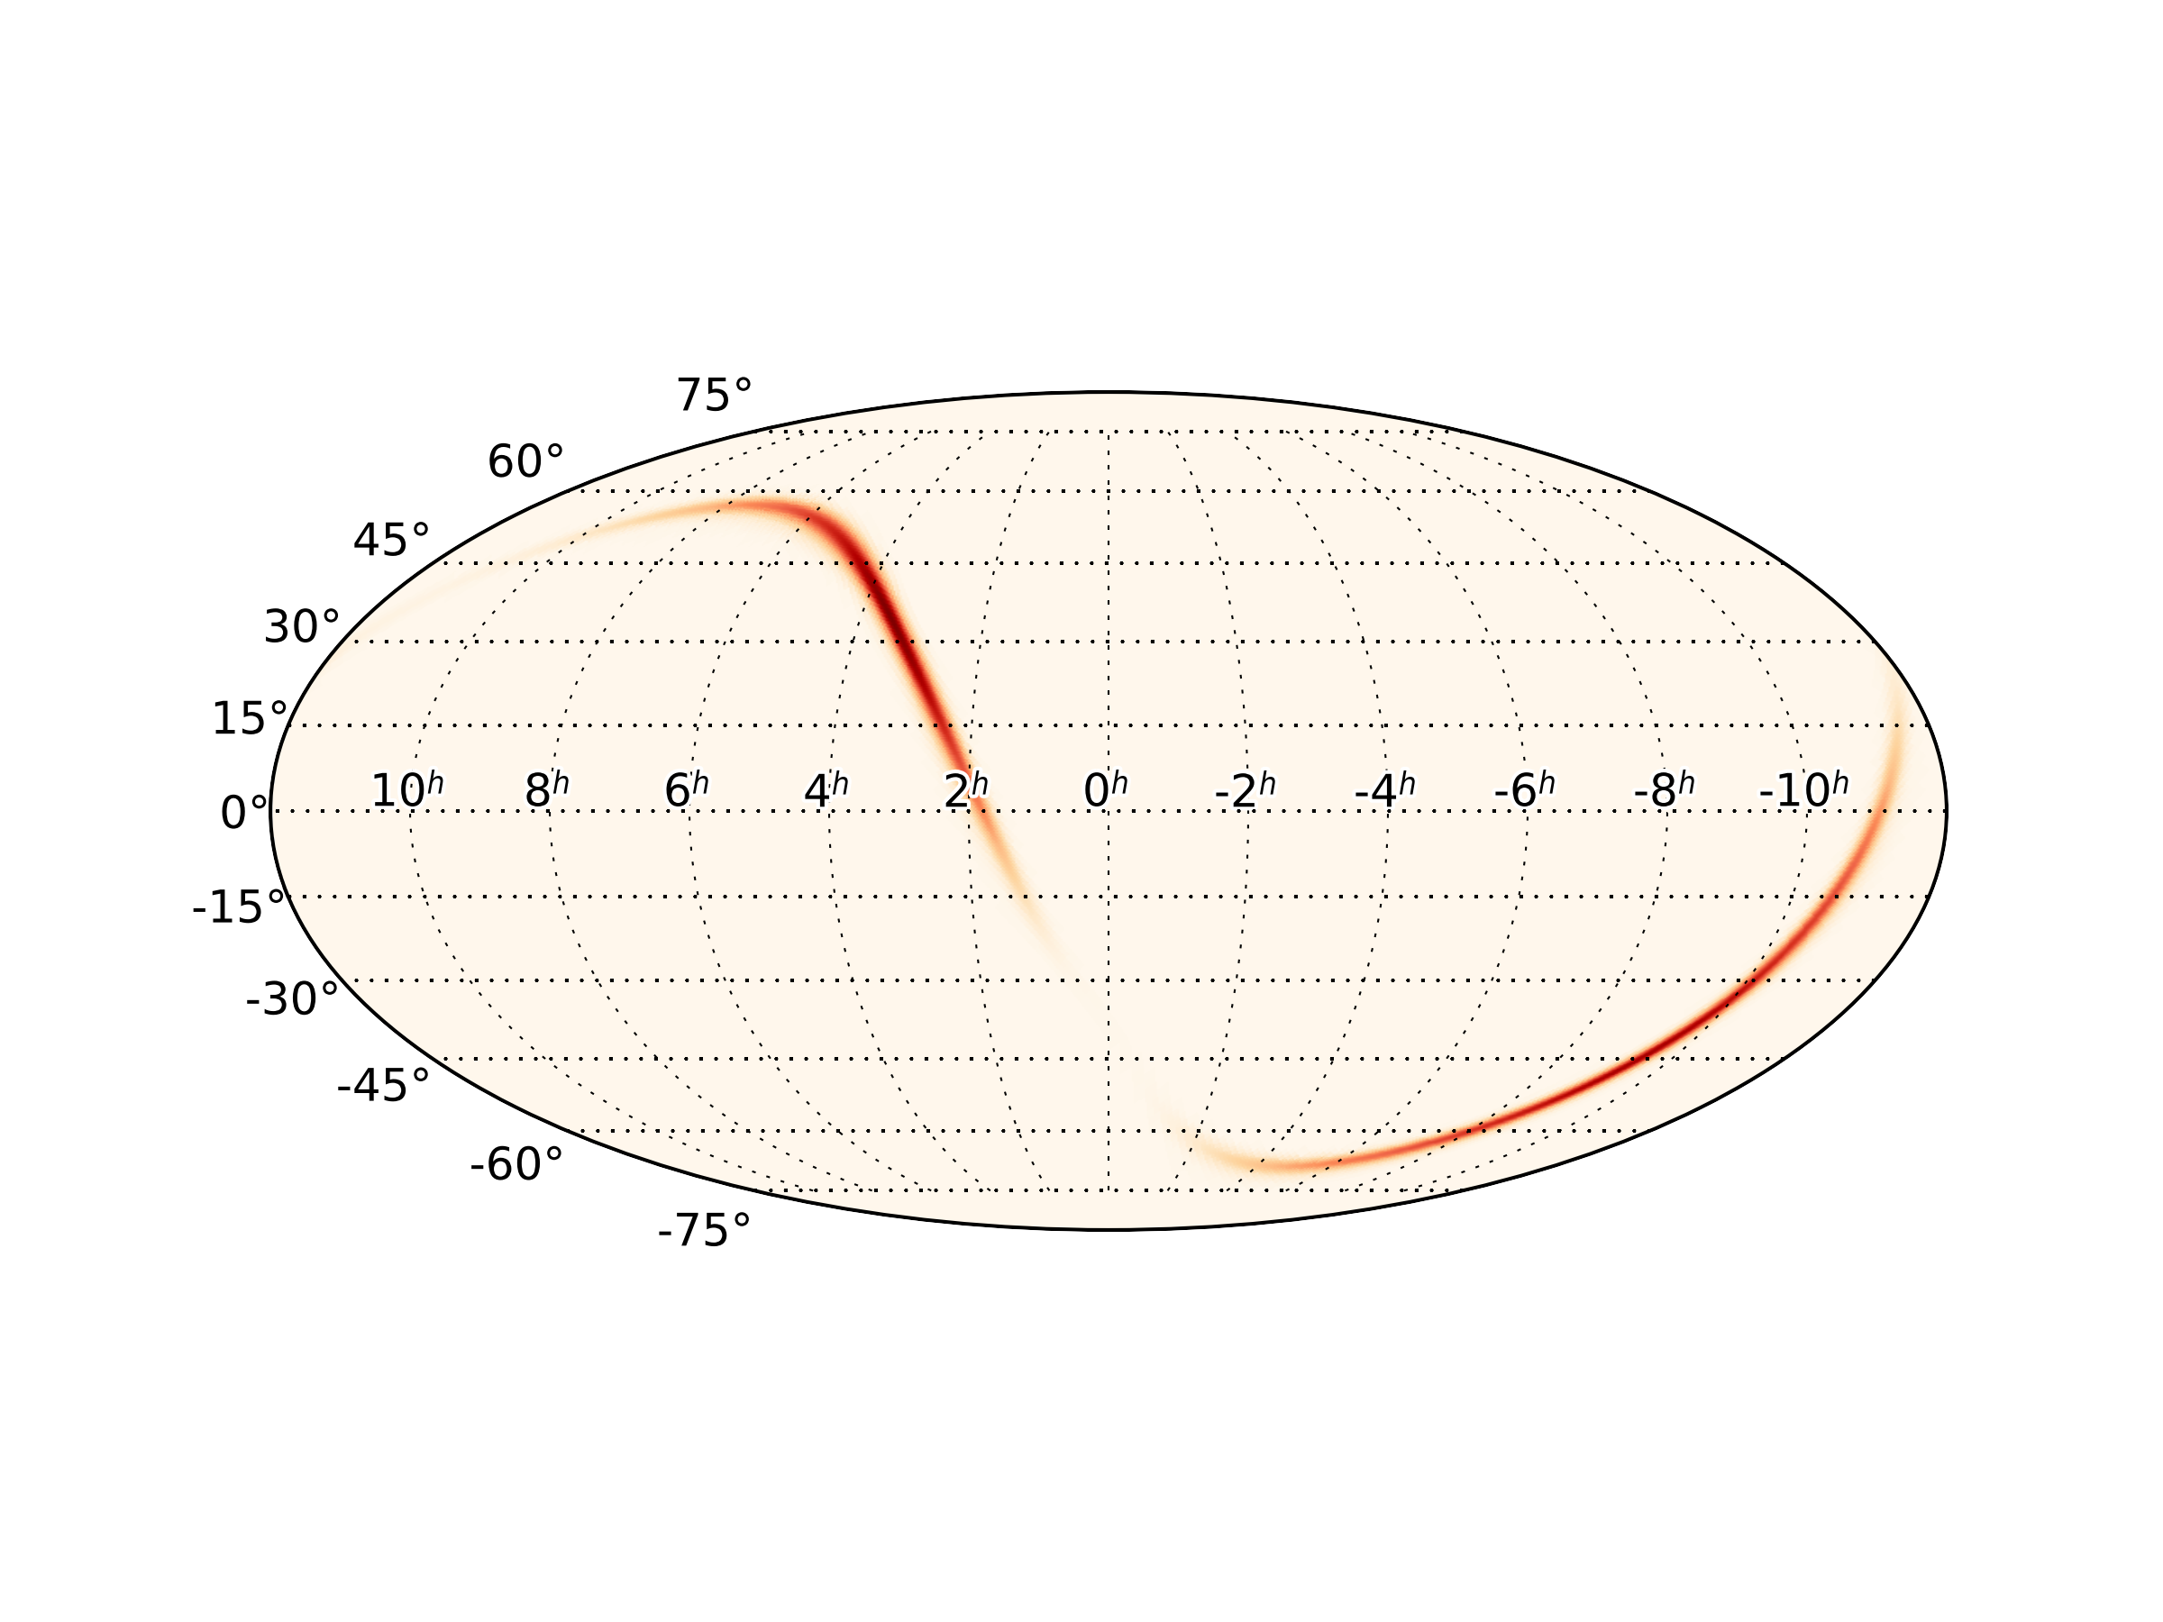
GW151226
Bayestar
Large portions of the GW sky map observed
Candidate counterparts rapidly characterized
In the optical, candidate counterparts identified to be normal population SNe, dwarf novae and AGN
No EM counterpart reported

Slide 15
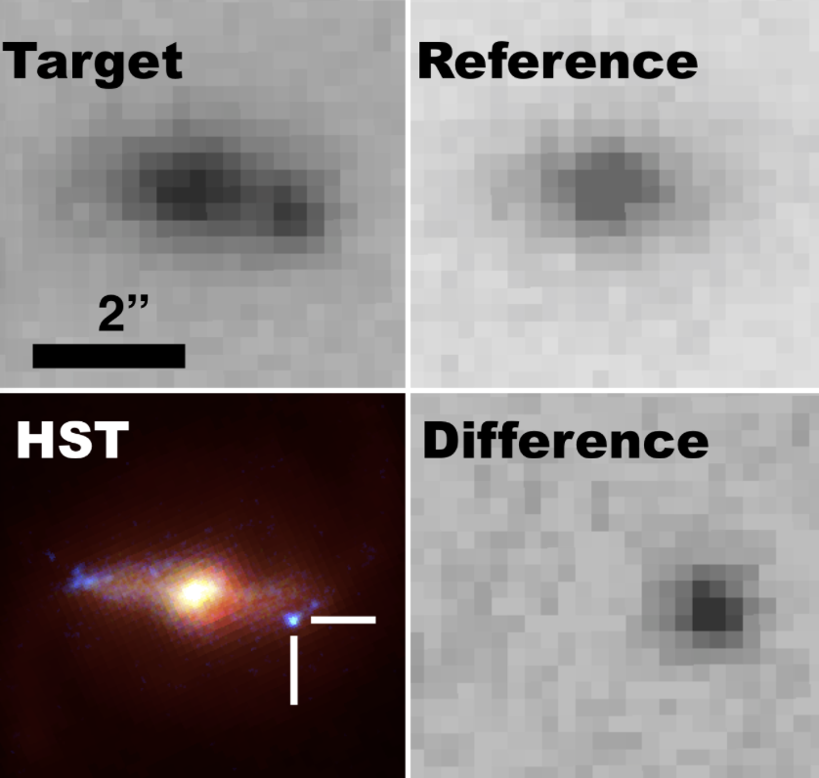
PS15dpn → unusual transient with an explosion temporally coincident with GW151226
rising light curve and very blue spectrum
Hα, HeI and HeII lines
no Swift detection
VLA radio detection
host galaxy at z=0.175
light curve coverage and optical/NIR spectra over months
→Identified as Type Ibn supernova
Pan-STARRS/PESSTO, VLA –Corsi/Palliyaguru, Swift iPTF, GRAWITA, GTC
Smartt et al. arXiv:1606.04795
EXCLUDED as counterpart → luminosity distance of the transient has a zero probability of being consistent with that of GW151226

Slide 16
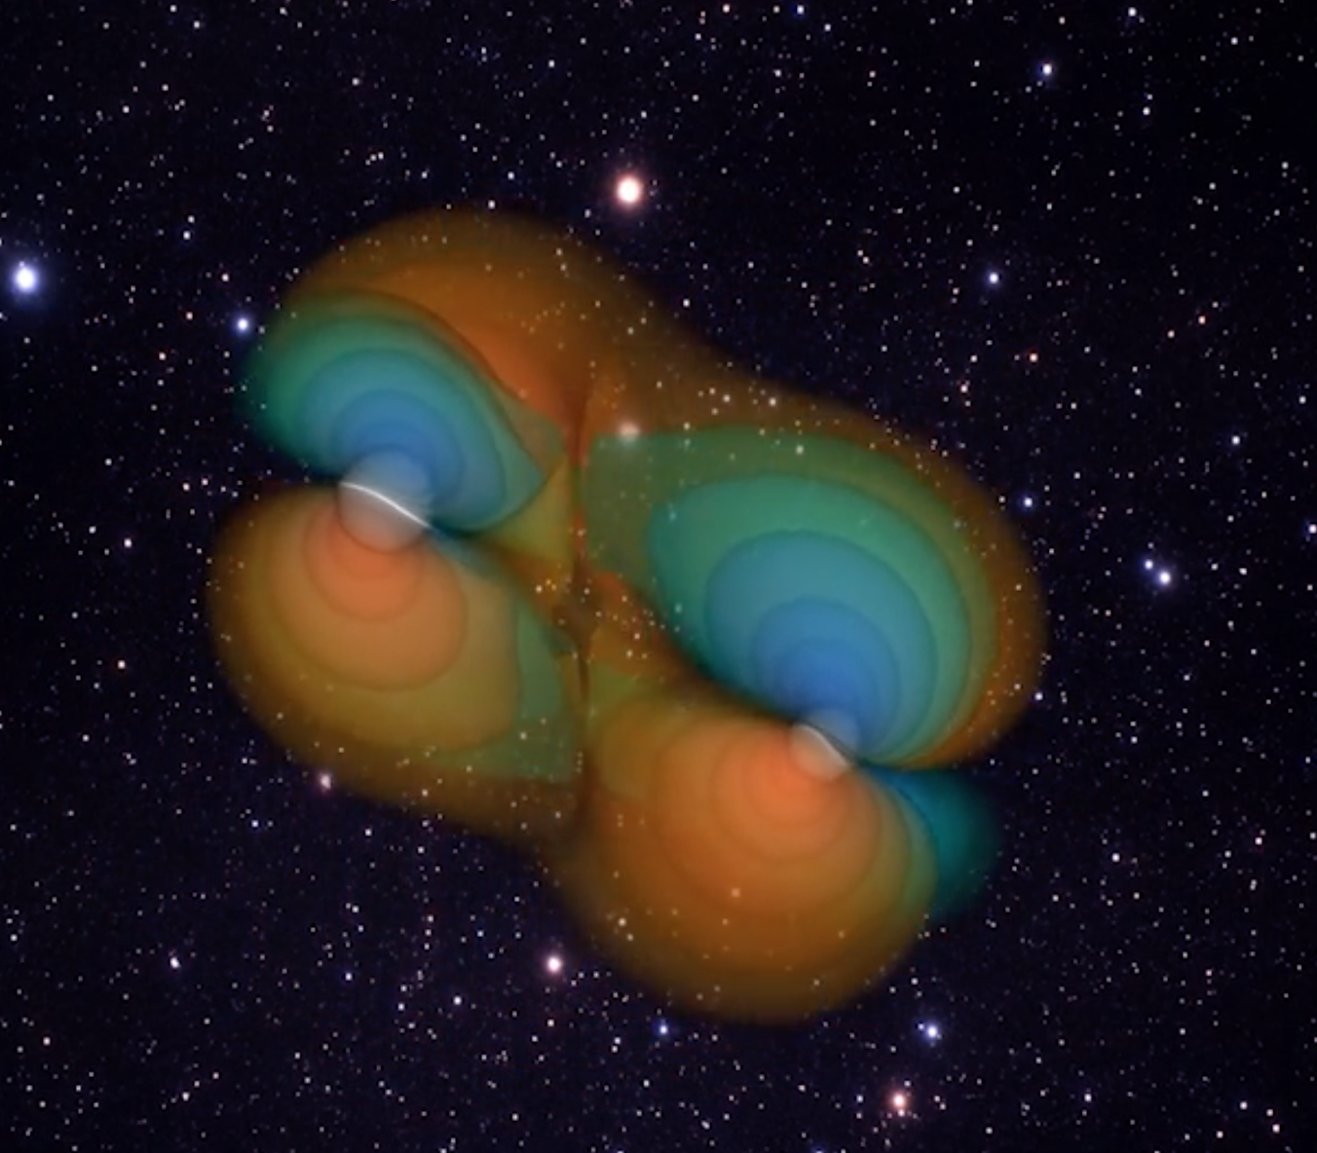
EM follow-up of GW150914 and GW151226 demonstrates the capability to cover large area, to identify candidates, and to rapidly activate larger telescopes
No stellar-BBH EM emission due to the absence of the accreting material
…but some mechanisms that could produce unusual presence of matter around BHs recently discussed
Loeb 2016 ; Perna et al. 2016 ; Zhang et al. 2016
Future EM follow-ups of GW will shed light on the presence or
absence of firm EM counterparts for BBH
The follow-up campaign sensitive to emission expected
from BNS mergers at 70 Mpc range
The widely variable sensitivity across the sky localization is a challenge for the EM counterpart search

Slide 17
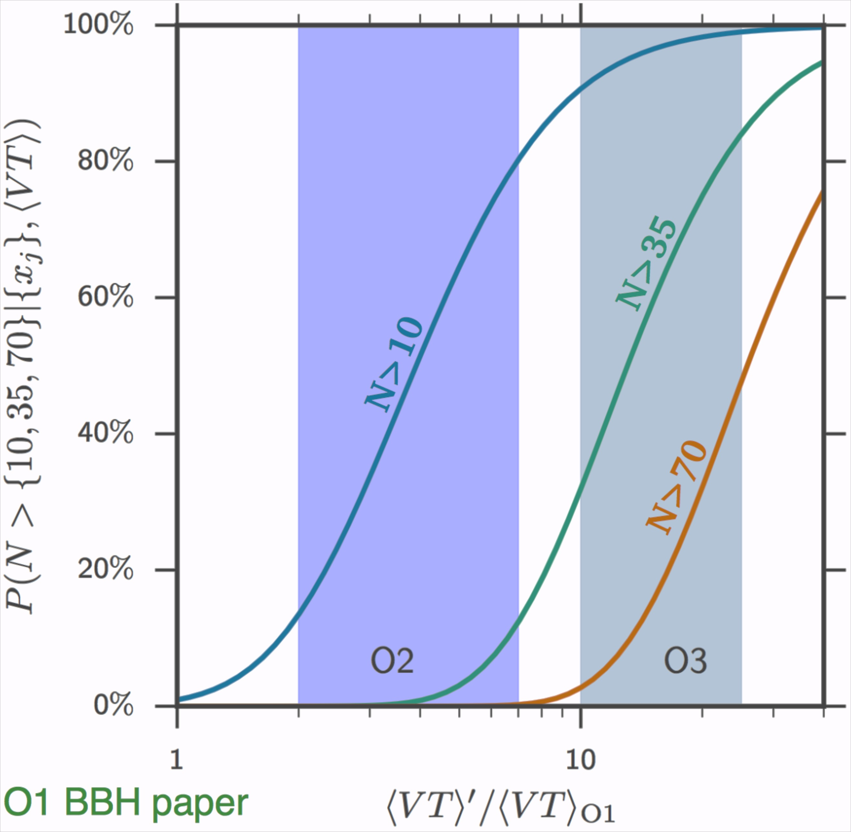
BBH merger rate based on O1 observations 9–240 Gpc⁻³ yr⁻¹
Number of expected highly significant events
(FAR < 1/century)
O2 → 10 BBH events
O3 → 35 BBH events
˜
˜
dcc.ligo.org/LIGO-P1600088/public
Notes:
Volume for an equal-mass binary with non-spinning components and total mass 60 Mo, assuming 6 months for O2 and 9 months for O3
Mrger rate 2-400 Gpc^-3/yr
Merger rate new 9-240 Gpc^-3/yr
From our observations we infer stellar- mass binary black hole merger rates lying in the range 9–240Gpc3 yr1
The probability of observing N > 10, N > 35, and N > 70 highly significant events, as a function of surveyed time-volume. The vertical line and bands show, from left to right, the expected sensitive time-volume for the second (O2) and third (O3) advanced detector observing runs.

Slide 18
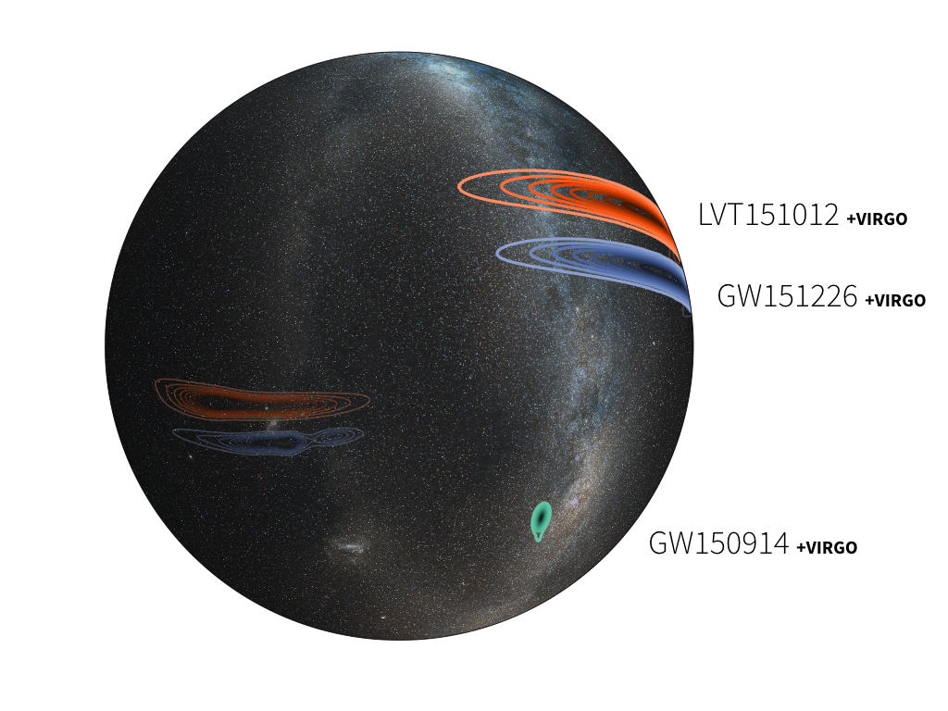
Sky localization with Virgo
Actual estimates
Simulated estimates with Virgo
Notes:
For these examples, the additional Virgo data shrinks the 90% credible areas to 10-20, 1000, and 600 deg2 respectively.
30 times, 1,6 times, 1,6 times. Note that the localizations of GW150914 and LVT151012 wrap around the celestial sphere, so the sky map is shown with a translucent sky dome. The font is Source Sans Pro Light.

Slide 19
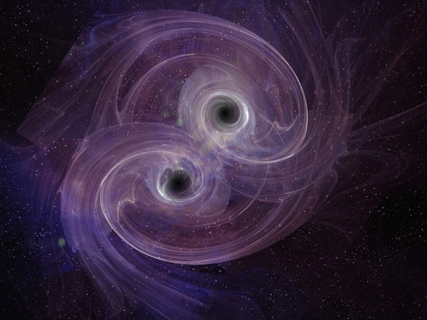
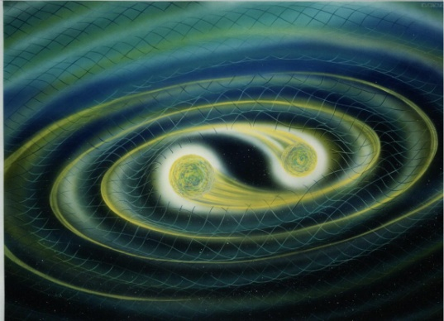
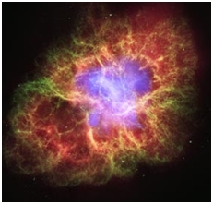
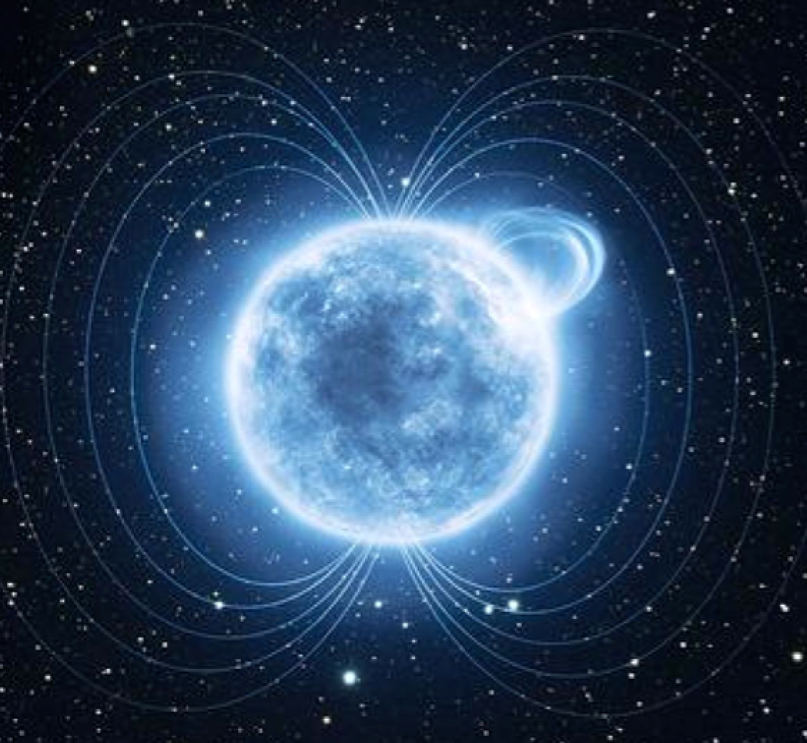
OTHER ASTROPHYSICAL SOURCES emitting transient GW signals detectable by LIGO and Virgo (10-1000 Hz)
Coalescence of binary
system of neutron stars (NS) and NS-BH
Core-collapse of
massive stars
Isolated neutron-star
Notes:
Intermediate-mass (>100) → unmodelled searches

Slide 20
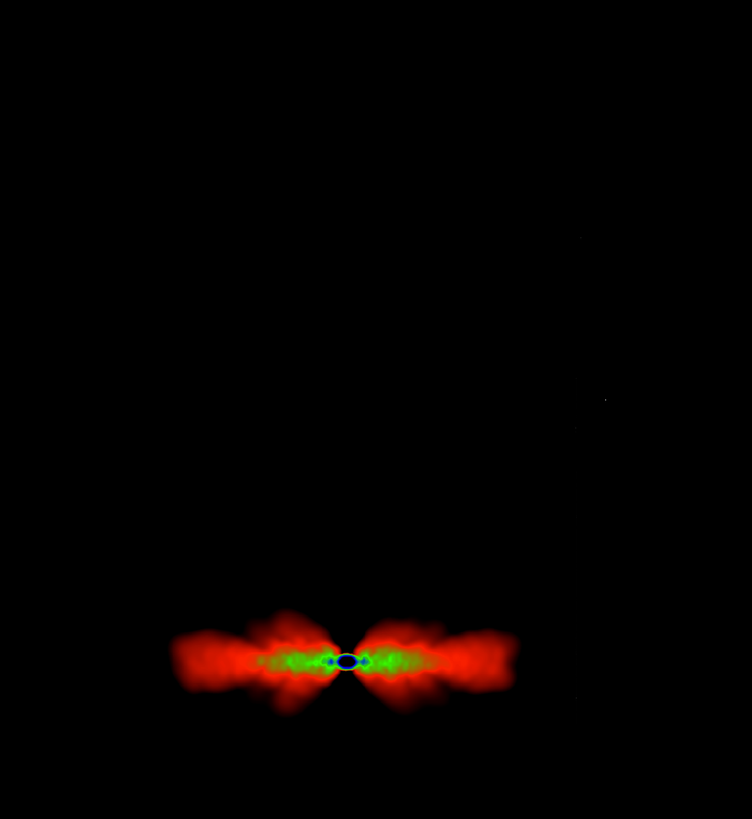
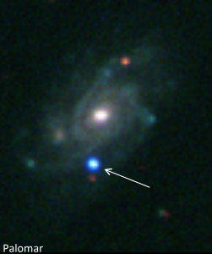

EM emissions
NS-NS and NS-BH mergers
Core-collapse
Short Gamma Ray Burst (sGRB)
SBO X-ray/UV
Optical
Radio
+ Long GRB
Ultra-relativistic
outflow
Sub-relativistic
dynamical ejecta
disk wind outflow
Spin-down luminosity
Isolated NS instabilities
Isotropic emission
Soft Gamma Ray
Repeaters and
Anomalous X-ray Pulsars
?
BH-BH mergers
Radio/gamma-ray
Pulsar glitches
Notes:
Ricordarsi long GRBs

Slide 21
EM emissions
NS-NS and NS-BH mergers
Core-collapse
GRB → prompt gamma (sec)
Afterglows X-ray, optical, radio
(minutes, hours, days, months)
SBO X-ray/UV
(minutes,days)
Optical
(weeks, months)
Radio
(years)
+ Long GRB
Off-axis afterglow
Kilonovae
(days)
Isolated NS instabilities
Isotropic emission
Radio remnants (months, years)
Soft Gamma Ray
Repeaters and
Anomalous X-ray Pulsars
X-ray (min, hrs)
?
BH-BH mergers
Radio/gamma-ray
Pulsar glitches

Slide 22


Prospects of Observing and Localizing GWs
Sensitivity evolution and observing runs
LVC 2016, LRR, 19, 1
Observing schedule,
sensitivities, and source localization
for BNS
22
22
22

Slide 23



GWs and photons provide complementary insight into the physics of
the progenitors and their environment
NASA
GWs
EM emission
Mass
Spins
Eccentricity
NS compactness and tidal deformability
System orientations
Luminosity distance
Explosion asymmetry
Energetics and beaming
Magnetic field strength
Precise (arcsec) sky localization
Host galaxy
Redshift
Nuclear astrophyisics
To constrain the NS equation of state
To shed light on birth and evolution of BH
To constrain geometry of the systems and emission models
Notes:
higher BH spin → higher Mdisk → shrinks the innermost stable orbit more rapidly than the tidal disruption orbit
NS EOS is softened → radius decreases → Mdisk decreases due to the increased difficulty in tidally disrupting the NS.
The stiffer the EOS, the higher the chances of having an EM counterpart. A stiff EOS gives pressure increases a lot for a given increase in density → material harder to compress. Soft equation of state produces a smaller increase of pressure for a change in density and is easy to compress.

Slide 24


The high-energy satellites are crucial:
To trigger the GW search
To follow-up GW candidate alerts
Advantage: less transient contaminants wrt optical band
To follow-up counterpart candidates identified in other EM bands

Slide 25
EXTRA SLIDE

Slide 26


Prospects of Observing and Localizing GWs
Progression of sensitivity and range for Binary Neutron Stars
Larger GW-detectable Universe
LVC 2016, Living Reviews in Relativity, 19
Advanced LIGO’s second run of 6 months will begin in the Fall 2016
Virgo is expected to join the network before the end of 2016
26
26
26

Slide 27





GW150914: two challenges to identify the host galaxies…
The poor sky localization
of the GW signal
620 sq. degrees
In the volume of the Universe corresponding to GW150914
there are 100000 galaxies
2) No significant EM
emission is expected from stellar-mass BBH mergers
Notes:
except for those in highly improbable environments pervaded by large ambient magnetic fields or baryon densities
Localization precison typically arcsecons arcmin

Slide 28

How many high-energy counterparts are expected?
Observed on-axis SHORT GRBs
So far ~100 of which
~25 at known distance
<z>=0.5 = 3 Gpc
zmin = 0.12 = 560 Mpc
Short GRB rate
R = 1-10 Gpc⁻³ yr⁻¹ (e.g. Wanderman & Piran 2015)
R_{GRB} (300* Mpc) = 0.1-1 yr⁻¹
R_{GRB} (600* Mpc) = 1-10 yr⁻¹
(*Distance range for NS-NS 200 Mpc and for NS-BH 400 Mpc expected times 1.5 for face-on systems)
Metzger & Berger 2012, ApJ 746
2.5
2.0
1.5
1.0
0.5
R_{GRB}(<z) yr⁻¹
All-sky gamma-ray monitor
→ 0.3 short GRBs per year (NS-NS range)
3 short GRBs per year (NS-BH range
0.1 Redshift z 1

Slide 29

X-ray: GRB afterglows and other models of BNS isotropic emission
Credits: S. Vinciguerra
Some numbers for off-axis short GRB:
R true = R_{GRB} / (1-cosθ)
(jet opening angle poorly constrained)
Ex:
R true = R_{GRB} x 10 assuming θ=30 deg
R true = R_{GRB} x 65 assuming θ=10 deg

Slide 30

Can massive black holes (>25 Mo) form?
Abbott et al. 2016, ApJL, 818L
BH mass depends on:
Stellar progenitor mass
Stellar wind mass loss
Metallicity
Rotation
SN mechanism
Lower metallicity → reduced opacity, easier radiation transport and reduced momentum transfer→ reduced mass loss from stellar surface
weaker winds
Belczynski 2010
Mapelli 2013, Ziosi 2014
The GW150914 BBH formed in a low-metallicity environment
below 1/2 Zo and possibly 1/4 Zo
Notes:
Radiation-driven wind
Strong old recipe for the stellar wind
Weak new recipe for stellar wind
Wind empirically derived and calibrated on observations
the metallicity or Z is the fraction of mass of a star or other kind of astronomical object that is not in hydroge or helium, metals all element nor hydrogen or helium

Slide 31



Formation pathways to form massive black holes (>25 Mo)
BHs can form in dense environment or in the galaxy field:
Globular Cluster/Young Star Cluster
R ~ 1-10 pc, N ~ 10³⁻⁷ stars
Galaxy field
R~10 kpc, N ~10¹⁰ stars
Massive BHs form:
1) from direct collapse in metal-poor environment
(BOTH CLUSTER AND FIELD)
2) dynamically triggered mergers of lower mass BHs or BH-star favored by three-body encounters(CLUSTER ONLY)
in GC unlikely since BBH ejected from host cluster before merger
in YSC low rate

Slide 32



Pathways to form “heavy” binary BHs
Isolated binary systems
Dense stellar environments
– dynamical origin
Figure: Ziosi et al. 2014
Primordial binary
Majority from dynamical exchanges
Mainly in GC → ejected
eccentric BBH
Figure: Belczynsky arXiv:1602.04531
Both scenarios consistent with GW150914 provided metallicities lower than 1/2 Zo
Crucial: identify the host galaxy and study the GW source environment through the EM counterpart discovery!
Notes:
In young star cluster BH BH-BH or BH-star
sufficiently eccentric to merge within the age of the Universe
Tgw=a^4*(1-e)7/2/(m1m2)(m1+m2)

Slide 33

NS-NS and NS-BH inspiral and merger
Final remnant contains most (>90%) of the mass initially in the binary
Ejected mass by tidal forces → dynamically unbound matter
Mass not gravitationally unbound from the central remnant can posses enough angular momentum to circularize into an accretion disk
Coalescence
NS-BH binary → unbound mass up to 0.1 Mo
depends on ratio of the tidal disruption radius to the innermost stable circular orbit
If < 1 → NS swallowed by the BH no mass ejection
If > 1 NS → tidally disrupted, long spiral arms
1) Dynamical Phase:
when the tidal effects become important, few to several orbits before merger (separation ~50 km)
last several tens of ms
Notes:
ISCO mass ratio, BH spin and NS radius EOS

Slide 34
NS-NS and NS-BH inspiral and merger
Ejected material not gravitationally unbound from the central remnant can fall back or circularizes into an accretion disk
Coalescence
Disk mass up to ∼ 0.3Mo
Disk mass depends on the mass ratio of the binary, the spins of the binary components, the EOS, and the total binary mass
Outflow mass and geometry influence
the EM emission
2) Accretion phase:
within 100 ms after the merger,
BH-torus system forms that can power a transient relativistic jet through accretion

Slide 35

The central remnant influences the EM emission
The central remnant influences GW and EM emission
What is central remnant?
It depends on the total mass of the binary
The mass threshold above which a BH forms directly depends EOS
Notes:
HMNS lifetime depend on:
Lifetime depend on angular momentum trasport via hydrodinamic torques, GWs or magnetorotational instabilties
and loss of thermal energy via neutrino emission:
MRI 10-100 ms and neutrino 1-10 s
SMNS Uniform rotational support -> spin-down timescale up to

Slide 36



GRBs emission - Fireball Model
Cataclysmic event
NS-NS NS-BH
merger
Core Collapse
Central engine
Black Hole
+
accretion disk
“Magnetar”
millisecond
magnetized
(B> 10¹¹ T)
Neutron Star
Surrounding medium
Relativistic
Outflow
Internal shocks
External Shocks
Prompt emission
ϒ-ray - within seconds
Afterglow emission
Optical, X-ray, radio -
hours, days, months
Kinetic energy of the relativistic jet converted in radiation
Mjet = 10⁻⁷-10⁻⁵ Mo, Γ≥100, E=10⁴⁸-10⁵¹ erg
Notes:
The internal shock is produced by collisions between various shells with different velocities inside the fireball. The directional kinetic energy of the fireball is then converted to internal energy, and finally the non-thermal radiation (the prompt emission) is produced by internal shocks.
GRBs result from internal collisions. The interaction of the ejecta in GRBs with the ISM produces the "afterglow" that follows some GRBs.

Slide 37


Macronova/Kilonova-Radio remnant
Significant mass (0.01-0.1 M_{o}) is dynamically ejected
during NS-NS NS-BH mergers
at sub-relativistic velocity (0.1-0.3 c)
Relatvistic Jet
r-process
Neutron capture rate much faster than decay, special conditions:
T > 10⁹ K, high neutron density 10²² cm⁻³
Dynamical
outflow
nucleosynthesis of heavy nuclei
radioactive decay of heavy elements
Rosswog et al. 2013
Power MACRONOVA
short lived IR-UV signal (days)
Kulkarni 2005, astro-ph0510256;
Li & Paczynski 1998,ApJL, 507
Metzger et al. 2010, MNRAS, 406;
RADIO REMNANT
long lasting radio signals (years)
produced by interaction of sub-relativistic outflow with surrounding matter
Piran et al. 2013, MNRAS, 430
Notes:
Viscous and nuclear heating drive winds during accretion
The accretion disk outflows in the case of a long-lived HMNS, can have a higher electron fraction and be in some cases lanthanide-free.
Rapid neutron capture porcess r-process
R-process in the dynamycally ejected outflow
Tidal tiles

Slide 38


Possible HST kilonova detection for short GRB 130603B after 9.4 days
Tanvir et al. 2013, Nature ,500
HST two epochs (9d, 30d) observations
F606W/optical
NIR/F160W
Time since GRB 130603B (days)
1 10
Afterglow and host galaxy z=0.356
21
23
25
27
29
10⁻¹¹
10⁻¹²
10⁻¹³
10⁻¹⁴
Orange curves → kilonova NIR model
ejected masses of 10⁻² Mo and 10⁻¹Mo
Solid red curves → afterglow +kilonova
Cyan curve → kilonova optical model
AB-magnitude
X-ray Flux (erg s⁻¹ cm⁻²)
14

Slide 39







NS-NS and NS-BH merger EM-emissions
X-ray
Optical
NS-BH, Piran 2013
NS-NS, Metzger 2010
NS-NS, Barnes & Kasen 2013
Source at 200 Mpc
On-axis sGRB
Off-axis sGRB
Isotropic kilonova
Radio
Piran 2013
NS-BH
NS-NS
Different emissions
Different timescales
Global network of
multi-wavelength observatories!

Slide 40
EM emissions
NS-NS and NS-BH mergers
Core-collapse of massive stars
GRB → prompt gamma (sec)
SBO X-ray/UV
(minutes,days)
Optical
(weeks, months)
→ Triggered Analysis: search that uses EM or neutrino observations to drive the detection of GWs
Isolated NS instabilities
Soft Gamma Ray
Repeaters and
Anomalous X-ray Pulsars
Radio/gamma-ray
Pulsar glitches

Slide 41

GRB prompt emission, SN explosion in local galaxies, flares SGR,
pulsar glitches, low and high energy neutrino → GW TRIGGERED ANALYSIS
Known event time and sky position:
→ reduction in search parameter space
→ gain in search sensitivity
Abadie et al. 2012, ApJ, 760
GW transient searches
Aasi et al. 2014,PhRvL, 113
Abadie et al. 2012, ApJ, 755
Unmodeled GW burst (< 1 sec duration)
Arbitrary waveform
→ Excess power
Adrián-Martínez et al. 2013, JCAP
Aartsen et al, PhysRevD, 90, 102002
Off source
On source
Off source
Compact Binary
Coalescence
Known waveform
→ Matched filter
Background estimate
EM trigger
Background estimate
What is time delay between the GW and EM emissions?
What is the time window to search for GWs?
Notes:
Neutrino astrophysical candidates
Single event to constrain progenitor, emission models, energy emitted in GW
Statistical studies?

Slide 42
EM emissions
NS-NS and NS-BH mergers
Core-collapse of massive stars
GRB → prompt gamma (sec)
Afterglows X-ray, optical, radio
(minutes, hours, days, months)
SBO X-ray/UV
(minutes,days)
Optical
(weeks, months)
Radio
(years)
Off-axis afterglow
→ EM follow-up: low-latency GW candidate events to trigger prompt EM observations and archival searches
Isotropic emission
Kilonovae (days)
Radio remnants (months, years)
X-ray (min, hrs)
Isolated NS instabilities
Soft Gamma Ray
Repeaters and
Anomalous X-ray Pulsars
Siegel & Ciolfi 2016, ApJ
?
BH-BH mergers
Radio/gamma-ray
Pulsar glitches

Slide 43
Sky map coverage
The astronomer teams tiled large portions of the GW sky maps
Weak signal of 1 sec 0.4 s after the event detected by FERMI, INTEGRAL and AGILE no signal and stringent upper limit
In the optical, candidate counterparts identified to be normal population type Ia and type II SNe, dwarf novae and AGN

