Slide 1
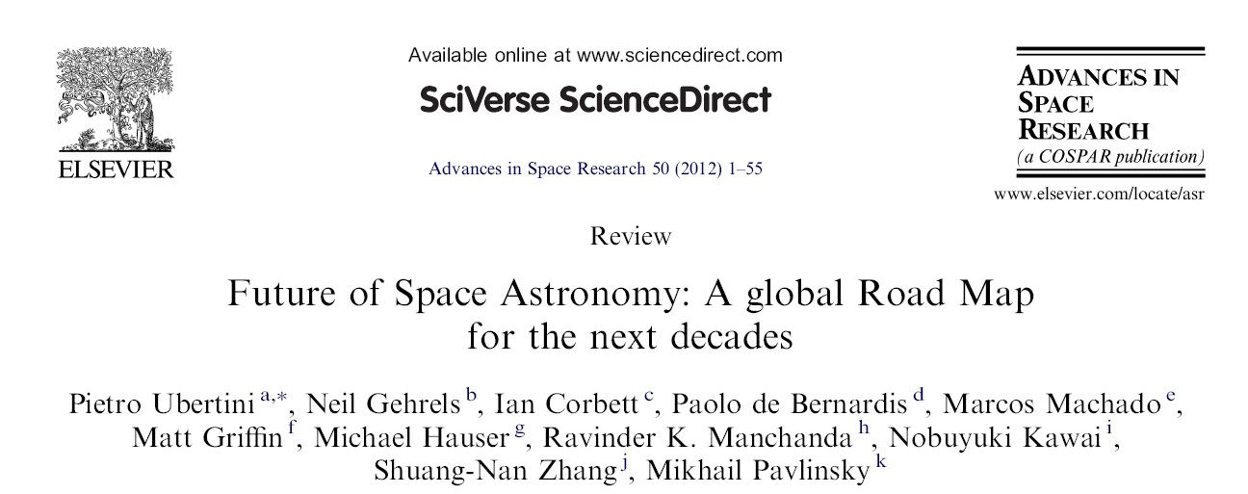
An update
Patrizia Caraveo

Slide 2
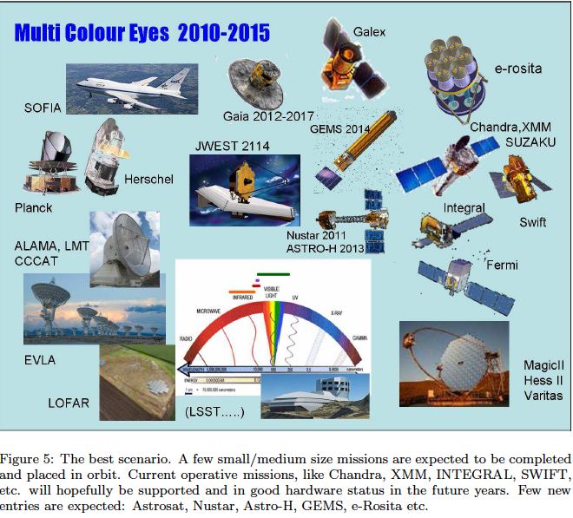

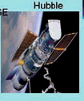
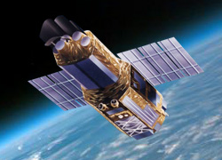
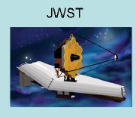
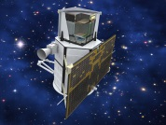
2013
End life
> 2018
Agile
a golden age for space astronomy..SPECTACULAR RESULTS FROM SPACE OBSERVATORIES

Slide 3
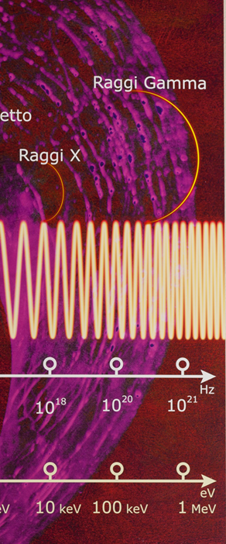

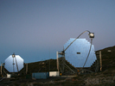






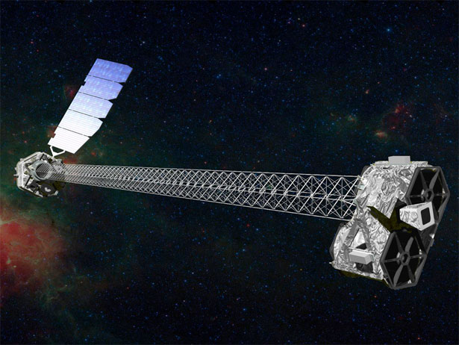

CALET
NuStar
ASTROSAT

Slide 4
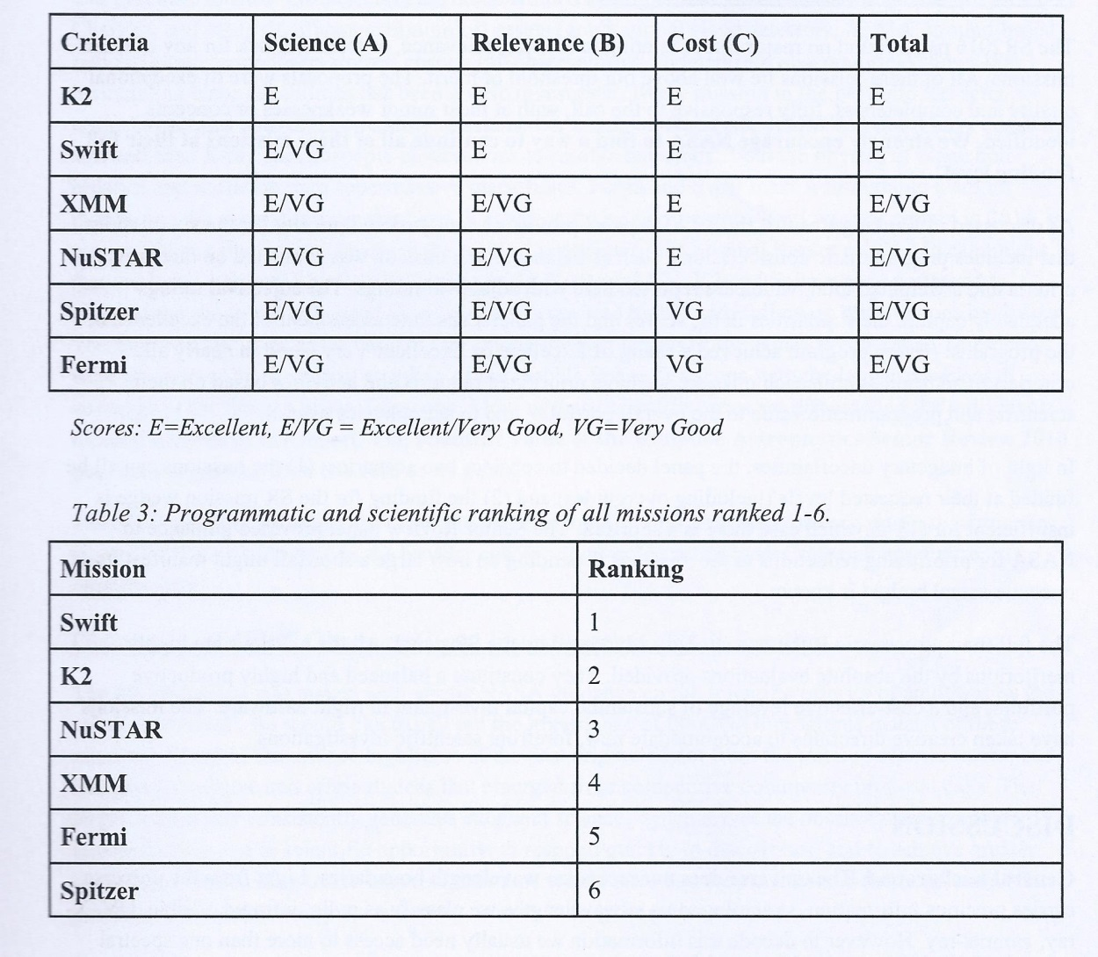
NASA senior Review
XMM and INTEGRAL operations will be supported by ESA up to 2020

Slide 5

NOW
XMM and INTEGRAL operations will be supported by ESA up to 2020

Slide 6
17
14
12
CALET
11
9
NUSTAR
7
4
8
ASTROSAT

Slide 7
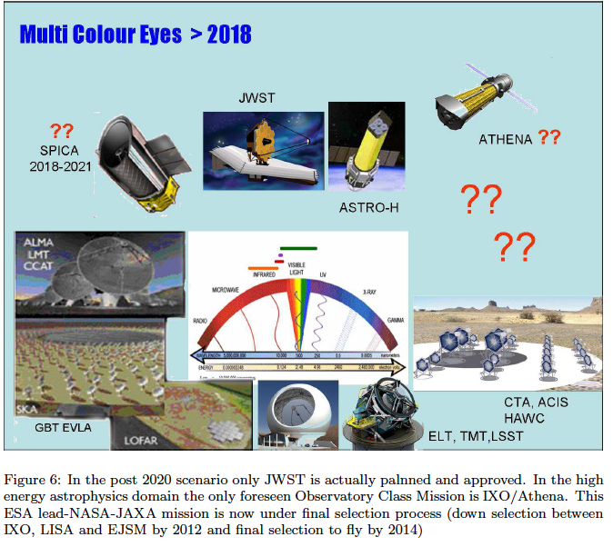
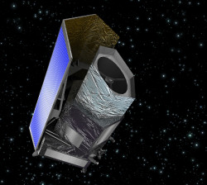
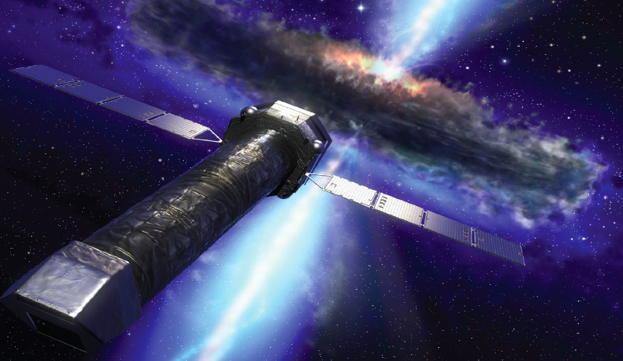
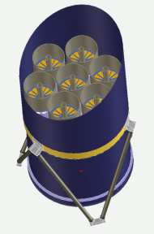
GEMS Polarization
mission 2014
NEW
ESA L 2-selection
Euclid
2028
2017

Slide 8

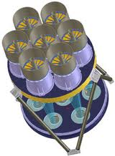
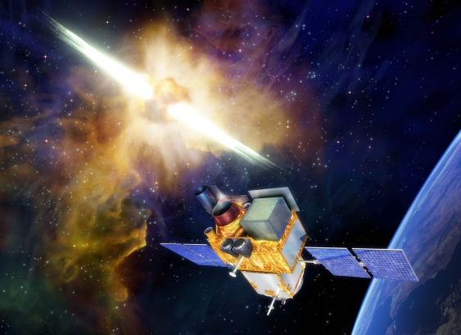

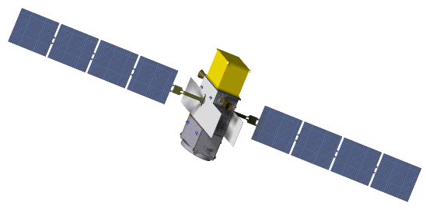
SVOM
E-Rosita
ESA M5
e-ASTROGAM
Athena

Slide 9
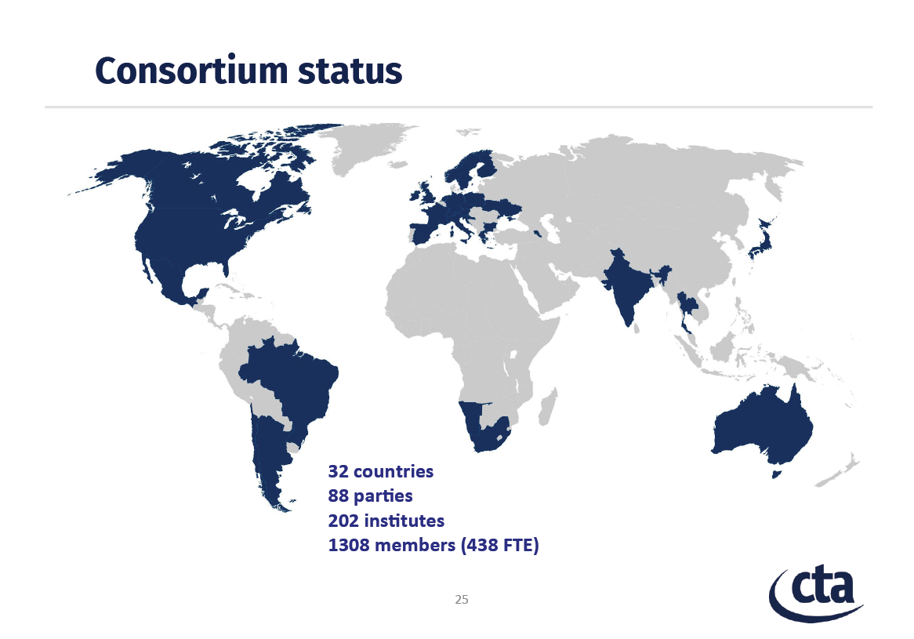
Maggio 2016

Slide 10
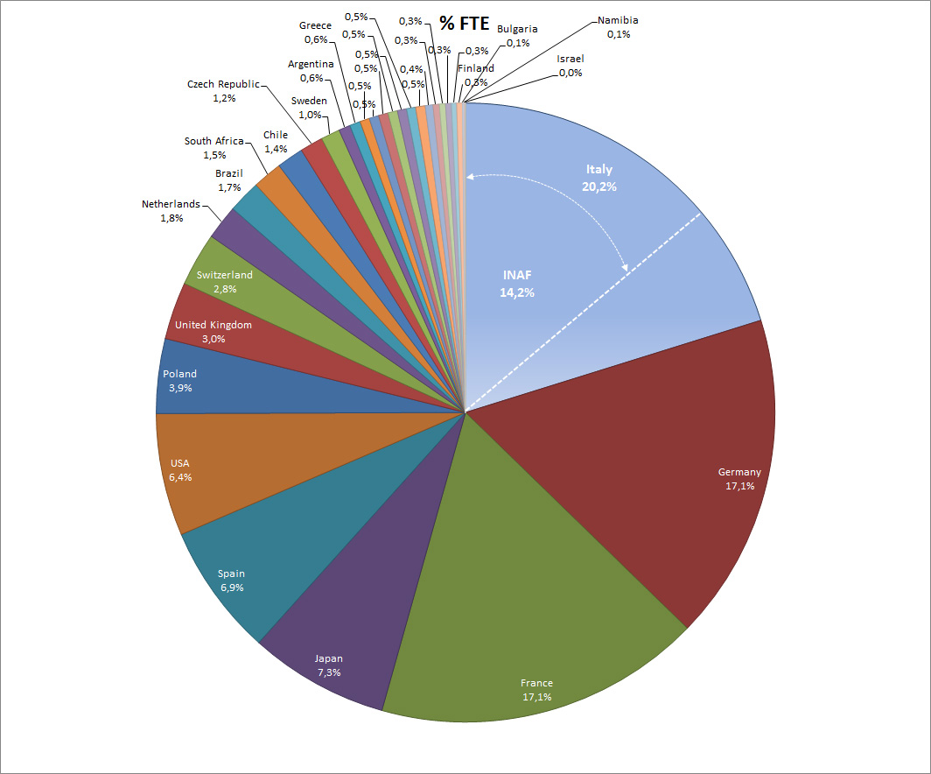

Slide 11
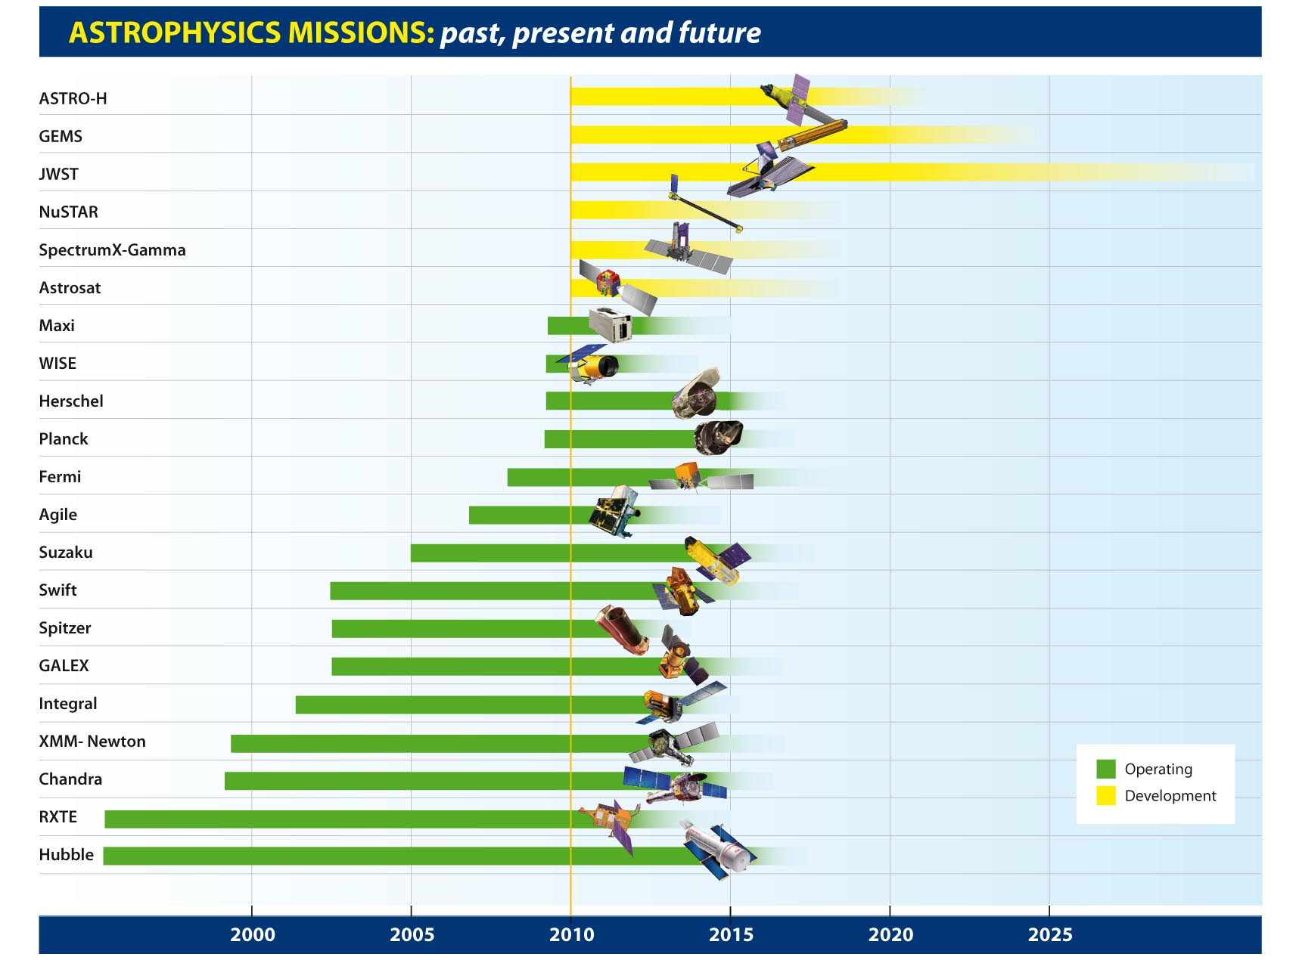
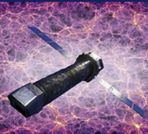

Athena
e-ROSITA
and CALET on the ISS
NeoWise
Post-op
Notes:
Bad outlook for the futuro if corrective actions are not implemented

