Slide 1

Relativistic tidal disruption events: what do we learn from their rate distribution?
Imma Donnarumma
INAF-IAPS
Italy
14th AGILE Workshop
June 20-21, 2016
ASI - Rome

Slide 2

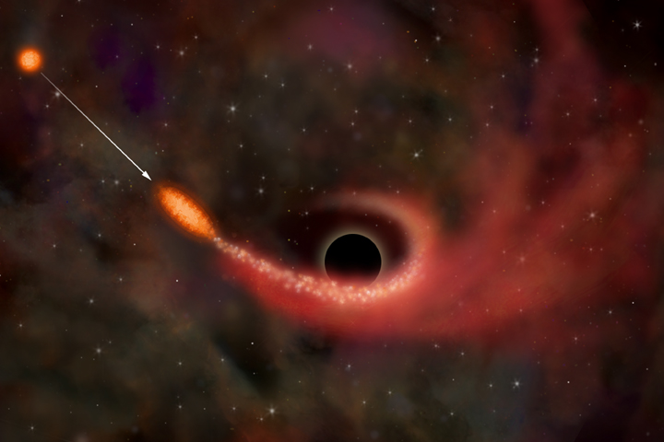
Tidal disruption events
When a star orbits close to a massive black hole and its periastron distance reaches
R~ R∗(M_{BH} / m∗)^{1/3}, it will be disrupted and cause what is commonly referred to as a tidal disruption flare.
MASS FALLS BACK AT A RATE:
Rees 88
Phinney 89

Slide 3
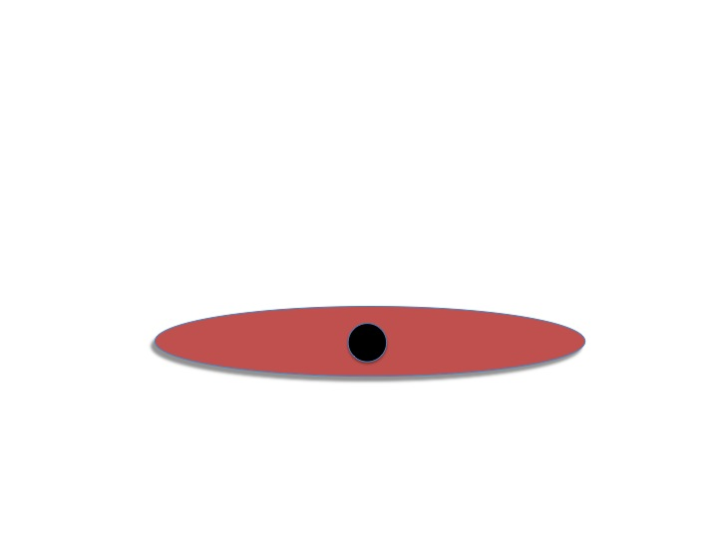
A TRANSIENT DISC,
ACCRETING AT THE FALLBACK RATE
IF SUB-EDDINGTON ONLY THERMAL
EMISSION IS FROM DISC

Slide 4
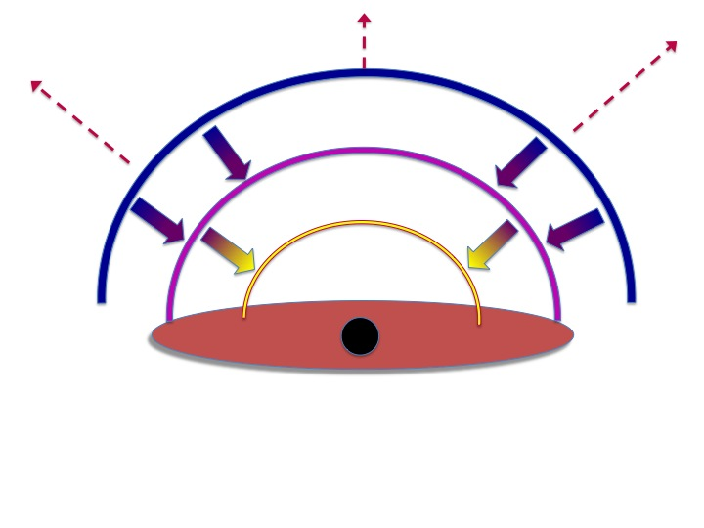
Super Eddington mass loss
Rossi & BEGELMAN ‘08
STRUBBE & QUATAERT ‘09
LODATO & Rossi ‘10
THE PEAK IS FIRST IN optical AND THEN IT MOVES TO higher FREQUENCIES
Notes:
concorrono all’emissione nelle diverse fasi dell’evoluzione (venti stellari, dischi di
accrescimento). Per BH con massa < 107 Msun, l’accrescimento avviene in regime super-Eddington,
per cui una frazione della massa della stella (circa il 10%) può essere espulsa sotto forma di venti
dando origine ad una gobba nella curva di luce seguita da un decadimento rapido ∝ t-2.6 una volta
raggiunto il picco in luminosità (1041-1043 erg s-1).
Quando il vento cessa (t ~ tedd), l’emissione è dominata dal disco di accrescimento, seguendo un
andamento che nell’ottico-UV è meglio approssimato da t-5/12 (la frequenza osservata, in questo caso,
cade nella Rayleigh – Jeans dello spettro di corpo nero, (\nu L\nu ∝Tdisk= Mdot1/4=(t-5/3 )1/4).

Slide 5
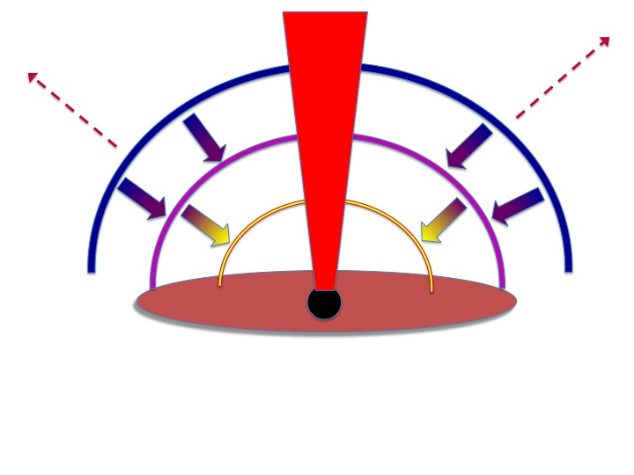
...and the jet
WHAT WE SEE DEPENDS ON THE VIEWING ANGLE

Slide 6
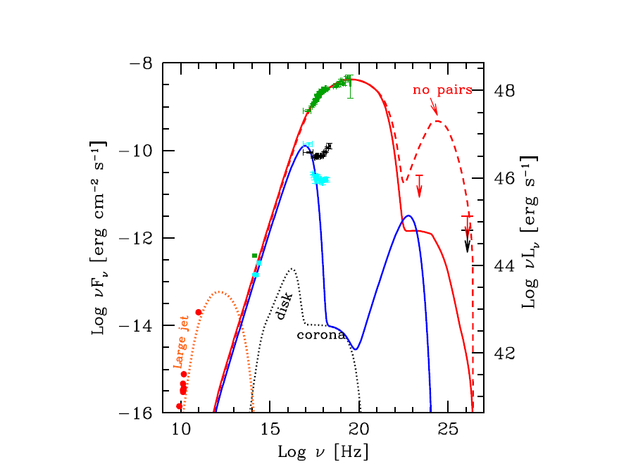
The High energy emission of jetted
TDEs
HE SED
modeled a Sync
The case of Sw J1644, Burrows et al. 2011, NATURE

Slide 7
OBSERVATION OF TDE IS IMPORTANT
Study disc accretion in different regimes on month timescale
Super Eddington accretion not well understood
constrain jet/disc connection
discover quiescent supermassive black holes (SMBH) and measure their mass
constrain SMBH mass function

Slide 8
How many TDEs so far (both thermal and non-thermal)
Current status
Relativistic TDEs: 3 objects detected so far
(BAT triggered)
Thermal TDEs: < 30 objects detected so far
(ROSAT, XMM, Chandra, ASAS-SN, SDSS, GALEX, INTEGRAL candidates)

Slide 9
Jetted TDE: 3 SWIFT Events
Sw J1644+57 (z=0.35; Burrows et al. 2011), Sw J2058+05 (z=1.18; Cenko et al. 2011), Sw J1112.2-8238 (z=0.89; Brown et al. 2015)
Exploded in quiescent galaxies.
Sw J1644 and Sw J2058 have position within 150 pc and 400 pc of their galactic center, respectively (Levan et al. 2011, Pasham et al. 2015)
Persistent (months), variable and bright X-rays lightcurve (L ~ 10⁴⁷ erg/s after 2 weeks)
Bright radio counterparts (e.g. Zauderer et al. 2011, Cenko et al. 2011)

Slide 10
Three jetted TDEs discovered in hard X-rays, inferring a very low rate:
can we deliver information about jet production efficiency from the BAT rate?

Slide 11
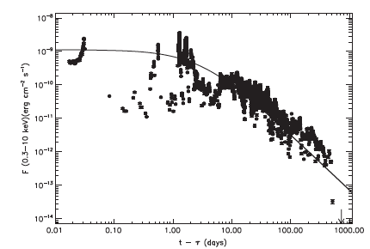
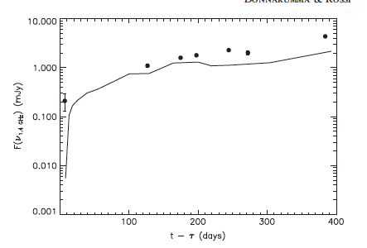


How can we derive the rate of jetted TDEs?
Donnarumma & Rossi 2015
Using Sw J1644 as a prototype to make predictions in X-rays and radio energy bands
0.3-10 keV
1.4 GHz
MDL
Notes:
Usually adopted for γ-ray burst afterglows. In this case, the radio flux
does not explicitly depend on the BH mass. A second approach is to assume that the luminosity
is proportional to the peak of the jet power, which in turn is proportional to the peak fall-back rate
L ∝ M ̇ . This introduces a mass dependence in the luminosity as L ∝ L ∝ M−1/2m1/2.
We now need to generalize our prototypical light curve to a
generic TDE. The main uncertainty is how the fl ux scales with
black hole and stellar masses. A fi rst possibility is to describe
the jet evolution with a Blandford Mckee ( thereafter “ BM
model”) solution, usually adopted for γ -ray burst afterglows
( e.g., Berger et al. 2012; Metzger et al. 2012) . Frequencies
below 5 GHz are in the self-absorbed part of the synchrotron
spectrum, for the whole observed duration of the event ( see
Figure 3 in Berger et al. 2012) . The observed specifi c
luminosity in this regime (n < na < nm) is given by the
Raleigh Jeans part of the blackbody spectrum
B(n d)d3 μ k T(n d) d
b
2 3 ( see Equation ( 8)) , with a kinetic
temperature given by 3kbT = mec g
2
min , where the minimum
Lorentz factor for the shocked accelerated electrons is
g μ G. min Therefore the specifi c radio luminosity is
Ln μ B(n d)d3(rq ) μ (rG) ,

Slide 12
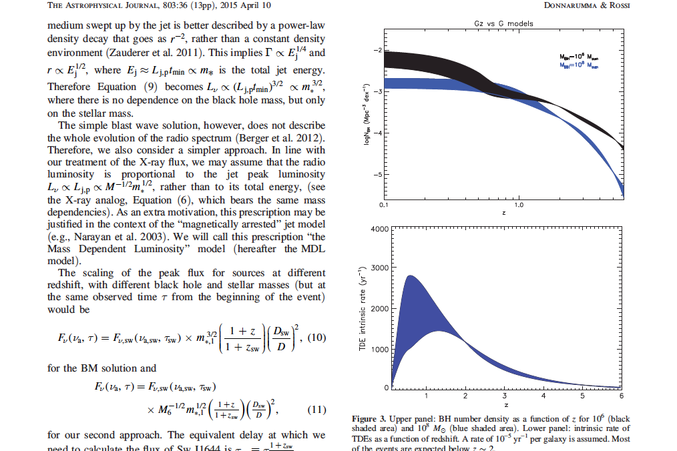
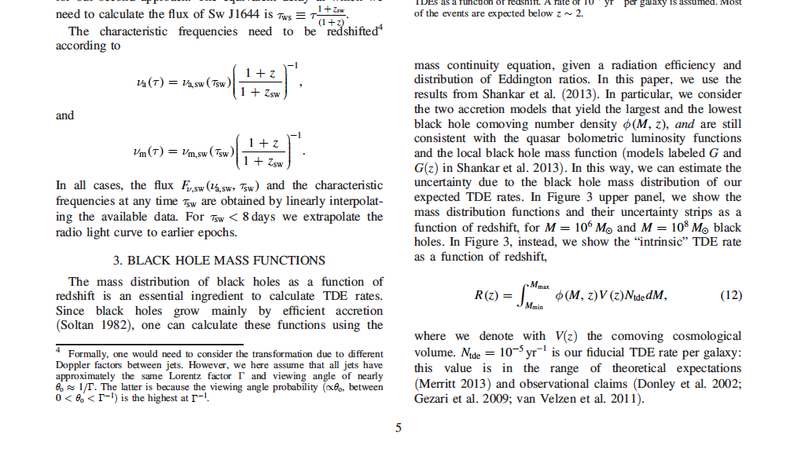
The intrinsic rate R(z) and the beaming reduction
Shankar et al. 2013 mass function (G and Gz models adopted)
Intrinsic rate
N_{TDE}~ a few x10⁻⁵ per yr per galaxy
M = [10⁶ ⁻ 10⁸ Msun ]
From intrinsic to jetted TDE rate: rescaling R(z) by a factor (2Γ)⁻²
Notes:
G and Gz model
the two accretion models that yield the largest and the lowest
black hole comoving number density f(M, z) , and are still
consistent with the quasar bolometric luminosity functions
and the local black hole mass function

Slide 13

Rate predictions: constraints from current observations
A Monte Carlo approach:
main ingredients, τ and m*
  τ - randomly extracted from a uniform distribution between 0 and 1 yr
  m* -extracted from a Kroupa IMF
τ = X-ray lag time
(the same applies to radio
light curve)
m* = star mass

Slide 14
Looking at the discovery potential for current and future missions
The Square Kilometre Array survey:
large sky coverage (~ 20,000 deg²) performed with multiple cadence (daily/weekly) at 1.4 GHz with a flux limit of 90 uJy
(Donnarumma et al. 2015, Fender et al. 2015, Donnarumma & Rossi 2015)
Current Hard X-ray survey
BAT
Future X-ray surveys:
eRosita, Einstein-Probe, LOFT-like Wide Field Monitor

Slide 15
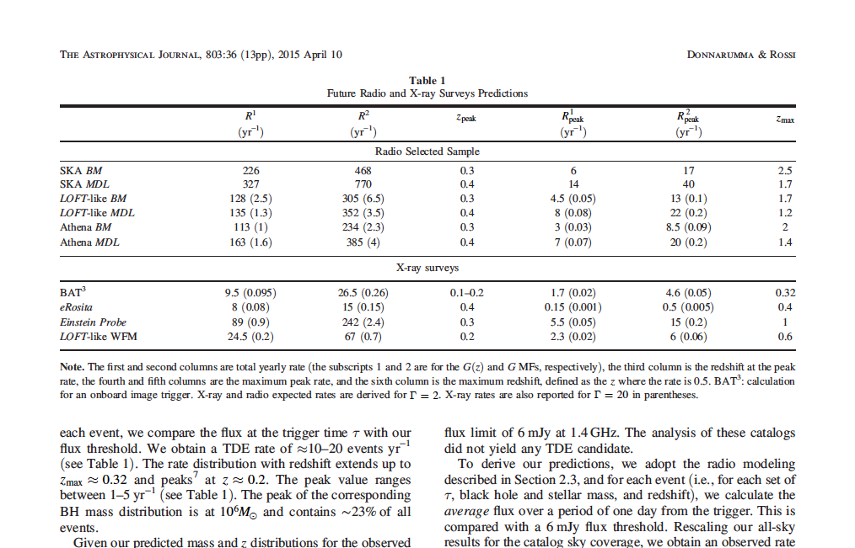
Radio and X-ray surveys predictions
Donnarumma & Rossi 2015
These rates assume a
a jet production efficiency of 100%

Slide 16
Jet production efficiency?
It is not possible to infer jet production efficiency from the BAT rate
this is due to the degeneracy between observing efficiency (sky coverage vs flux limit) and the value of the bulk Lorentz factor Γ
Note that even assuming a jet production efficiency of 100%, Γ in the range 10 – 20 can reconcile observations with predictions

Slide 17
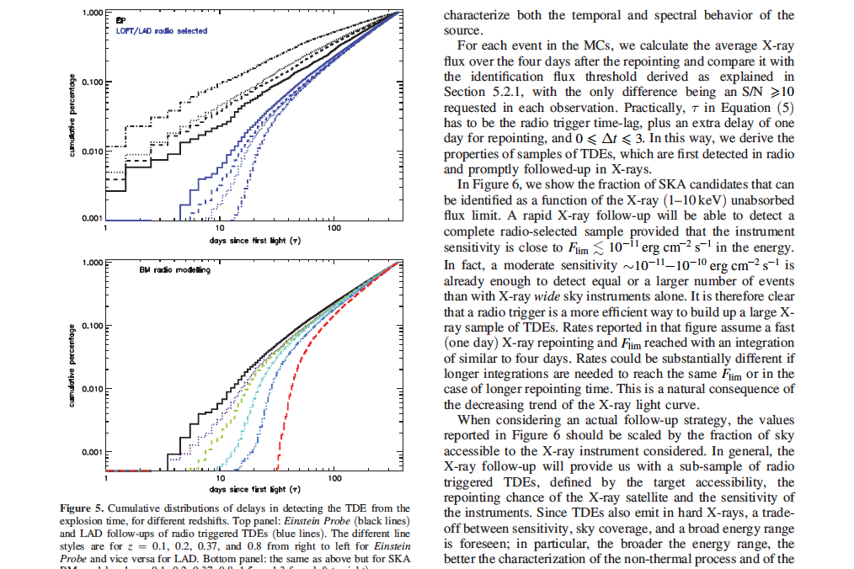
The trigger time: the complementary roles of radio and X-ray surveys
z = 0.1, 0.2, 0.37,0.8, 1.5, 3
z = 0.1, 0.2, 0.37,0.8

Slide 18
Main findings
SKA survey
a great discovery potential of relativistic TDEs in combination with a prompt follow-up at higher energies. Hundreds of TDEs expected to be detected up to z ~ 2.5
(if a jet efficiency of 100% is assumed)
Future X-ray surveys
complementary to the SKA detections, because of the chance to detect the TDE earlier than in radio, enabling the study of the first phases of disc/jet formation

Slide 19
Summary
The rate of TDEs will strongly depend on the observing strategy (20000 deg² of the sky covered in daily/even weekly passes at 90 uJy looks as an effective strategy)
A rapid quick look alert system needed for a fast repointing at higher energies
Great perspectives in the future thanks to the synergy among radio (SKA), optical (LSST) and possibly X-gamma ray surveys
Jetted TDEs will provide a unique tool to detect quiescent SMBHs in the far Universe z ~2 -3, mainly in the low-mass tail of the SMBH mass function (L_{TDE} ∝ M_{BH}^{-1/2})

Slide 20
SKA-Rebaseline
SKA1-SUR no more applicable (90 uJy e 20000deg²)
Monthly cadence to achieve 90 uJy sensitivity per half-sky scan
Alternatively, 10-day cadence with 160 uJy flux limit is still a viable option
…. Still to discuss

Slide 21
Future perspectives: new code for the rate distribution
Accounting for the spin distributions for different BH seed models (low vs high mass seeds)
TDE rate dependence on BH mass
SPIN dependence included in the calculation of the peak luminosity in TDEs
Work in progress with E. Rossi, A. Sesana, E. Barausse

Slide 22
Preliminary TDE luminosity Functions
Low mass seed model
Preliminary
Preliminary
High mass seed model
The derived LFs are expected to be substantially different: they mainly reflect the BH mass distribution

Slide 23
Conclusions
The jet power distribution can be quite different in the two
seed models:
for a low mass seed distribution, jet power does not appreciably extend above 10⁴⁸ erg/s, while for a high mass seed population a larger energy tail is present.
For high mass seeds, TDEs preferentially happen in galaxies with mass < 10⁶M⊙ , and since the jet power scales inversely with the black hole mass, jets are in average more luminous than in the other seed model, where TDEs happen for a wider black hole mass range.

Slide 24
Future HE Missions: new diagnostics?
X-ray light curves
Polarimetry
Wide Field Survey in low energy gamma-rays

Slide 25
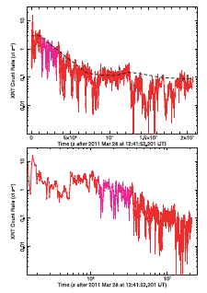
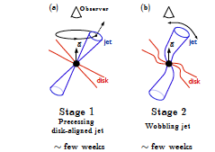
The jet precession/wobbling in relativistic TDEs
HE Polarimetry will play a crucial role in assessing the role of precession at the beginning of the event for the brightest events
Need for fast alerts (LSST, SKA, SVOM, Einstein Probe, and……)
Saxton et al. 2012
Tchekhovskoy et al. 2013
Notes:
In general the angular momentum of the initial stellar orbit and
fall-back accretion disk will not be aligned with the spin of the BH.
Such tilted, geometrically-thick accretion disks undergo precession
due to Lense-Thirring torques, and their jets are also expected to
Preceed.
Stage 2 The lack of evidence of jer precession may be due to a Disalignment between the spin axis and the disk-jet axis
precess (Fig. 2a).
Stage 3 Steady Spin-Aligned Jet: the magnetic flux becomes relevant after months (1.5 yrs) from the disruption
In the MAD state, the magnetic field is suciently strong to offset gravitational forces acting on the inner disk and to align the axis of the disk
axis (and hence the jets) with the BH spin (so-called “magneto-alignment effect”; MTB12a). However, it takes time for the entire disk and jet to align with
the BH spin.

Slide 26
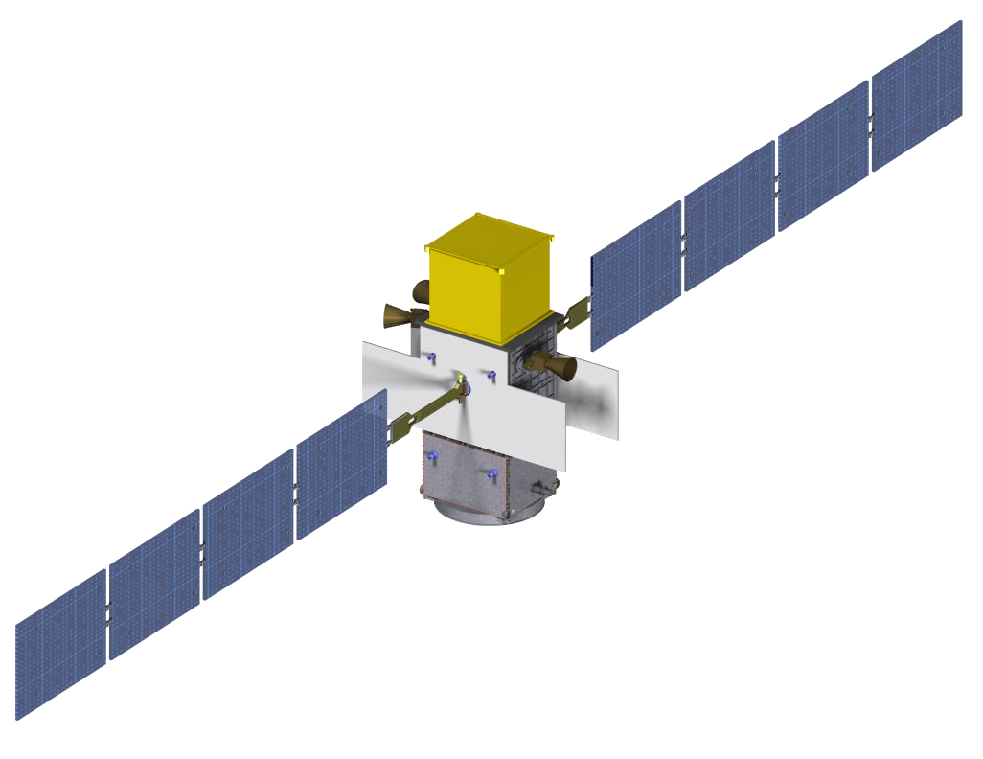








The next gamma-ray MeV-GeV mission:
the e-ASTROGAM project
MeV – GeV astrophysics
MeV – GeV community
LoI submitted to ESA M5 call on June 6th;
e-ASTROGAM is focused on gamma-ray astrophysics in the range 0.3-100 MeV with excellent capability up to GeV energies.

Slide 27
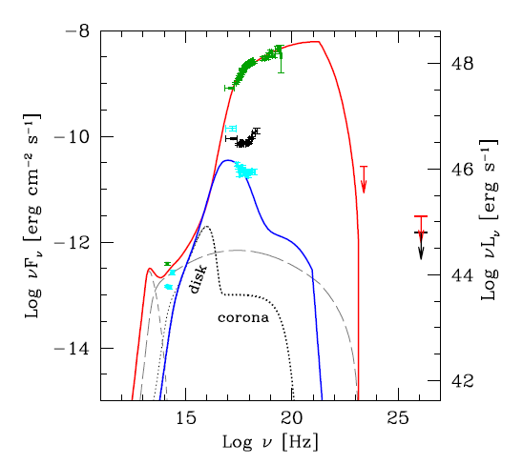
The High energy emission of a relativistic
TDE: the missing piece
e-ASTROGAM energy band will cover the SED peak
new chances to trigger these events with a wide FoV + a strategy optimized for transients
Strong constraints on the HE emission model with the broad band and polarimetric
measurements (300 keV – a few MeV)-> synergy with future X-ray polarimeters (XIPE, IXPE)
HE SED
modeled a Sync
HE SED modeled as IC
e-ASTROGAM

Slide 28


Slide 29
Backup slides

Slide 30
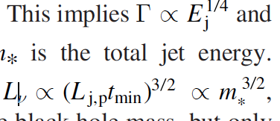
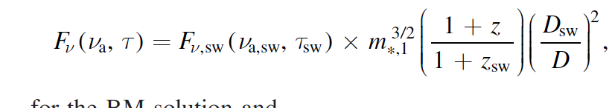

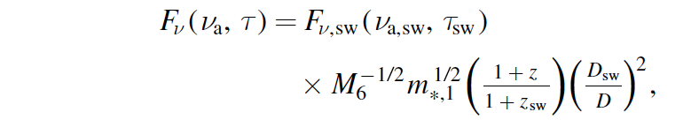
BM and MDL formulae
Densità del mezzo esterno ~ r⁻²
BM
MDL
Notes:
The peak of the accretion rate3 is quite intuitively the mass of
the star divided by the characteristic timescale, tmin= time needed to the debris to arrive at the periastron

Slide 31
How to deal with thousands of SKA transient alerts
A rapid optical follow-up aimed at determining the host galaxy has to be foreseen
Localization of the brightest transients with a precision of ∼ 100 milliarcsecond (mas) (resolution of about 2 arcsec (SKA1-SUR) and 0.6 arcsec or better (SKA1-MID) (Dewdney et al. 2013))
This angular localization is at the current alignment accuracy level of radio and optical reference frames (Orosz & Frey 2013), corresponding to linear scales of 0.5–0.8 kpc at z > 0.3.

Slide 32
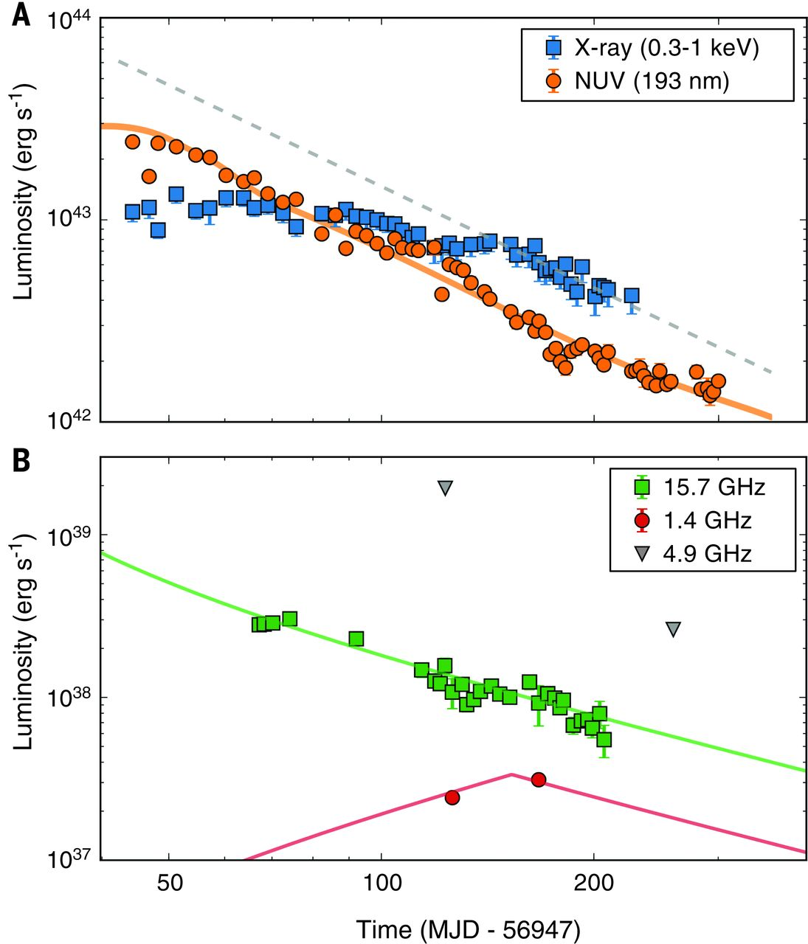
Jet efficiency: radio counterpart discovery relies on the fast multi-frequency follow-up
Sw J1644+57
ASAS-SN 14li
~10 days after the optical
discovery
Relativistic
Thermal, but radio jet
z=0.35
z=0.02
Burrows et al. 2011, Nature
Van Velzen et al. 2016, Science
Again radio sky surveys are the best tool to detect the jetted TDEs and trigger higher energy follow-up
Notes:
The multiwavelength properties of the source present a natural analogy with accretion-state changes of stellar mass black holes, which suggests that all TDFs could be accompanied by a jet. In the rest frame of the TDF, our radio observations are an order of magnitude more sensitive than nearly all previous upper limits, explaining how these jets, if common, could thus far have escaped detection.
before the first Swift observation of ASASSN-14li and applying a simple blast wave model yields a total jet energy of Ej ~ 1048 erg, under the common assumption that 20 and 1% of the energy dissipated by the shocks is placed into relativistic electrons and magnetic fields, respectively (1). This energy is four orders of magnitude lower than the total jet energy of Swift J1644+57. By the time of our radio observations, the newly launched jet would have swept up enough matter to slow to mildly relativistic velocities (bulk Lorentz factor Γj ≈ 2),
Besides spin, powerful jets may require a large magnetic flux near the black hole horizon (27). Our observations could suggest that the magnetic flux stored in a preexisting accretion flow is not tapped efficiently upon the disruption and accretion of a star, contrary to simulation predictions (28).

Slide 33
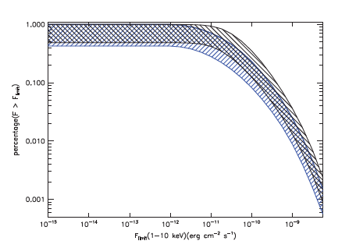
Predictions for future X-ray surveys
Higher discovery potential with follow-up observations
Complete X-ray radio-selected sample
(sky accessibility and repointing efficiency)
ATHENA mission will be able to follow-up “almost” all radio triggered TDEs
(it depends on the sky accessibility, ~50%)

Slide 34
New code for the rate distribution
New spin distributions for different BH seed models
low mass seed
high mass seed (Begelman & Volonteri)
2) TDE rate dependence on the BH mass (Eq. 18 in Brockamp et al. 2011)
NTde = 6.29 10⁻⁸ (M_{BH}/M_{sun})^{0.446} yr⁻¹
3) SPIN (a) dependence included in the calculation of the peak luminosity in TDEs
X-ray and radio luminosities are both proportional to a²

Slide 35
BH mass and spin distributions….
Low mass seed model
Spirals
ellipticals
High mass seed model
Spirals
ellipticals
A broader distribution in the case of low mass seed models, with a well defined peak at M_{BH}=a few x 10⁵ M in HMSM
Notes:
In this paper, we adopt the MF predictions for “quiescent” SMBHs from different
scenarios for SMBH seed formation: the “PoP III scenario”, where low mass seed
(∼ 100M⊙ ) black holes are produced in the core collapse of the first generation
of massive stars (Madau & Rees 2001); and the “direct collapse scenario”, where
high mass seeds (> 104M⊙ ) can directly form from the collapse of gas gathered
at the centre of low metallicity proto-galaxies (e.g. Begelman et al. 2006). In
particular, we assume the MFs predicted by Sesana et al. (2014), to which we
refer the reader for more details on the code, modelling and its assumptions.
We define “quiescent” a SMBHs accreting at an Eddington ratio ≤ 10−4 and
we separately consider predictions for spiral and elliptical host galaxies.

Slide 36
Spin distribution
Low mass seed model
Spirals
ellipticals
High mass seed model
Spirals
ellipticals

