Slide 1

Blazars at γ–ray and VHE energies
Paolo Giommi
Italian Space Agency - ASDC

Slide 2
The 100 MeV-100 GeV sky seen by Fermi

Slide 3
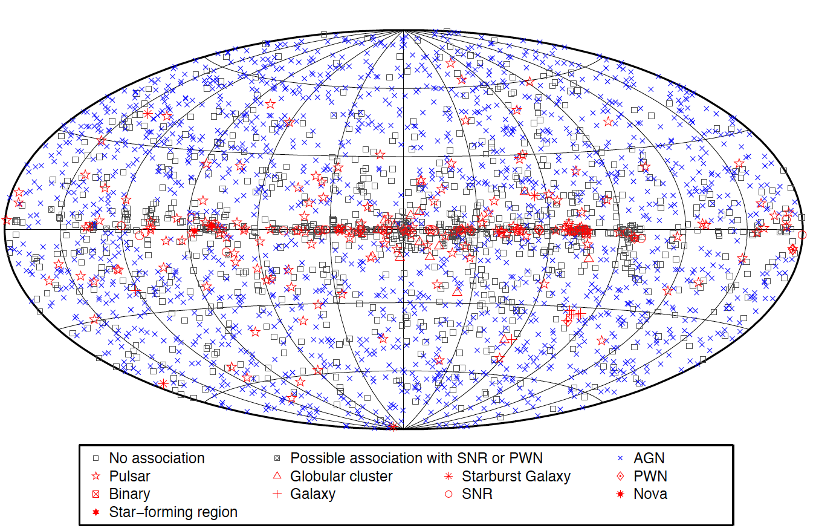
Fermi 3FGL catalog: Ackermann et al. 2015, ApJ 810, 14, arXiv:1501.06054
4 years of PASS 7 data: 3033 sources

Slide 4
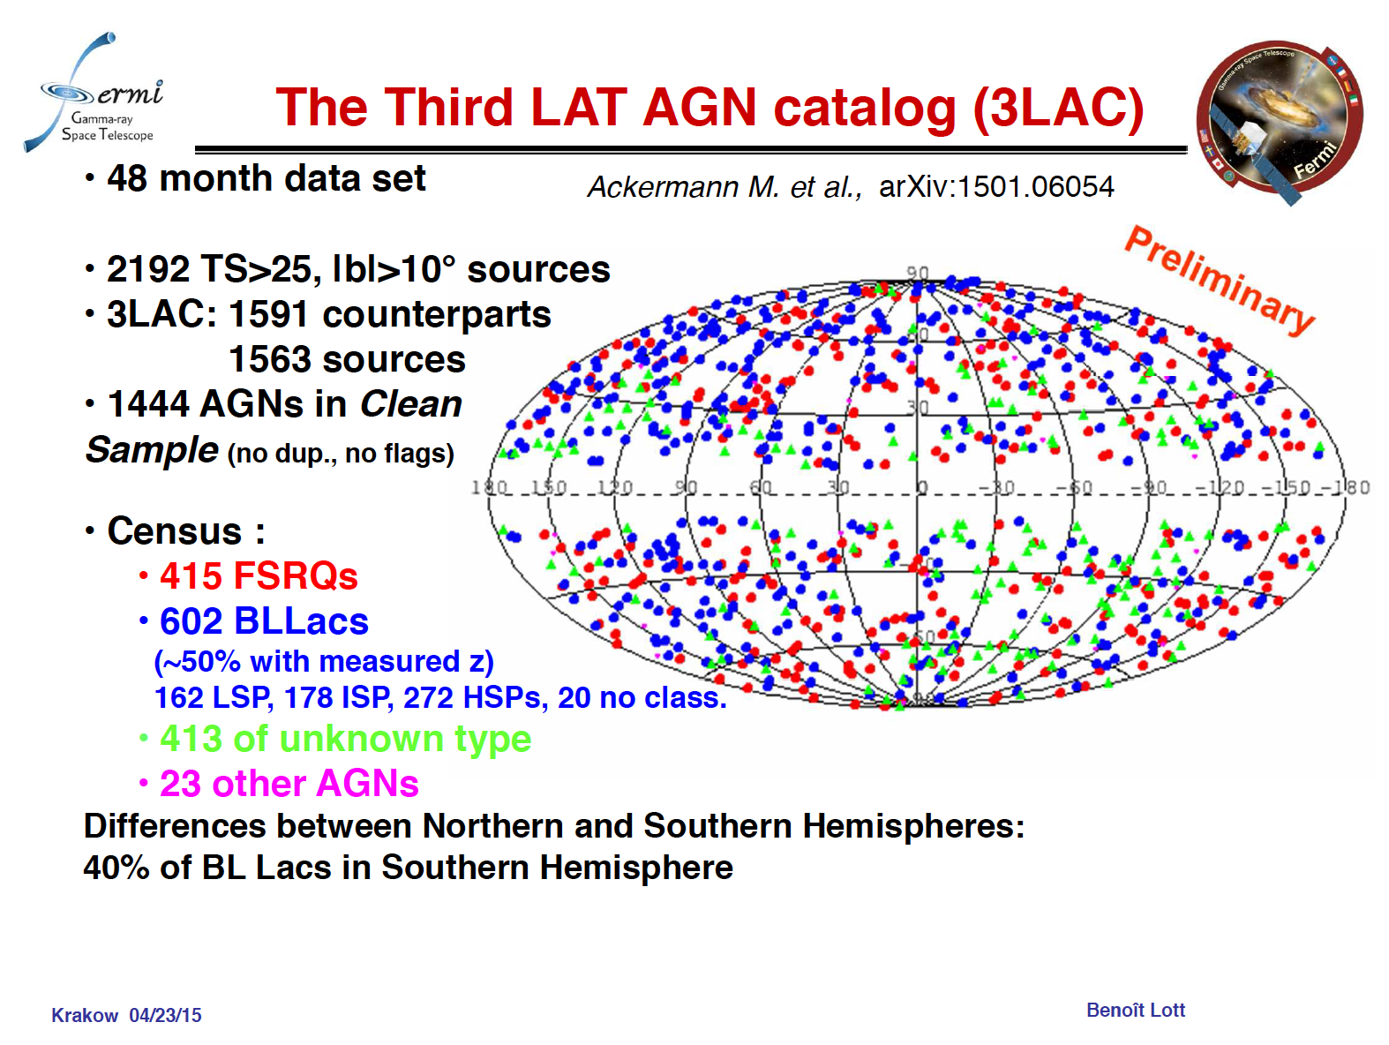

Slide 5
Fermi 2FHL
The Fermi-LAT view of the
Very High Energy Sky
Ackermann et al. ApJS 222, 1, 2016,. arXiv:1508.04449

Slide 6
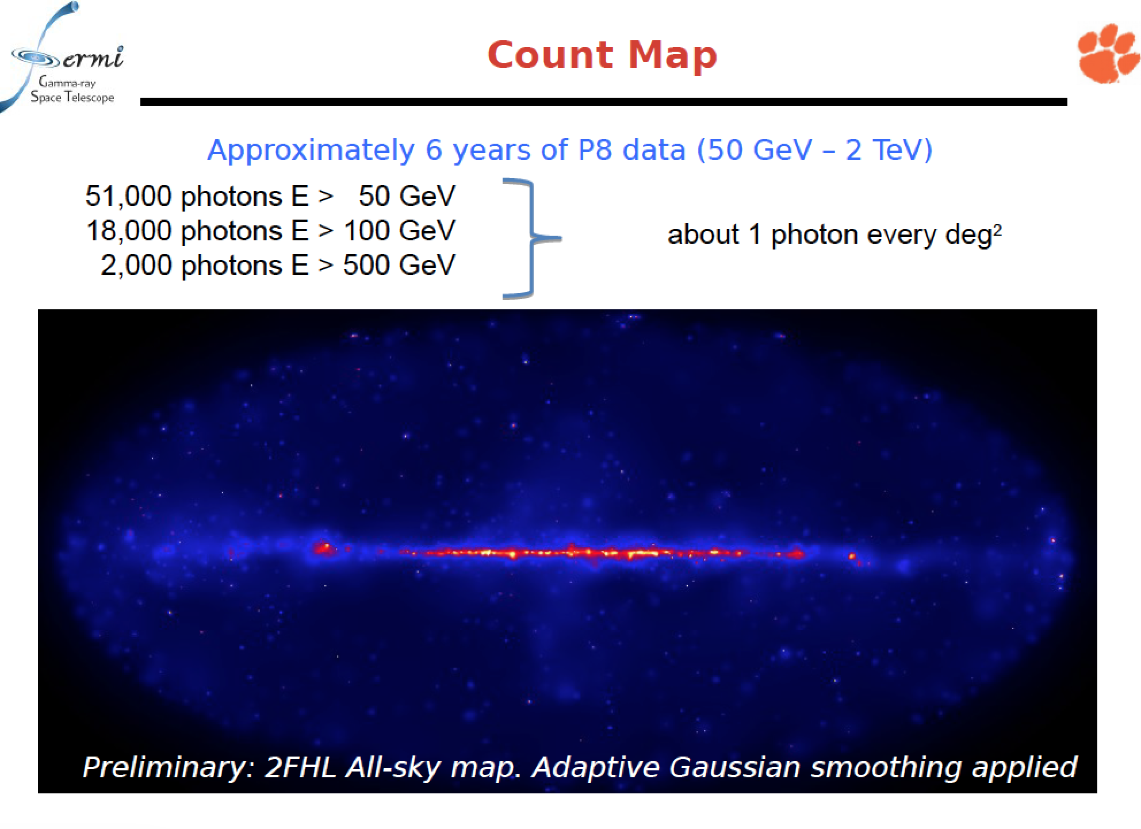

Slide 7
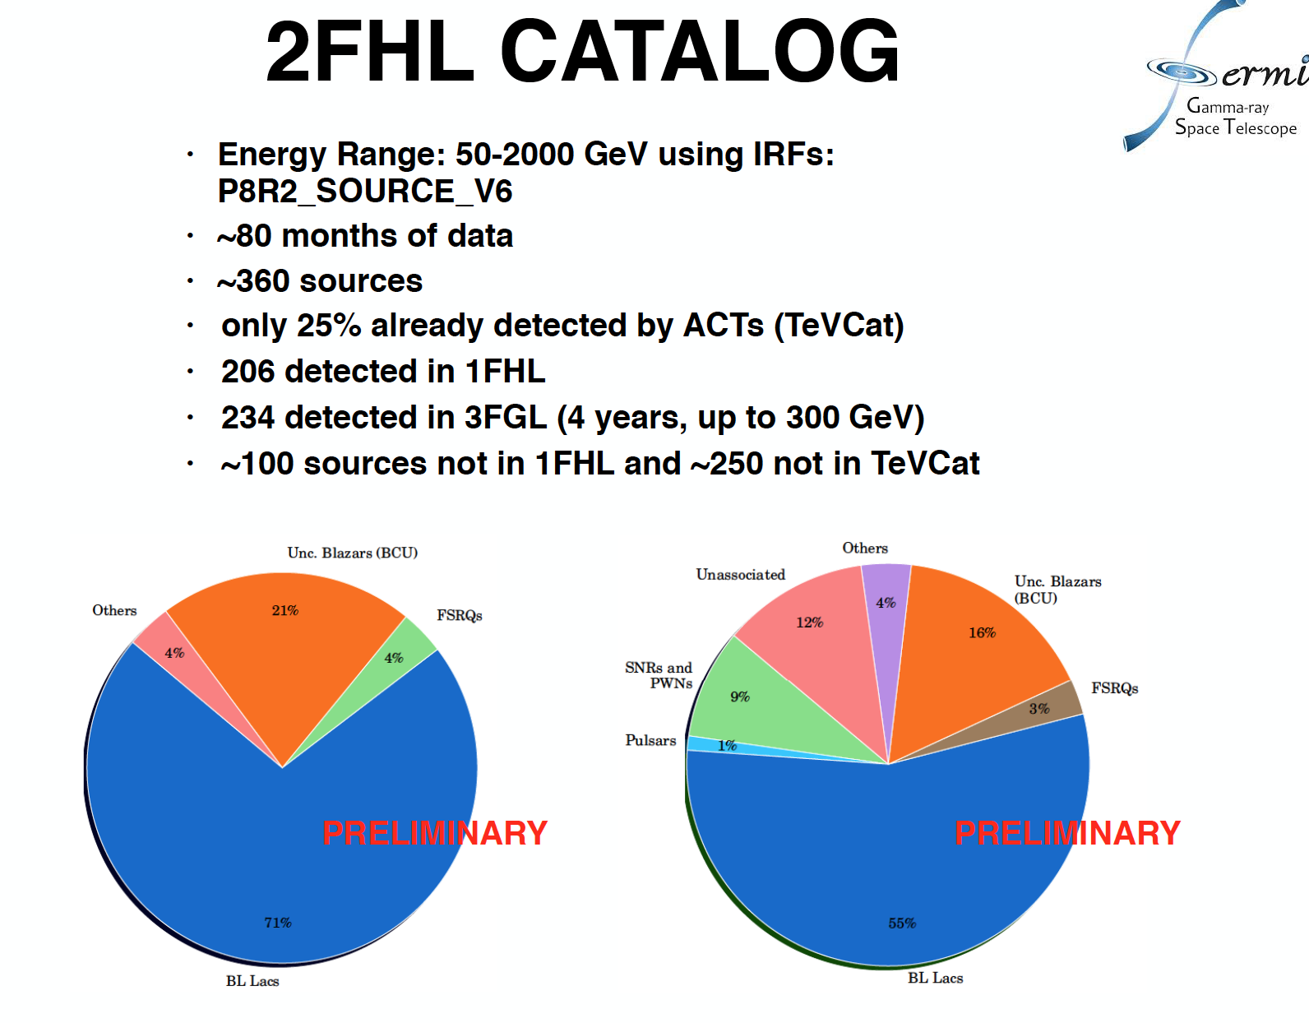

Slide 8
Monte Carlo Simulations of blazars surveys

Slide 9
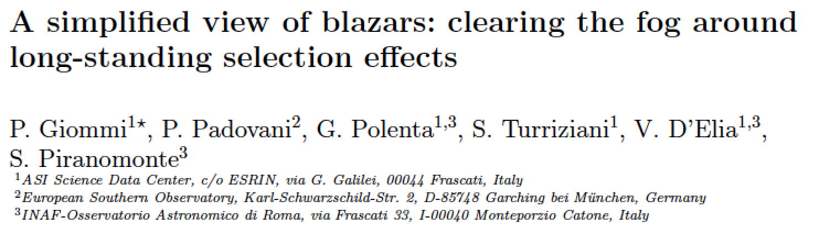
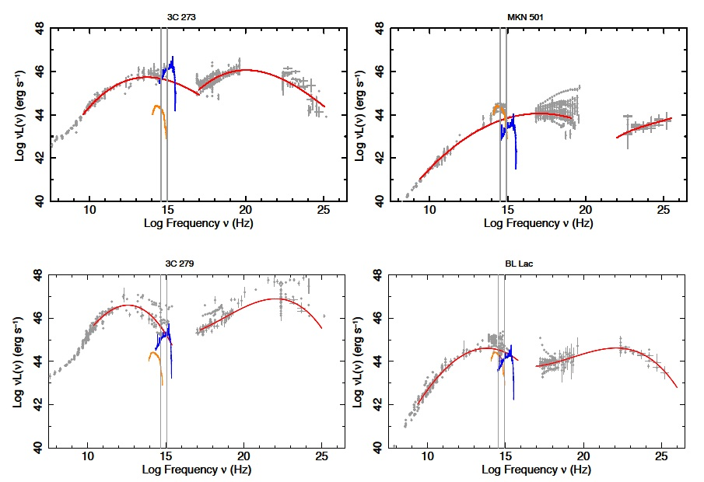
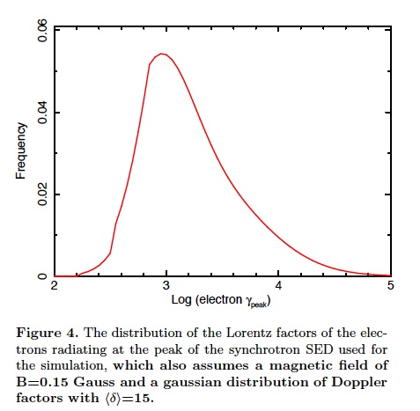
MNRAS, 2012, 420, 2899
Monte Carlo survey simulations
Occam’s razor approach
LBLs/LSPs
HBLs/HSPs

Slide 10
Paper II
γ-ray (Fermi) band

Slide 11
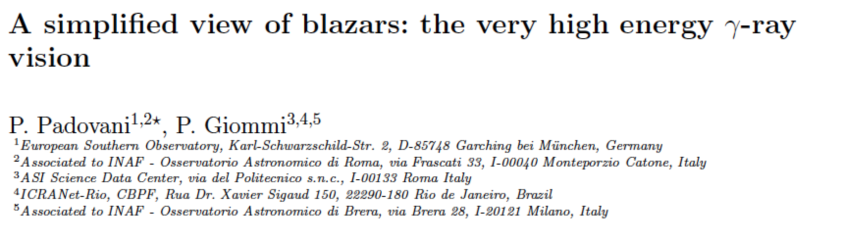
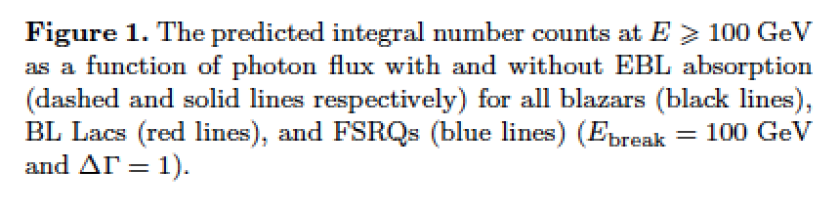
MNRAS 2015, 446L, 41
arXiv 1410.0497
2FHL N(>F (> 50 GeV) = 1.e-11)
2FHL N(> F(> 50 GeV) = 1.e-10)

Slide 12
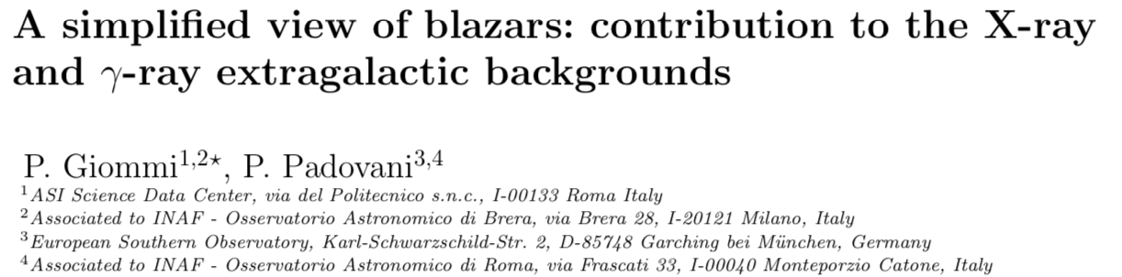
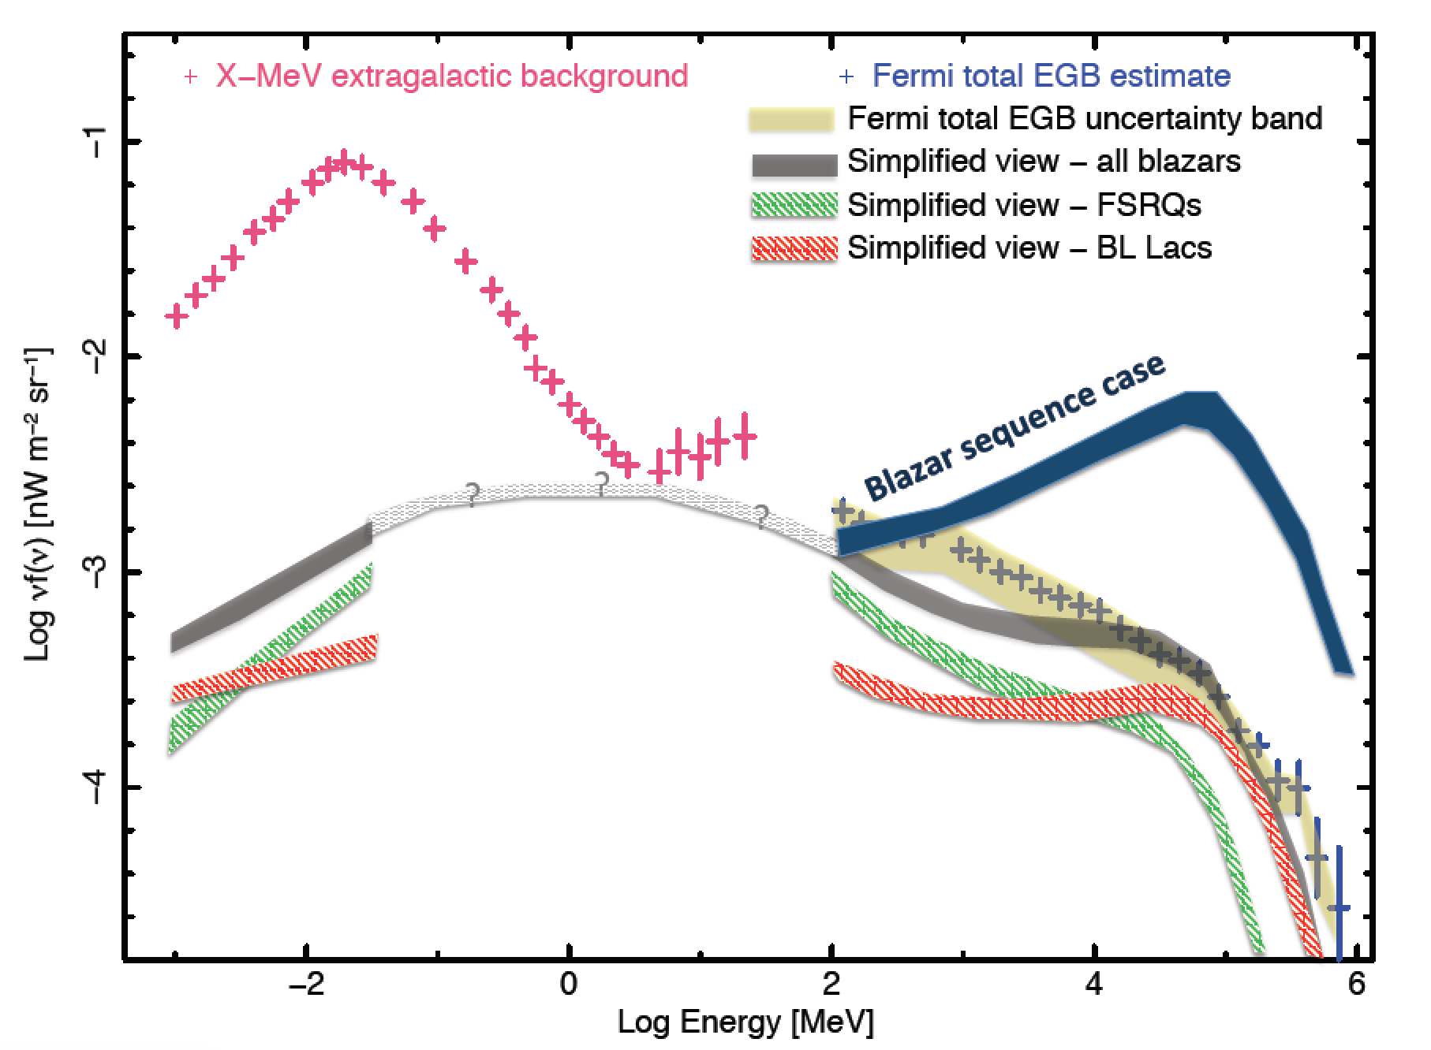
2015, MNRAS 450, 2404
arXiv:1504.01978

Slide 13
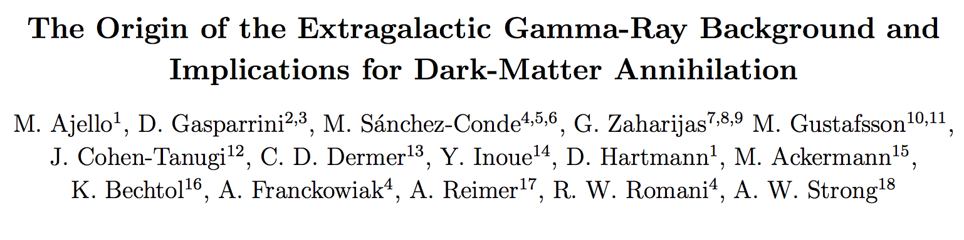
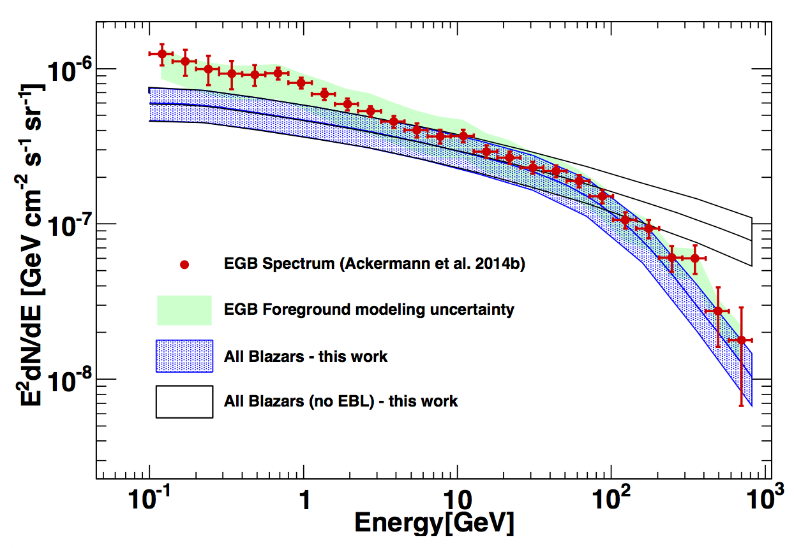
2015, ApJL 800L, 27, arXiv:1501.050301

Slide 14
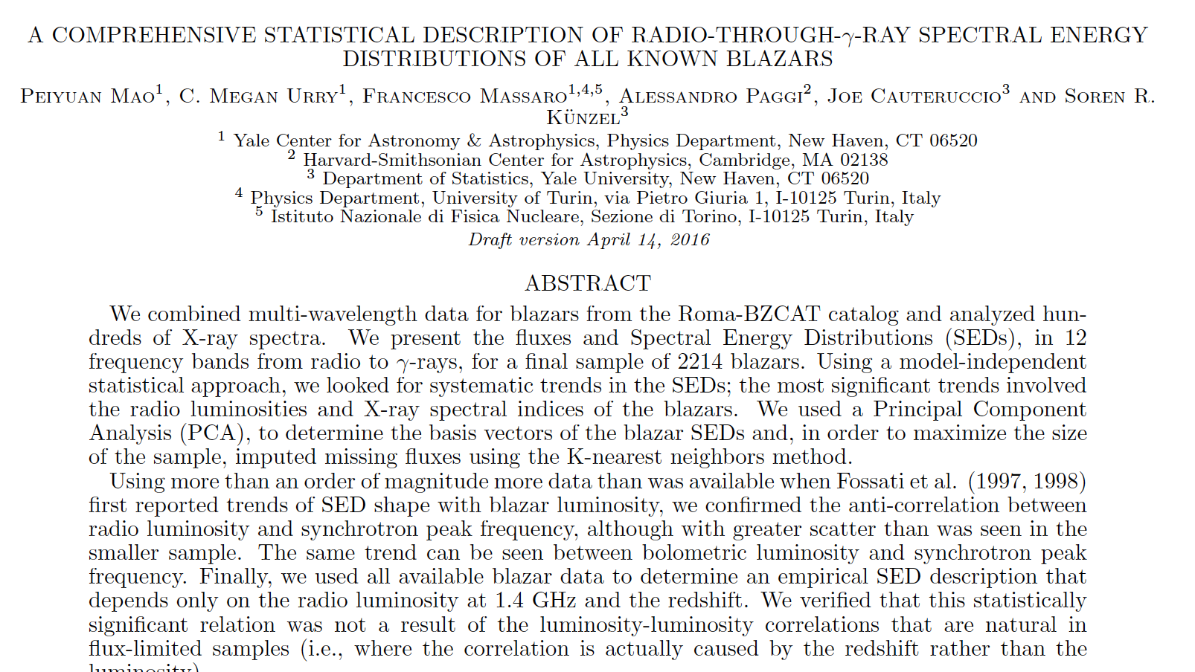

Slide 15
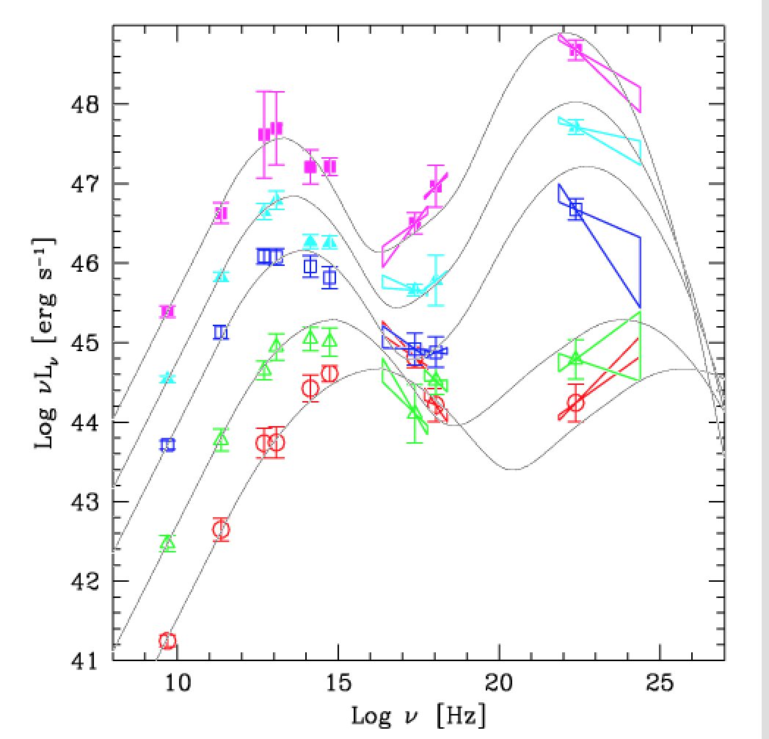
Blazar sequence

Slide 16
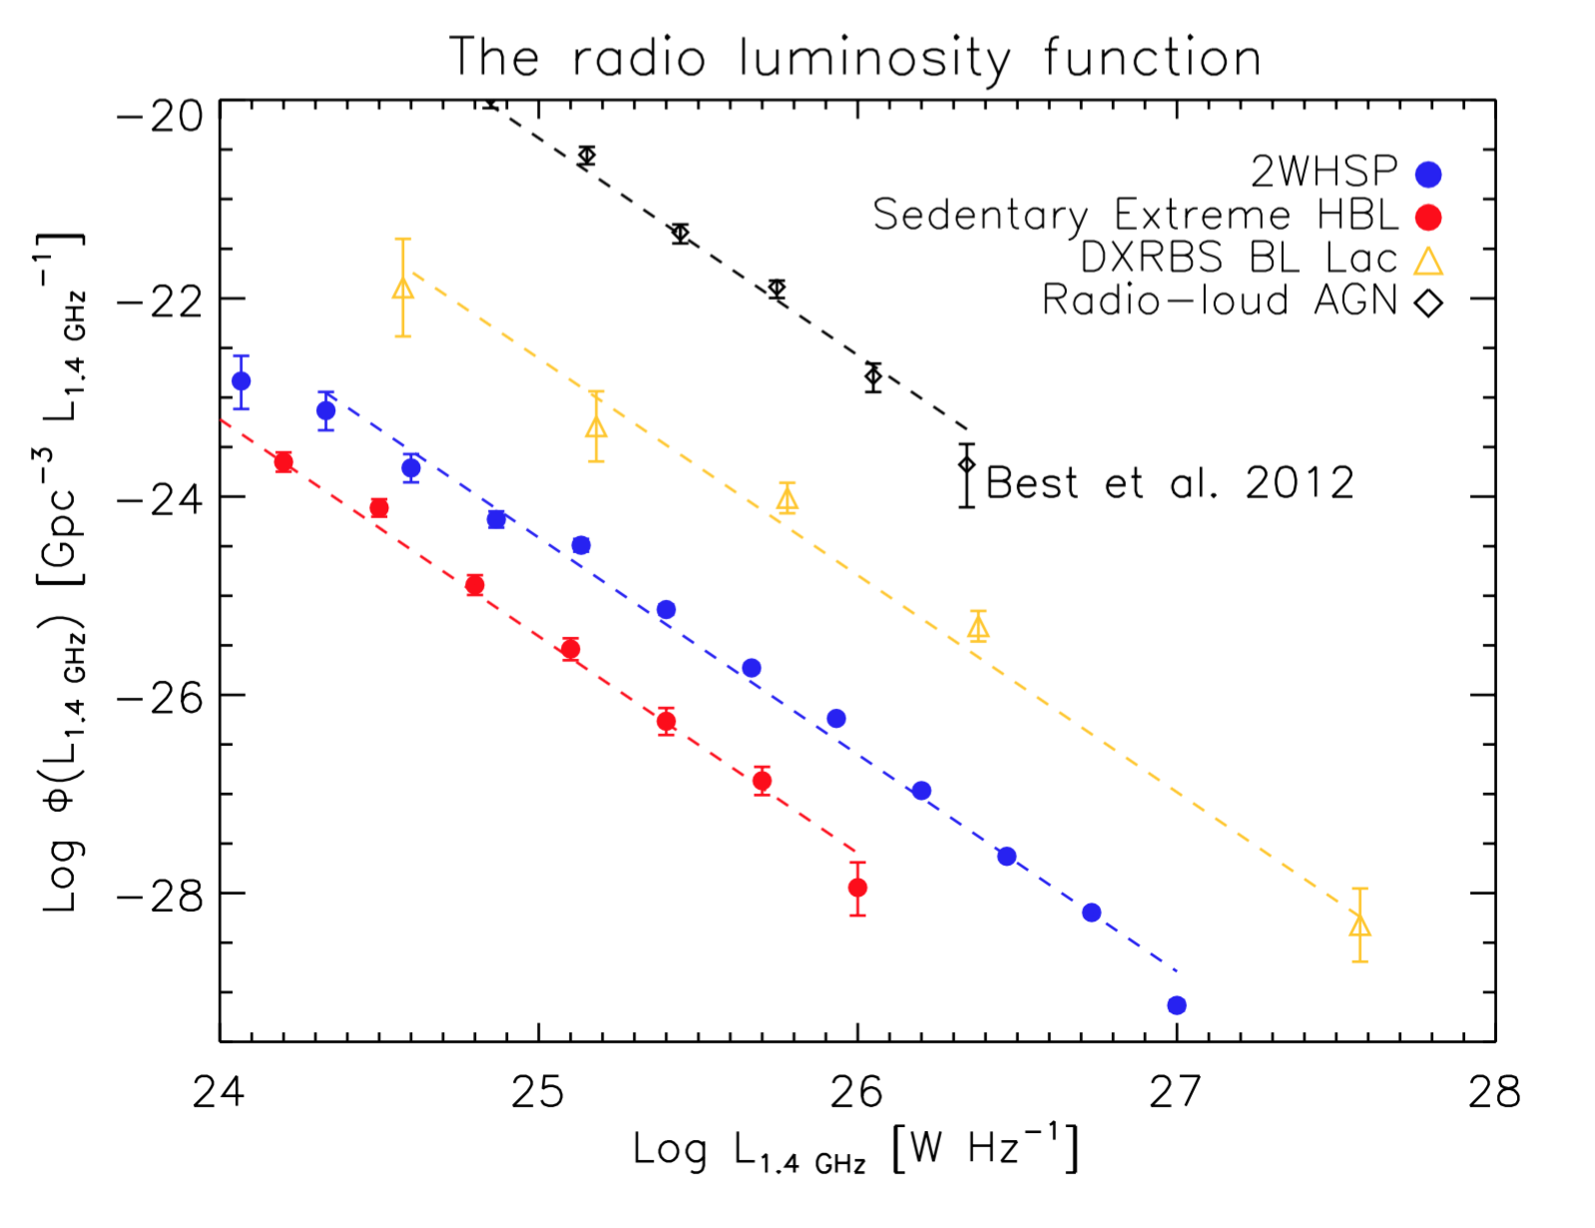
All ν_{peaks}
ν_{peak} > 10¹⁵ Hz
PRELIMINARY
ν_{peak} >~ 10¹⁶ Hz
PRELIMINARY
Chang, Giommi et al. 2016 in preparation

Slide 17
Blazar sequence

Slide 18
New large samples of high-energy synchrotron peaked blazars
-The most powerful and energetic particle accelerators known and likely VHE emitters -

Slide 19
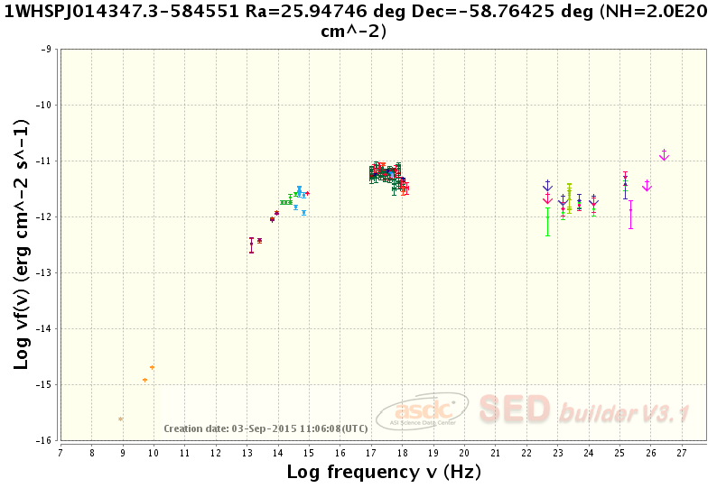
FOM = ν_{peak}F(ν_{peak})/5.x10⁻¹²
ν_{peak} > 10¹⁵Hz
ν_{peak}F(ν_{peak})
VHE-TeV band

Slide 20
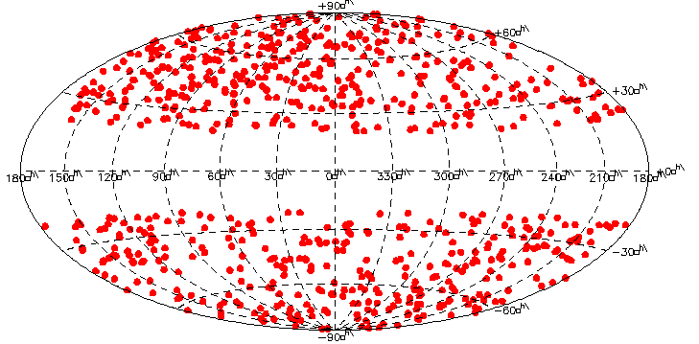
A&A 2015, A&A, 2015, 579, 34
DOI: 10.1051/0004-6361/201424148

Slide 21
2WHSP ~1,700 objects
Y-L. Chang, B. Arsioli, P. Giommi, P. Padovani, 2016 in preparation

Slide 22
The very high energy (VHE)
(E > 50 GeV) sky

Slide 23
The VHE sky (IACTs)
F > ~ 10 mC.U.

Slide 24
The VHE sky (IACTs+Fermi 2FHL)
F > ~ 10 mC.U.
F > ~ 10 mC.U.

Slide 25
The VHE sky (IACTs+Fermi 2FHL+2WHSP bright)
F > ~ 10 mC.U.
F > ~ 10 mC.U
F > ~ 10 mC.U
PRELIMINARY

Slide 26
5BZB J1427+2348: an example of Blazar in 2FHL and in the 2WHSP sample

Slide 27
5BZU J0221+3556: an example of Blazar in 2FHL but not in the 2WHSP sample

Slide 28
About 1/3 of the
Fermi 2FHL blazars have ν_{peak} < 10¹⁵Hz
(not in 2WHSP)

Slide 29
The VHE sky (IACTs+Fermi 2FHL+2WHSP bright)
F > ~ 10 mC.U.
F > ~ 10 mC.U
F > ~ 10 mC.U
PRELIMINARY

Slide 30
The VHE sky (IACTs+Fermi 2FHL+2WHSP bright + faint)
PRELIMINARY
F > ~ 1 mC.U
~ CTA sensitvity

Slide 31

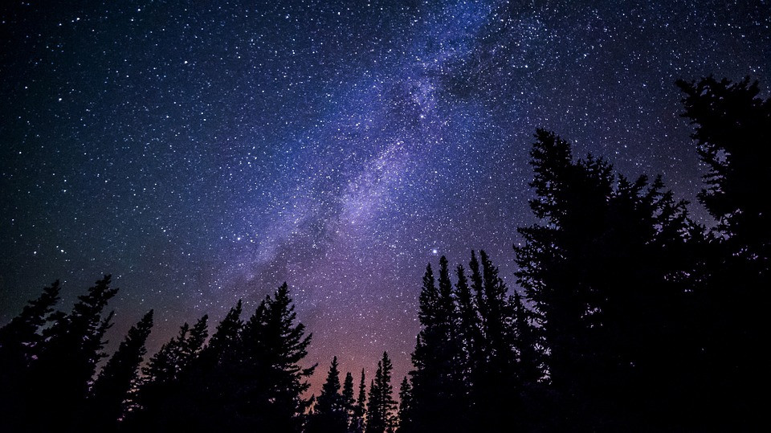
Open Universe
Paolo Giommi
Senior Scientist, Italian Space Agency
An initiative under the auspices of COPUOS announced by the ASI president
and described in a conference room paper presented by Italy
for expanding availability of and accessibility to open source space science data
Approved by the general assembly of COPUOS at its 59th session (June 2016)

Slide 32
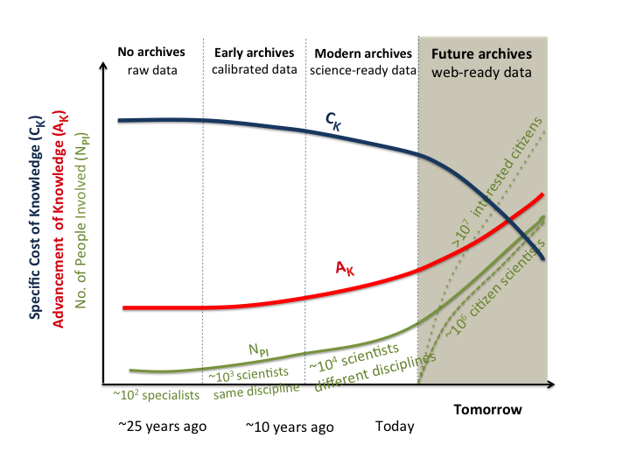
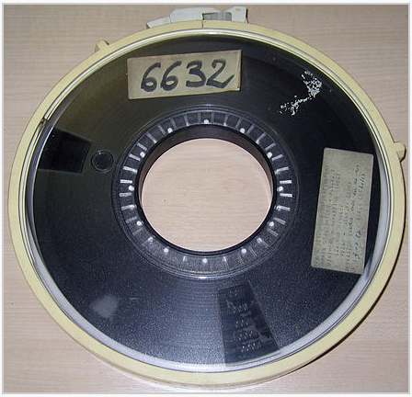

Slide 34
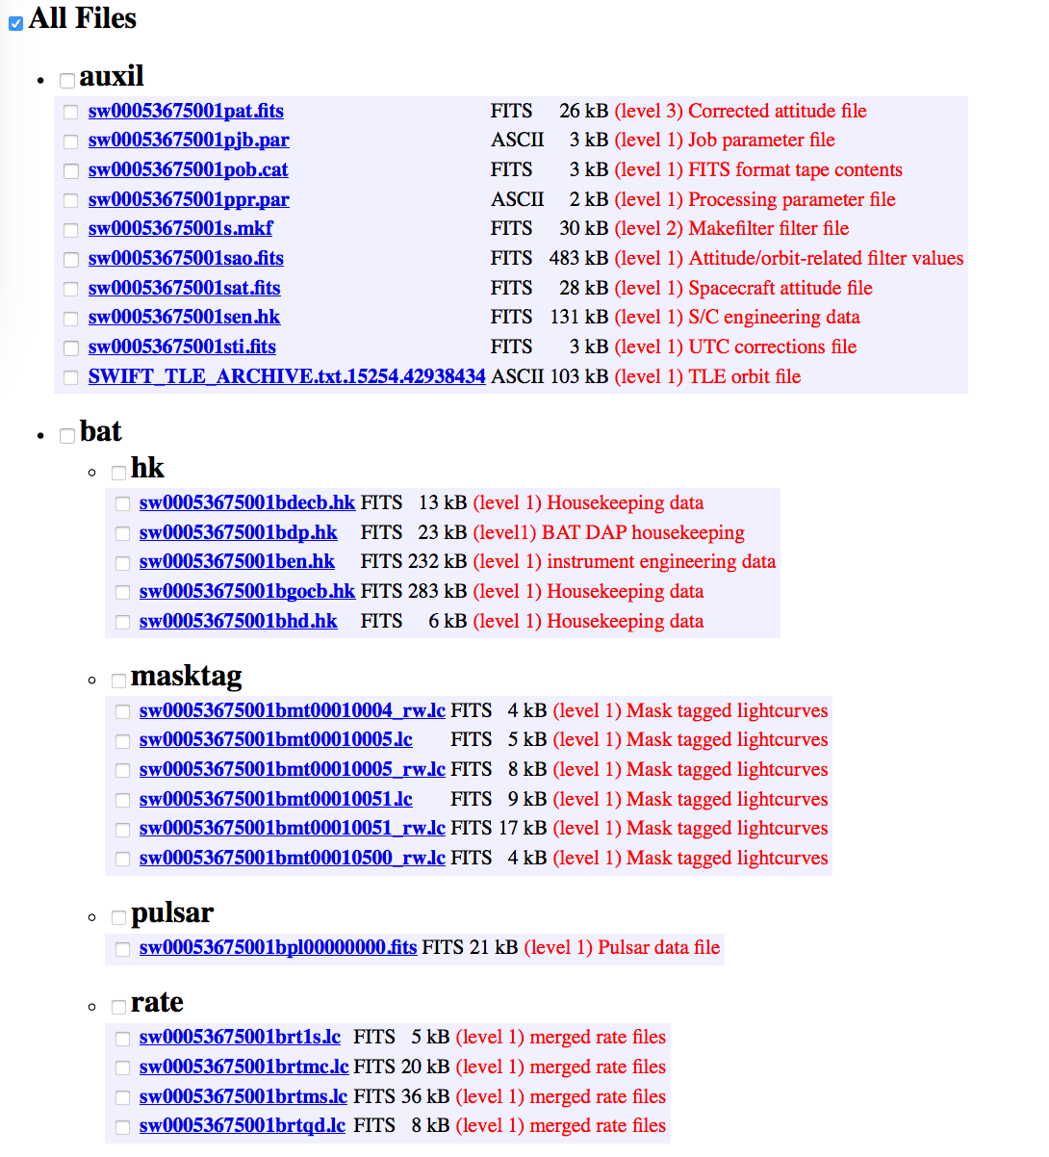
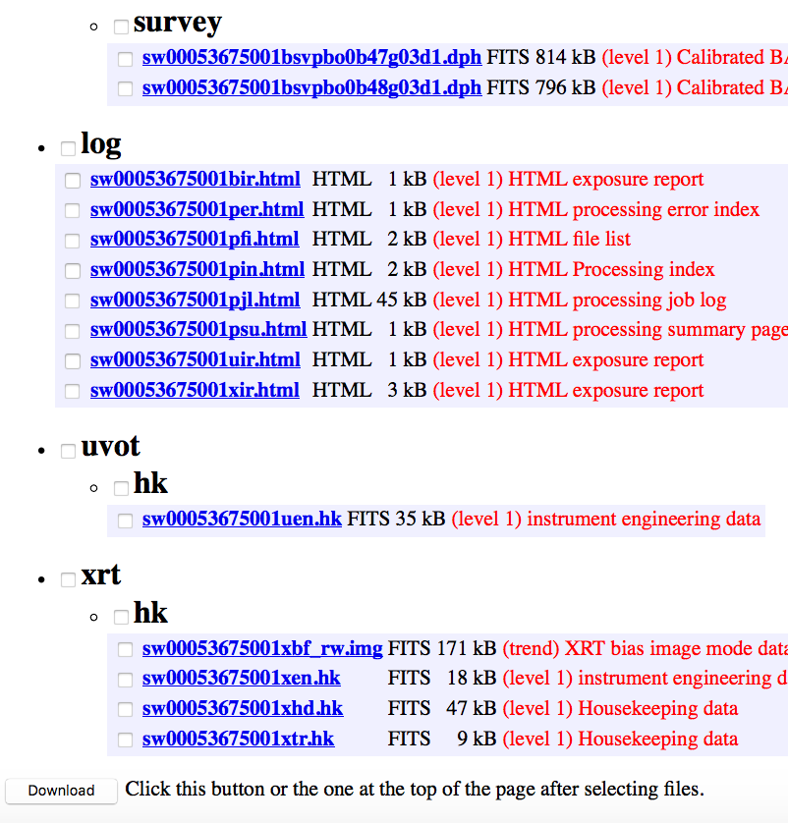
NASA-UK-ASI Swift satellite Data
Data plus reduction software

Slide 36

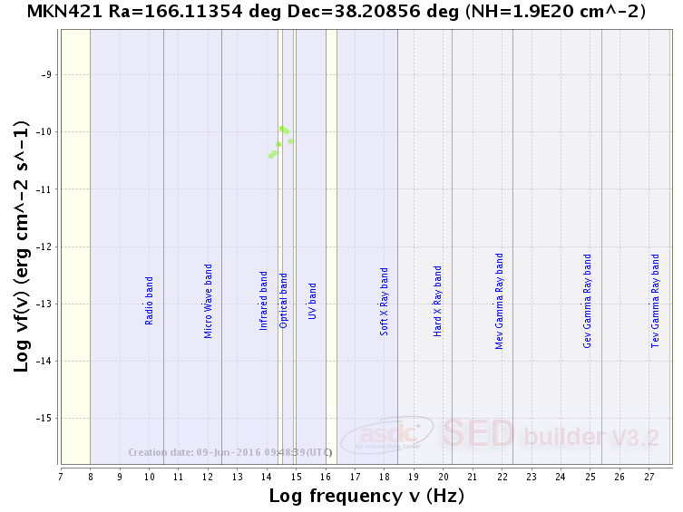
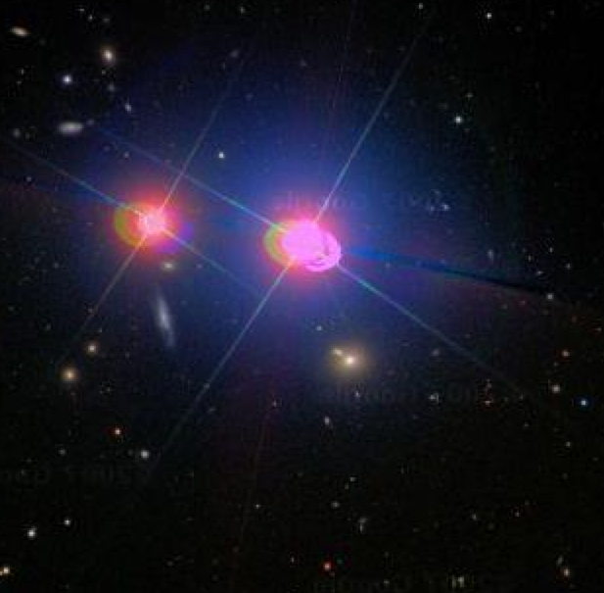
The active galaxy MKN 421

Slide 37
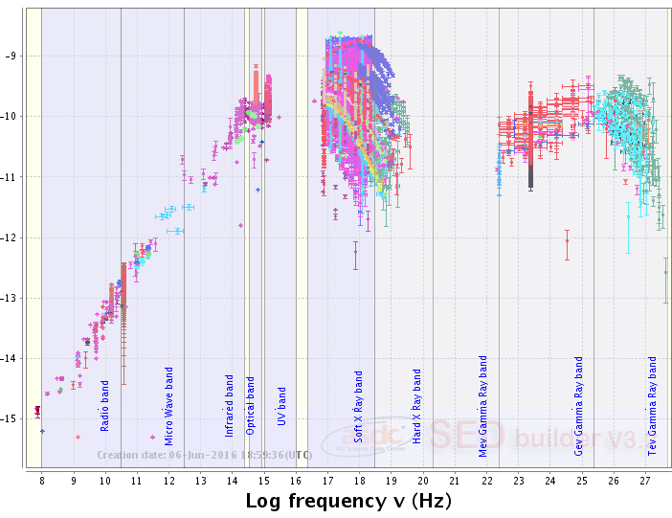

The active galaxy MKN 421

Slide 38

Proposal for a United Nations/ASI workshop
to discuss the Initiative
Early 2017
Open to experts and data providers
from all interested countries.
The outcome would be part of the process leading to
UNISPACE+50
within the thematic priority “Capacity Building”
with focus on
Science, Technology, Engineering and Mathematics (STEM)

