Slide 1
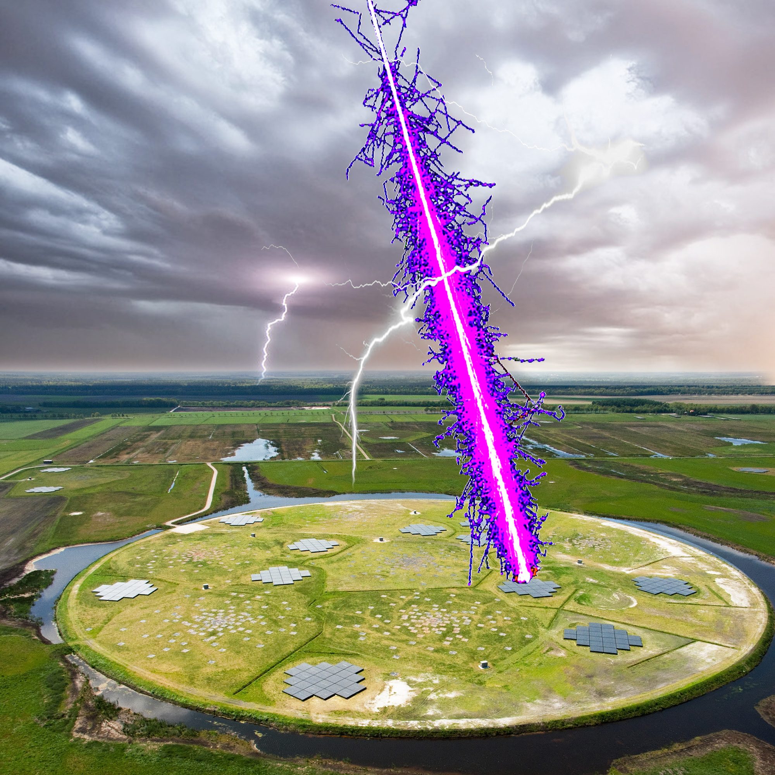

Lightning physics with LOFAR.
- Non-intrusive E-field determination
- Nano-second LMA
Olaf Scholten
LOFAR Cosmic Ray KSP & Cosmic Lightning Project
G. Trinh, P. Schellart, S. Buitink, A. Corstanje, U. Ebert, J.E. Enriquez, H. Falcke, J.R. Hörandel, C. Köhn, A. Nelles,
J. P. Rachen, L. Rossetto, C. Rutjes, O. Scholten, P. Schellart, S. Thoudam, S. ter Veen, A. M. van den Berg

Slide 2
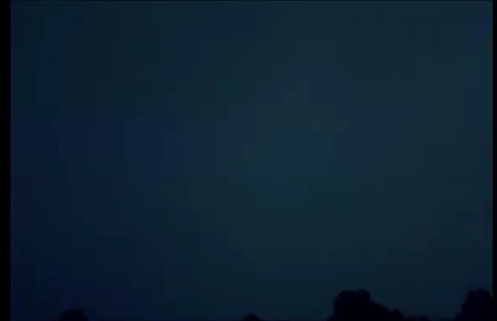
Physics of Lightning
Challenges:
Strongly nonlinear dynamics
Distances from atomic to kilometers
Energies from meV to MeV
In situ measurements typically intrusive
LOFAR:
1) Non-intrusive E-field determination
2) Nano-second LMA

Slide 3
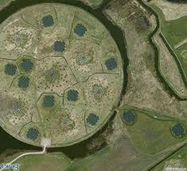
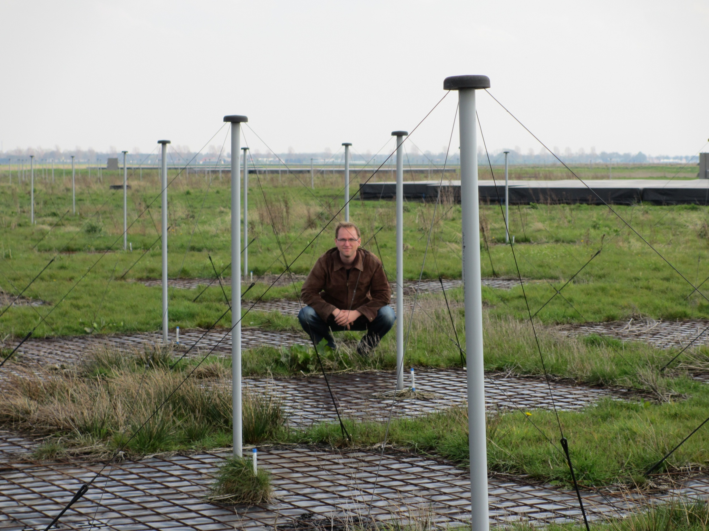
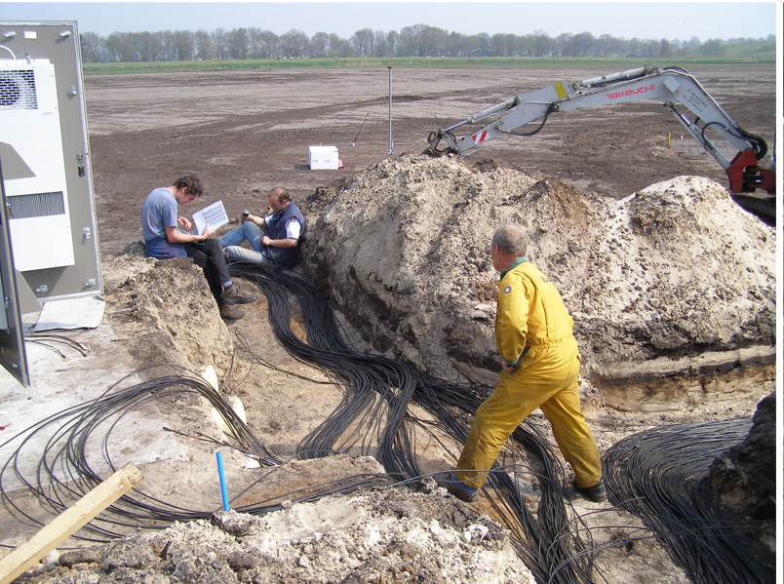

LOFAR
Low-Frequency Array
New generation radio-telescope
High resolution= long baseline
omnidirectional
6 stations on Superterp
18 Core Stations (<2 km from Superterp)
14 Dutch Remote Stations (<70 km from Superterp)
12 European Stations (<1000 km from Superterp)
Each station:
- 96 Dual polarized Low Band Antennas (10-90 MHz)
- 5 nano second sampling (=200 MHz)
Each antenna:
- Coupled to a ring buffer storing 5 seconds data

Slide 4



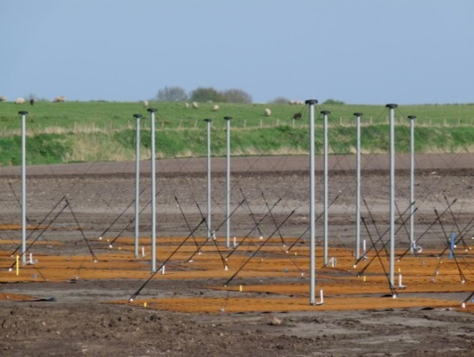
Non-intrusive E-field determination
Phys. Rev. Lett. 114, 165001 (2015)
Serendipitous to cosmic ray observations
LORA Scintillator
4
LBA: 30 - 80 MHz
LOFAR Superterp

Slide 5
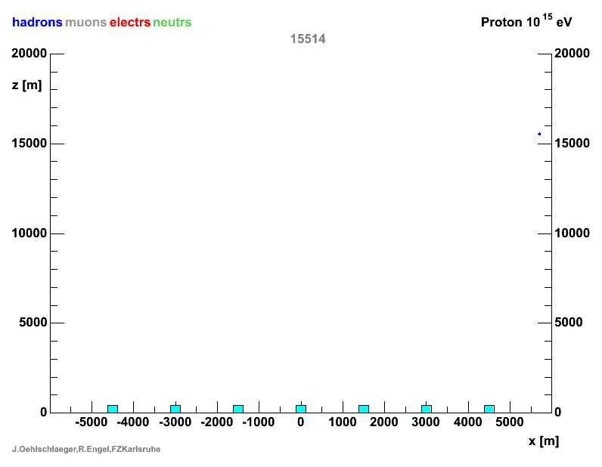
Air shower, from side

Slide 6
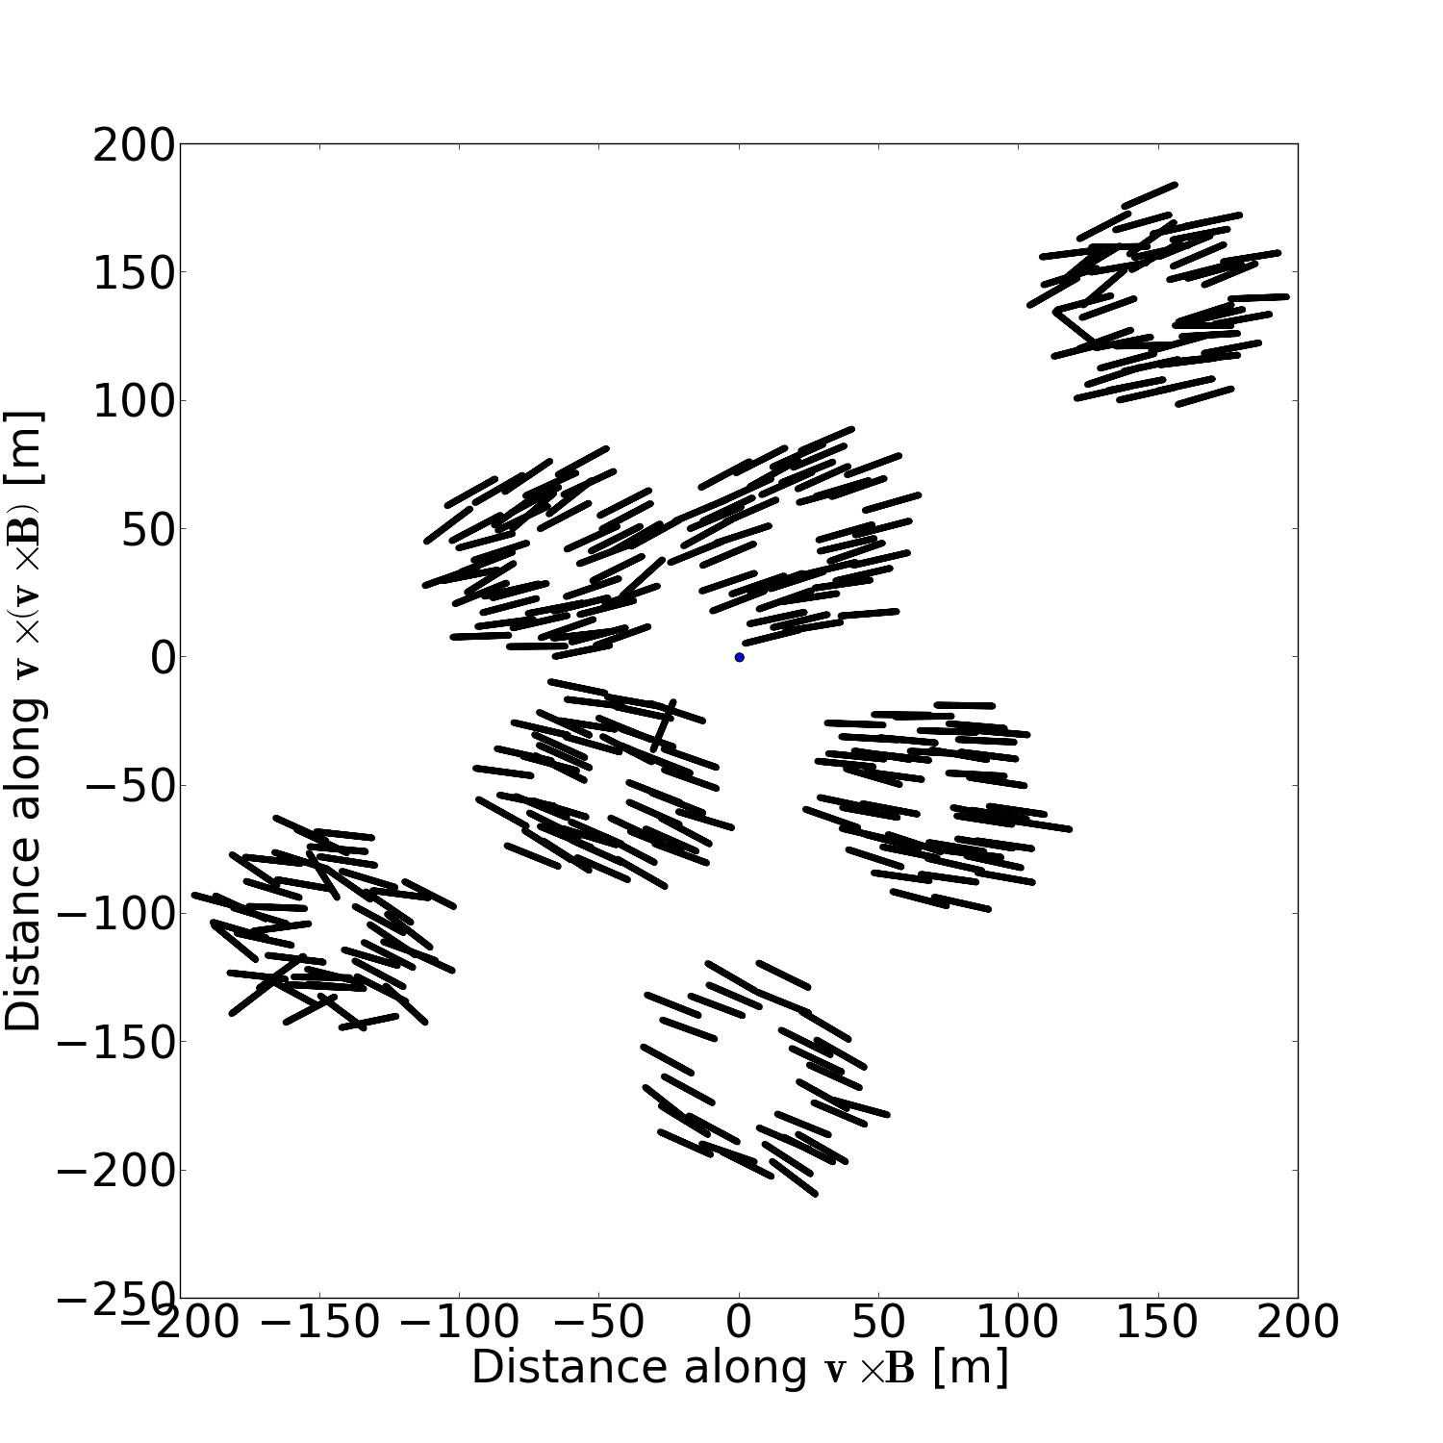
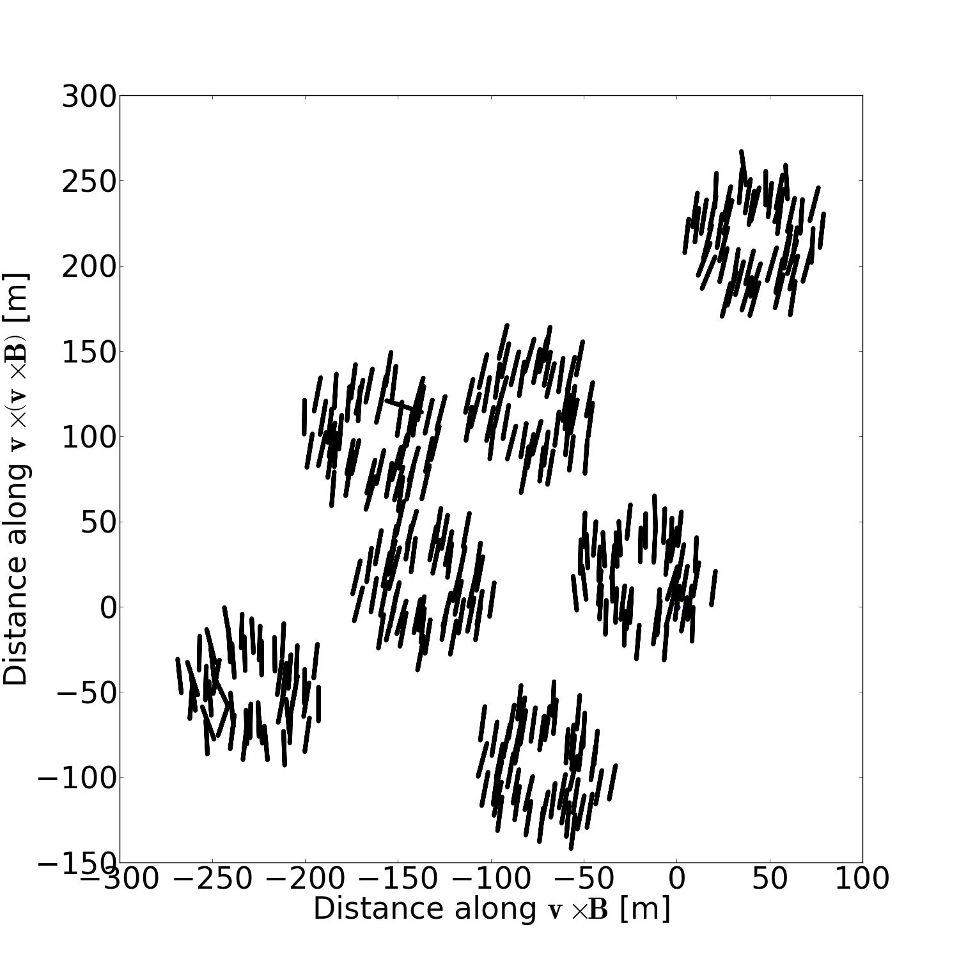
Observations; polarization footprint
Fair weather vs thunderstorm
P. Schellart et al.
(PRL 114, 165001)

Slide 7
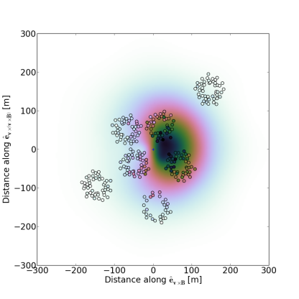
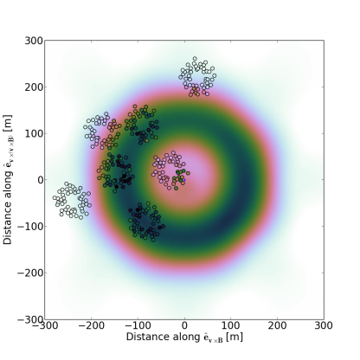
Fair weather vs thunderstorm
Observations; intensity footprint
S. Buitink et al.
PRD 90, 082003 (2014)
P. Schellart, T.N.G. Trinh et al.,
PRL 114, 165001 (2015)

Slide 8
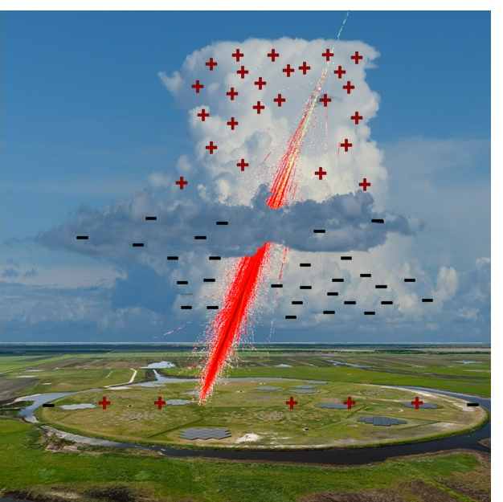








Fitting the intensity
P. Schellart , T.N.G. Trinh et al.
(PRL 114, 165001)
$$h$$
$$h_{above}$$
E_{a}
$${\vec{E}}_{⊥above}$$
$$h_{below}$$
$${\vec{E}}_{⊥below}$$
E_{b}
$$E_{⊥below }= {kE}_{⊥above}$$
$$\vec{v}$$
0
$$E_{⊥}$$

Slide 9
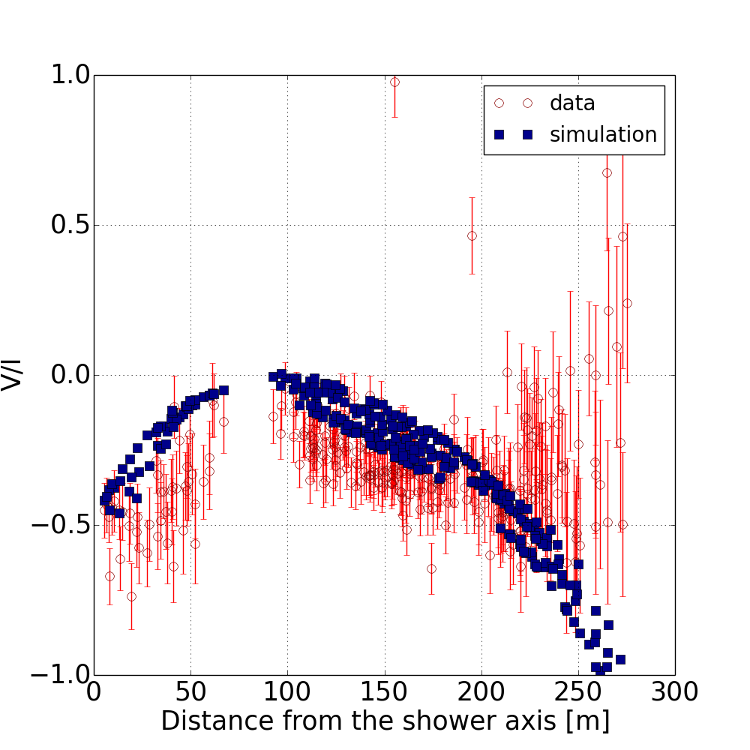








Refinement: circular polarization
T.N.G.Trinh et al. in prep (2016)
measures rotation of E-field along direction CR
Circular polarization
h1 = 8 km
h2 = 7 km
h3 = 2.8 km
E1 = 50 kV/m
k = 0.4
Xmax = 583 g/cm²
$$h$$
h1 = 8 km
h2 = 7 km
h3 = 2.8 km
E1 = 50 kV/m
k = 0.4
Xmax = 583 g/cm²
$$h_{1}$$
$$h_{2}$$
$${\vec{E}}_{3}$$
$$h_{3}$$
$${\vec{E}}_{2}$$
$$\vec{v}×\vec{B}$$
$${\vec{E}}_{1}$$
0
$$E_{⊥}$$
Non zero at core!!!

Slide 10
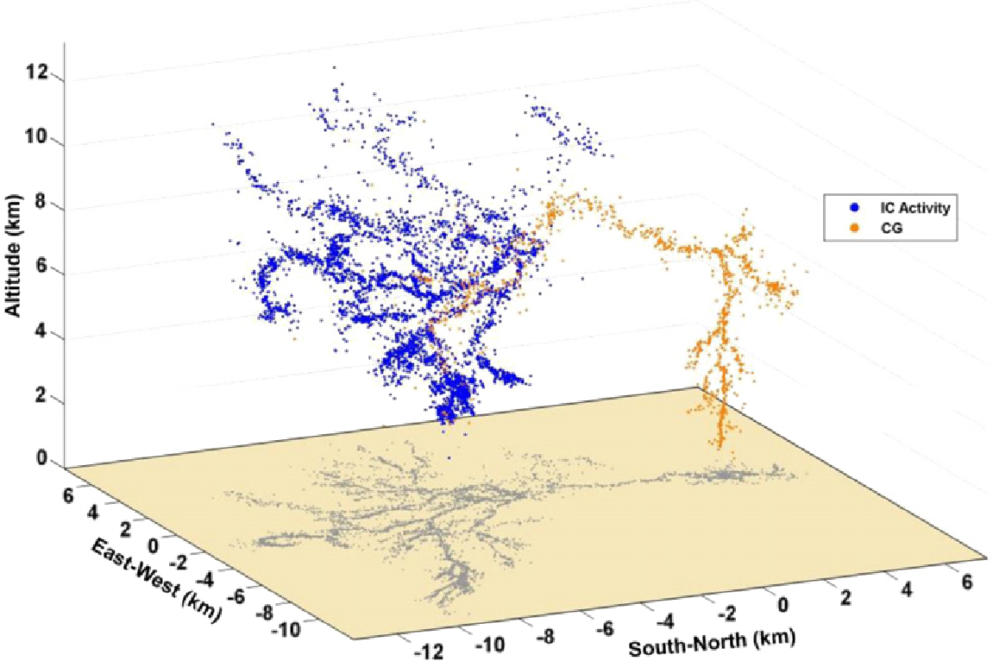
LOFAR as Lightning Mapping Array (LMA)
J.R. Dwyer and M.A. Uman, Phys. Rep. 534, 147 (2014).
lightning step
radio waves
State of Art:
~10 antennas
~microsecond resolution
No polarization
LOFAR-LMA:
~5000 antennas
~nanosecond resolution
Full polarization
LMA-antennas

Slide 11
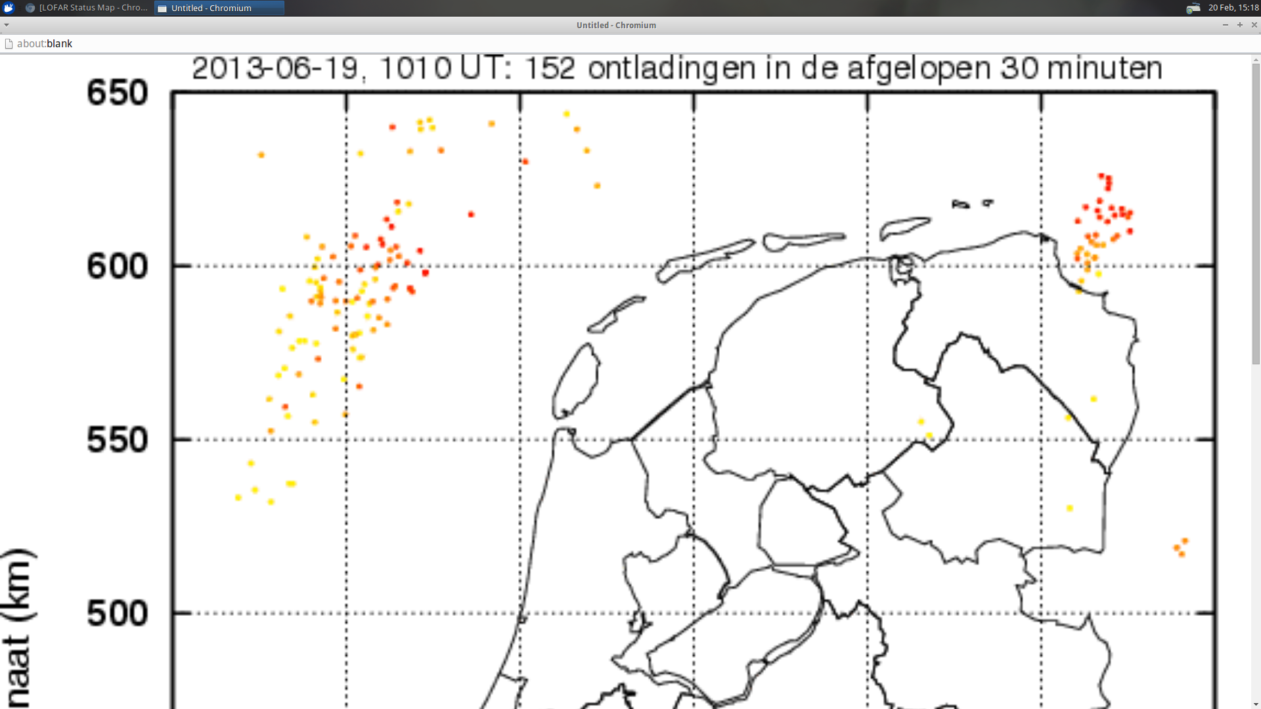
LOFAR as lightning mapping array
Lightning activity

Slide 12
Detailed structure
20 nano second structure
1 sample=5 ns
1 micro-second trace
5 mili-seconds trace length
Polarisation 1
Preliminary
Polarisation 2

Slide 13
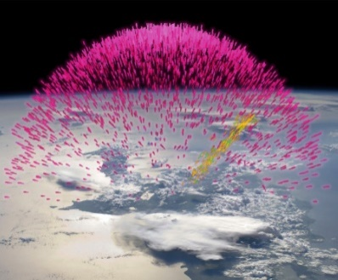

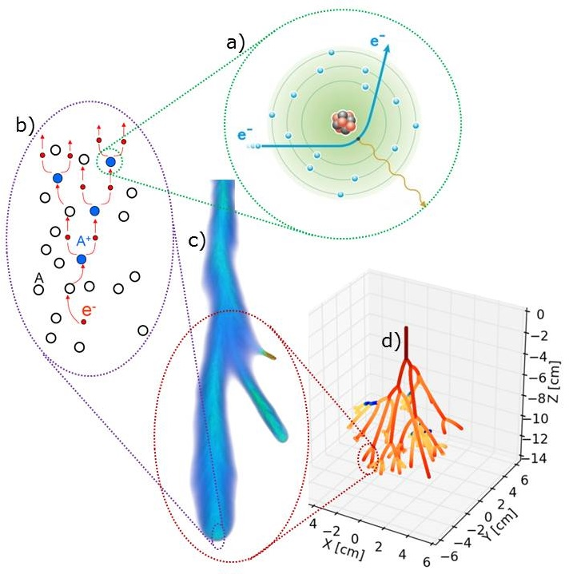
LOFAR Lightning Physics
Combine with TGF observations to resolve physics origin
LOFAR E-field
Present
LOFAR
Credit: Ute Ebert
State of Art:
~10 antennas
~microsecond resolution
No polarization
LOFAR-LMA:
~5000 antennas
~nanosecond resolution
Full polarization

Slide 14
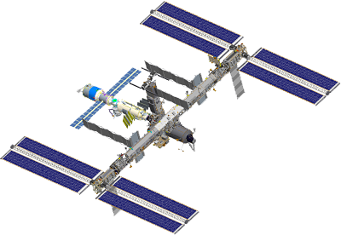
Lightning Physics
From Microscopic to Macroscopic
Terrestrial Gamma-ray Flashes
LOFAR:
- Non-intrusive E-field determination
- Nano-second LMA
Present
LOFAR
- Runaways or leader stepping?
- Peculiar in-cloud dynamics?
State of Art:
~10 antennas
~microsecond resolution
No polarization
LOFAR-LMA:
~5000 antennas
~nanosecond resolution
Full polarization
Sub-meter scale physics
Resolve streamers + branching
Zoom into initiation region
Correlate space and ground observations!

Slide 15
LOFAR, new instrument for lightning physics:
LOFAR: New non-intrusive method for E-field measurements
  Full set of Stokes polarization observables
  Improving analysis
LOFAR: LMA with nanosecond structure & polarization
LOFAR Lightning Publications:
- Pim Schellart, Gia Trinh et al., Probing Atmospheric Electric Fields in Thunderstorms through Radio Emission from
Cosmic-Ray-Induced Air Showers, Phys. Rev. Lett. 114, 165001 (2015); arXiv:1504.05742.
- Anna Dubinova, Caspar Rutjes, et al., Prediction of Lightning Inception by Large Ice Particles and Extensive Air Showers., Phys. Rev. Lett. 115, 015002 (2015)
- Gia Trinh, Olaf Scholten, et al., Influence of Atmospheric Electric Fields on the Radio Emission from Extensive
Air Showers., Phys. Rev. D 93, 023003 (2016); arXiv:1511.03045.
- Gia Trinh, Olaf Scholten, et al., Determining atmospheric electric fields from the Stokes parameters as measured for extensive air showers, in preparation.

Slide 16
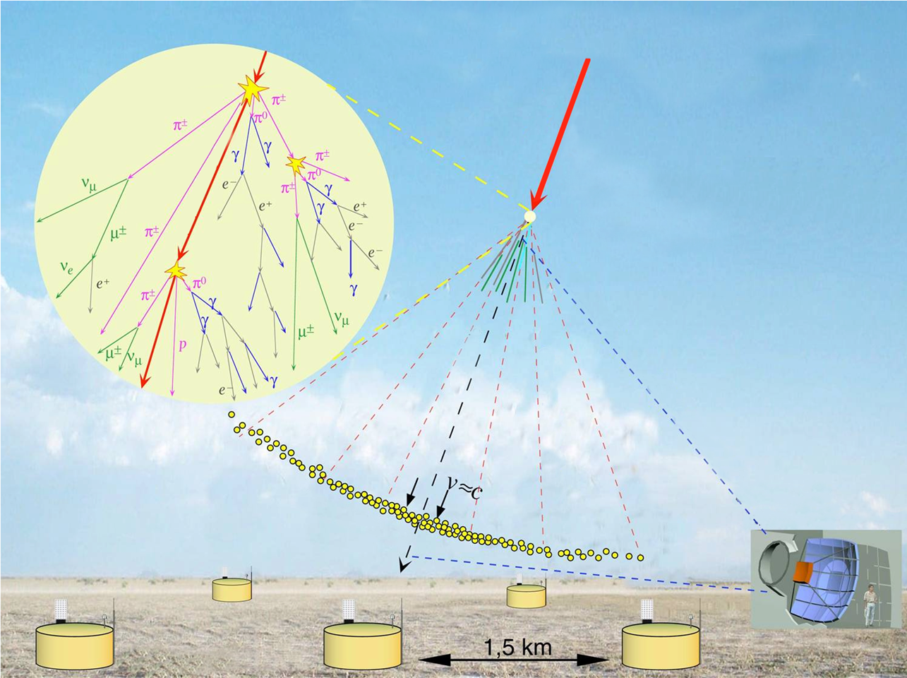
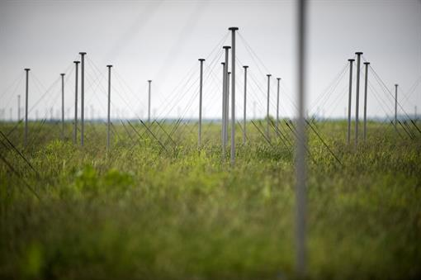

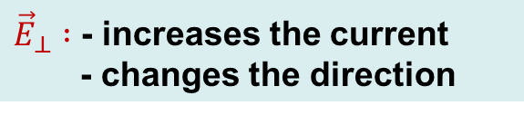
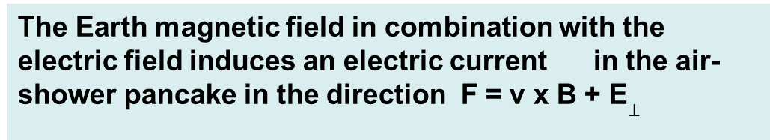


Radio emission in presence of an electric field
The Earth magnetic field in combination with the electric field induces an electric current in the air-shower pancake in the direction F = v x B + E$⊥$
j
${\vec{E}}_{⊥} :$ - increases the current
- changes the direction
$${\vec{E}}_{⊥}$$
${\vec{E}}_{//} :$- minor change in current
$${\vec{E}}_{//}$$
B_{E}
Earth’s magnetic field
j

Slide 17
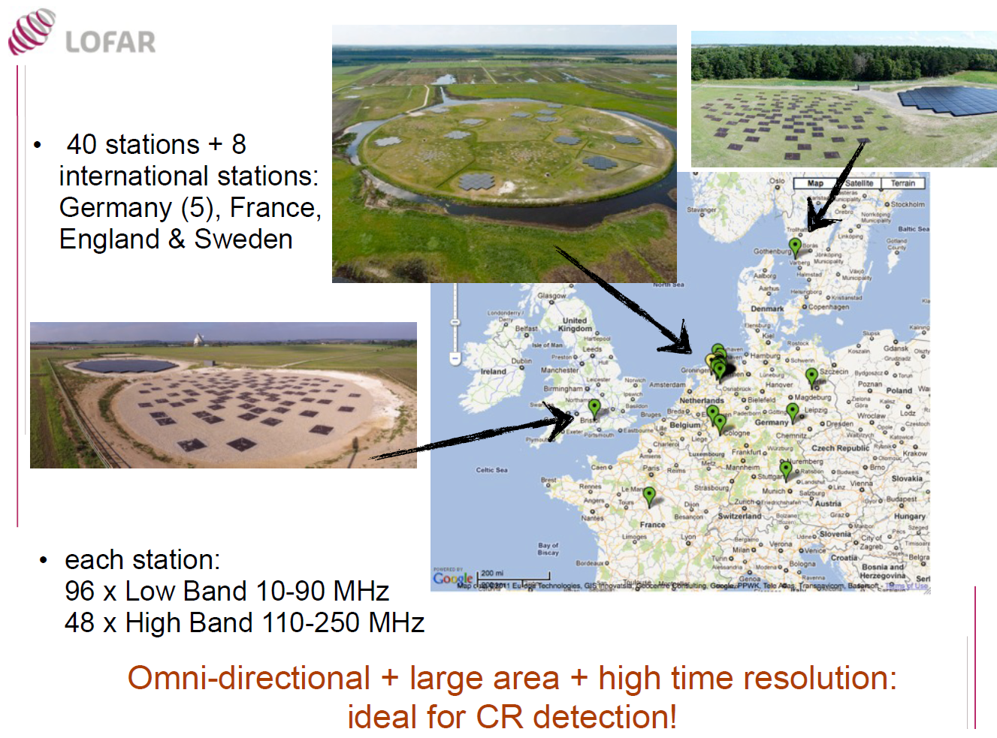
LOFAR

Slide 18
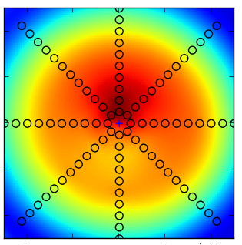
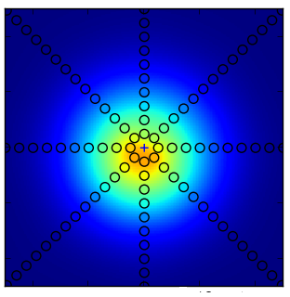
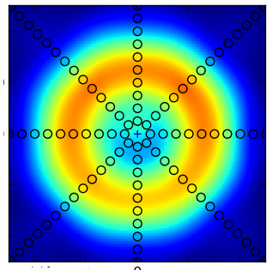
Ring vorming door intergerentie
$$h$$
$$h$$
$$h$$
$$h_{above}$$
$$h_{above}$$
Two-layer E-fields $↔$ ring-like structure
$$h_{below}$$
$$h_{below}$$
$$h_{below}$$
0
$$E_{⊥}$$
0
$$E_{⊥}$$
0
$$E_{⊥}$$
+
=

Slide 19
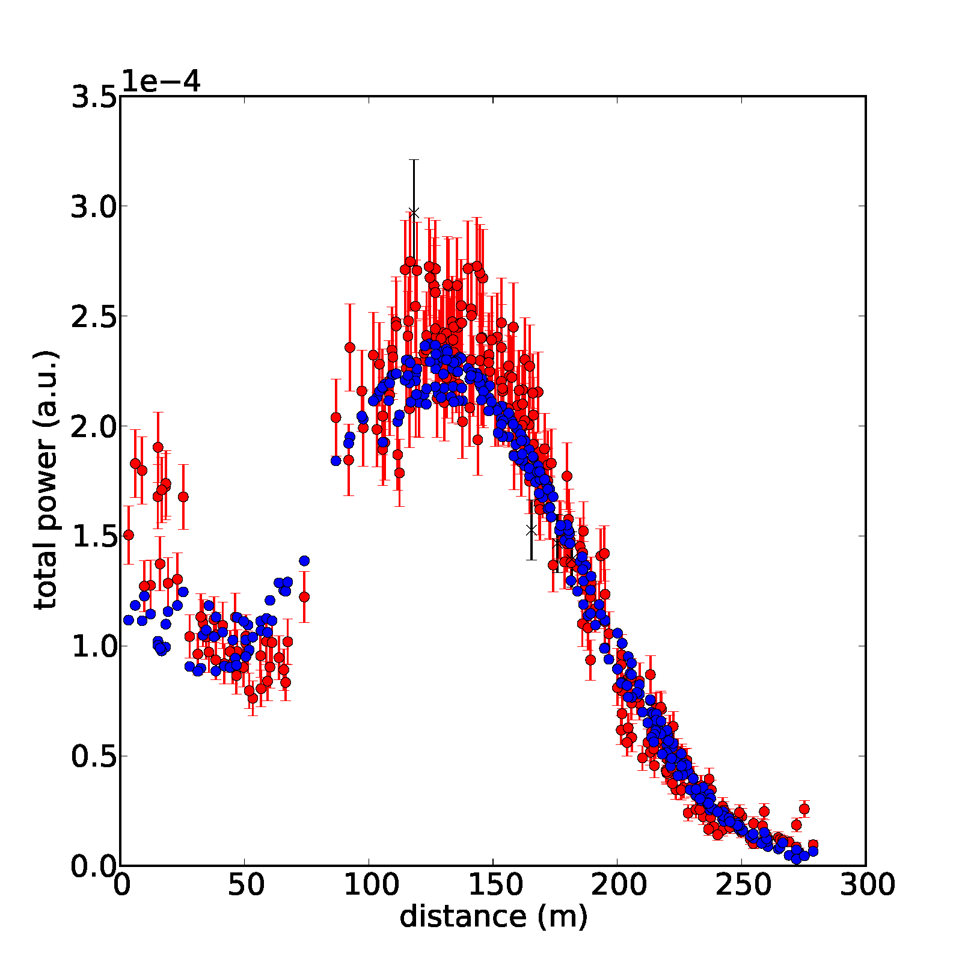
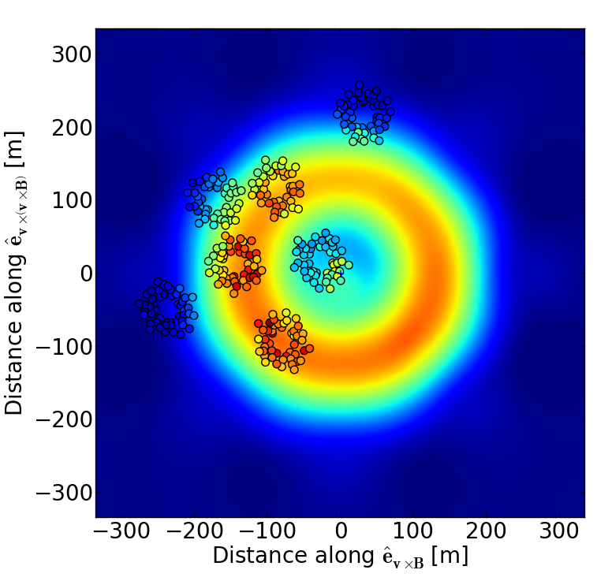
Structure of the field
A reconstructed thunderstorm event
P. Schellart et al.
(PRL 114, 165001)
P. Schellart et al.
(PRL 114, 165001)

Slide 20
Full polarization, Stokes
Stokes parameters: I, Q, U, V
Linear polarization angle: 2 φ =atan(U/Q)
NEW: Circular polarization = V/I
Interesting result thunderstorm:
Finite circular pol. near core

Slide 21
Terrestrial Gamma-ray Flashes
Correlate space and ground observations!
- Runaways or leader stepping?
- Peculiar in-cloud dynamics?

