Slide 1
AGILE as particle monitor: an update
G. Piano
A. Argan, M. Tavani, A. Trois
14th AGILE Workshop
“AGILE on the wave”

Slide 2
Paper published in
Journal of Geophysical Research: Space Physics
“AGILE as a particle detector: Magnetospheric measurements
of 10–100 MeV electrons in L shells less than 1.2”
Argan, A., Piano, G., Tavani, M., Trois, A.
JGR Space Physics, 121, 3223–3239 (2016),
doi:10.1002/2015JA022059.

Slide 3
The AGILE orbit
Quasi-circular orbit with an average altitude of 500 km
Small inclination → i = 2.7°
Low particle background → optimal configuration for γ-ray astronomy

Slide 4
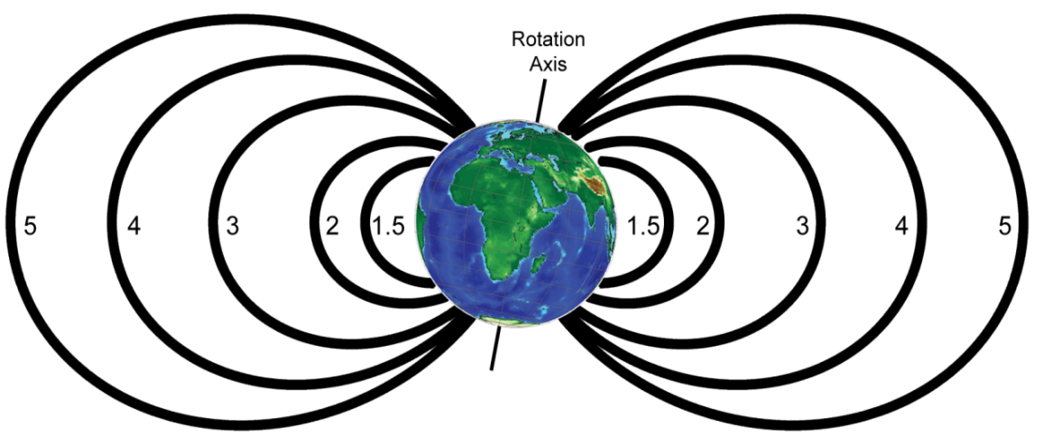
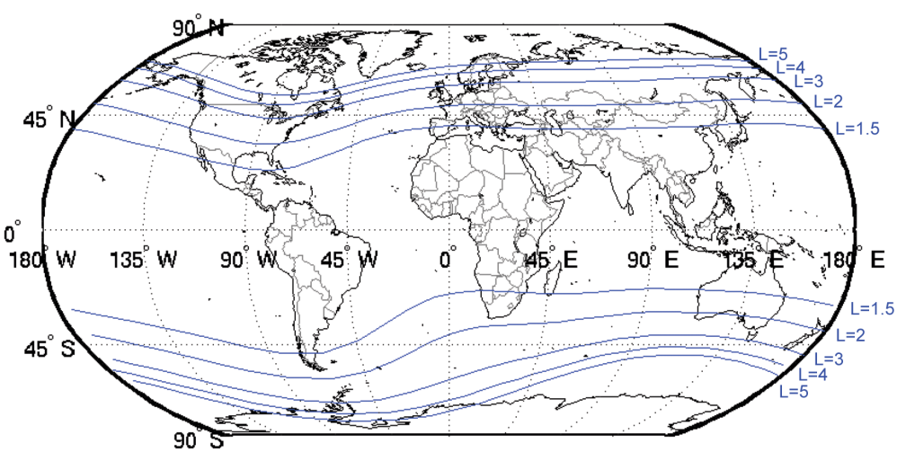
The AGILE orbit
Quasi-circular orbit with an average altitude of 500 km
Small inclination → i = 2.7°
Low particle background → optimal configuration for γ-ray astronomy
Inner Earth magnetosphere (1.0 ≤ L ≤ 1.2)
L-shell → set of magnetic field lines (shell) crossing the magnetic equator at L Earth radii (McIIlwain, 1961)

Slide 5
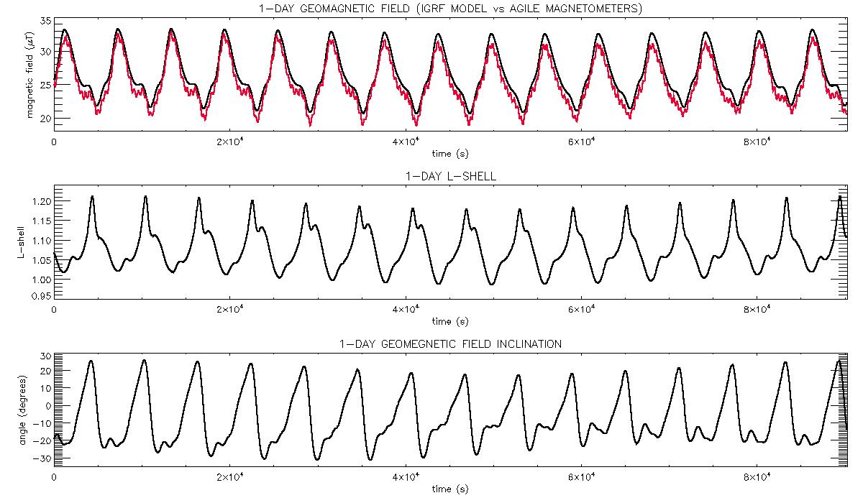
Geomagnetic characteristics of the AGILE orbit

Slide 6
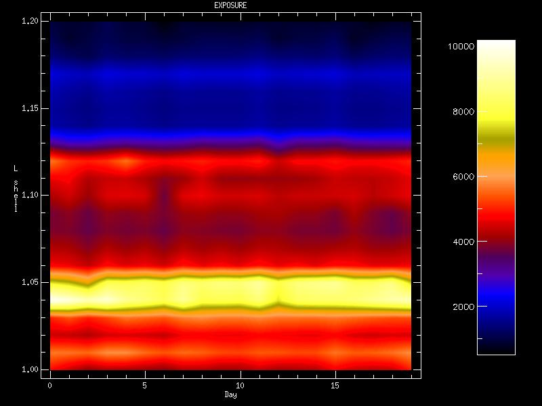
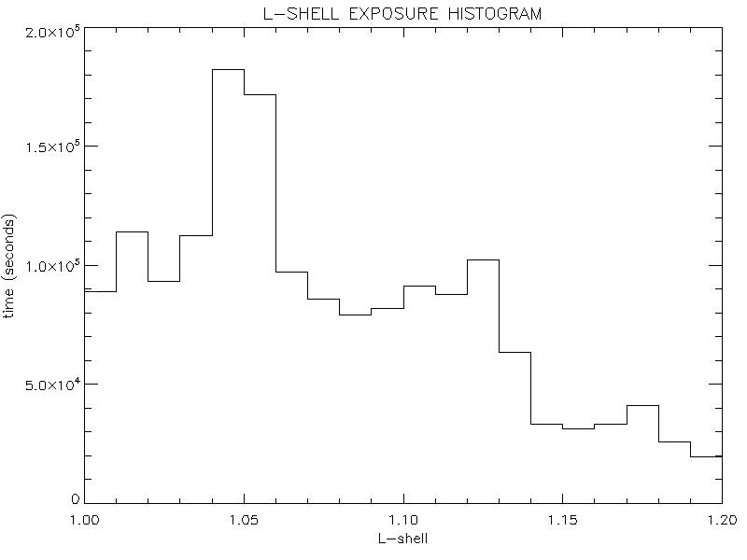
AGILE L-shell exposure-time map
April 14 – May 5 2015 (orbits: 41220-41520)
DAILY EVOLUTION OF THE L-SHELL EXPOSURE TIME
OVERALL L-SHELL EXPOSURE TIME
time (s) during which the AGILE satellite was in a given L-shell

Slide 7
AGILE L-shell exposure-time map
April 14 – May 5 2015 (orbits: 41220-41520)
DAILY EVOLUTION OF THE L-SHELL EXPOSURE TIME
OVERALL L-SHELL EXPOSURE TIME
best coverage: 1.04 ≤ L ≤ 1.06
time (s) during which the AGILE satellite was in a given L-shell

Slide 8
The AGILE tracker as a charged-particle detector
AGILE has been conceived to detect γ-rays from astrophysical sources:
  charged particles (trapped in the magnetosphere) represent the strongest background
  p/γ ratio ≈ 10⁴
Most of the charged particles are rejected onboard:
  Anticoincidence (AC) system + veto logic
But…
Many residual particles are detected and tracked anyway:
  No AC panels at the bottom side
  Lateral AC panels have a less restrictive veto logic

Slide 9
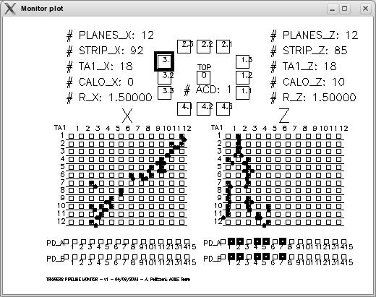
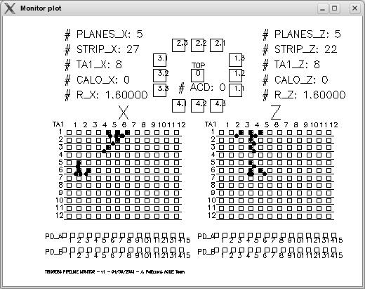
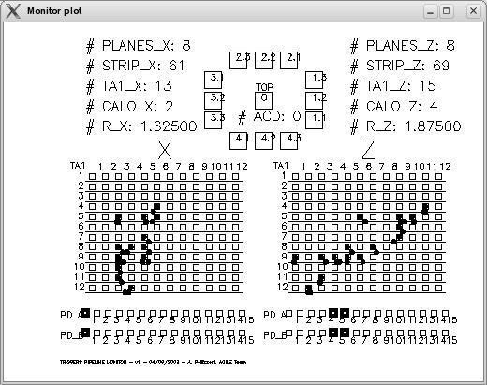
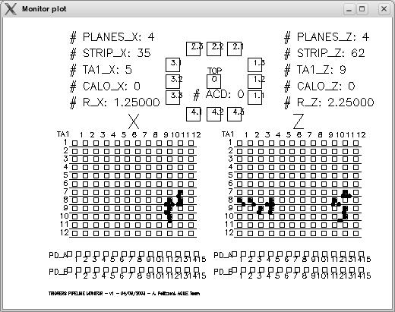
“P” (particle) events
All events flagged as “P” by our ground pipeline
Complex topology
Most of them come from the bottom of the GRID (no AC panels)
Standard Kalman filter reconstructs the track from top to bottom (0° ≤ θ ≤ 90°)

Slide 10
“P” (particle) events
All events flagged as “P” by our ground pipeline
Complex topology
Most of them come from the bottom of the GRID (no AC panels)
Standard Kalman filter reconstructs the track from top to bottom (0° ≤ θ ≤ 90°)
difficult reconstruction of the incoming direction

Slide 11
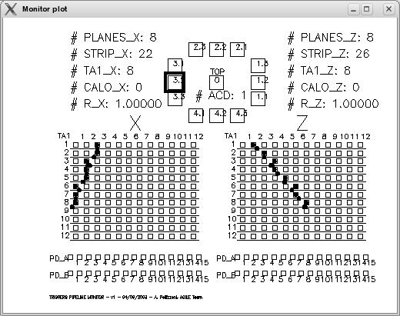
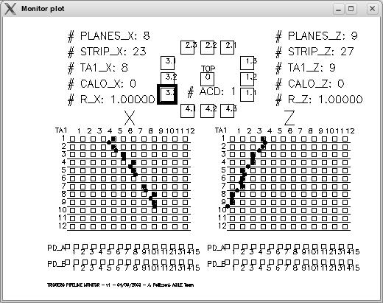
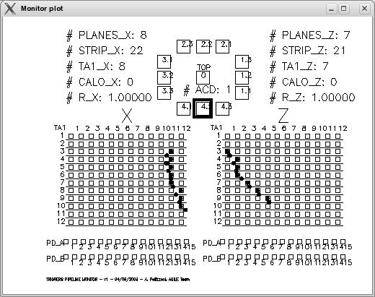
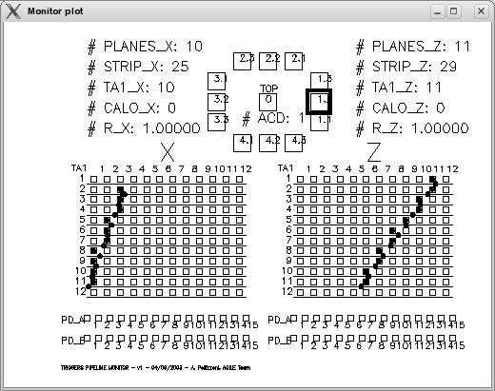
“S” events
If:
“good” single tracks (Rx and Rz ≤ 1.3)
signal in 1 lateral AC panel
no signal in the last tracker plane
no signal in the mini-CAL
Discrimination between “top-down” and “bottom-up” tracks
Bottom-up events have bottom-up track reconstruction (inverted Kalman)
0° ≤ θ ≤ 180° distribution
“S”/“P” event ratio ≈ 1%

Slide 12
“S” events
If:
“good” single tracks (Rx and Rz ≤ 1.3)
signal in 1 lateral AC panel
no signal in the last tracker plane
no signal in the mini-CAL
Discrimination between “top-down” and “bottom-up” tracks
Bottom-up events have bottom-up track reconstruction (inverted Kalman)
0° ≤ θ ≤ 180° distribution
“S”/“P” event ratio ≈ 1%
reconstruction of the incoming direction

Slide 13
Testing the AGILE reconstruction strategy for “S” events
STEP 1
Simulation: monocromatic electrons from a given direction (θ_{s}, ϕ_{s})
200000 simulated events inside the tracker
E = 100 MeV
(θ_{s}, ϕ_{s}) = (150°, 45°) → bottom-up events
Reconstruction strategy for “S” events applied to the simulated electrons

Slide 14
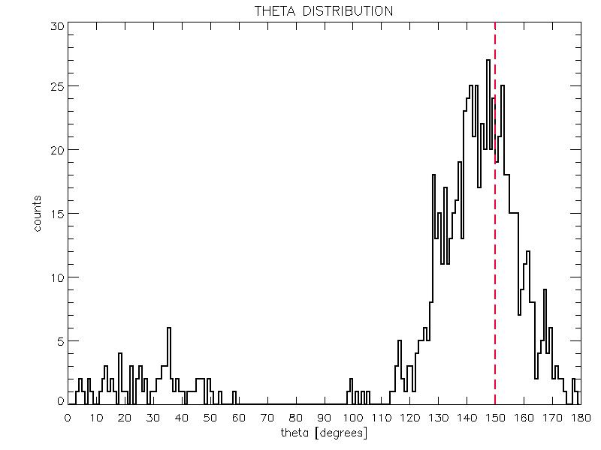
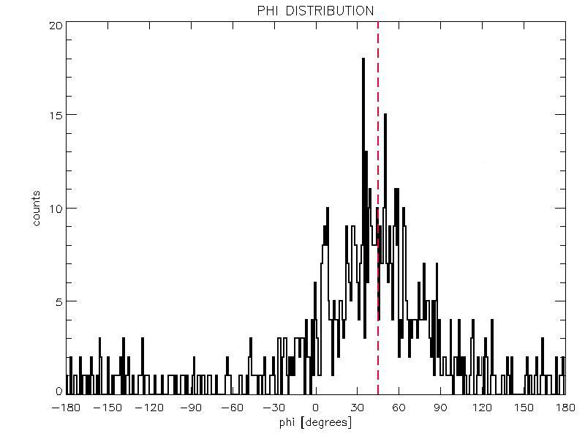
Simulations
STEP 1
785 events have been reconstructed as “S” events → ~0.4% of the simulated events are selected as “S” events
712 events have been reconstructed as bottom-up “S” events → 91% of the reconstructed “S” events

Slide 15
Testing the AGILE reconstruction strategy for “S” events
STEP 2
Simulation: spatially isotropic distribution of electrons with a power-law spectrum
10⁹ simulated events inside the tracker
power-law distribution between 10 and 100 MeV, index = 1.6 (based on theoretical particle distribution along the AGILE orbit)
Reconstruction strategy for “S” events applied to the simulated electrons

Slide 16
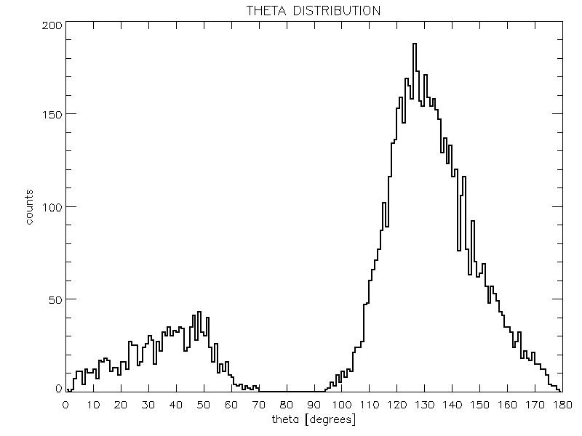
Simulations
STEP 2
~83% of the total “S” events are reconstructed as bottom incoming (observed data: ~81% )
main angular component peaks at ~130° (the same as for the observed data)

Slide 17
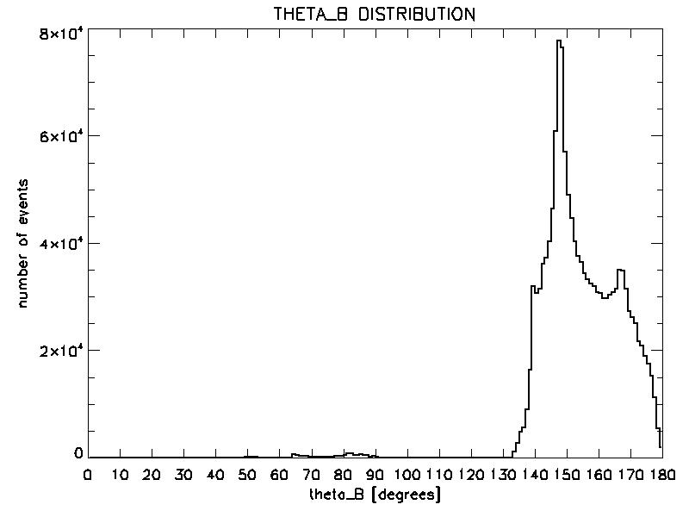
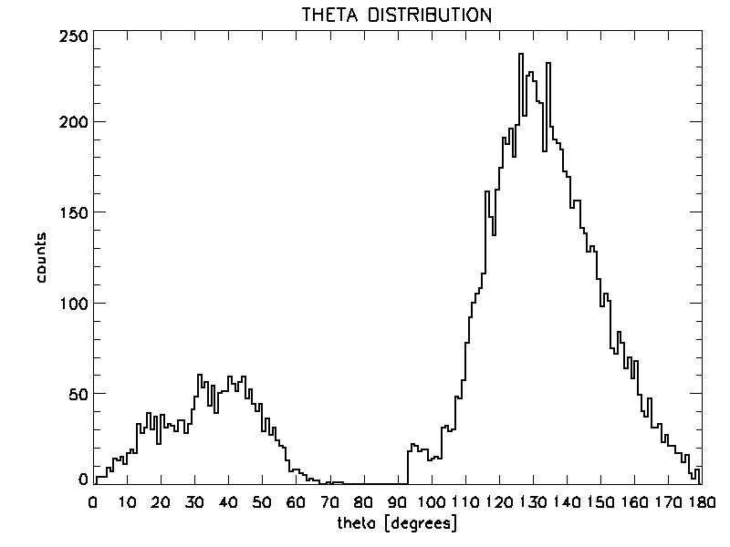
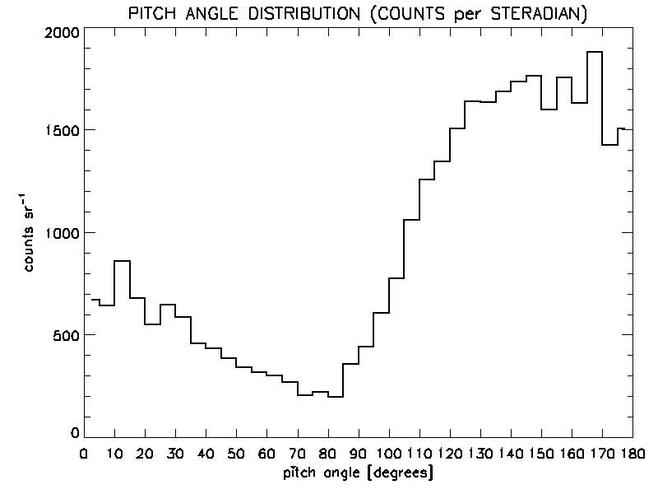
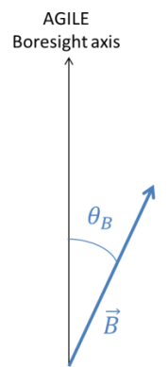
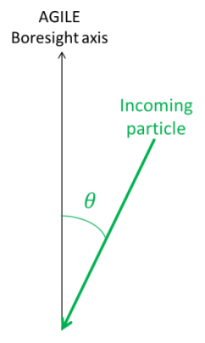
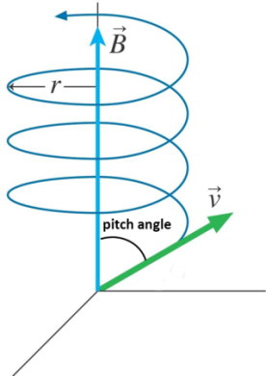
“S” events
Pointing (orbits: 1582-1709)
E < 100 MeV

Slide 18
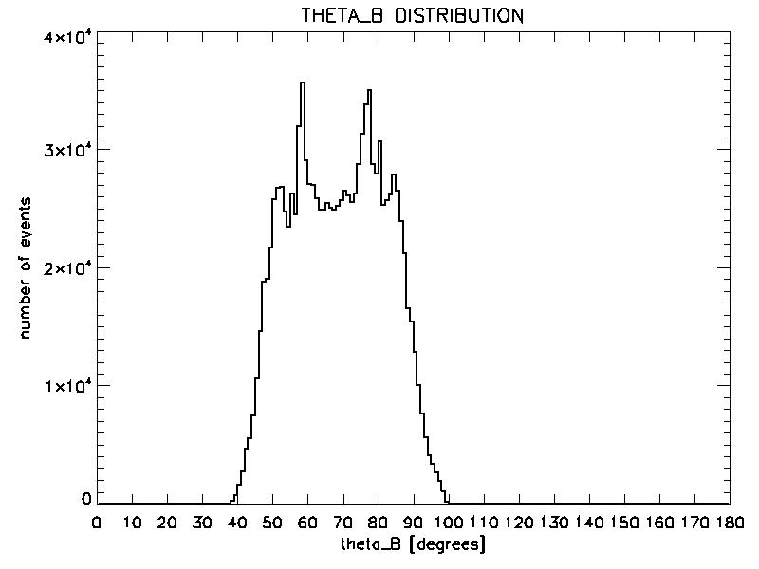
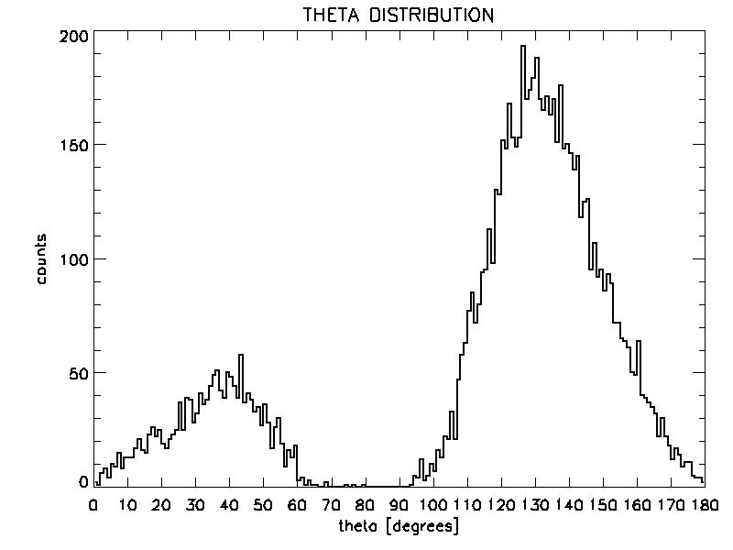
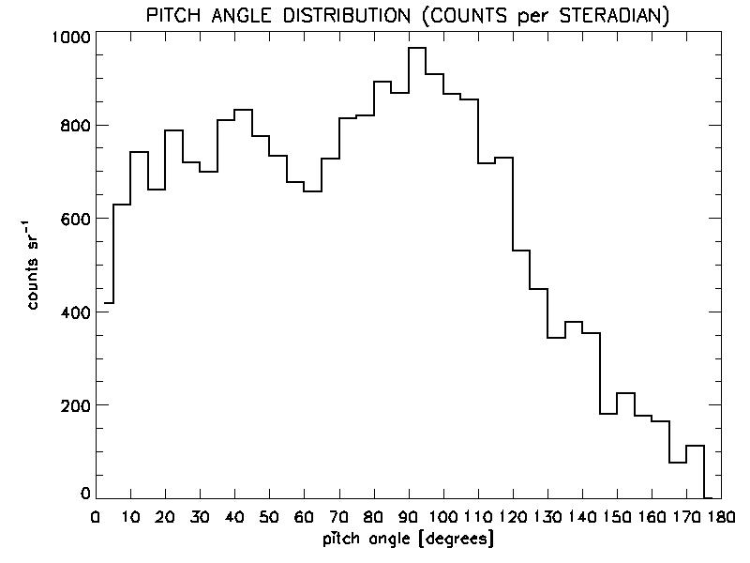
“S” events
Pointing (orbits: 2320-2420)
E < 100 MeV

Slide 19
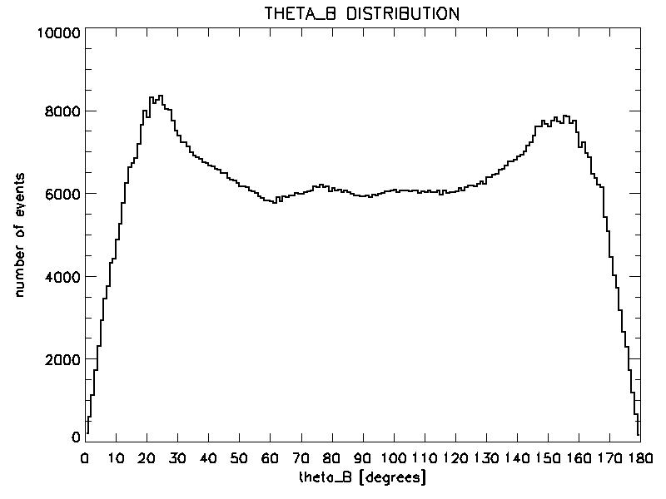
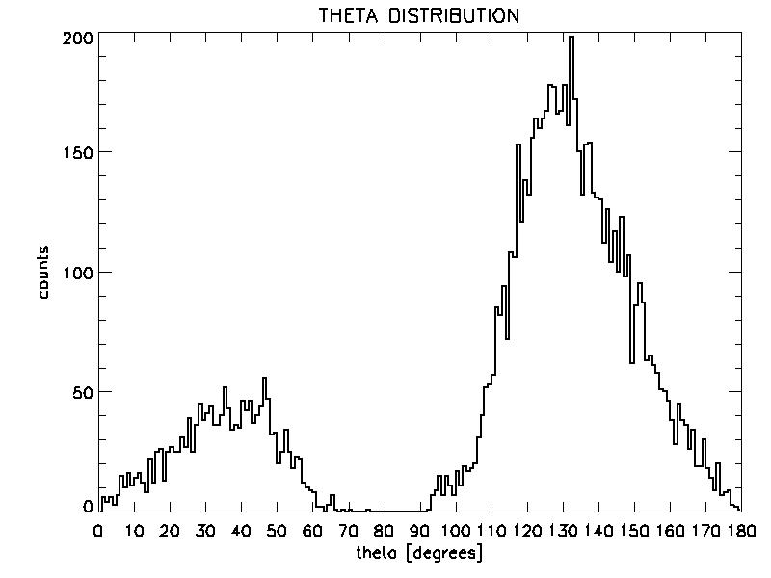
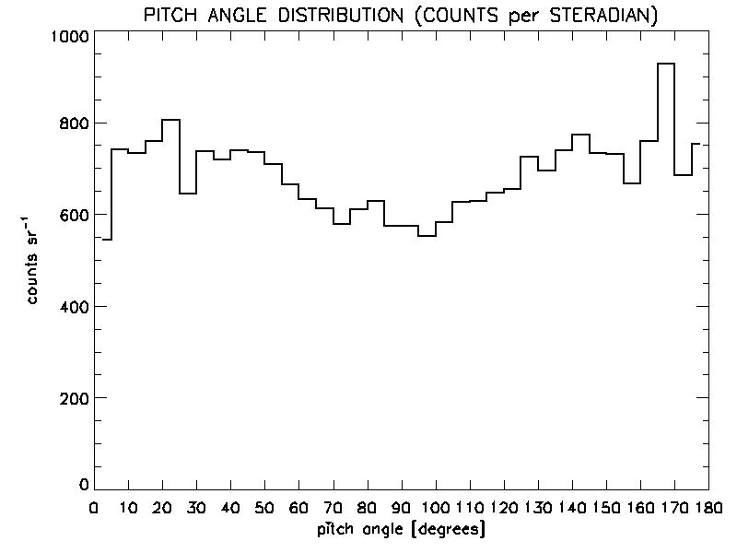
“S” events
Spinning (15000-15098)
E < 100 MeV

Slide 20
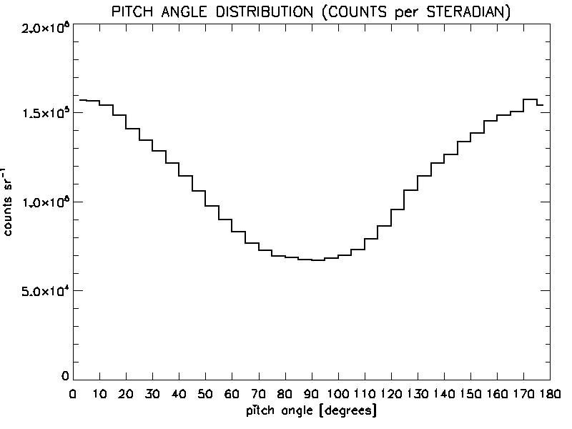
Pitch-angle distribution
“P” and “S” events
Spinning (15000-15098)
E < 100 MeV
“P” events
“S” events
Quasi-symmetrical distribution → “dumbbell”

Slide 21
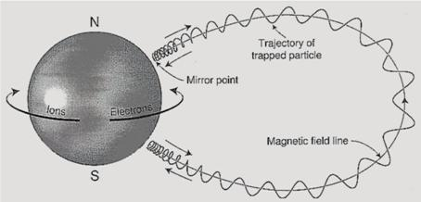
Trapped particles in magnetosphere
Gyromagnetic revolution around magnetic field lines
Bouncing motion between two mirror points
Longitudinal drift of the guiding center (ions drift westwards, electrons eastwards)
L-parameter → invariant
Trapped particles keep moving into a given magnetic L-shell

Slide 22
Trapped particles in magnetosphere
Gyromagnetic revolution around magnetic field lines
Bouncing motion between two mirror points
Longitudinal drift of the guiding center (ions drift westwards, electrons eastwards)
L-parameter → invariant
Trapped particles keep moving into a given magnetic L-shell

Slide 23

Bouncing motion
Adiabatic invariant: µ = constant
  $$μ=\frac{mv_{⊥}^{2}}{2B}= \frac{mv^{2}\sin^{2}{α}}{2B} ⟹ \frac{\sin^{2}{α}}{B}=constant$$
Magnetic equator → $\sin^{2}{α}$ = minimum
Mirror point → $α=90° (\sin^{2}{α}=1)$

Slide 24
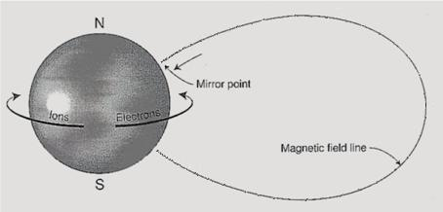
Bouncing motion
Adiabatic invariant: µ = constant
  $$μ=\frac{mv_{⊥}^{2}}{2B}= \frac{mv^{2}\sin^{2}{α}}{2B} ⟹ \frac{\sin^{2}{α}}{B}=constant$$
Magnetic equator → $\sin^{2}{α}$ = minimum
Mirror point → $α=90° (\sin^{2}{α}=1)$
local tangent of the particle trajectory

Slide 25
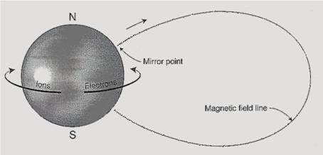
Bouncing motion
Adiabatic invariant: µ = constant
  $$μ=\frac{mv_{⊥}^{2}}{2B}= \frac{mv^{2}\sin^{2}{α}}{2B} ⟹ \frac{\sin^{2}{α}}{B}=constant$$
Magnetic equator → $\sin^{2}{α}$ = minimum
Mirror point → $α=90° (\sin^{2}{α}=1)$
local tangent of the particle trajectory

Slide 26
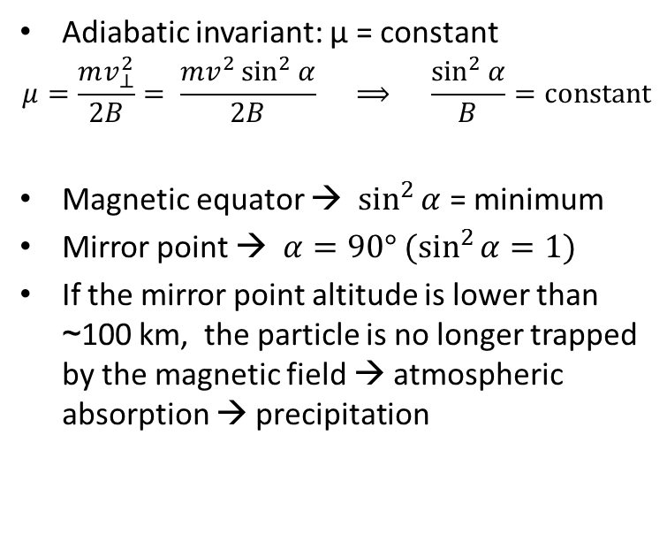
Bouncing motion
Adiabatic invariant: µ = constant
  $$μ=\frac{mv_{⊥}^{2}}{2B}= \frac{mv^{2}\sin^{2}{α}}{2B} ⟹ \frac{\sin^{2}{α}}{B}=constant$$
Magnetic equator → $\sin^{2}{α}$ = minimum
Mirror point → $α=90° (\sin^{2}{α}=1)$
If the mirror point altitude is lower than ~100 km, the particle is no longer trapped by the magnetic field → atmospheric absorption → precipitation

Slide 27
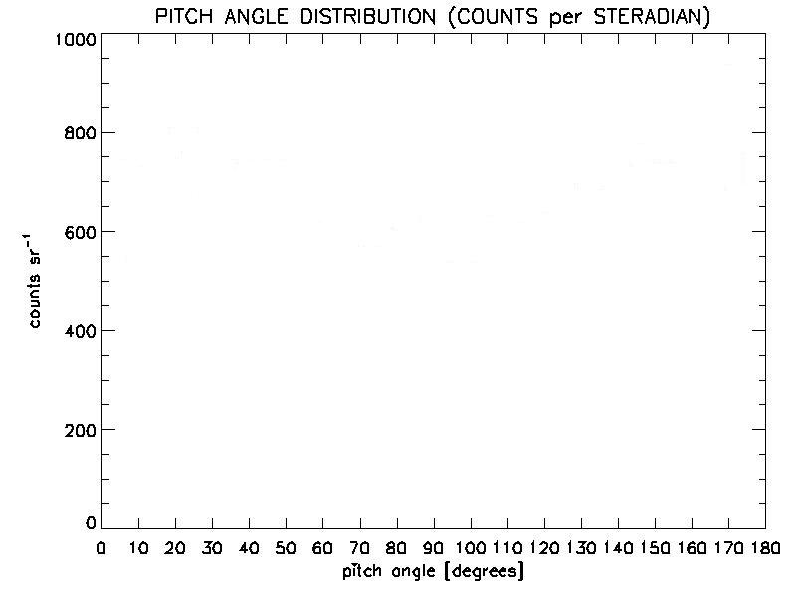
Along the AGILE orbit:
pitch angles around 90° → stably trapped particles
pitch angles around 0° and 180° (loss cone) → possible precipitation

Slide 28
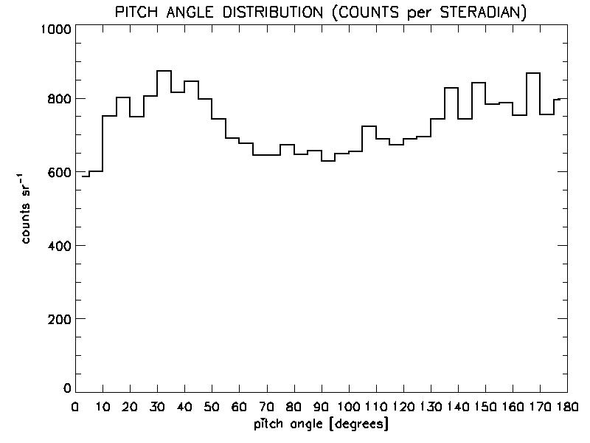
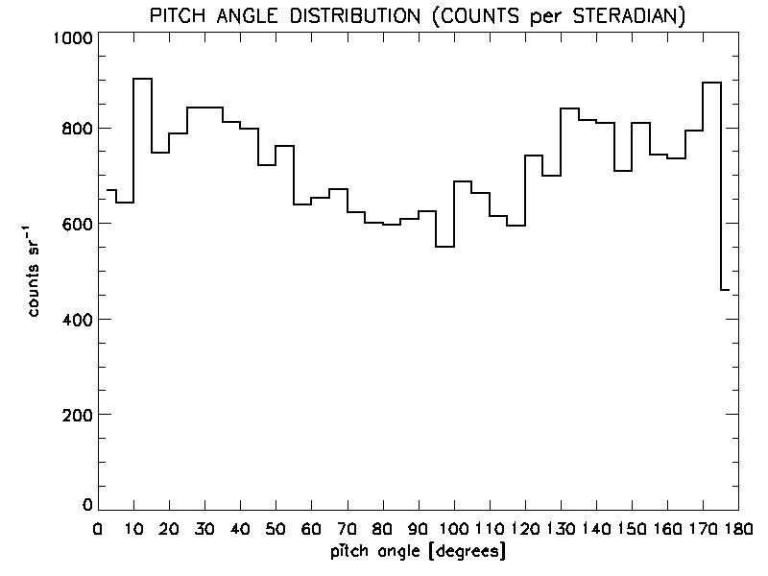
Pitch-angle distribution
“S” events
Spinning
E < 100 MeV
orbits: 15000-15098
orbits: 20000-20099
orbits: 20100-20199

Slide 29
Pitch-angle distribution
“S” events
Spinning
E < 100 MeV
orbits: 15000-15098
orbits: 20000-20099
orbits: 20100-20199
depletion around 90°

Slide 30
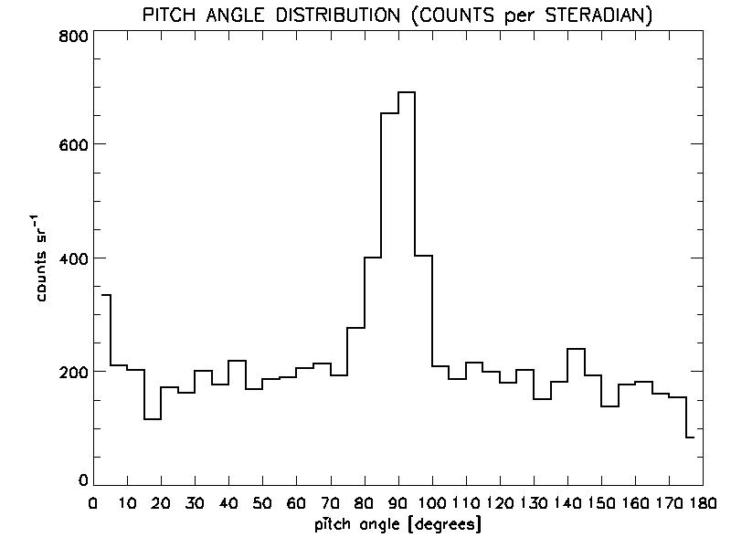
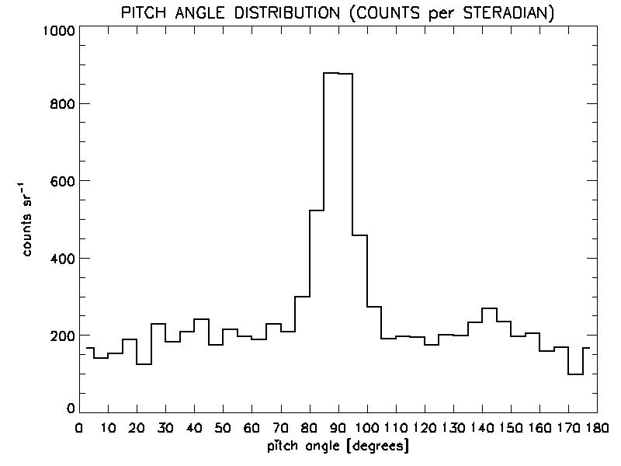
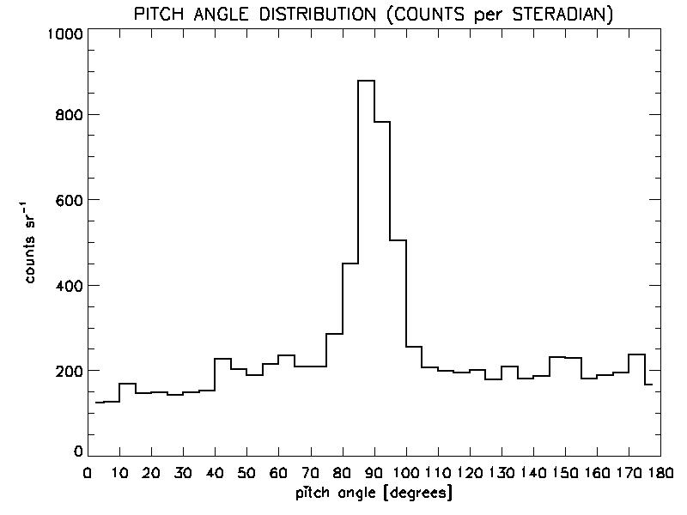
Pitch-angle distribution
“S” events
Spinning
E > 1 GeV
orbits: 15000-15098
orbits: 20000-20099
orbits: 20100-20199

Slide 31
Pitch-angle distribution
“S” events
Spinning
E > 1 GeV
orbits: 15000-15098
orbits: 20000-20099
orbits: 20100-20199
peak at ~90°

Slide 32
AGILE as a particle detector: experimental evidences
Pitch-angle distributions as detected by AGILE:
> 1 GeV: peak at ~90° → stably trapped particles
< 100 MeV: “dumbbell” → precipitation

Slide 33
AGILE as a particle detector: experimental evidences
Pitch-angle distributions as detected by AGILE:
> 1 GeV: peak at ~90° → stably trapped particles
< 100 MeV: “dumbbell” → precipitation
what is the physical mechanism responsible for that?

Slide 34
Wave-particle interaction
ULF (sub-kHz) waves propagate as Alfvén waves along the magnetic field lines
Bounce resonance with trapped particles in the magnetosphere
Pitch angle diffusion
→ lowering of the bouncing-motion mirror points → particle precipitation

Slide 35
Wave-particle interaction
“dumbbell” pitch-angle distribution of charged particles observed by AGILE in the low-energy band (< 100 MeV)
  → hint of resonant interaction with plasma waves?
origin of these ULF plasma waves?
  equatorial noise? (persistent ultra-low frequency emission)
  [e.g., Balikhin et al., 2015, Nature Communications 6, 7703]
  lithosphere? (EM emission from seismic events)
  [e.g., Athanasiou et al., 2011, Nat. Hazards Earth Syst. Sci., 11, 1091]

Slide 36
AGILE as a particle detector: remarks
Innovative event selection and reconstruction strategy
→ large-acceptance particle detector
  [~50 cm² sr (“P” events, current configuration)]
Spinning-mode observations
→ continuous monitoring of the complete pitch-angle range
[particle precipitation, E < 100 MeV]

Slide 37
AGILE as a particle detector: remarks
Innovative event selection and reconstruction strategy
→ large-acceptance particle detector
  [~50 cm² sr (“P” events, current configuration)]
Spinning-mode observations
→ continuous monitoring of the complete pitch-angle range
[particle precipitation, E < 100 MeV]
Optimal configuration to monitor trapped particles in the Earth magnetosphere

Slide 38
AGILE as a particle detector: remarks
Thanks
for your attention
Innovative event selection and reconstruction strategy
→ large-acceptance particle detector
  [~50 cm² sr (“P” events, current configuration)]
Spinning-mode observations
→ continuous monitoring of the complete pitch-angle range
[particle precipitation, E < 100 MeV]
Optimal configuration to monitor trapped particles in the Earth magnetosphere

