Slide 1
Results from 3D MHD simulations of Resistive Magnetic Reconnection
Edoardo Striani¹, Andrea Mignone², Bhargav Vaidya², Gianluigi Bodo³, Attilio Ferrari^{1,2}
1 – INFN Torino
2 – University of Torino
3 – Osservatorio Astronomico Torino

Slide 2
Outline
General features of magnetic reconnection
Results from MHD simulations of magnetic reconnection in a plasma column (Striani et al., submitted to MNRAS)
The future: MHD-PIC code
Summary and conclusions

Slide 3
Magnetic Reconnection
Rapid rearrangement of
magnetic field topology
Violent release of magnetically-stored energy and conversion/dissipation into heat, plasma kinetic energy and non-thermal particle acceleration
Important in astrophysics because is regarded as mechanism to account for the fast variability observed in many scenarios, like the gamma ray flares from the Crab Nebula (Tavani et al. 2011)

Slide 4
Acceleration mechanisms
Linear acceleration in X-points by means of the induced electric field (Sironi, Cerutti, Zenitani, Uzdensky, …)
(Uzdensky et al. 2011)

Slide 5
Acceleration mechanisms
Linear acceleration in X-points by means of the induced electric field (Sironi, Cerutti, Zenitani, Uzdensky, …)
(Uzdensky et al. 2011)
Fermi 1st order acceleration in the merging/deforming islands or reconnecting magnetic fields (de Gouveia, Kowal, Drake, Guo, …)
(Guo et al. 2015)

Slide 6

The classical Sweet-Parker model for
magnetic reconnection
Reconnection time
$t_{rec}∼t_{A}$ S^{1/2}
where S = L v_{A}/$η$ is the Lundquist number, $η$ the resistivity of the plasma and t_{A} = L/v_{A} is the Alfven time
PROBLEM
S >> 1 in many scenarios of interests
Example: the Solar flares
  $S∼{10}^{14}$ in the Solar corona
  $t_{A}≃0.5 s$
  The Sweet-Parker model therefore predicts for the solar flares $t_{rec}∼{5×10}^{6}s ≃2$ months, much longer than the observed 15 min
  The Sweet-Parker model is not very fast!

Slide 7

The classical Sweet-Parker model for
magnetic reconnection
Reconnection time
$t_{rec}∼t_{A}$ S^{1/2}
where S = L v_{A}/$η$ is the Lundquist number, L a length scale, $η$ the resistivity of the plasma and t_{A} = L/v_{A} is the Alfven time
PROBLEM
S >> 1 in many scenarios of interests
Example: the Solar flares
  $S∼{10}^{14}$ in the Solar corona
  $t_{A}≃0.5 s$
  The Sweet-Parker model therefore predicts for the solar flares $t_{rec}∼{5×10}^{6}s ≃2$ months, much longer than the observed 15 min
  The Sweet-Parker model is not very fast!

Slide 8
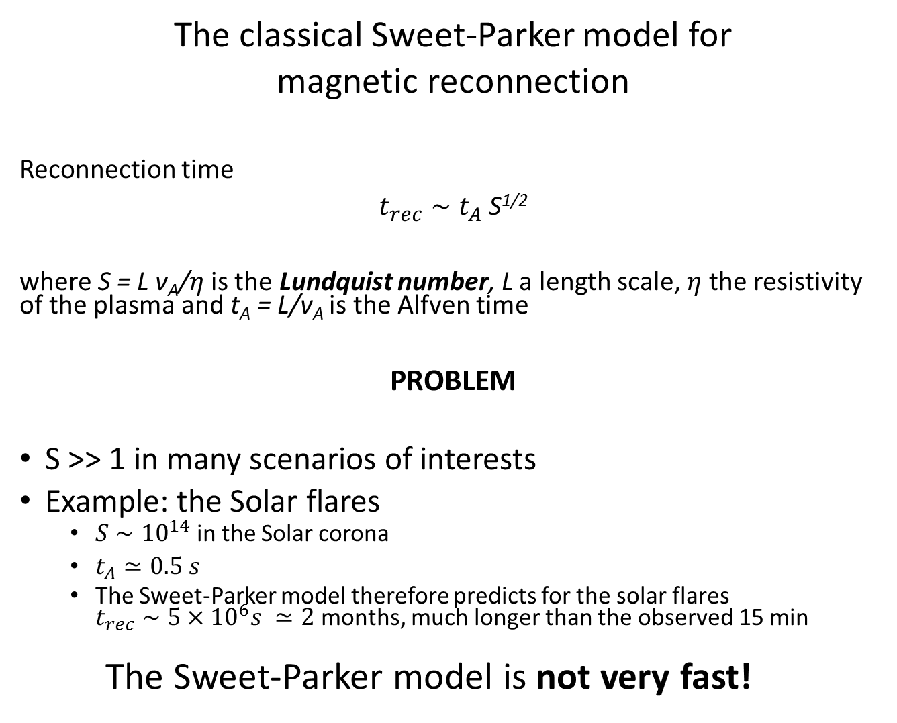
The classical Sweet-Parker model for
magnetic reconnection
Reconnection time
$t_{rec}∼t_{A}$ S^{1/2}
where S = L v_{A}/$η$ is the Lundquist number, L a length scale, $η$ the resistivity of the plasma and t_{A} = L/v_{A} is the Alfven time
PROBLEM
S >> 1 in many scenarios of interests
Example: the Solar flares
  $S∼{10}^{14}$ in the Solar corona
  $t_{A}≃0.5 s$
  The Sweet-Parker model therefore predicts for the solar flares $t_{rec}∼{5×10}^{6}s ≃2$ months, much longer than the observed 15 min
  The Sweet-Parker model is not very fast!

Slide 9
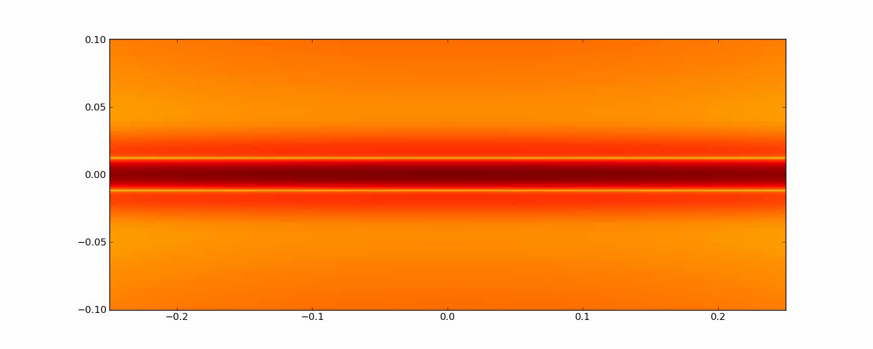

When $S>{10}^{4}$the current sheet becomes unstable to secondary tearing instability: production of plasmoids
Fast reconnection regime
  Formation of small sized current-sheets with S_{eff} << S
  Effective reconnection rate $∼0.1 −0.01 t_{A}$ independent of S

Slide 10
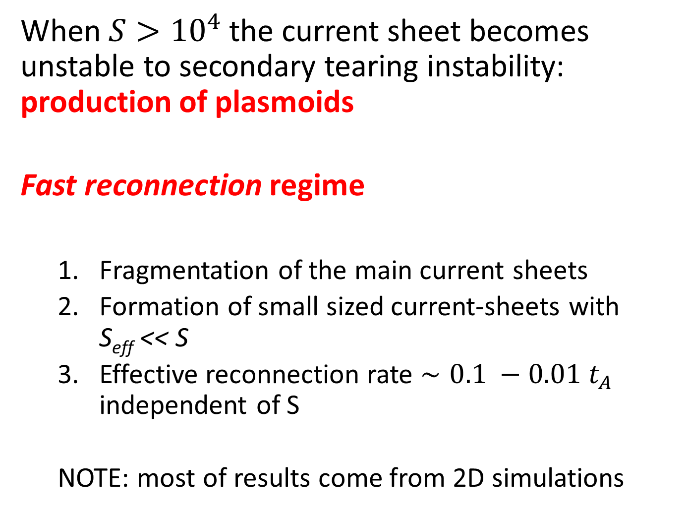
When $S>{10}^{4}$the current sheet becomes unstable to secondary tearing instability: production of plasmoids
Fast reconnection regime
  Fragmentation of the main current sheets
  Formation of small sized current-sheets with S_{eff} << S
  Effective reconnection rate $∼0.1 −0.01 t_{A}$ independent of S
  NOTE: most of results come from 2D simulations

Slide 11
What happens in 3D?
3D simulations require a lot of computational power
Recent work by Oishi et al. 2015 suggests that 3D instability offers a fast reconnection mechanism without appeal to secondary tearing instability or turbulence
I will present the results from our 3D resistive MHD simulations with the PLUTO code (Mignone et al. 2007)

Slide 12
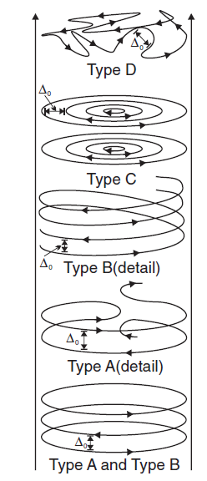
(J. McKinney and D. Uzdensky 2012)

Slide 13
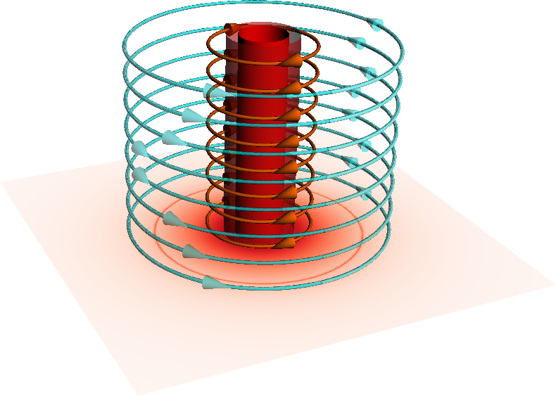
(J. McKinney and D. Uzdensky 2012)
B_{phi} reversal along r
Magnetic reconnection in a plasma column
pressure-balanced equilibrium (pressure-driven instabilities)
force-free equilibrium (current-driven instabilities)
How magnetic reconnection is affected by 3D instabilities?

Slide 14
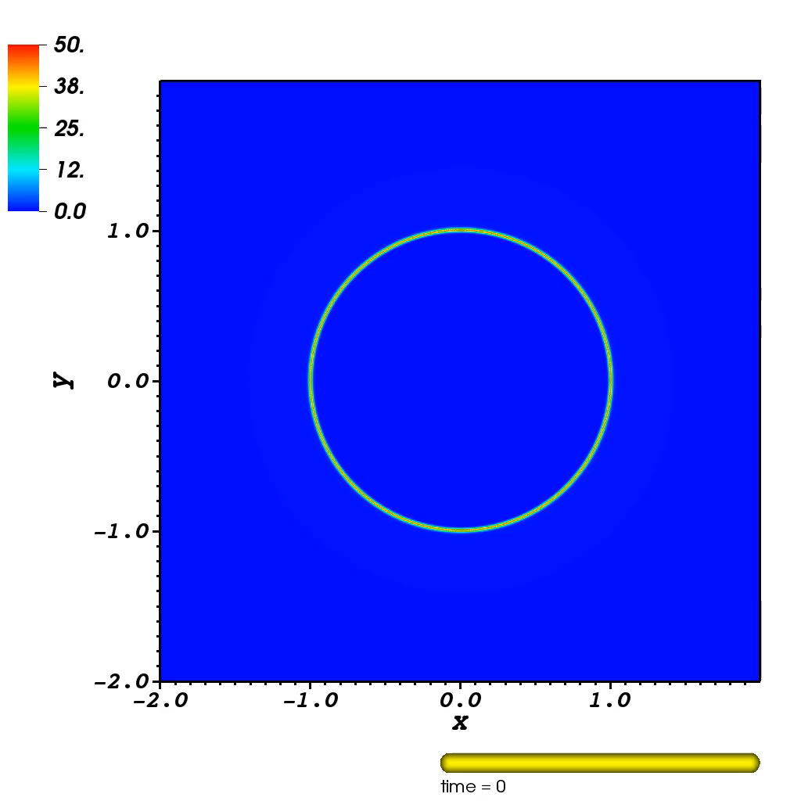
2-dimensional case

Slide 15
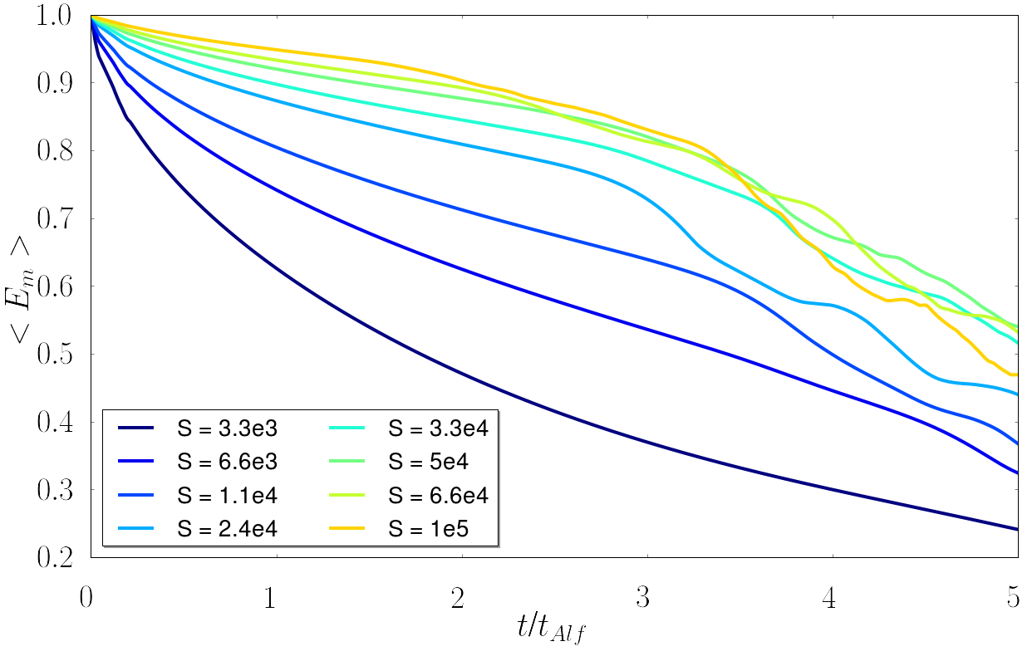
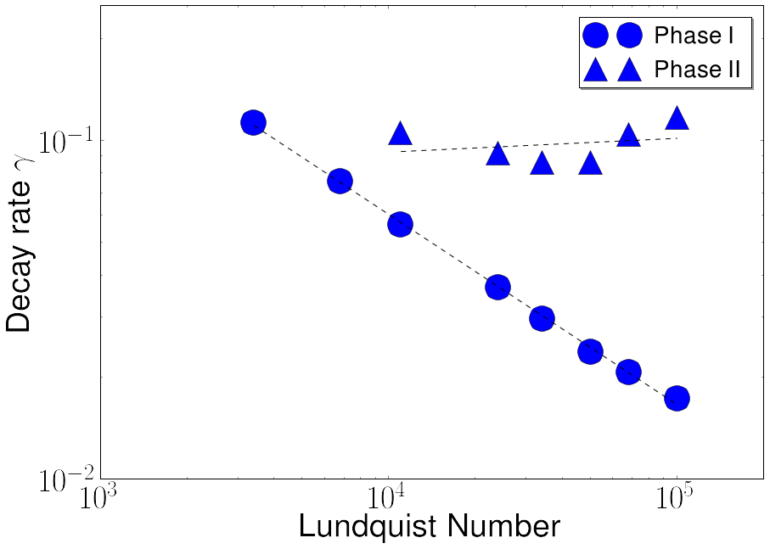
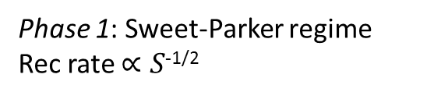
Phase 1: Sweet-Parker regime
Rec rate $∝S$^{-1/2}

Slide 16
Phase 1: Sweet-Parker regime
Rec rate $∝S$^{-1/2}

Slide 17
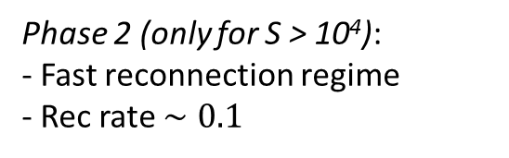
Phase 1: Sweet-Parker regime
Rec rate $∝S$^{-1/2}
Phase 2 (only for S > 10⁴):
- Fast reconnection regime
- Rec rate $∼0.1$

Slide 18
3D simulations:
Pressure balanced equilibrium

Slide 19
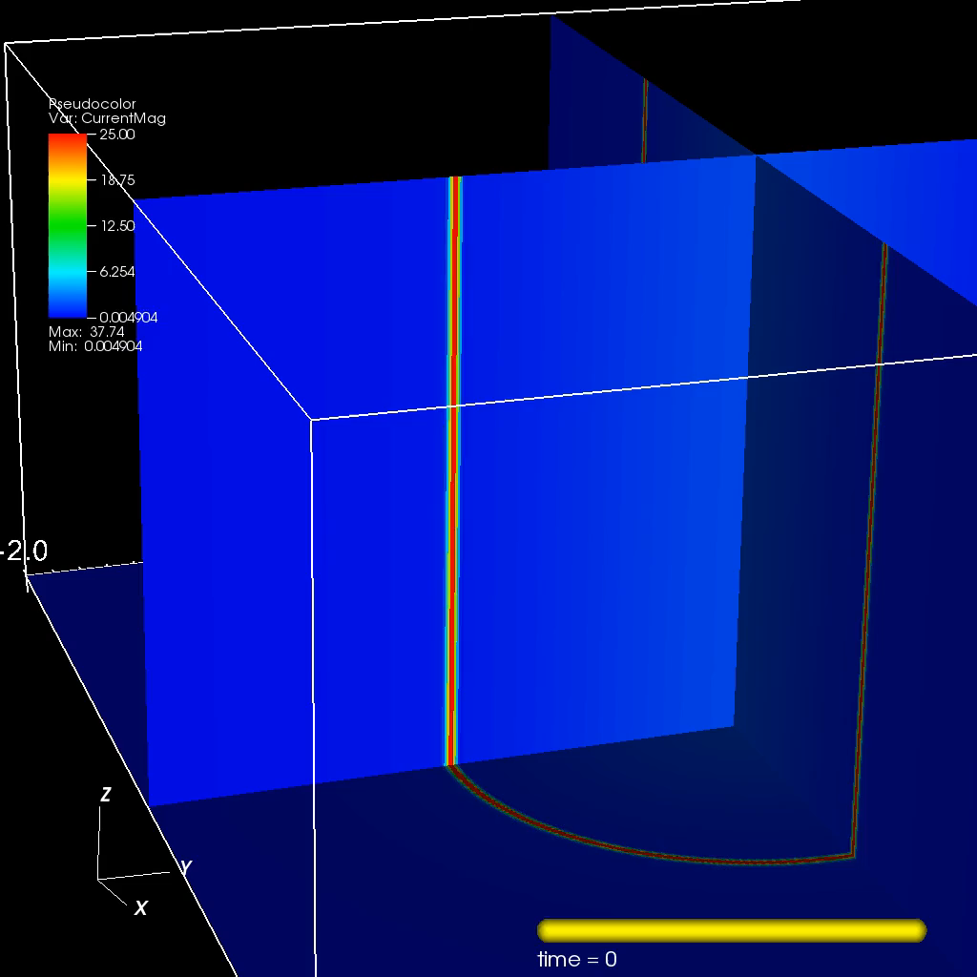

Slide 20
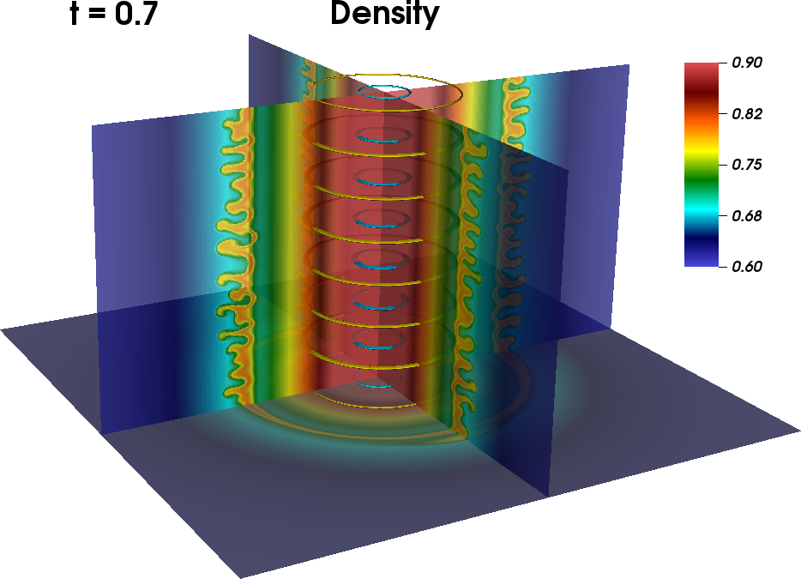
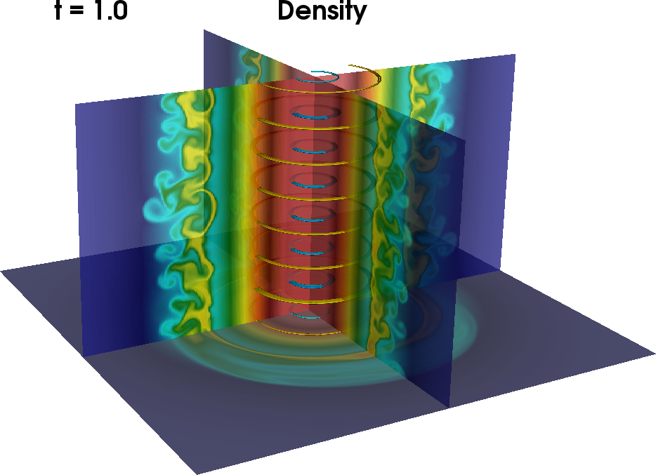
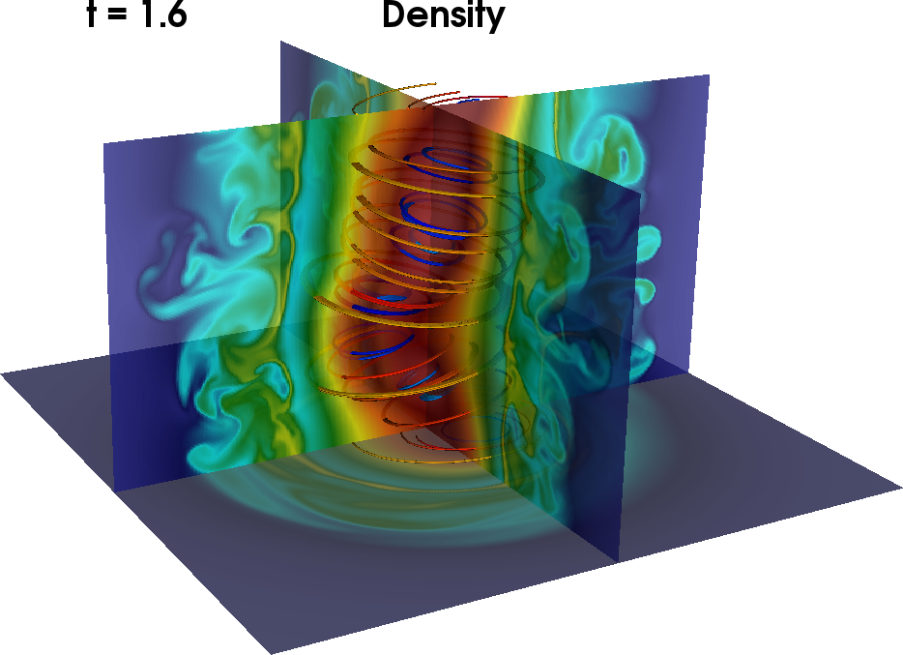
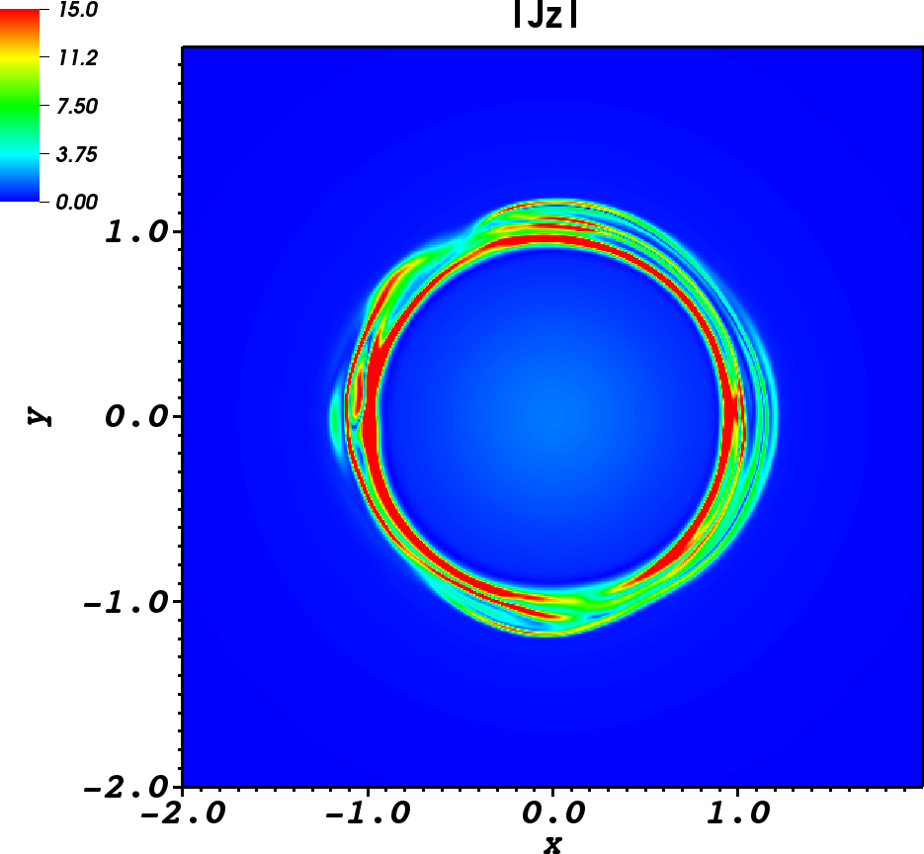
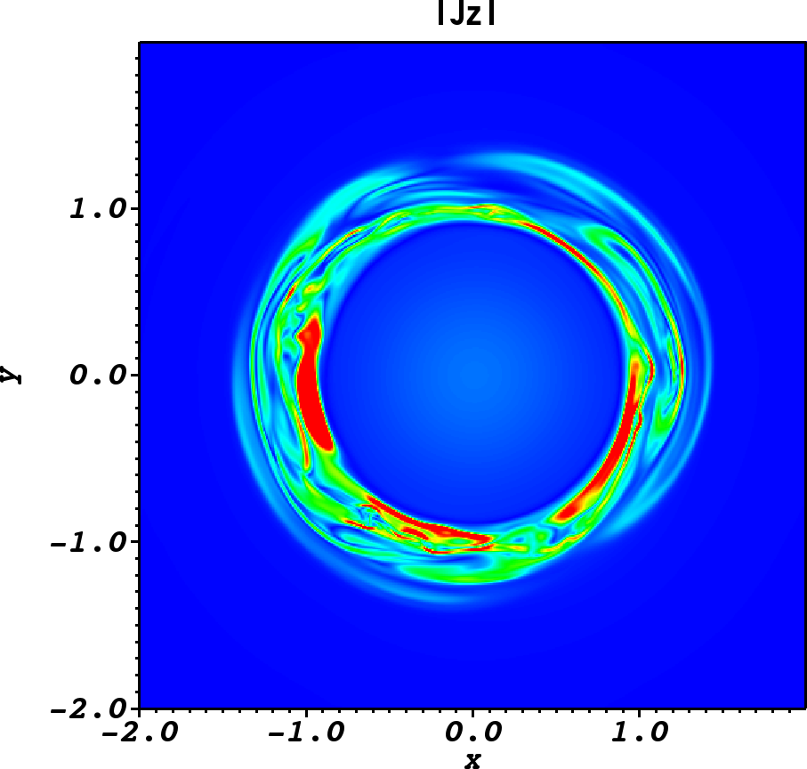
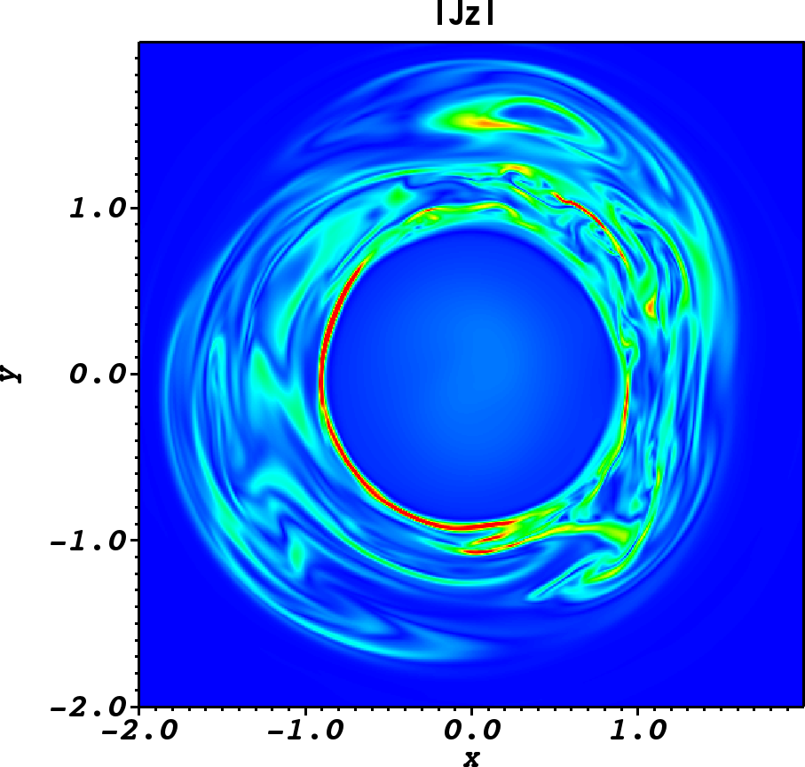

Slide 21
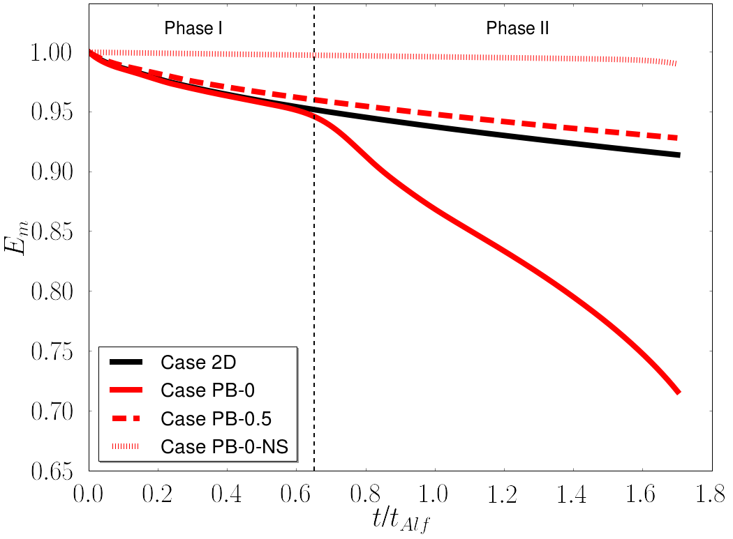
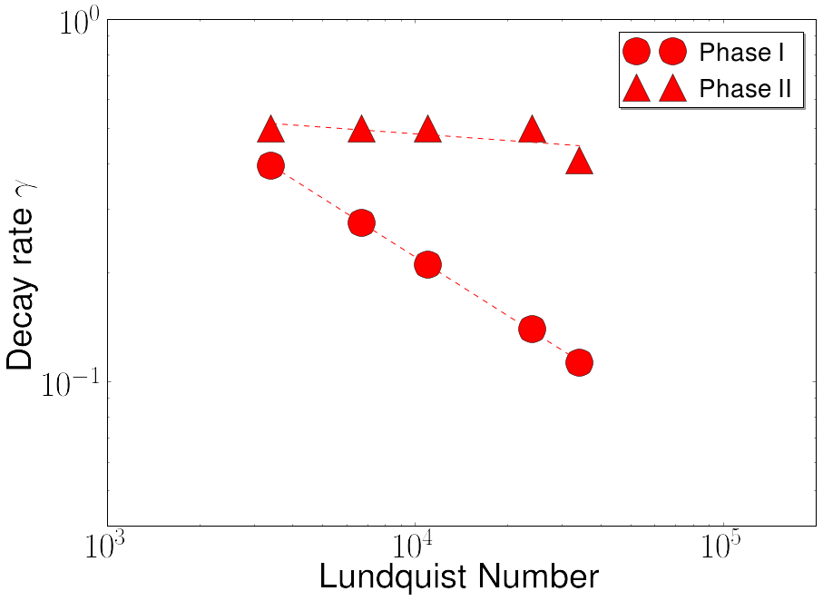
Beginning of PDI

Slide 22
Beginning of PDI
The pressure driven instability triggers a fast reconnection regime
When the 3D instabilties are damped, the reconnection rate follows the slow reconnections rate of 2D simulations

Slide 23
3D simulations:
Force-free equilibrium

Slide 24
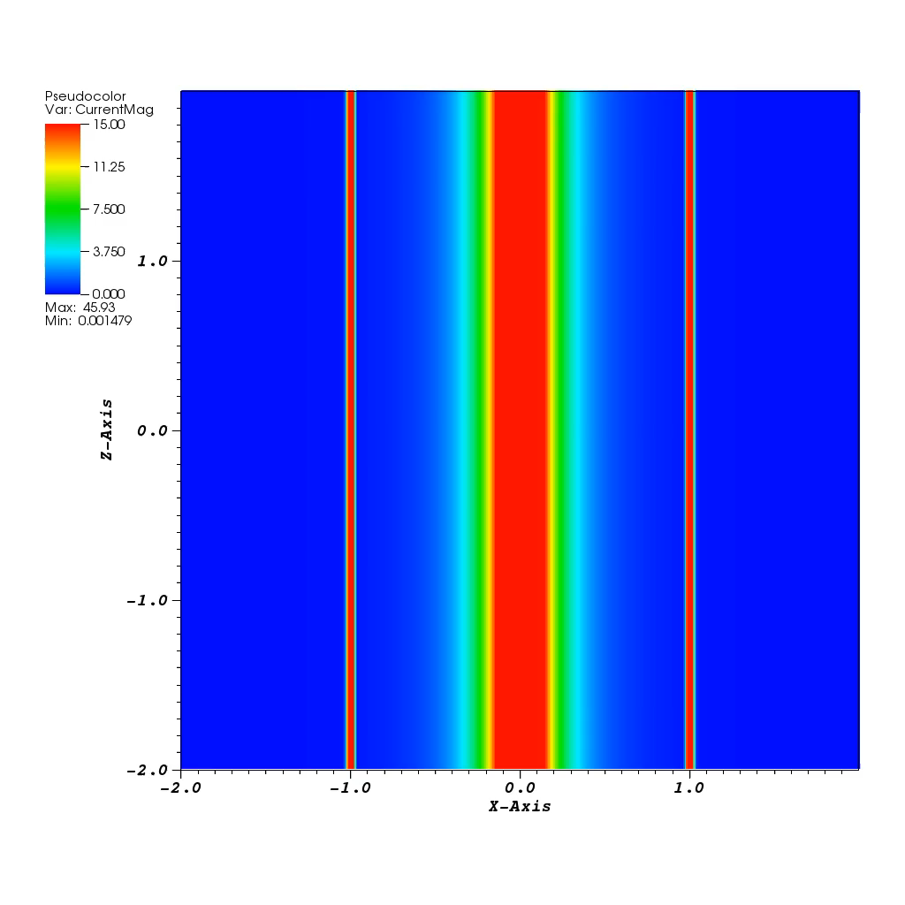
slice on the x-z plane

Slide 25
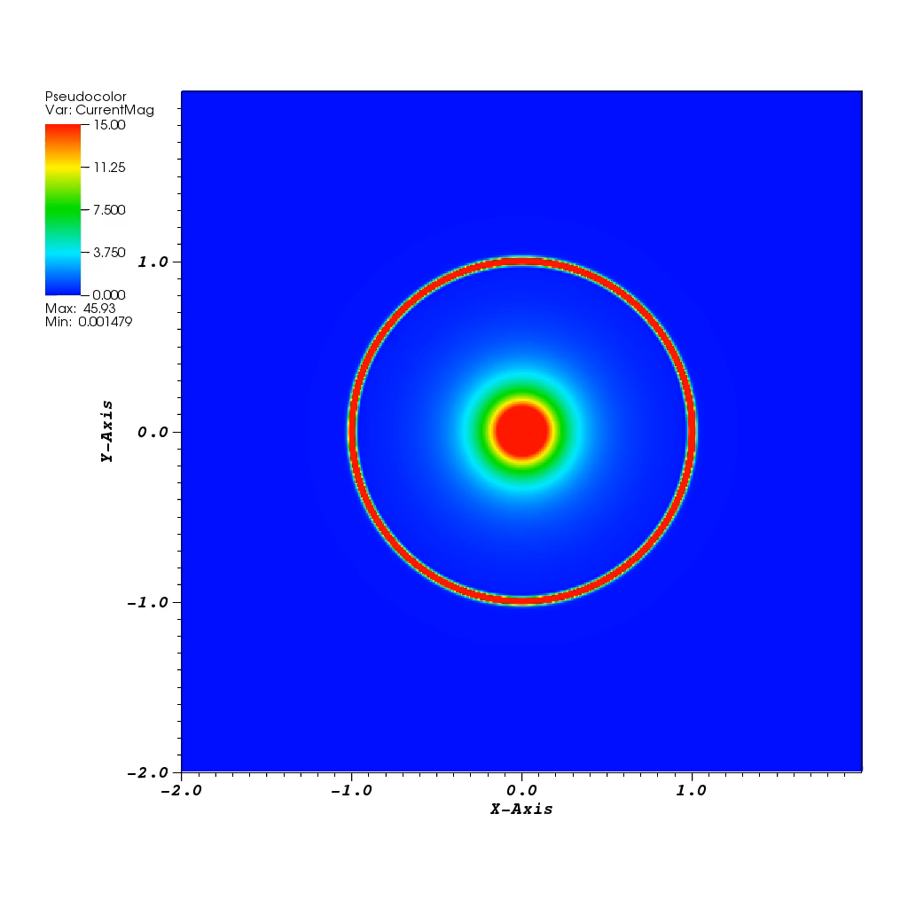
slice on the x-y plane

Slide 26
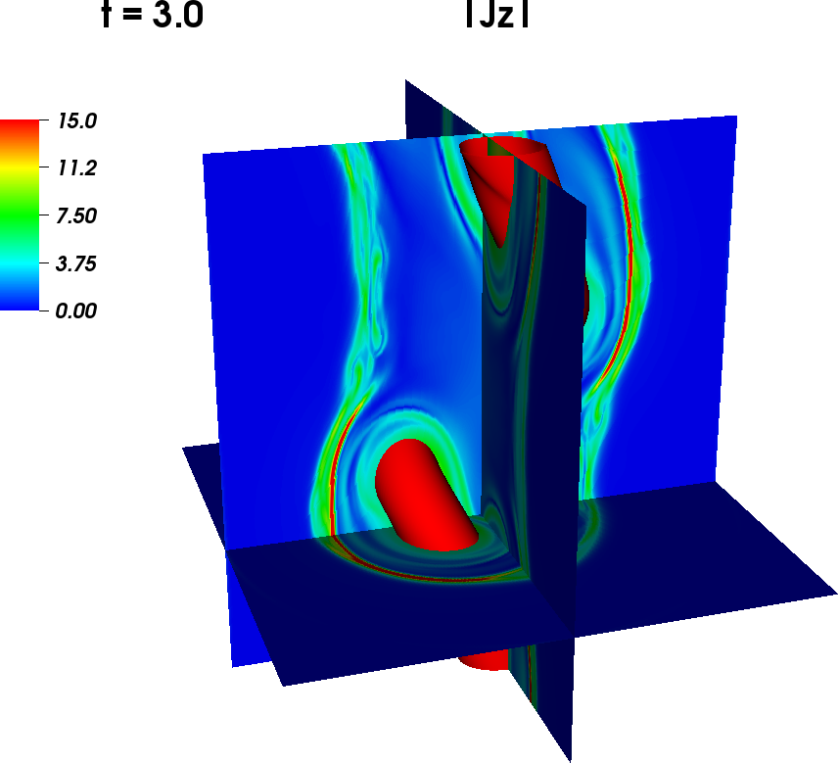
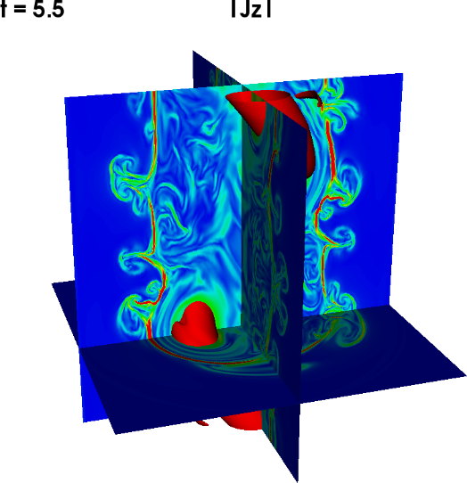
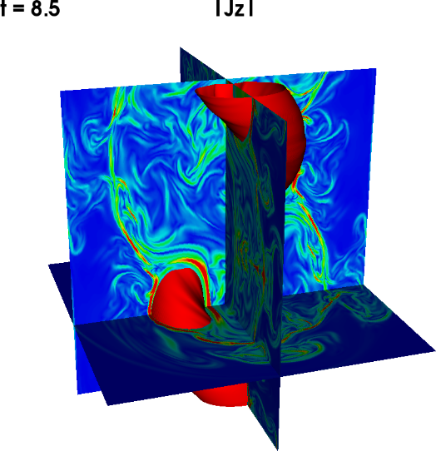
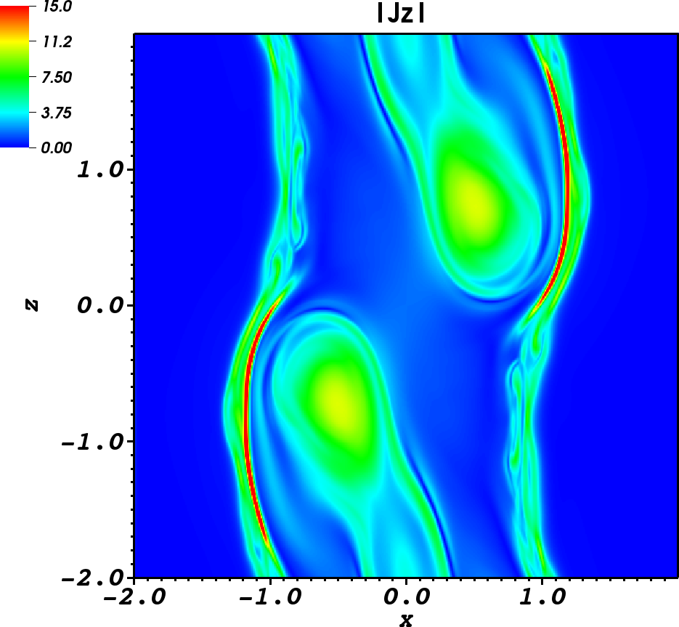
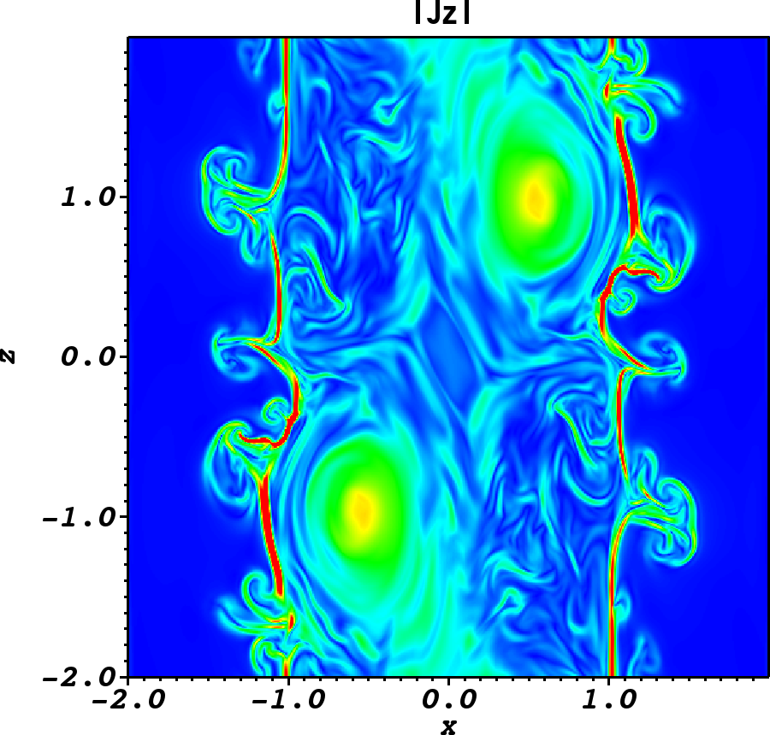
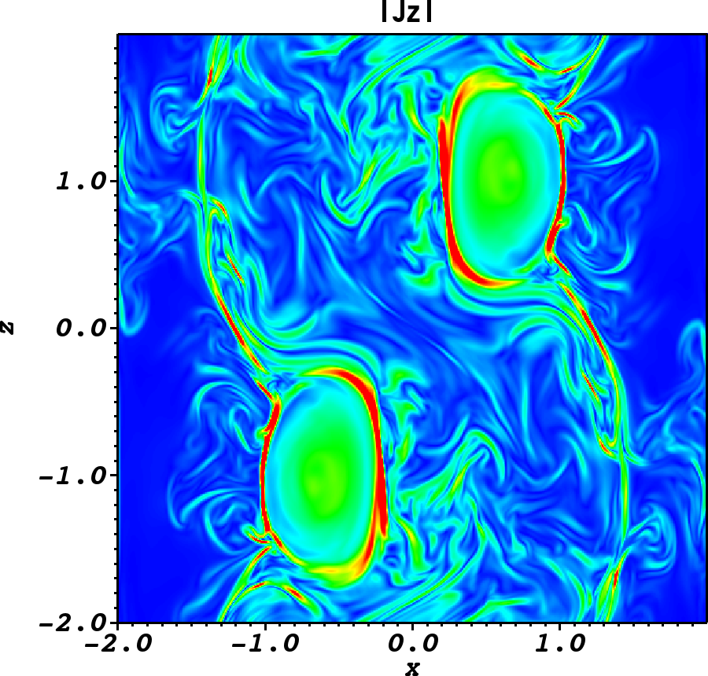
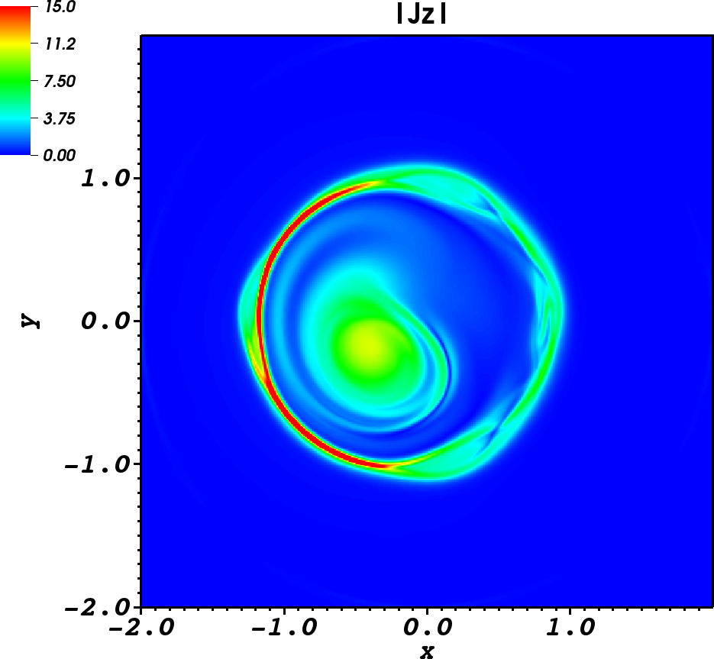
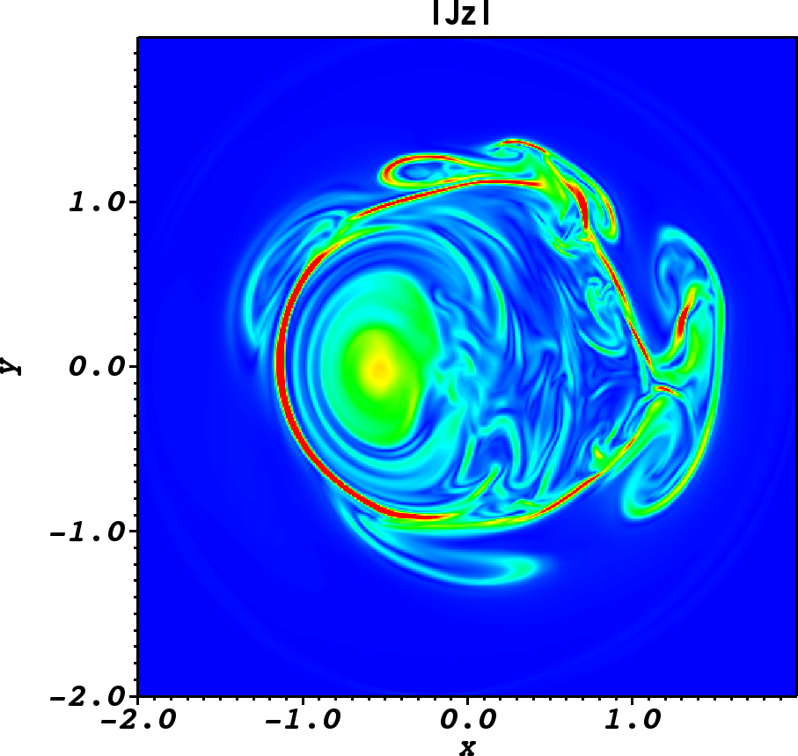
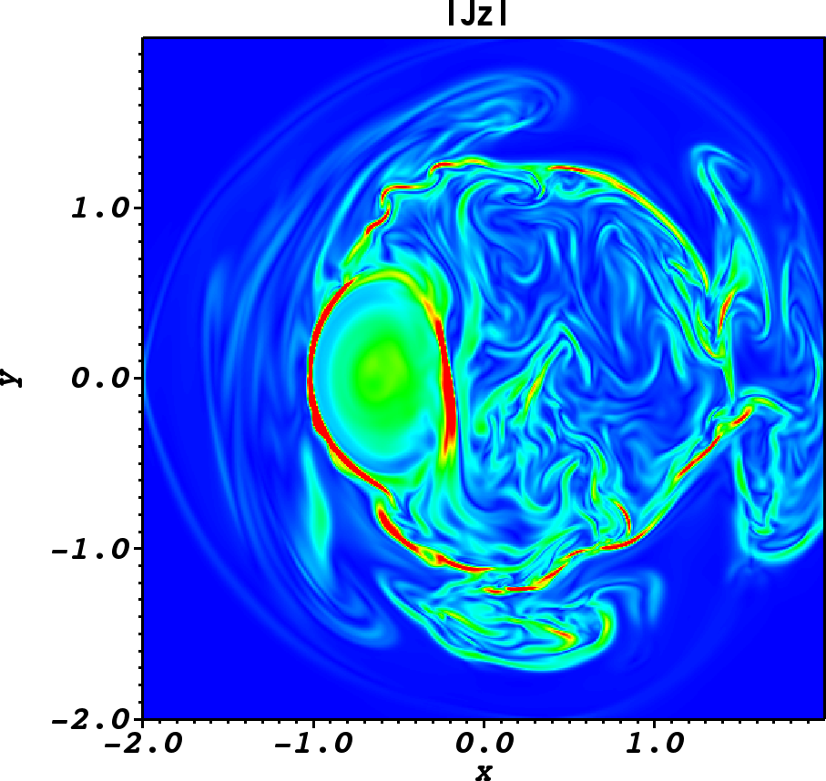

Slide 27
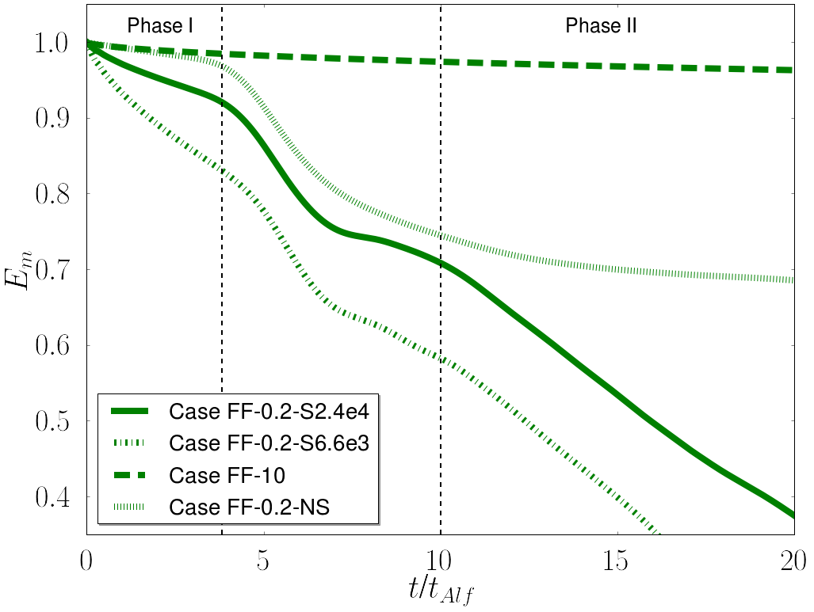
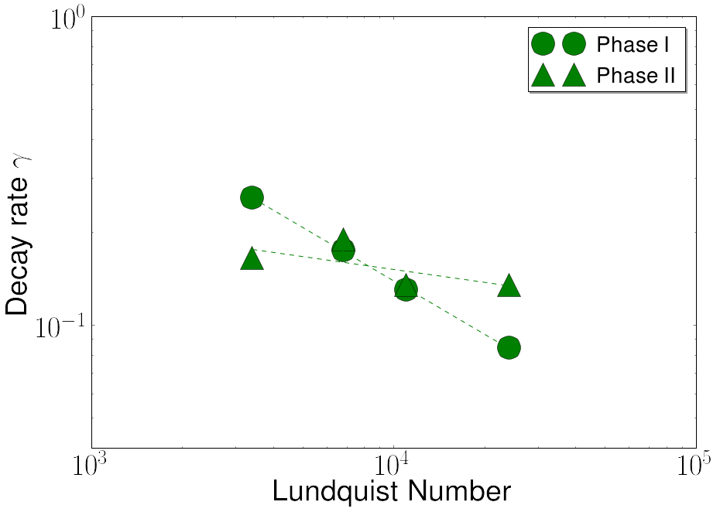

Slide 28
Like in the pressure-balanced case:
the 3D instability triggers a fast reconnection regime
When the 3D instabilty is damped, the dissipation of magnetic energy is much slower

Slide 29
Future: The Hybrid MHD-PIC module
Particles moving according to Lorentz force
Particle acceleration
Follow trajectory: localize where the acceleration takes place
Spectra (preliminary results reproduce power laws)
☹ Simulations of jets+MR+particles is difficult since it requires a lot of computational power, but we can zoon on specific areas.

Slide 30
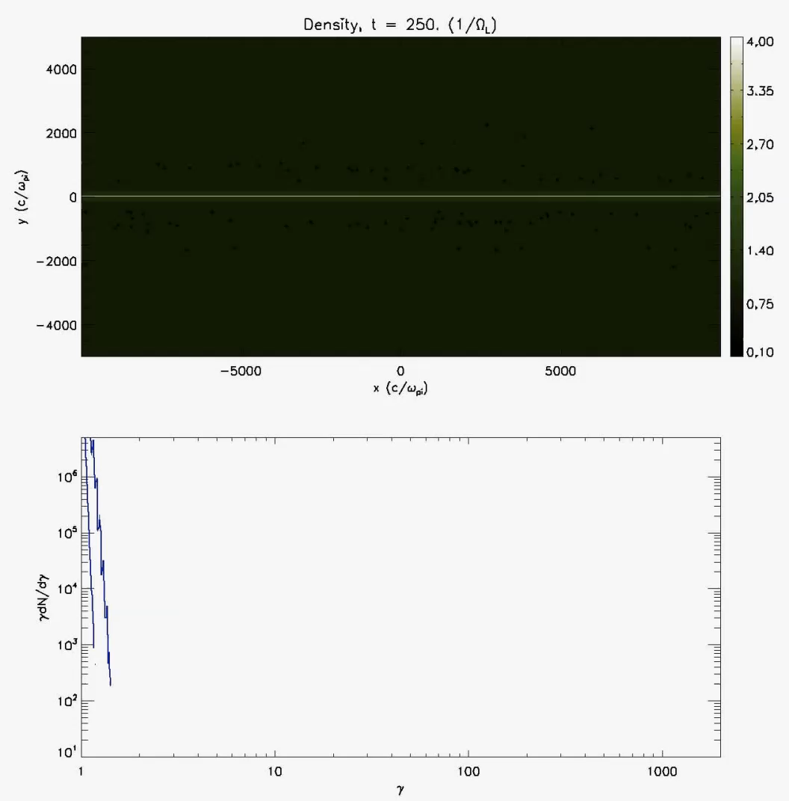
- 2M test particles
No feedback on the fluid
Maxwellian (non-relativistic) initial distribution

Slide 31
Conclusions
Magnetic reconnection can account for fast variability observed in many astrophysical environments (PWNe, AGNs, Sun)
3D MHD simulations show that 3D instabilities always lead to a fast reconnection regime
Future 1: study of magnetic reconnection in astrophysical jets
Future 2: study of particle acceleration (where? how? how much?) in magnetic reconnection events

