Slide 1

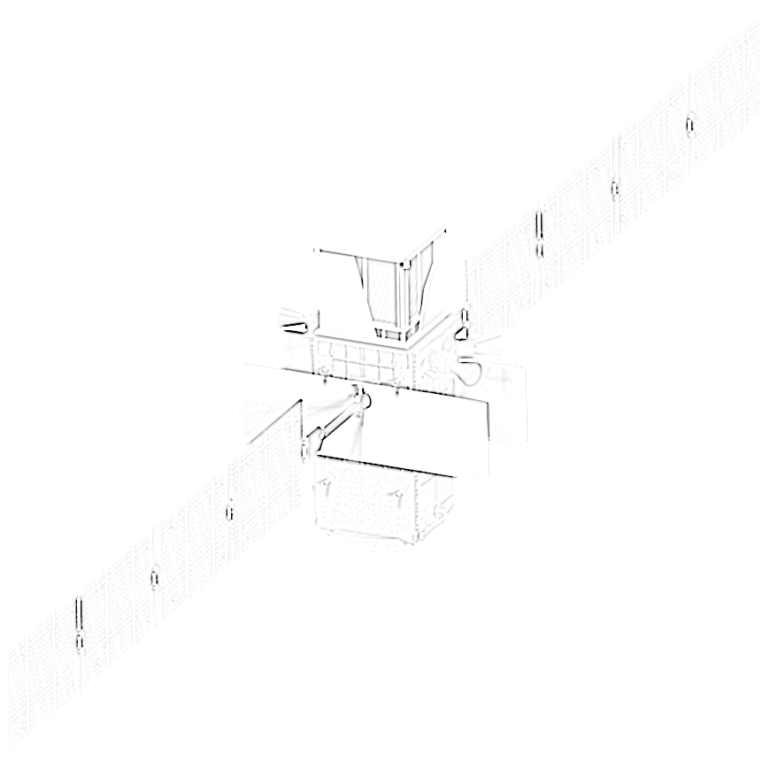
The e-ASTROGAM gamma-ray space mission
A sensitive wide-field observatory
for the MeV / sub-GeV band
Vincent Tatischeff
On behalf of the e-ASTROGAM Collaboration

Slide 2
The MeV/sub-GeV domain
e-ASTROGAM
2
Worst covered part of the electromagnetic spectrum (only a few tens of steady sources detected so far between 0.2 and 30 MeV)
Many objects have their peak emissivity in this range (GRBs, blazars, pulsars...)

Slide 3
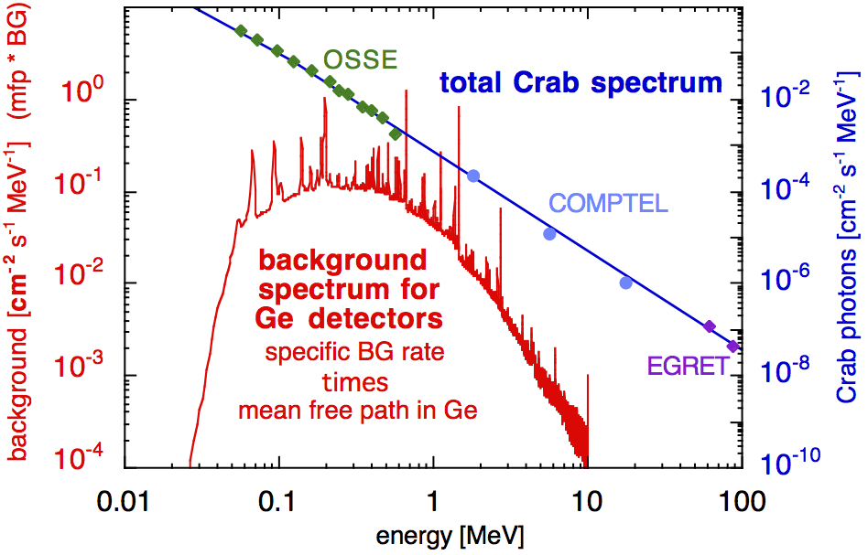
Observational challenges
e-ASTROGAM
3
The MeV range is the domain of nuclear γ-ray lines (radioactivity, nuclear collision, positron annihilation, neutron capture)
Strong instrumental background from activation of space-irradiated materials
Photon interaction probability reaches a minimum at ∼ 10 MeV
Three competing processes of interaction, Compton scattering being dominant around 1 MeV ⇒ complicated event reconstruction

Slide 4
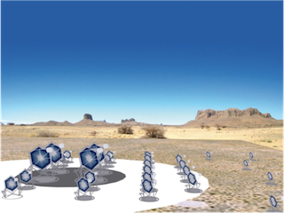

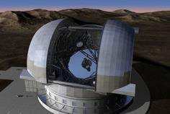
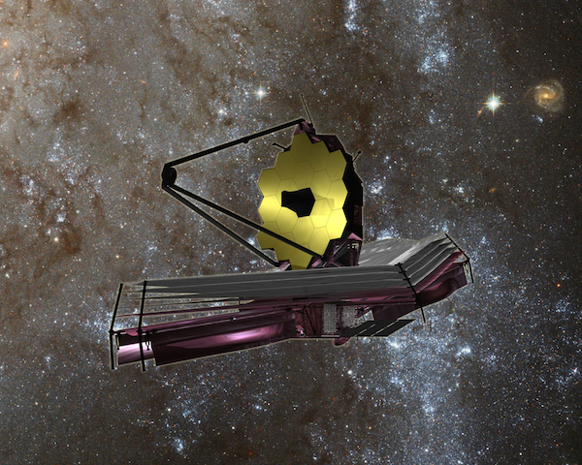
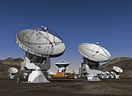
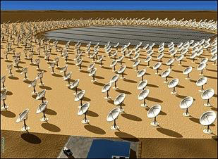
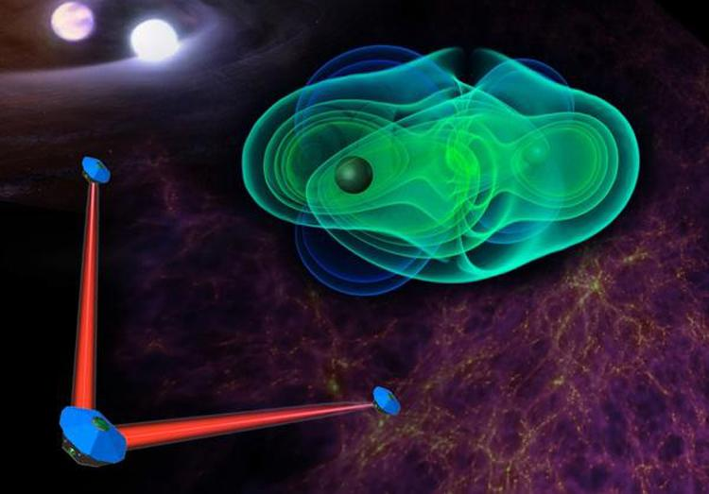
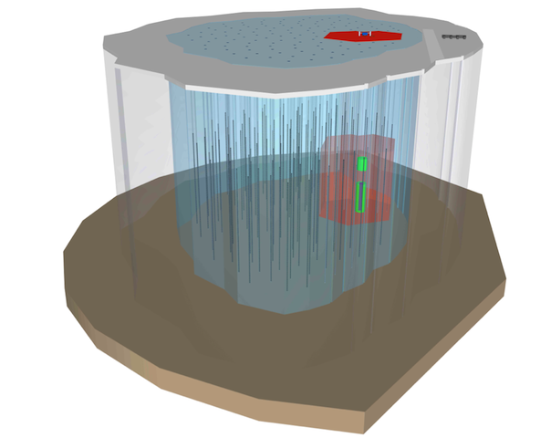
γ-ray astronomy in context
e-ASTROGAM
CTA
Athena
E-ELT
JWST
ALMA
4
SKA
?
eLISA − Gravitational waves
IceCube-Gen2 − Neutrinos
New Astronomies: gravitational waves neutrinos
Need for a sensitive, wide-field γ-ray space observatory operating at the same time as facilities like SKA and CTA, as well as eLISA and neutrino detectors, to get a coherent picture of the transient sky and the sources of gravitational waves and high-energy neutrinos

Slide 5
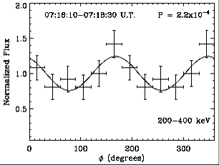
Gamma-ray polarization
e-ASTROGAM
5
γ-ray polarization in objects emitting jets (GRBs, Blazars, X-ray binaries) or with strong magnetic field (pulsars, magnetars) ⇒ magnetization and content (hadrons, leptons, Poynting flux) of the outflows + radiation processes
γ-ray polarization from cosmological sources (GRBs, Blazars) ⇒ fundamental questions of physics related to Lorentz Invariance Violation (vacuum birefringence)
e-ASTROGAM will measure the γ-ray polarization of ∼ 100 GRBs per year (promising candidates for highly γ-ray polarized sources)
INTEGRAL/IBIS − GRB 140206A (z = 2.74)
Götz et al. (2014)
Π > 48% (68% c. l.)
GRB 140206A with e-ASTROGAM
Θ_{off-axis} = 30°
ΔE = 0.2 − 1 MeV
Π = (75.0 ± 7.2)%

Slide 6
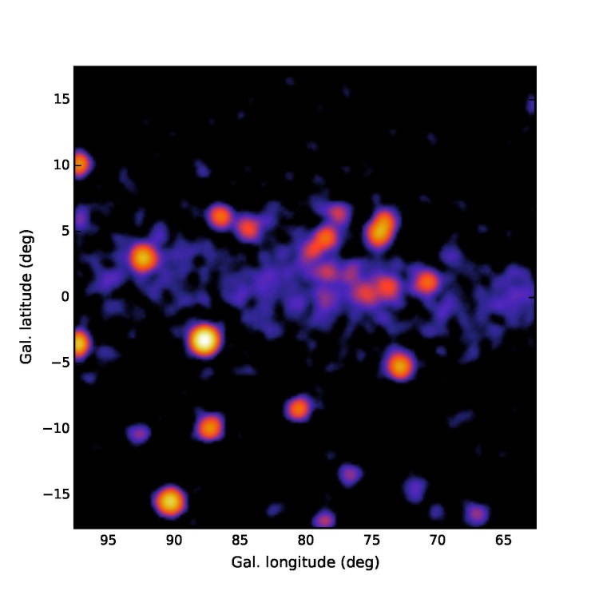
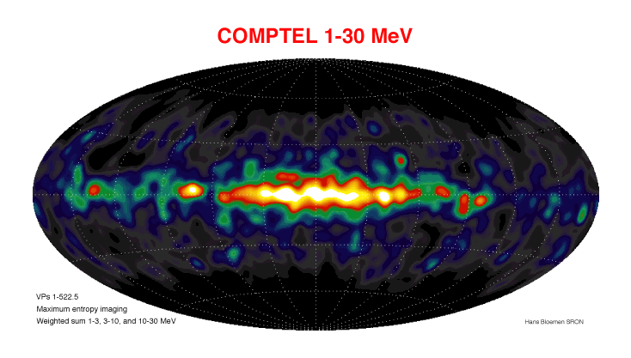
Angular resolution
e-ASTROGAM
6
Angular resolution needs to be improved close to the physical limits (Doppler broadening, nuclear recoil)
Cygnus region in the 1 - 3 MeV energy band with the e-ASTROGAM PSF (extrapolation of the 3FGL source spectra to low energies)
Notes:
ASTROGAM angular resolution better than that of COMPTEL by a factor of 4 at 5 MeV and better than that of Fermi/LAT by a factor of 3.5 at 1 GeV.
ASTROGAM energy resolution is about 10 keV (1 sigma) at 1 MeV. Is a factor of 4 better than COMPTEL

Slide 7
Measurement principle
e-ASTROGAM
7
Compton e⁻
Tracker
γ
Calorimeter
Tracker − Double sided Si strip detectors (DSSDs) for excellent spectral resolution and fine 3-D position resolution
Calorimeter − High-Z material for an efficient absorption of the scattered photon ⇒ CsI(Tl) scintillation crystals readout by Si Drift Diodes for better energy resolution
Anticoincidence detector to veto charged-particle induced background ⇒ plastic scintillators readout by Si photomultipliers

Slide 8
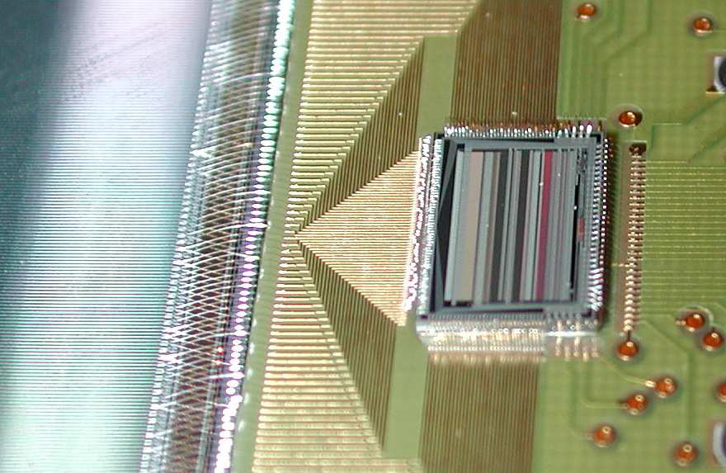
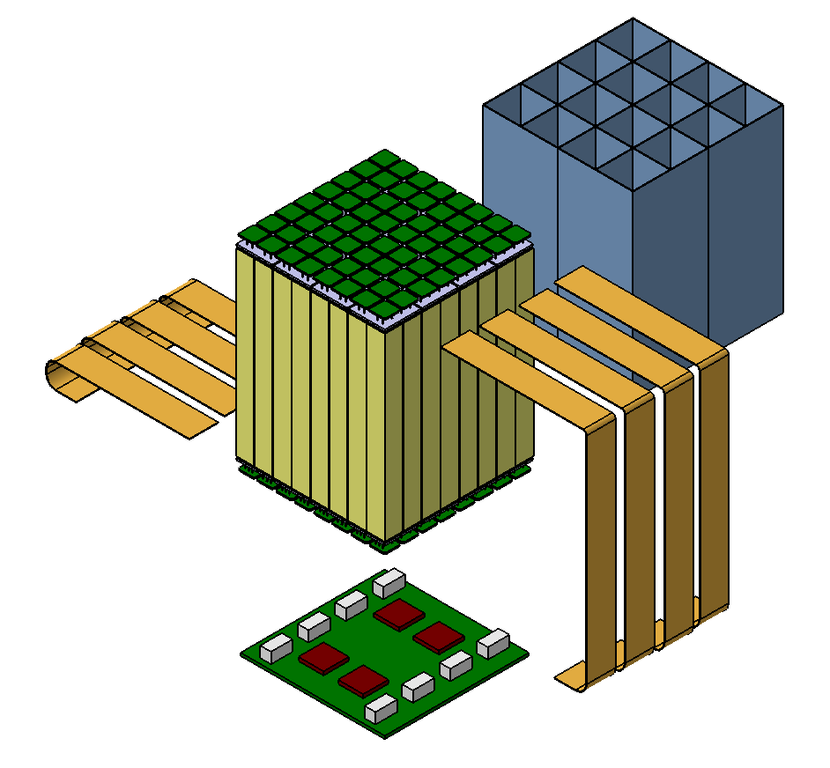
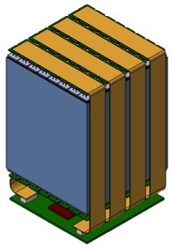
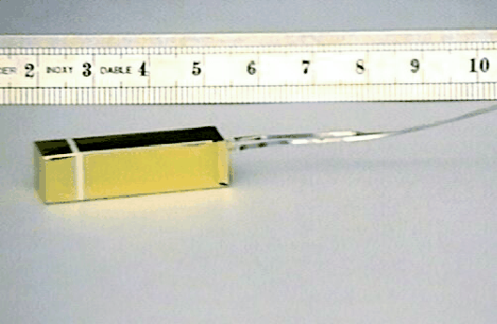
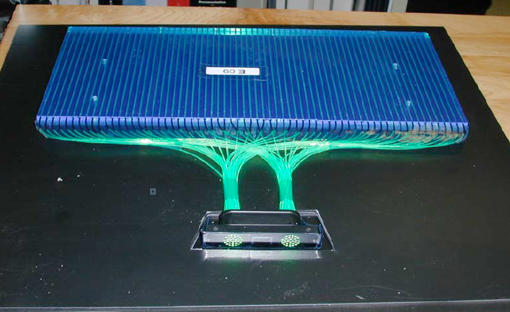
Payload
e-ASTROGAM
Detail of the detector-ASIC bonding in the AGILE Si Tracker
8
Tracker: 56 layers of 4 times 5×5 DSSDs (5 600 in total) of 500 μm thickness and 240 μm pitch
DSSDs bonded strip to strip to form 5×5 ladders
Light and stiff mechanical structure
Ultra low-noise front end electronics
PICSiT CsI(Tl) pixel
Calorimeter: 33 856 CsI(Tl) bars coupled at both ends to low-noise Silicon Drift Detectors
ACD: segmented plastic scintillators coupled to SiPM by optical fibers
Heritage: AGILE, Fermi/LAT, AMS-02, INTEGRAL, LHC/ALICE…
Fermi/LAT AC system

Slide 9
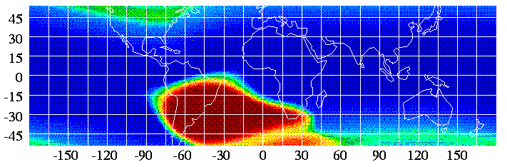
Mission profile
e-ASTROGAM
9
Orbit − Equatorial (inclination i < 2.5°, eccentricity e < 0.01) low-Earth orbit (altitude in the range 550 - 600 km)
Launcher − Ariane 6.2
Satellite communication −
ESA ground station at Kourou
+ ASI Malindi station (Kenya)
Data transmission − via X-band (available downlink of 10 Mbps)
Observation modes − (i) zenith-pointing sky-scanning mode, (ii) nearly inertial pointing, and (iii) fast repointing to avoid the Earth in the field of view
In-orbit operation − 3 years duration + provisions for a 2+ year extension
Background environment in an ELEO

Slide 10
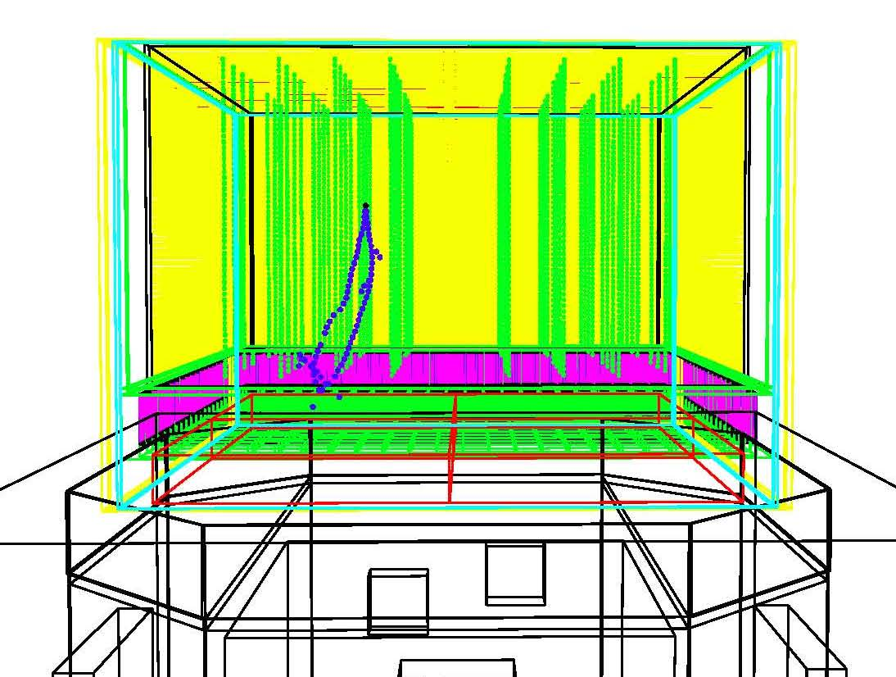
Performance assessment
e-ASTROGAM
10
e-ASTROGAM performance evaluated with MEGAlib (Zoglauer et al. 2006) and Bogemms (Bulgarelli et al. 2012) − both tools based on Geant4 − and a detailed numerical mass model of the gamma-ray instrument

Slide 11
Core science
e-ASTROGAM
11
Jet astrophysics: a unique link to new astronomies (gravitational waves, neutrinos, ultra-high energy cosmic rays)
The high-energy mysteries of the Galactic center region
Supernovae, nucleosynthesis and Galactic chemical evolution

Slide 12
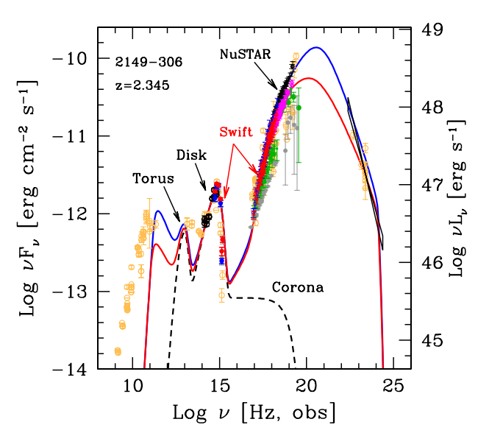
Core science topic #1
e-ASTROGAM
12
Jet astrophysics in the era of new astronomies
Launch of ultra-relativistic jets in GRBs? Ejecta composition, energy dissipation site, radiation processes?
Can short-duration GRBs be unequivocally associated to gravitational wave signals?
How does the accretion disk/jet transition occur around supermassive black holes in AGN?
Are BL Lac blazars sources of UHECRs and high-energy neutrinos?
PKS 2149-306 (z = 2.345)
e-ASTROGAM
With its wide field of view, unprecedented sensitivity over a large spectral band, and exceptional capacity for polarimetry, e-ASTROGAM will give access to a variety of extreme transient phenomena

Slide 13
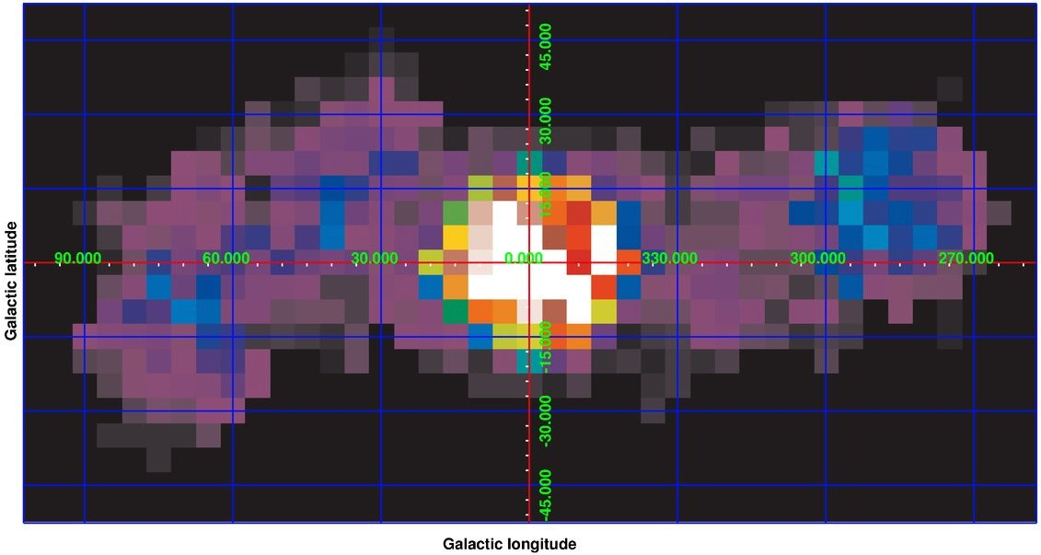
Core science topic #2
e-ASTROGAM
13
The high-energy mysteries at the Galactic Center
Origin of the Fermi Bubbles and of the 511 keV emission from the Galaxy’s bulge? Are these linked to a past activity of the central supermassive black hole? What is causing the GeV excess emission from the center region?
With a sensitivity and an angular resolution in the MeV − GeV range significantly improved over previous missions, e-ASTROGAM will enable a detailed spectro-imaging of the various high-energy components
INTEGRAL/SPI − 511 keV (Bouchet et al. 2010)
Fermi/LAT
E > 1.7 GeV
INTEGRAL/SPI
e-ASTROGAM FWHM

Slide 14
Core science topic #3
e-ASTROGAM
14
Supernovae, nucleosynthesis, and Galactic chemical evolution
How do thermonuclear and core-collapse SNe explode? How are cosmic isotopes created in stars and distributed in the interstellar medium?
With a remarkable improvement in γ-ray line sensitivity over previous
missions, e-ASTROGAM should allow us to finally understand the progenitor system(s) and explosion mechanism(s) of Type Ia SNe (⁵⁶Ni, ⁵⁶Co), the dynamics of core collapse in massive star explosions (⁵⁶Co, ⁵⁷Co), and the history of recent SNe in the Milky Way (⁴⁴Ti, ⁶⁰Fe...)
(adapted from Diehl et al. 2015)

Slide 15
BL Lacs
Other/Unknown
Radio Lobes
>1000 sources expected with e-ASTROGAM
Central Engine
FSRQs
Blazars
Radio Galaxies
Sgr A*
Solar Flares
Supermassive Black Holes
Unidentified
Short
Solar System
Gamma-Ray Bursts
Terrestrial γ-Ray Flashes
Gamma-Ray Source Classes
Satellite Galaxies
Long
Core-collapse
Supernovae
Milky Way
Starburst Galaxies
Globular Clusters
Thermonuclear
Supernova Remnants
Interstellar Medium
Stellar Objects
Galaxy’s Bulge
Colliding Winds
Magnetars
Pulsars
Binary Systems
Neutron Star binaries
Superbubbles
Molecular Clouds
Star-forming Regions
Pulsar Wind Nebulae
Magnetospheric emission
Novae
Black Hole Binaries

Slide 16
Discovery space
e-ASTROGAM
16
Over 3/4 of the sources from the 3rd Fermi LAT Catalog (3FGL), 2415 sources over 3033, have power-law spectra (E_{γ} > 100 MeV) steeper than E_{γ}⁻², implying that their peak energy output is below 100 MeV
These includes more than 1200 (candidate) blazars (mostly FSRQ), about 150 pulsars, and nearly 900 unassociated sources
Most of these sources will be detected by e-ASTROGAM ⇒ large discovery space for new sources and source classes
Notes:
Flat Spectrum Radio Quasars = most distant and energetic LAT sources
Unassociated (unidentified) sources => large discovery space

Slide 17









Collaboration
e-ASTROGAM
Principal investigator: Alessandro De Angelis (INFN, Italy)
INFN, INAF, University Tor Vergata, University of Udine
CSNSM, IRAP, APC, CEA, LLR, LUPM, IPNO
Univ. Mainz, Univ. Wuerzburg, MPE, RWTH, DESY, Univ. Erlangen
ICE (CSIC-IEEC), IMB-CNM (CSIC), IFAE-BIST, Univ. Barcelona
University College Dublin, DIAS
DTU
University of Geneva
Jagiellonian University, CBK, NCAC
NASA GSFC, NRL, Clemson Univ., Washington Univ., Yale Univ., UC Berkeley
Ioffe Institute
University of Tokyo

Slide 18
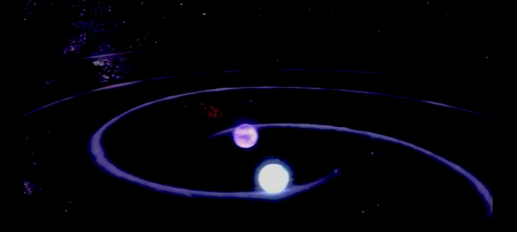
Conclusions
e-ASTROGAM
18
The MeV / sub-GeV gamma-ray band is potentially one of the richest energy domain of astronomy
e-ASTROGAM will be an essential observatory to study the extreme transient sky at the era of astronomy’s new messengers
The e-ASTROGAM payload is innovative in many respects, but the technology is ready

