Slide 1
AGILE: a Resilient and Evolving ASI Small Mission

Slide 2
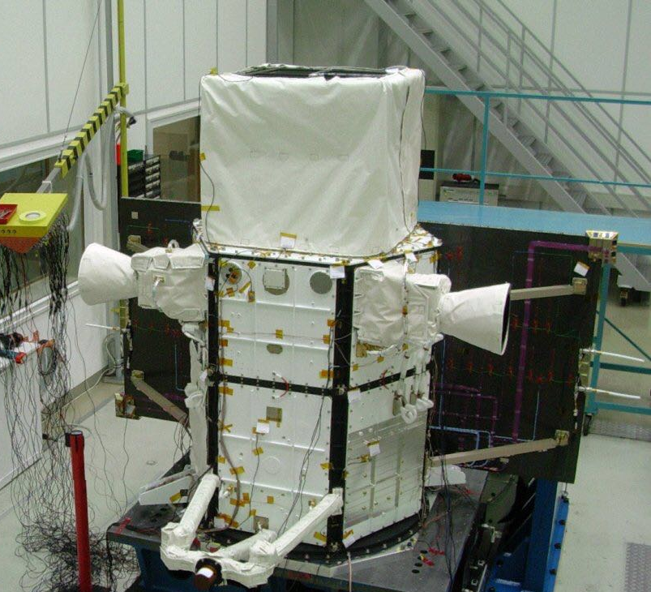

Agile
10 Years, 3653 Days in Orbit

Slide 3




