Slide 1
1ES 1011+496 – The 2012 data stacking problem
C. Schultz, S. Paiano, P. da Vela

Slide 2
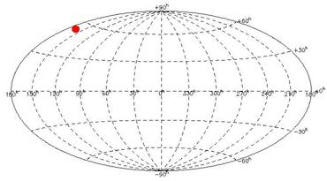
Source details
HBL
z=0.212
2006 Observations
  ULs (Albert et al. 2008, Aleksic et al. 2011)
MAGIC source (Albert et al. 2007)
  Optical outburst
MWL campaign in 2008 (Reinthal et al. 2012)
Stereo observations in 2011
  Missed 5 σ
Reobservations in 2012
  MWL campaign

Slide 3
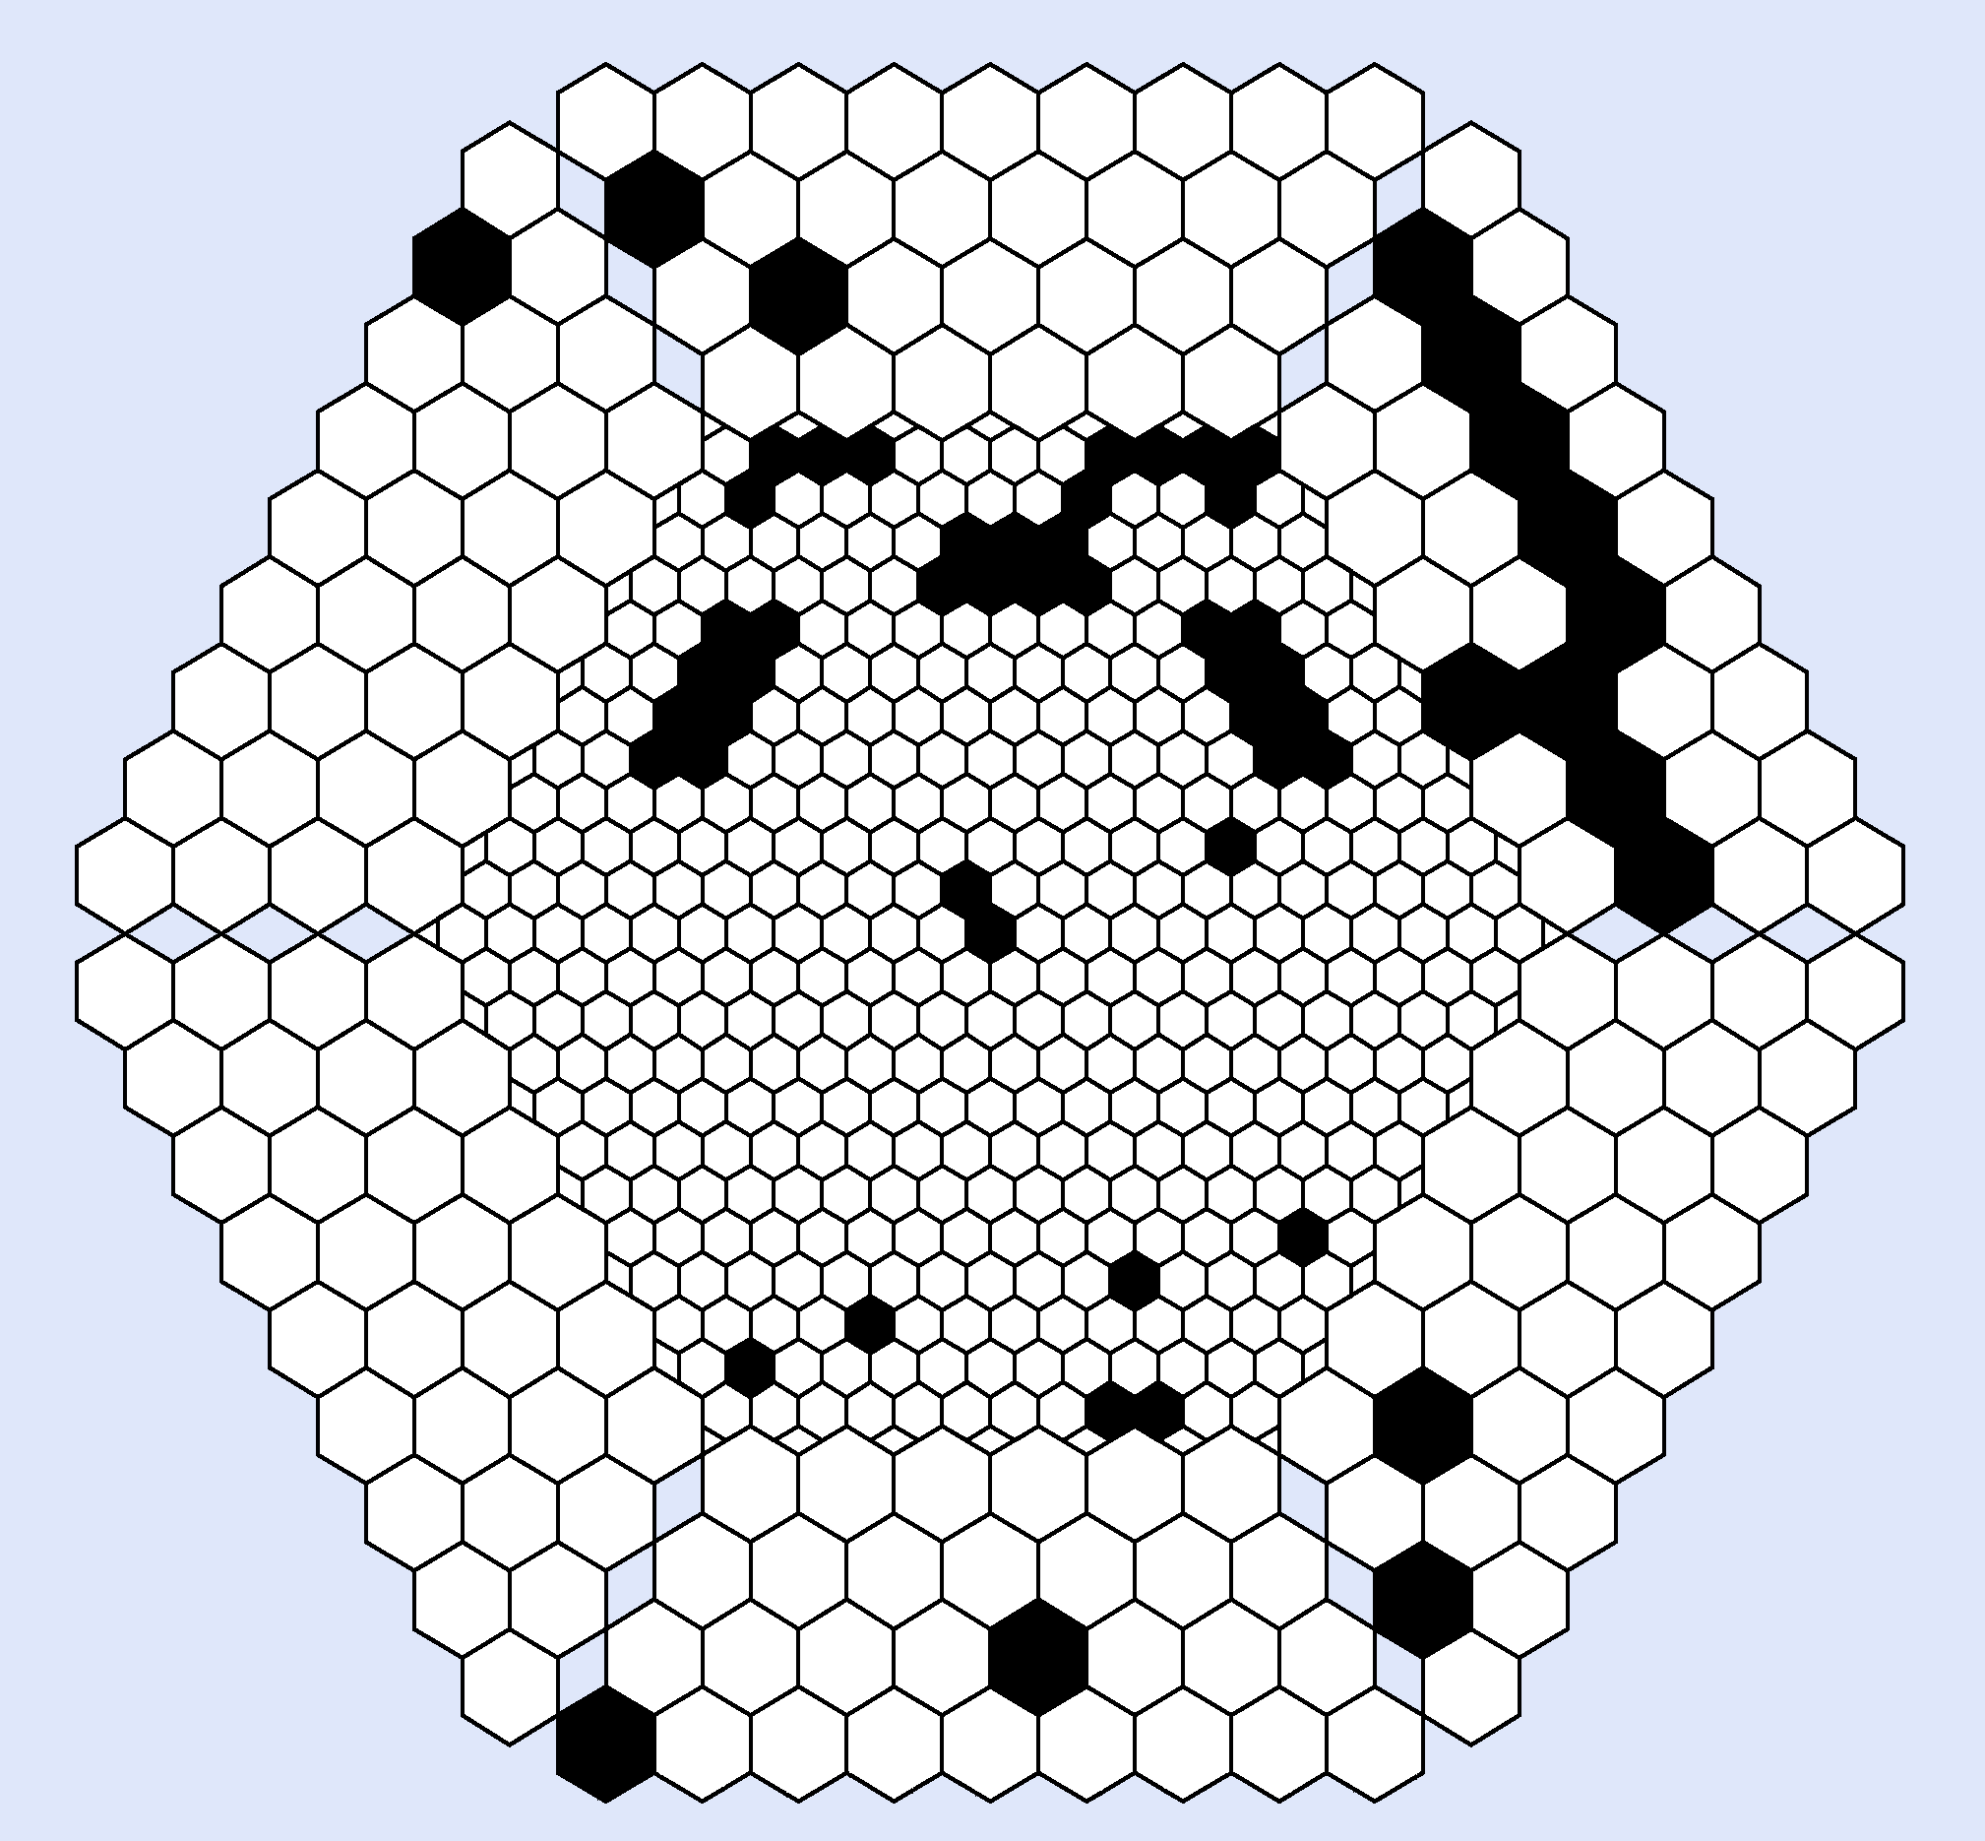
2012 Observations
Right after first phase of the Upgrade
  DRS4 installed in M I and M II readout system
  Commissioning phase
    Missing trigger pattern until January 30th
      Time stamp used for superstar
    Calibration runs included in data files
      Additional cut (MNewImagePar.fconc>0.025)
Persistent hardware problems
  Wrong M I PSF due to bug in new AMC software (until March 9th)
  Holes in the MI camera (until February 25th)
Good data from March to May
Observations with 4 wobble positions
Only observations during dark night
Few nights discarded due to wrong focusing (January 28th & April 16th)

Slide 4
Dedicated MCs, OFF data and Crab Data
January to February
  MC: Holes bad PSF
  No Crab data before January 31th
  Difficulties to find similar OFF (Zd)
  Some data (M2) got lost when copied to PIC
  Changes in sorcerer
    Recalibration
    Restarification
High Rates
Low Rate

Slide 5
Dedicated MCs, OFF data and Crab Data
February to March
  Bad PSF
  Restarification

Slide 6
Dedicated MCs, OFF data and Crab Data
March to May
  “Standard”
  Restarification until April 5th
Unstable rate

Slide 7
Data Subsample Definition
January 23rd to February 25th
  One or two periods?
  MCs do not account for missing trigger pattern (until January 31st)
  No OFF data taken with same “conditions” in January
  No Crab sample taken
Paolo & I considered as one period
Simona considered two periods
  Problems to find matching OFF for January
    No covering for low Zd source data

Slide 8
OFF data
When possible, different OFFs
  January – February
    Cornelia: PKS 1222
    Simona: M87 (January) PKS 1222 (February)
    Paolo: SegueJ, PKS 1222, PKS 1510
  February March
    Cornelia: M87
    Simona: M87
    Paolo: 1ES 1011
  March May
    Cornelia: M87
    Simona: M87
    Paolo: SegueJ, PKS 1222, M87

Slide 9
RF approach
Cornelia & Paolo
  200 trees (only Cornelia)
  SelectMC
    Test/Train Sample (“write reject” option)
      A lot of MCs for training
      In the case of January and February few MC for the data analysis
Simona
  200 trees
    30% Test & 70% Training sample
Crab tests
  For all periods similar sensitivities in the FR (~0.8%) and LE (1.5%) range
  Crab spectrum well reproduced (despite few test data f same Zd range)

Slide 10
Signal Detection Plot Dilemma(Jungle!)
How many Offs?
  Source observed with 4 wobble positions but due to division into subsamples not equilibrated
    Large Normalization factor
    Except for February-March Period

Slide 11
Cornelia’s Zoo
    bka
January - February
February - March
March - April

Slide 12
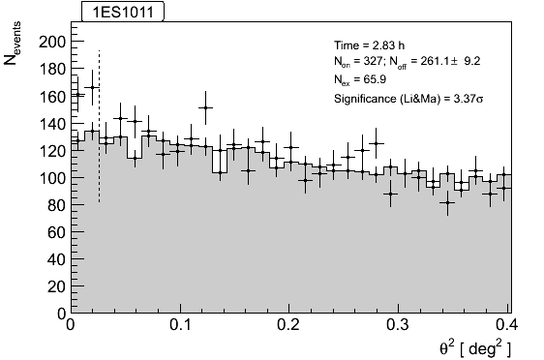
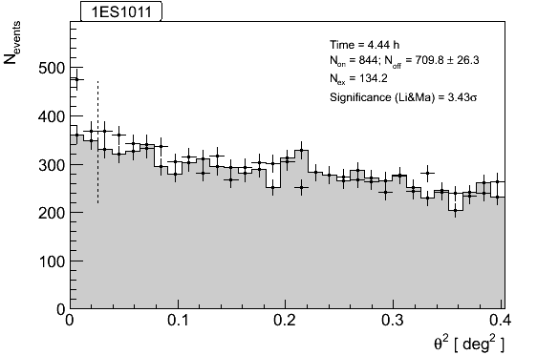
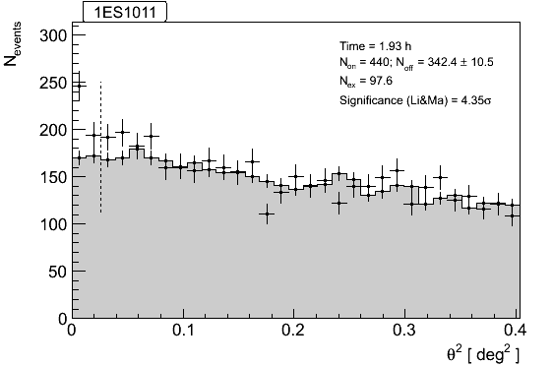
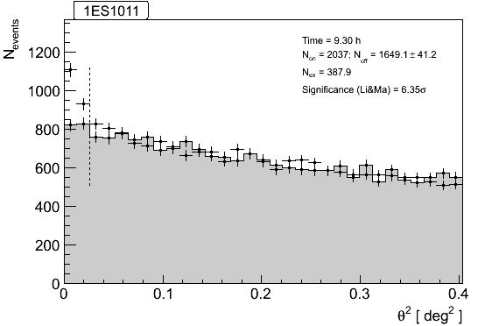
Simona’s Zoo
January
February
February - March
March - May

Slide 13
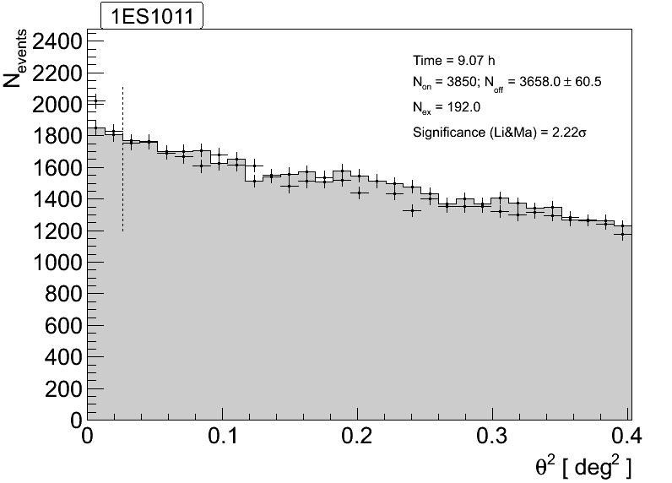
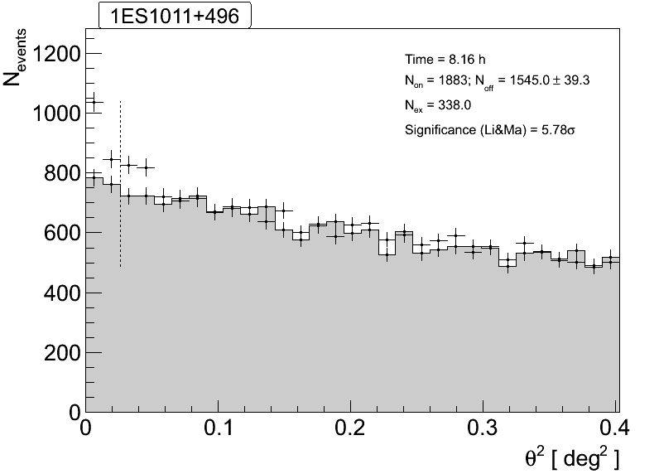
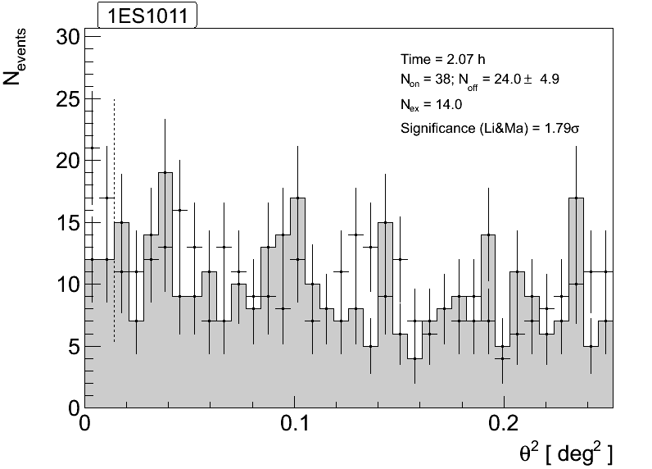
Paolos’s Zoo (LE, 1OFF)
January - February
February - March
March - May

Slide 14
Analysis Strategy
Signal search for subsamples & stacking
Light curve for each subsample
  Check that threshold is the same
Differential flux for subsamples & stacking
  Even if not detected !!!!!
  Is this the correct approach?

Slide 15
Analysis Summary
  Already Problem at Odie Level
    Do we have to agree among the different subsamples?
  As PI I will write to the SoBo to clarify the issue here (before writing a nice paper draft and finding ourselves in the unpleasant situation of reanalyzing everything at an advanced paper status)
Simona and Paolo as cross checkers do a very good job
  Light curves and spectra (partially) available
Should we use the January and February data for the final analysis
  “In my opinion yes since 1ES 1011*496 is known to have a very soft spectrum. Besides dedicated MCs have been provided so not doing the effort analyzing these data would mean to have wasted the time of someone else”
All the three of us have to update the wikipage

Slide 16
Very Preliminary “Stacking” Results
Since I had to finish my PhD Thesis. These results are not cross checked at all!
LE standard cuts plus f.conc>0.025 cut and 3 OFFs

Slide 17
Light curve above 150 GeV
Eth ~100 GeV, Checked on MCs assuming spectral slope of -4)
Januray
February
March

Slide 18
Quite Stable Light curve
Size > 50
1 Off
First nights of January effective time estimation fails
Large errors

Slide 19
Stacked Differential Spectrum
Binning adjusted according to March –May period (28)
After unfolding first data point slightly below Eth
  Overestimated!
    A lot of excess events but too small collection area
      Any solution I am not aware of?
      Detailed spectrum but not extended. EBL study potential?
      Binning not optimized: Too few data points for fit.

Slide 20
MWL Coverage 2011 & 2012
2011

Slide 21
MWL Coverage 2011 & 2012
2012

Slide 22
Source Variability
Rather stable in HE and VHE gamma-rays
Clearly variable in X-rays and in the optical regime
Very stable in radio band
MWL correlation studies might be worth it
First optical polarimetry data
  Very low degree of polarization
  Interpretation of data by Ulisses in combination with MOJAVE multiepoch radio maps still ongoing

Slide 23
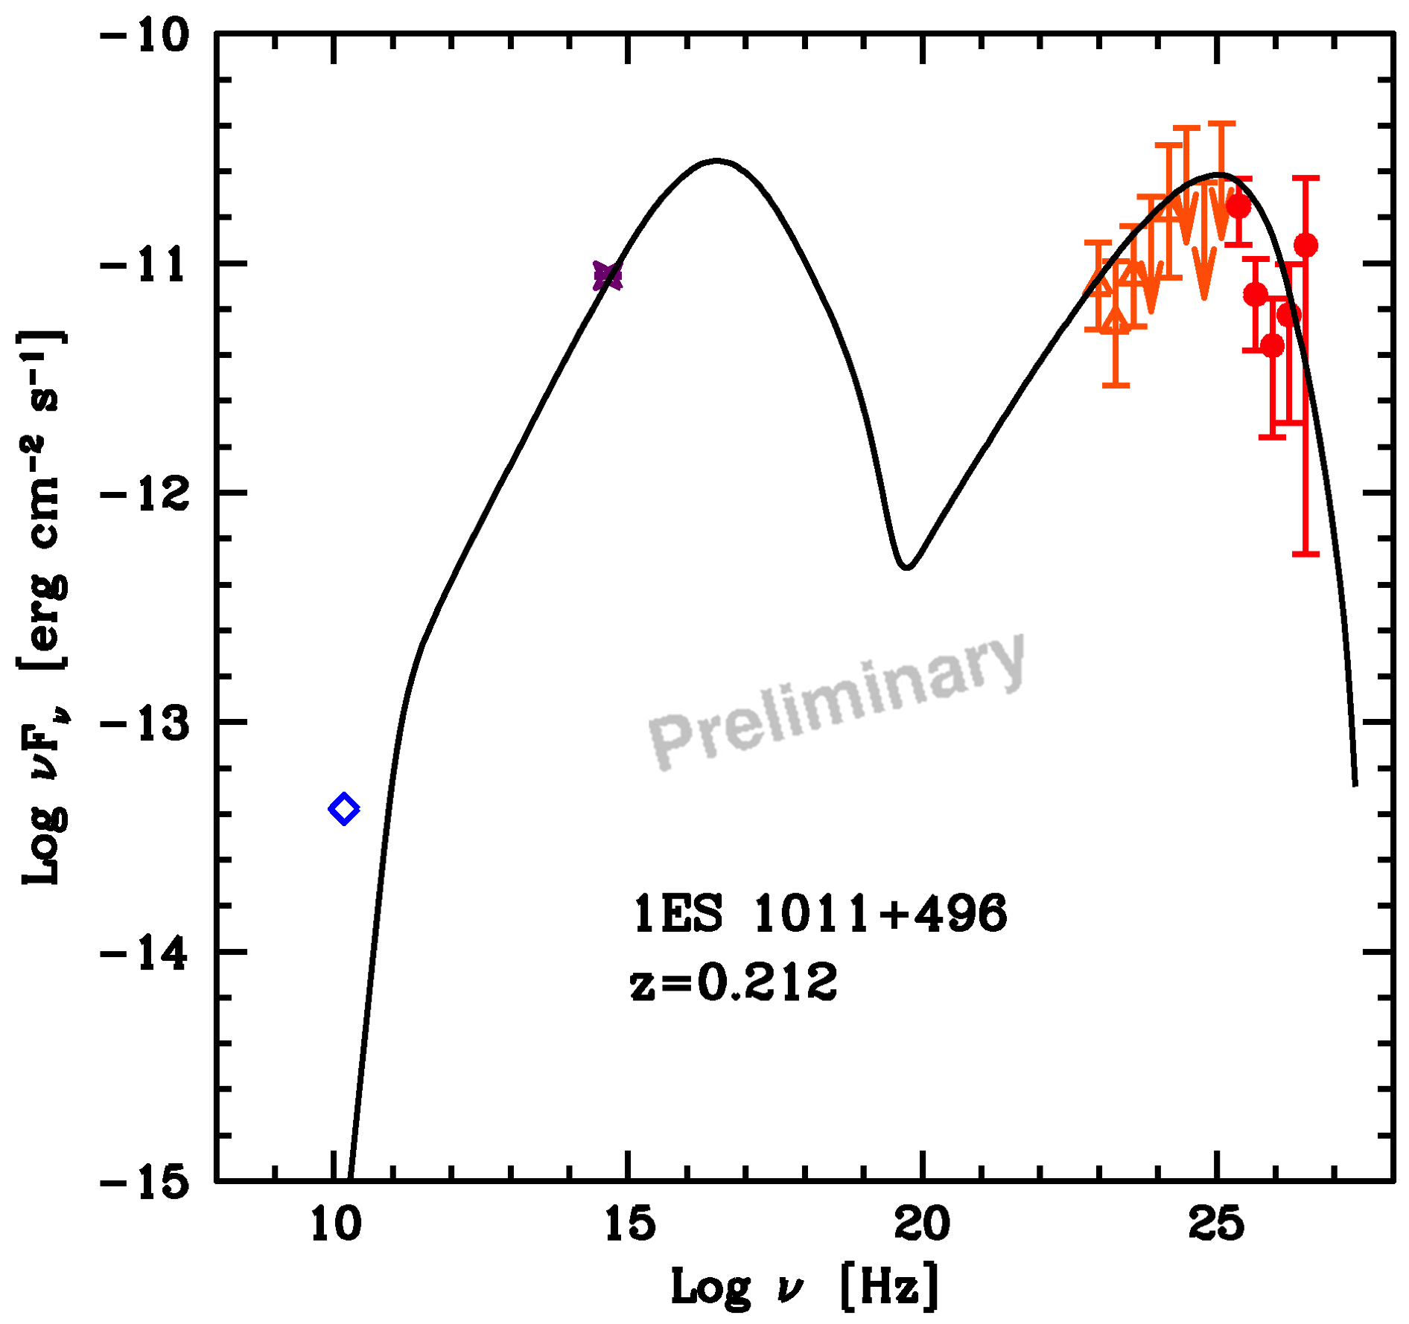
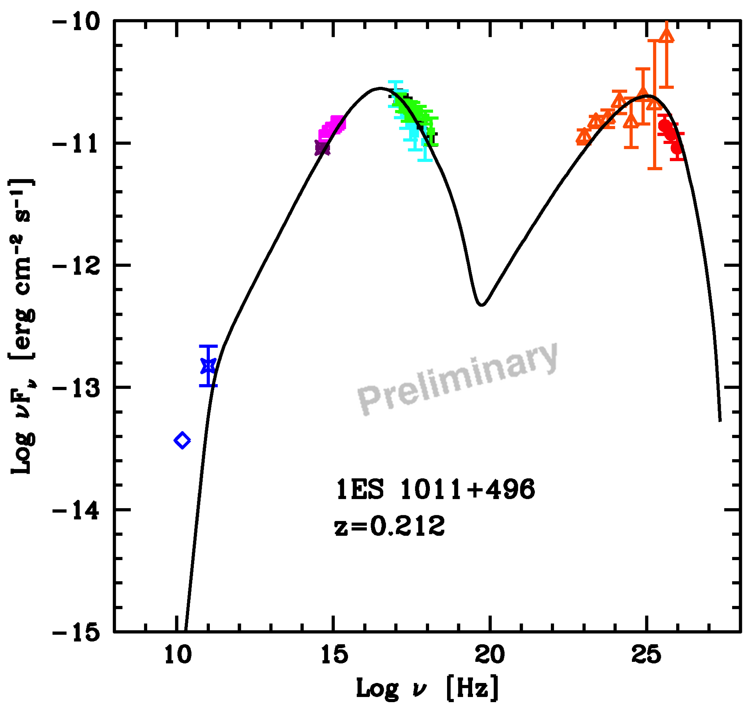
SED 2011 & 2012
Typical HBL fit parameters
First detailed coverage of the IC peak

Slide 24
Summary and Outlook
2012 data are very promising
  EBL studies
Very good MWL coverage of the source
  MWL correlation studies
  Detailed IC peak coverage
    For the first time simultaneously with Fermi
First optical polarimetry data
We would like to present some of the results at the ICRC
  But are we in time?
The inclusion of 2011 data might be difficult to justify
  No source detection

Slide 25
Thank You

