Slide 1
IGMF with MAGIC
A feasible key-project for MAGIC
Proposers: A. Stamerra, F. Tavecchio
Contribution: P. Da Vela, A. Neronov

Slide 2
Inter Galactic Magnetic Field (IGMF)
The problem of 1-10 μG magnetic fields in galaxies and galaxy clusters is one of the long-standing problems of astrophysics and cosmology.
Possible amplification mechanisms of week “seed” fields
This seed fields were never detected
How MAGIC can contribute to solve this puzzle?

Slide 3
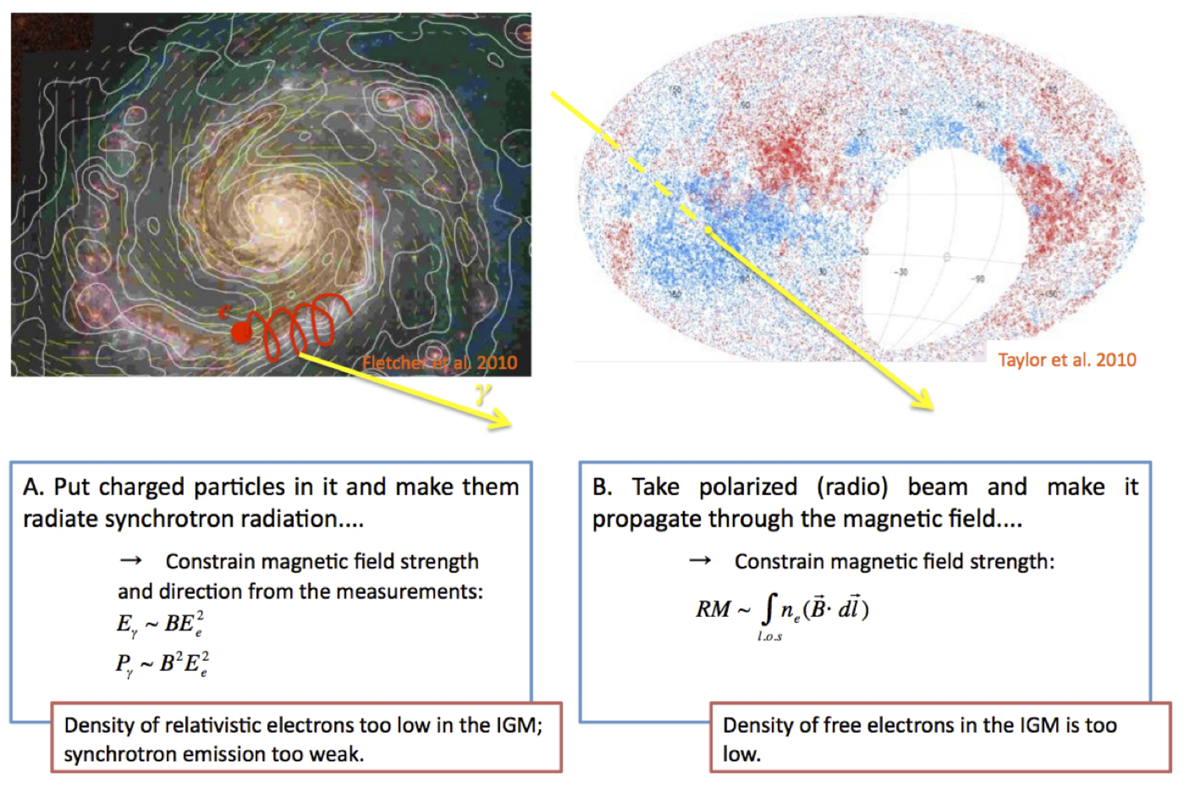
How to measure magnetic fields
extacted from Neronov 2012 IAU XXVIII

Slide 4
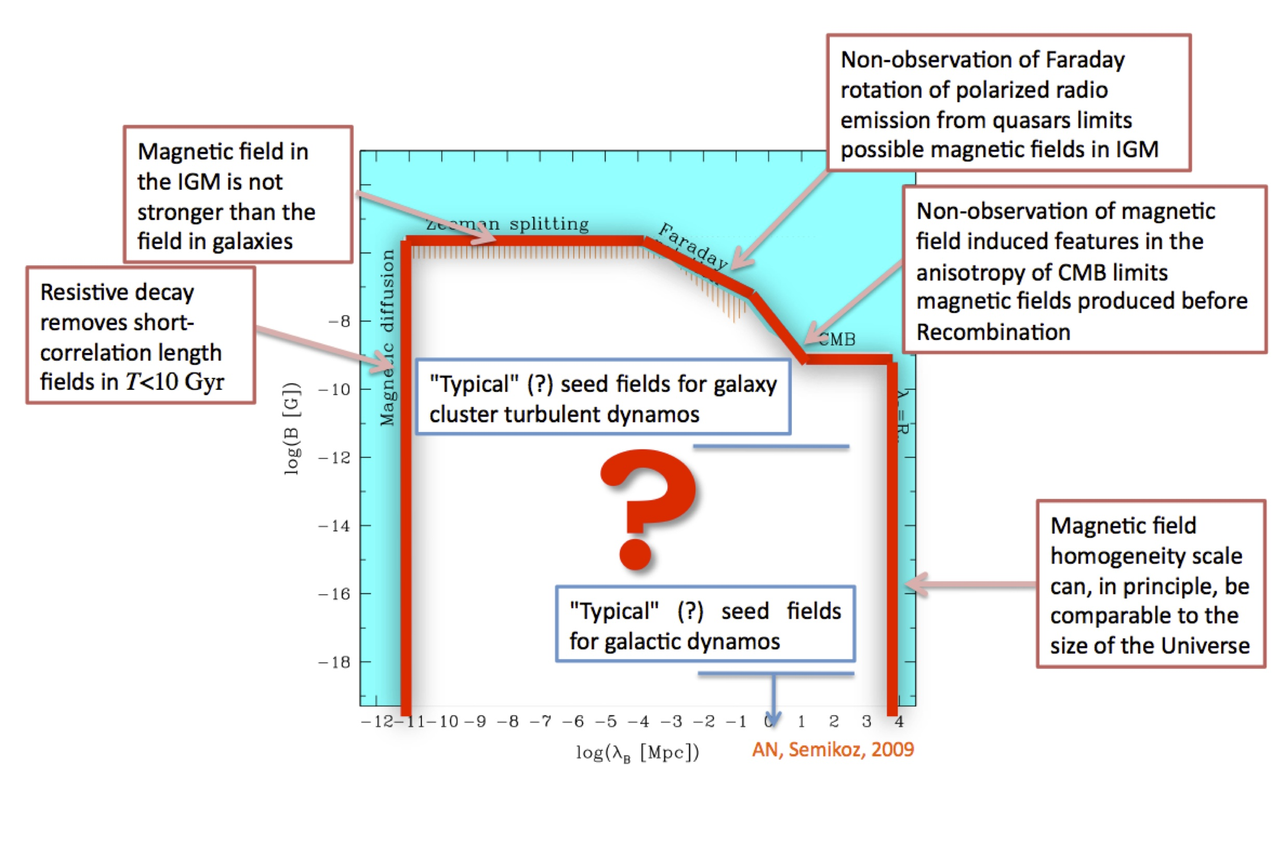
Limits on IGMF
extacted from Neronov 2012 IAU XXVIII

Slide 5
Limits on IGMF with MAGIC
Reprocess of TeV photons in the GeV band
spectral features
Extended emission
CMB
EBL
γ_{GeV}
γ_{TeV}
e⁺ e⁻
γ_{TeV}
IGMF

Slide 6
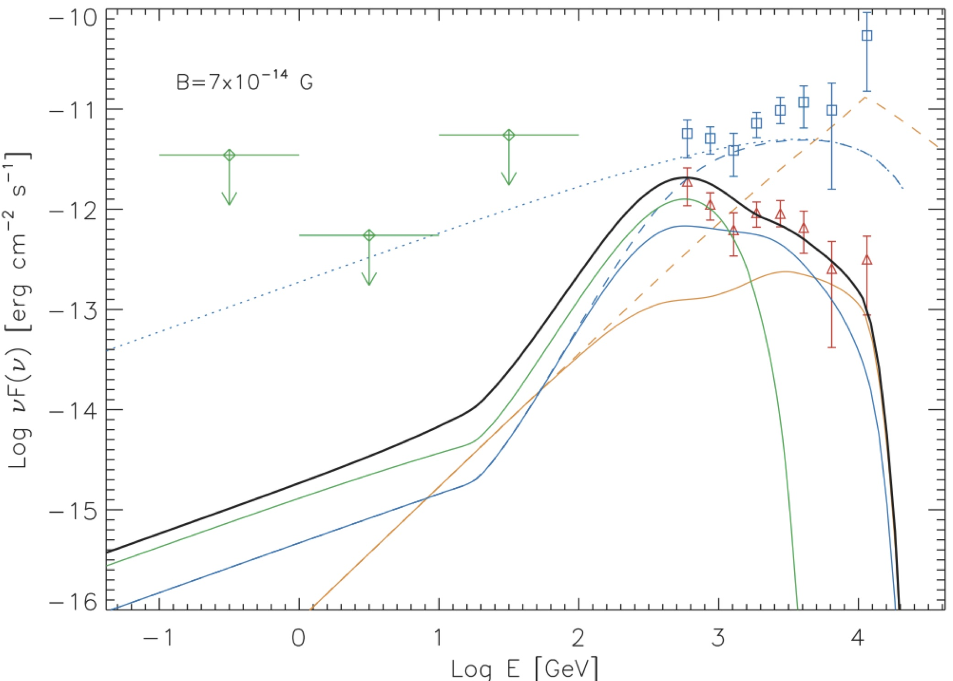
Limits on IGMF with MAGIC
Reprocessing of TeV photons in the GeV range:
A primary VHE gamma photon coming from a distant point source interacts with EBL producing pairs. Via Inverse Compton with CMB secondary gamma rays are produced:
Tavecchio et al. 2010, Neronov&Semikoz 2009
no IGMF
intrinsic
1ES0229+200

Slide 7
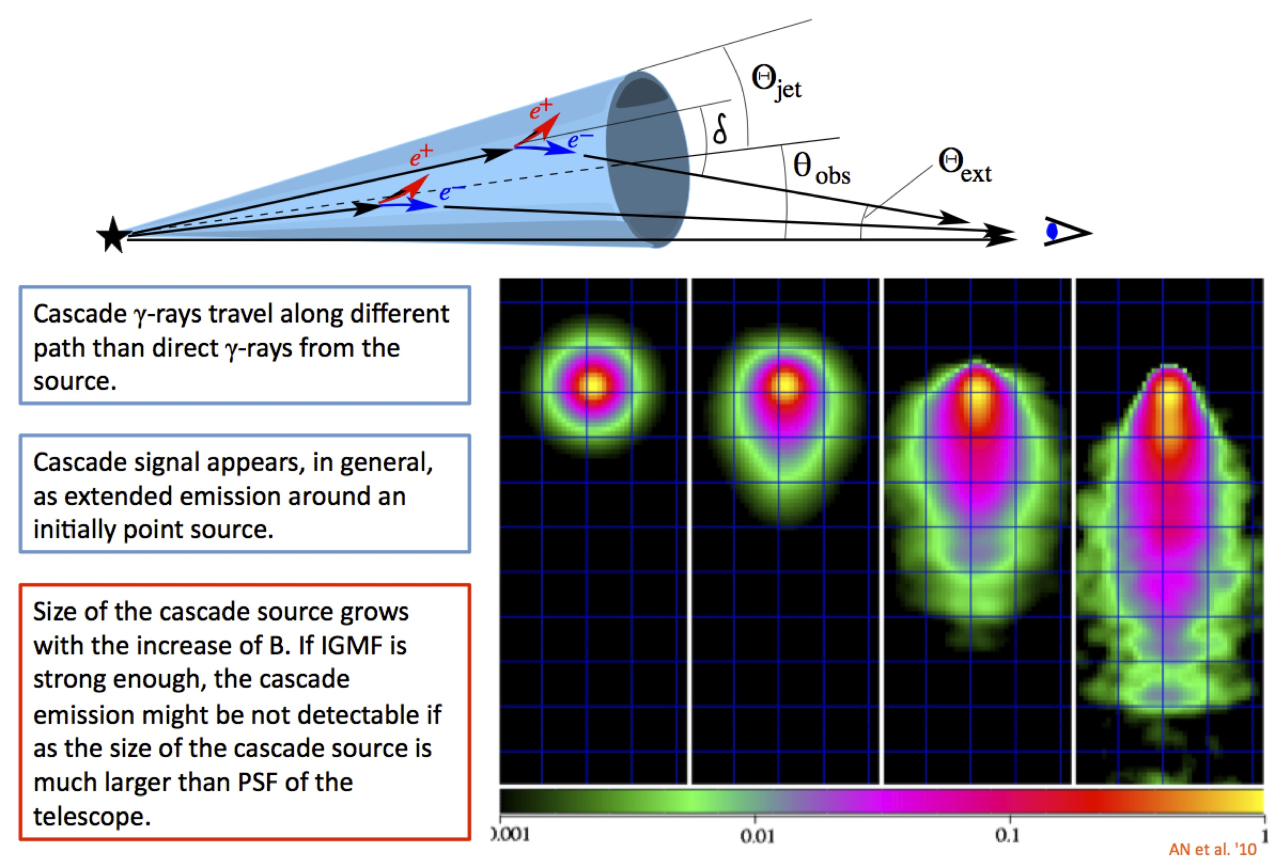
Limits on IGMF with MAGIC
Observable effect: IGMF deflects pairs → extended emission around the point source.

Slide 8
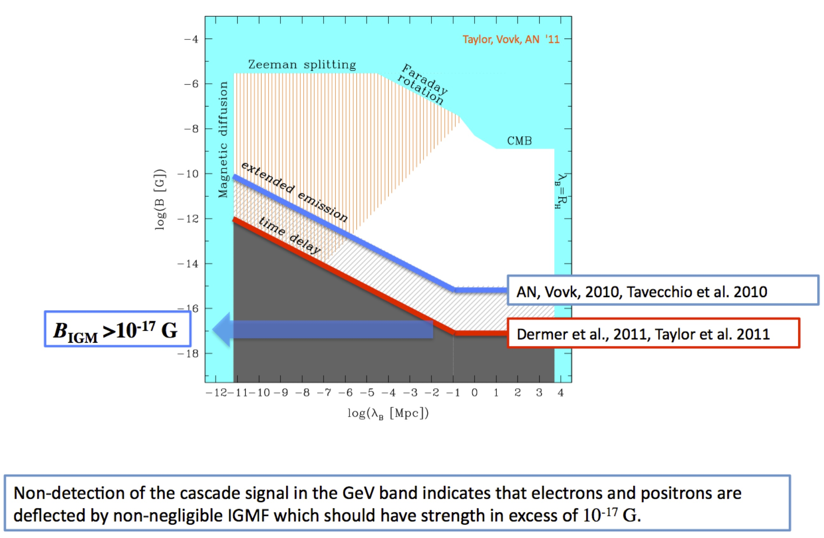
Limits on IGMF from TeV-GeV
extacted from Neronov 2012 IAU XXVIII

Slide 9
Search for an extended VHE gamma ray emission from an extragalactic source: a way to constrain the IGMF
Paolo Da Vela
Antonio Stamerra, Andrii Neronov

Slide 10
Markarian 421 and 501
The search of the halo around a point source was already performed by MAGIC for Mrk 421 and Mrk 501.
In that case mono data were used.
These results can be improved because:
  stereo data
  better sensitivity
  better angular resolution
  lower energy threshold
In the future the situation can be even better taking advantage of the improved angular resolution of the upgraded MAGIC system

Slide 11
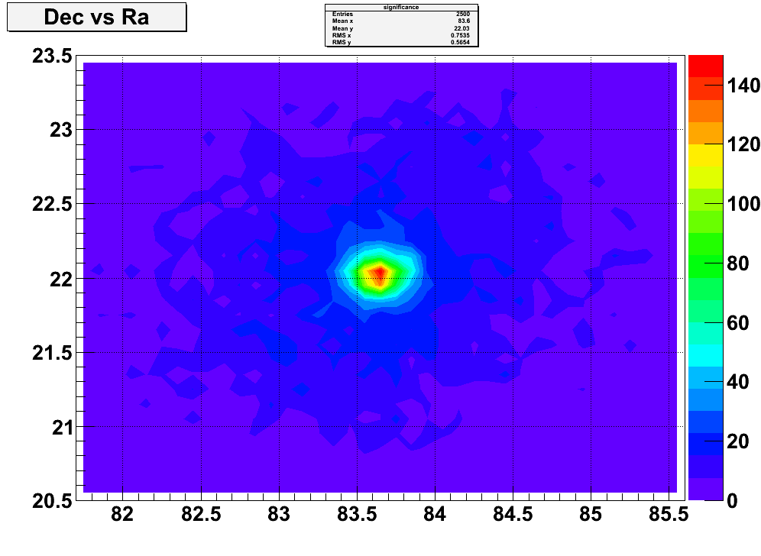
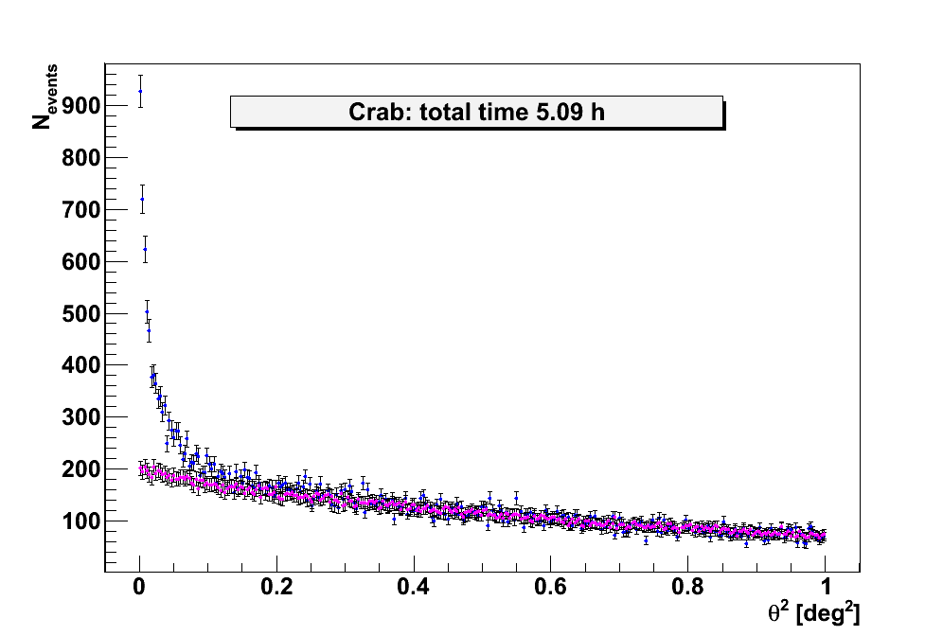
Possible strategies to detect the halo
We indentified two main ways to detect an extended emission
“Theta Square” approach:
Get a good model of PSF
Rescale the PSF to the spectrum of the source
Test different shapes of halo and convolve them with PSF
Compare the “simulated” theta squared with observed one
“Sky Map” approach:
Get a gamma-like count map
Get a background map
Rescale the background map to the gamma-like map
Perform a significance map

Slide 12
Extended emission: summary
What is the best approach? We are still working to answer to this question…in any case it is clear that:
For both approaches it is crucial to know which is a good model for the real PSF (a deep study on this topic is needed!)
If we want to detect a halo It is very important to understand the beahviour of the background.
The study of extended emission is an important skill to constrain the IGMF.
Once we optimized the general procedure it will be very interesting to apply it to different sources (different redshift) to explore different regions of the exclusion plot.
Comments and suggestions are very welcome!

