Slide 1
The present and the future in VHE gamma rays:
MAGIC and CTA
Stamerra
INAF – Torino
INFN – Pisa e INFN-Torino

Slide 2

What have we learned on AGNs from VHE observations?
The goals:
VHE sources/population studies
VHE emission processes
Jet physics
EBL / IGMF
UHE cosmic rays
Hints of new physics

Slide 3
What have we learned on AGNs from VHE observations?
The tools:
VHE spectra
MWL SED
Variability
Multi-band correlations / lags

Slide 4
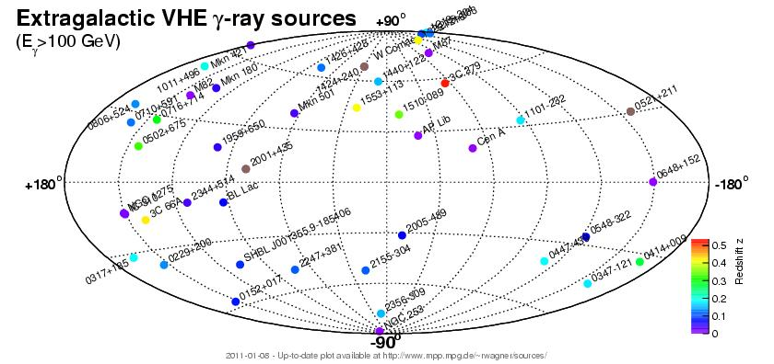
The VHE sky
53 extragalactic sources
  29 detected by MAGIC (15 discovered)

Slide 5
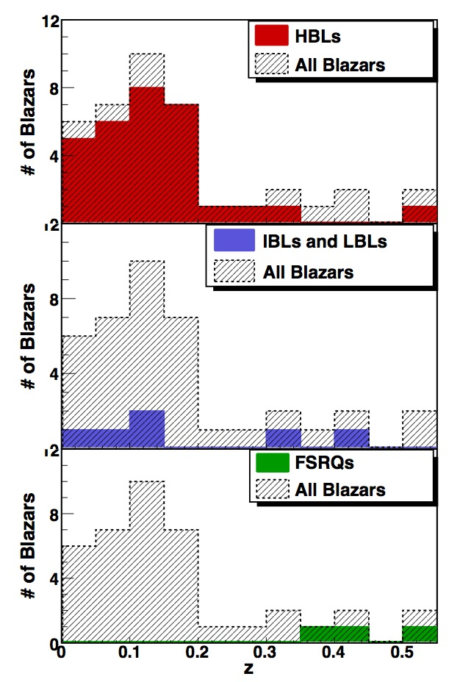
Populations
Sentürk et al. 2013
39 HBLs
8 IBL/LBL
3 FSRQ
3 RG (FRI)
High selection bias
TeV AGNs

Slide 6

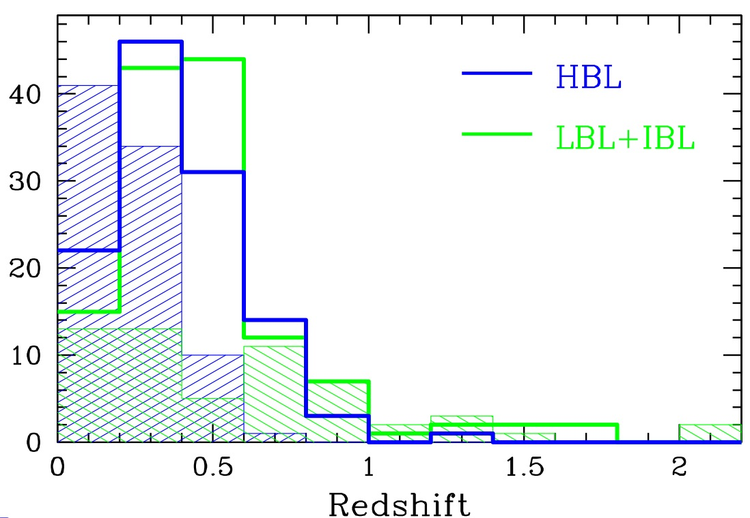
Populations
Sentürk et al. 2013
39 HBLs
8 IBL/LBL
3 FSRQ
3 RG (FRI)
High selection bias
TeV AGNs
0.23 0.33
Fermi/LAT
known z
lower z
Shaw et al. 2013

Slide 7
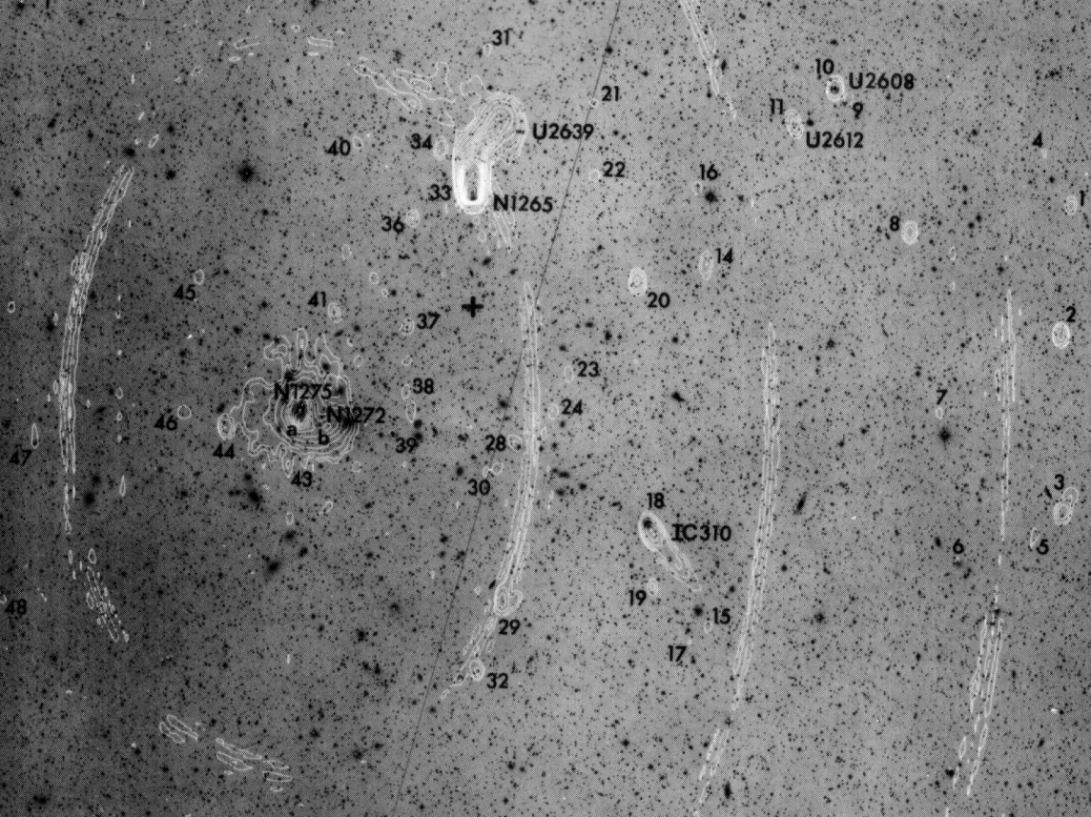
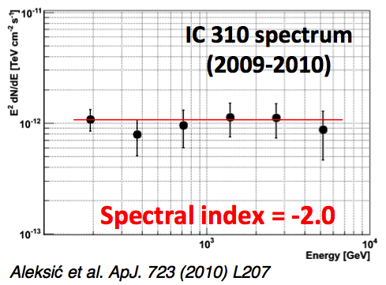
The unexpected guest
IC 310: a radio-tail galaxy emitting TeV?
MAGIC detection
a flat GeV-TeV peak

Slide 8
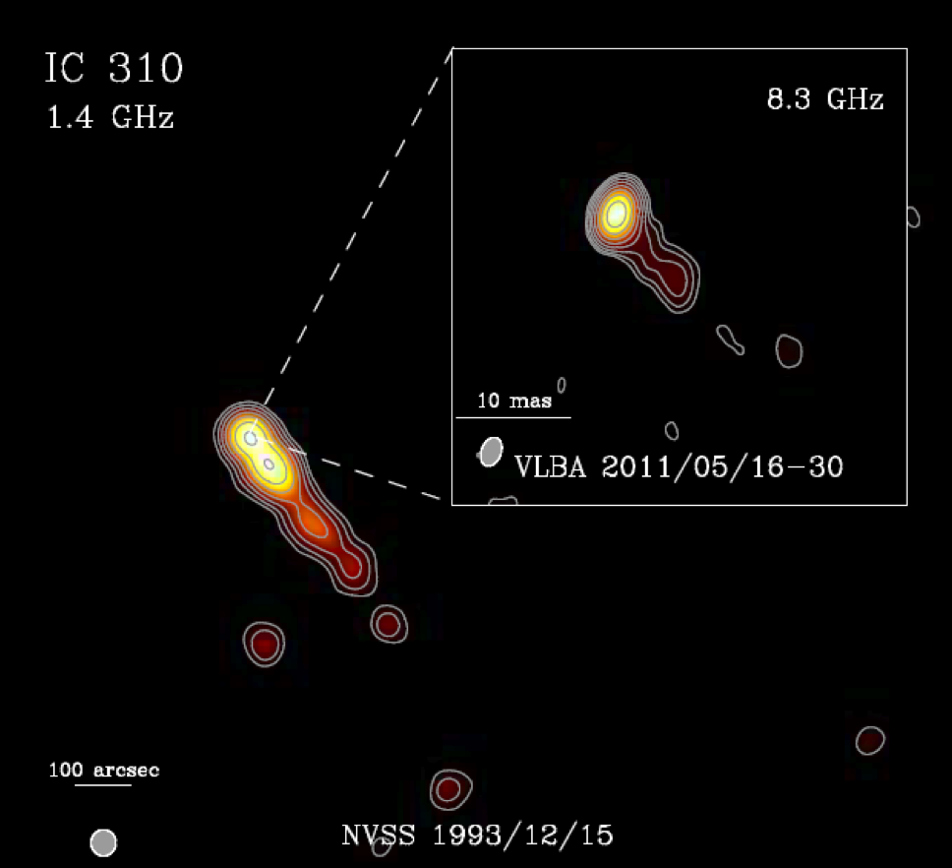
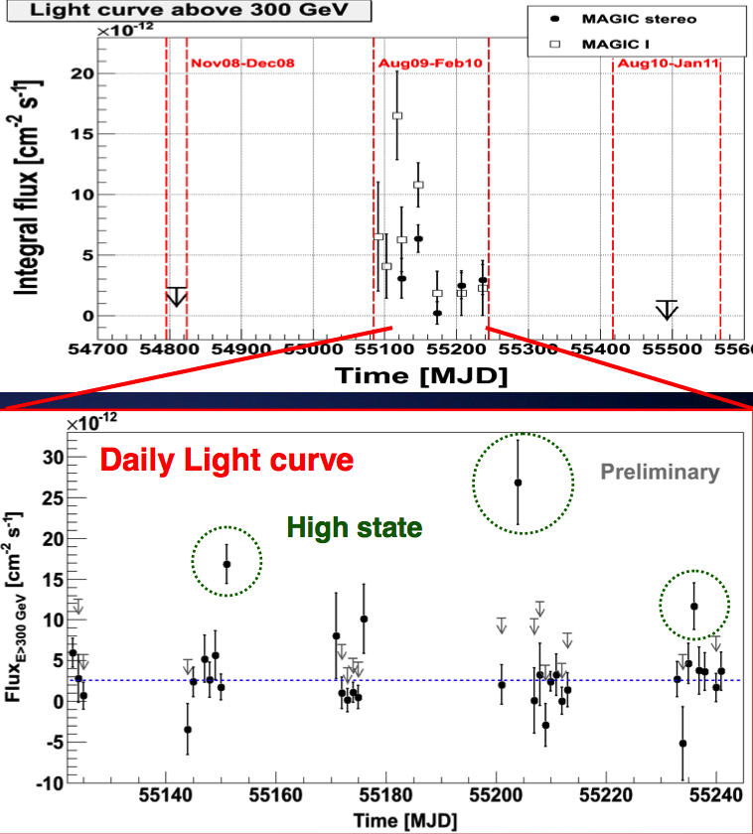
The unexpected guest
A blazar structure
jet angle <30 deg
TeV variability
Kadler et al. 2012
MAGIC coll.
A&A 539 (2012)
ApJL 723 (2010)
Gamma2012 - Heidelberg
Notes:
The variability rules out the emission from a bow-shock within the cluster (Neronov 2010); the blazar radio morphology suggests emission tpical of TeV blazars. But the flat Gev-TeV SED challenges the leptonic models.

Slide 9
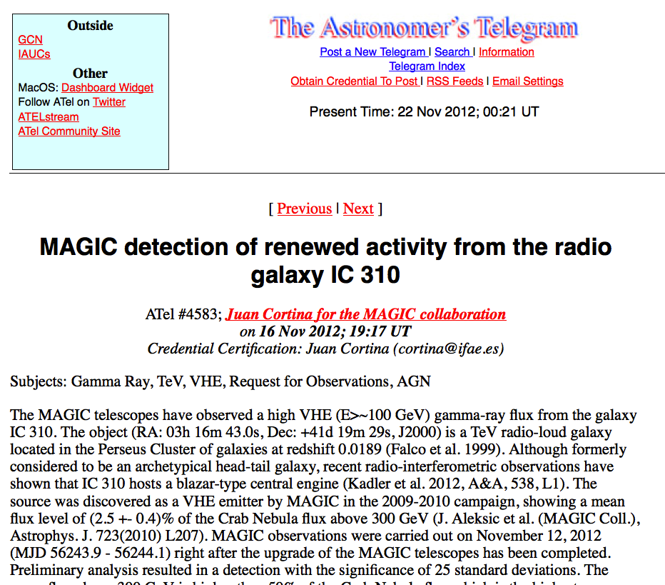
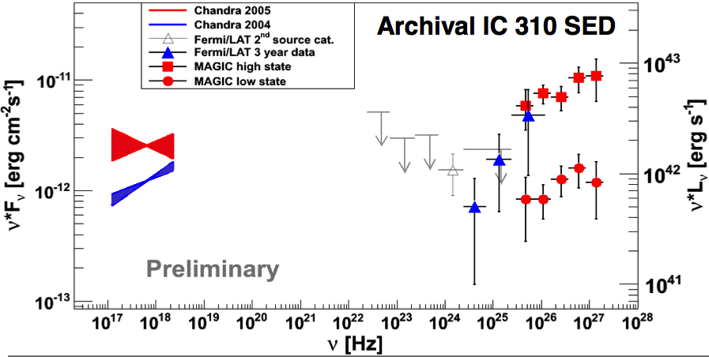
The unexpected guest
A blazar structure
jet angle <30 deg
TeV variability
IC 310 is a blazar!
an extreme one...
Notes:
The variability rules out the emission from a bow-shock within the cluster (Neronov 2010); the blazar radio morphology suggests emission tpical of TeV blazars. But the flat Gev-TeV SED challenges the leptonic models.

Slide 10
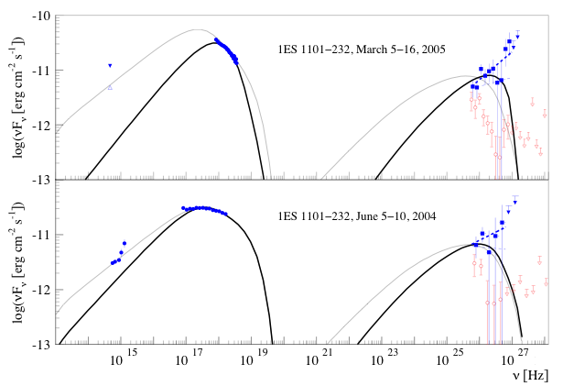
Extreme blazars
“Extreme” blazars: (too) hard TeV spectra
IC peak at ~TeV range
1ES 1101-232 z=0.186
simultaneous (days)
1 TeV
HESS coll. A&A 2007
Notes:
SSC crisis came first with distant objects; the intrinsic VHE spectrum deabsorbed could not easily described within a SSC model. Does it address a SSC problem or a poor knowledge of the EBL emission? Or some exotic explanations (axions...)?
For 1ES0414 an IC peak energy above 1-2 TeV– are difficult to explain in the framework of a pure one-zone SSC model, unless using unusual values for the main parameters.

Slide 11
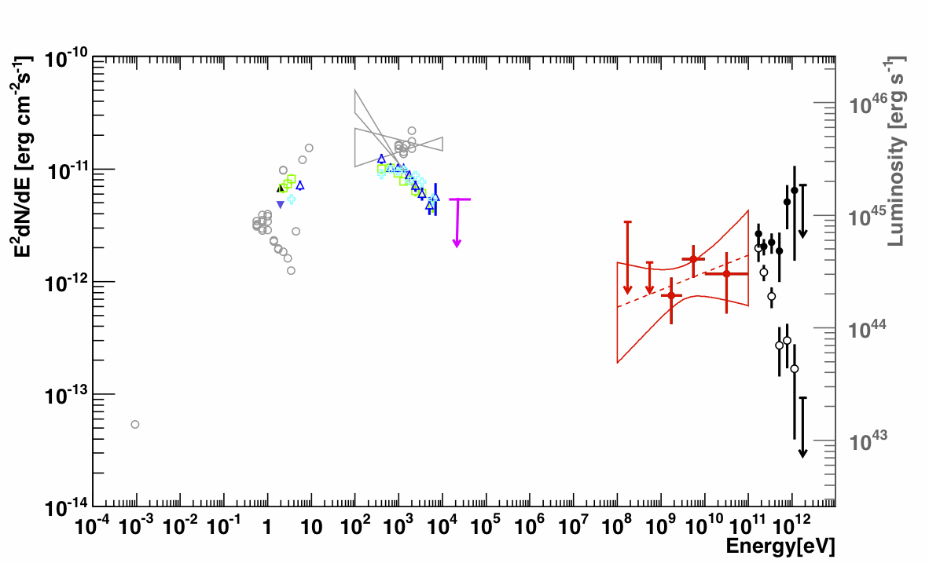

Extreme blazars
“Extreme” blazars: (too) hard TeV spectra
IC peak at ~TeV range
K-N effects
particle acceleration limits
1ES 0414+009 z=0.287
averaged SED
HESS coll. 2012
arXiv:1201.2044
Notes:
SSC crisis came first with distant objects; the intrinsic VHE spectrum deabsorbed could not easily described within a SSC model. Does it address a SSC problem or a poor knowledge of the EBL emission? Or some exotic explanations (axions...)?
For 1ES0414 an IC peak energy above 1-2 TeV– are difficult to explain in the framework of a pure one-zone SSC model, unless using unusual values for the main parameters.

Slide 12
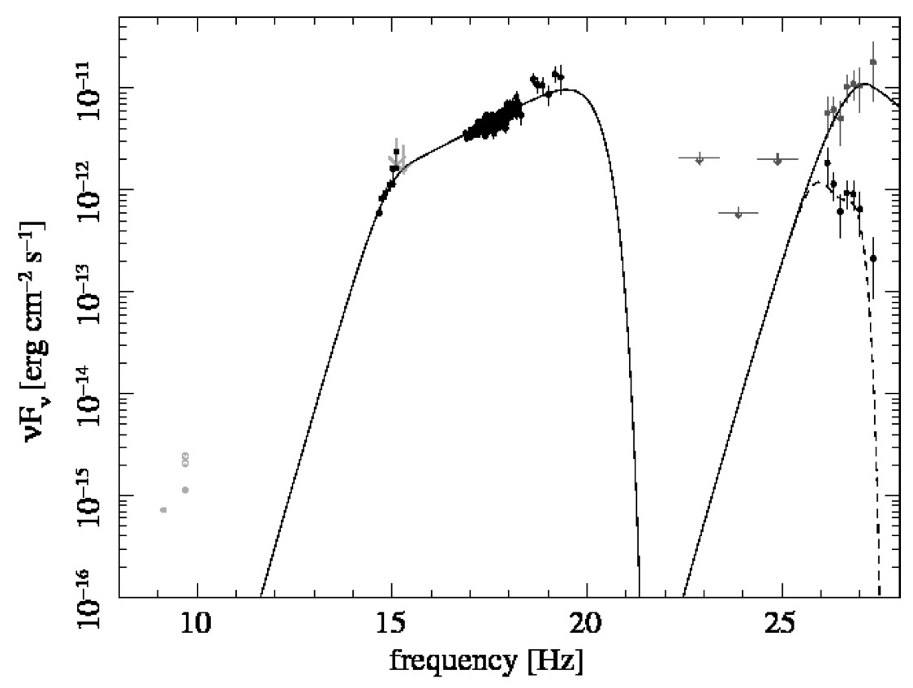
Extreme blazars
“Extreme” blazars: (too) hard TeV spectra
IC peak at ~TeV range
K-N effects
particle acceleration limits
1ES 0229+200 z=0.14
α=−1/3
α=−1/3
see Katarzyn ́ski et al. 2007, 2011
Tavecchio et al. 2009
Kaufmann et al. 2011
Notes:
SSC crisis came first with distant objects; the intrinsic VHE spectrum deabsorbed could not easily described within a SSC model. Does it address a SSC problem or a poor knowledge of the EBL emission? Or some exotic explanations (axions...)?
For 1ES0414 an IC peak energy above 1-2 TeV– are difficult to explain in the framework of a pure one-zone SSC model, unless using unusual values for the main parameters.

Slide 13
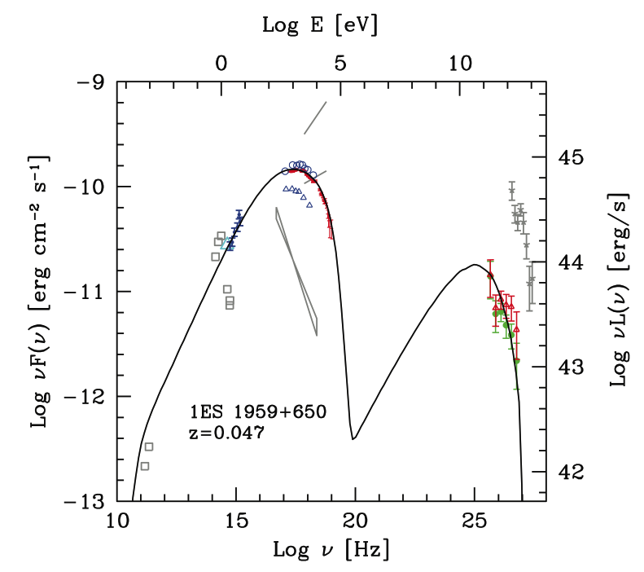
Emission process / Jet
A well-known nearby HBL
SED prior to Fermi/LAT compatible with
single-zone SSC emission
SSC model prior to Fermi/LAT
Tagliaferri et MAGIC coll. 2009
Notes:
The XXX HBL has been observed for a long period; no evidence of high activity was found; the SED should describe a stationary state. Nonetheless a plateu in the GeV region is visible which does not fit any single zone model. On the other hand multi-zone models are not really justified.
A suggestive connection can be drawn with the SED measured on the Tycho SN remnant, which fits the hadronic scenario (Giordano et al 2011).

Slide 14
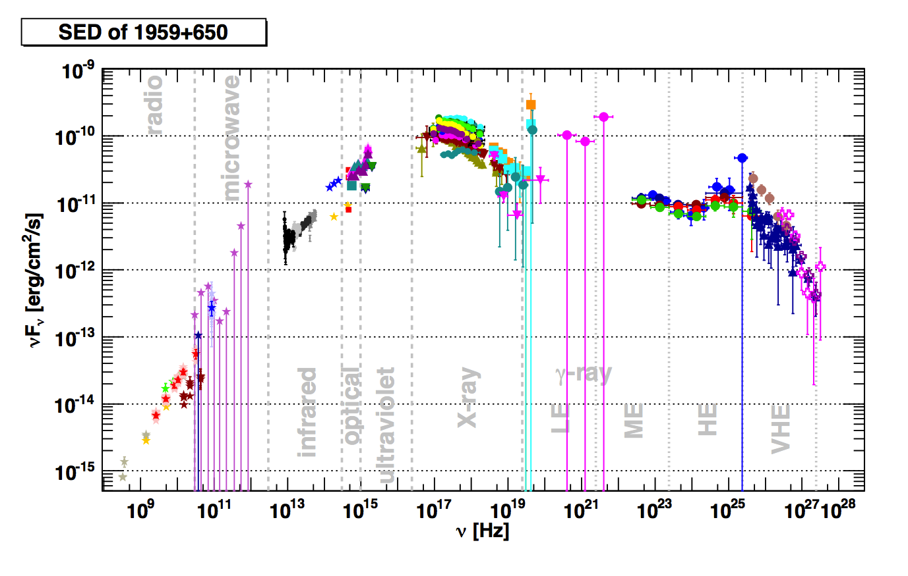
Emission process
A “standard” blazar (no EBL fx, no hardTeV,....)
HBL CERTIFIED
1ES 1959+650 z=0.05
Credit: M. Backes, PhD thesis
http://hdl.handle.net/2003/29464
Notes:
The XXX HBL has been observed for a long period; no evidence of high activity was found; the SED should describe a stationary state. Nonetheless a plateu in the GeV region is visible which does not fit any single zone model. On the other hand multi-zone models are not really justified.
A suggestive connection can be drawn with the SED measured on the Tycho SN remnant, which fits the hadronic scenario (Giordano et al 2011).

Slide 15
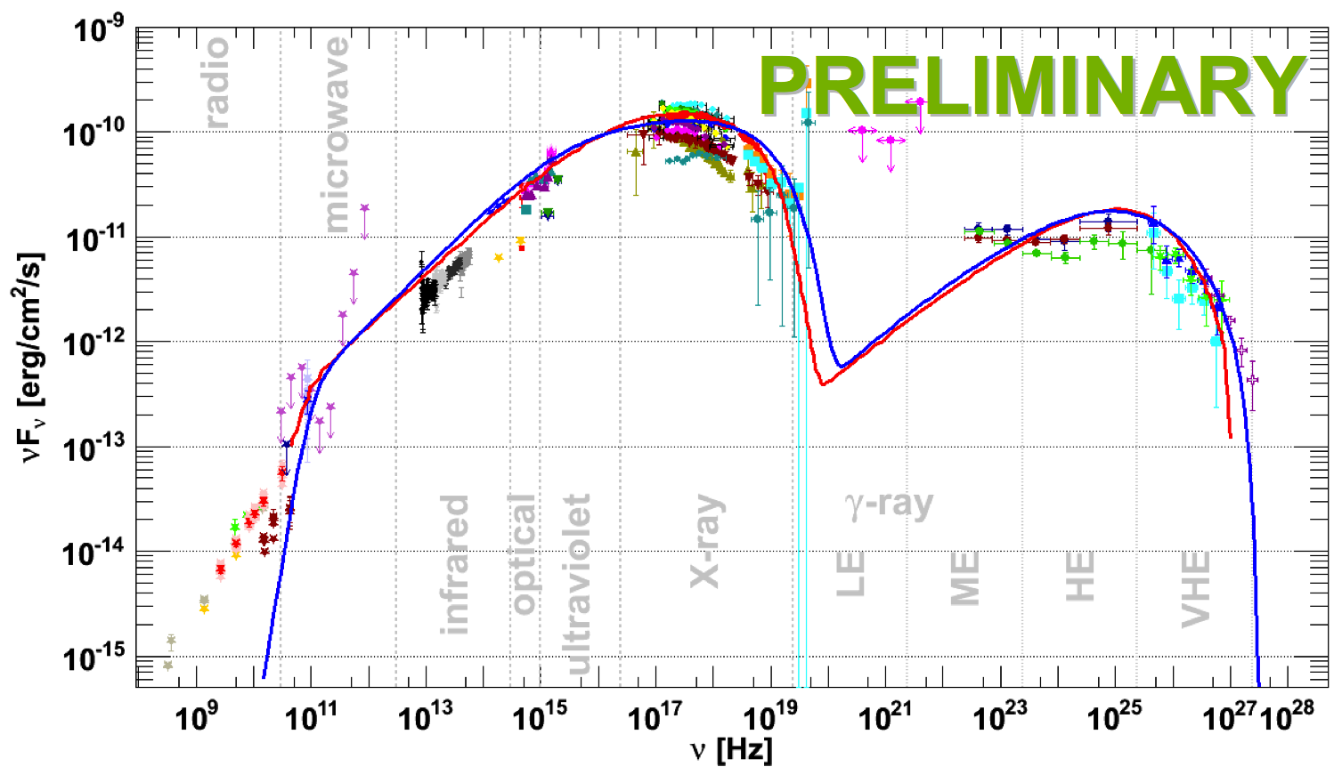
Emission process
A “standard” blazar (no EBL fx, no hardTeV,....)
HBL CERTIFIED
1ES 1959+650 z=0.05
SSC model prior to Fermi/LAT
Credit: M. Backes, PhD thesis
http://hdl.handle.net/2003/29464
Notes:
The XXX HBL has been observed for a long period; no evidence of high activity was found; the SED should describe a stationary state. Nonetheless a plateu in the GeV region is visible which does not fit any single zone model. On the other hand multi-zone models are not really justified.
A suggestive connection can be drawn with the SED measured on the Tycho SN remnant, which fits the hadronic scenario (Giordano et al 2011).

Slide 16
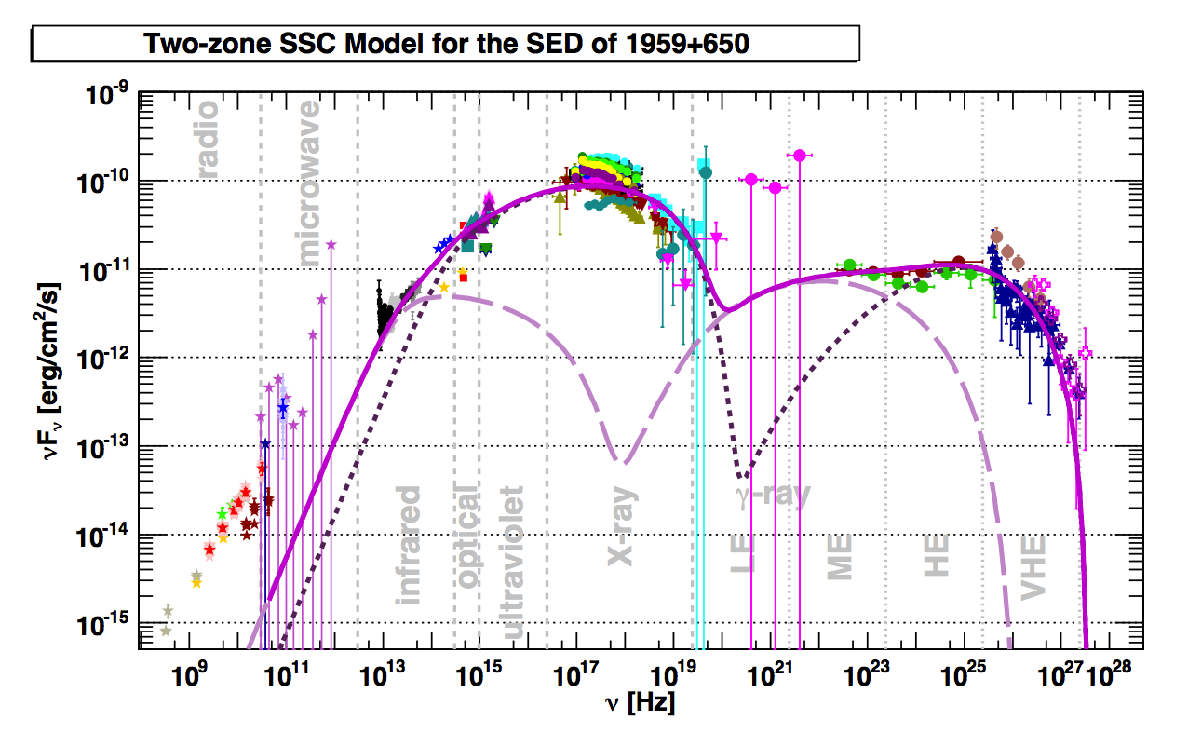
Emission process
A HBL with an hadronic VHE bump? (captivating speculation...)
Leptonic Multi-zones emission? (quiescent state...)
Two-zones SSC model
M. Backes, Gamma2012 - Heidelberg
Notes:
The XXX HBL has been observed for a long period; no evidence of high activity was found; the SED should describe a stationary state. Nonetheless a plateu in the GeV region is visible which does not fit any single zone model. On the other hand multi-zone models are not really justified.
A suggestive connection can be drawn with the SED measured on the Tycho SN remnant, which fits the hadronic scenario (Giordano et al 2011).

Slide 17
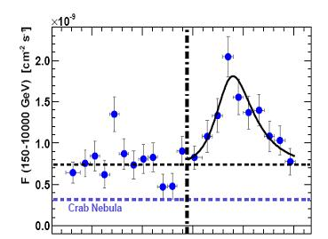
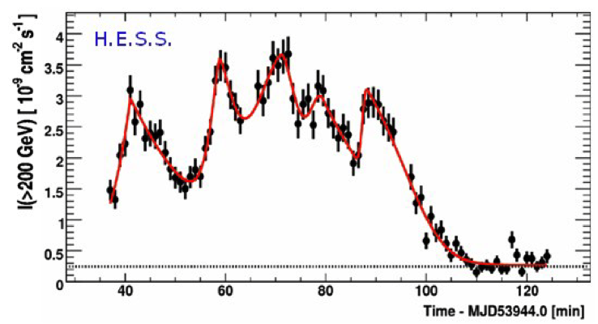
Multi-zone emission (and models)?
Evidence of substructures
since 2005: sub-flares on top of major flares
Time evolution of SZ-SSC models?
How are the regions connected?
Mrk 501 (MAGIC 2005)
PKS 2155-304
10 min
Notes:
Observation of sub-flares during major flares is just a selection effect due to the sensitivity of the instrument.
Sub-flares are not visible otherwise.

Slide 18
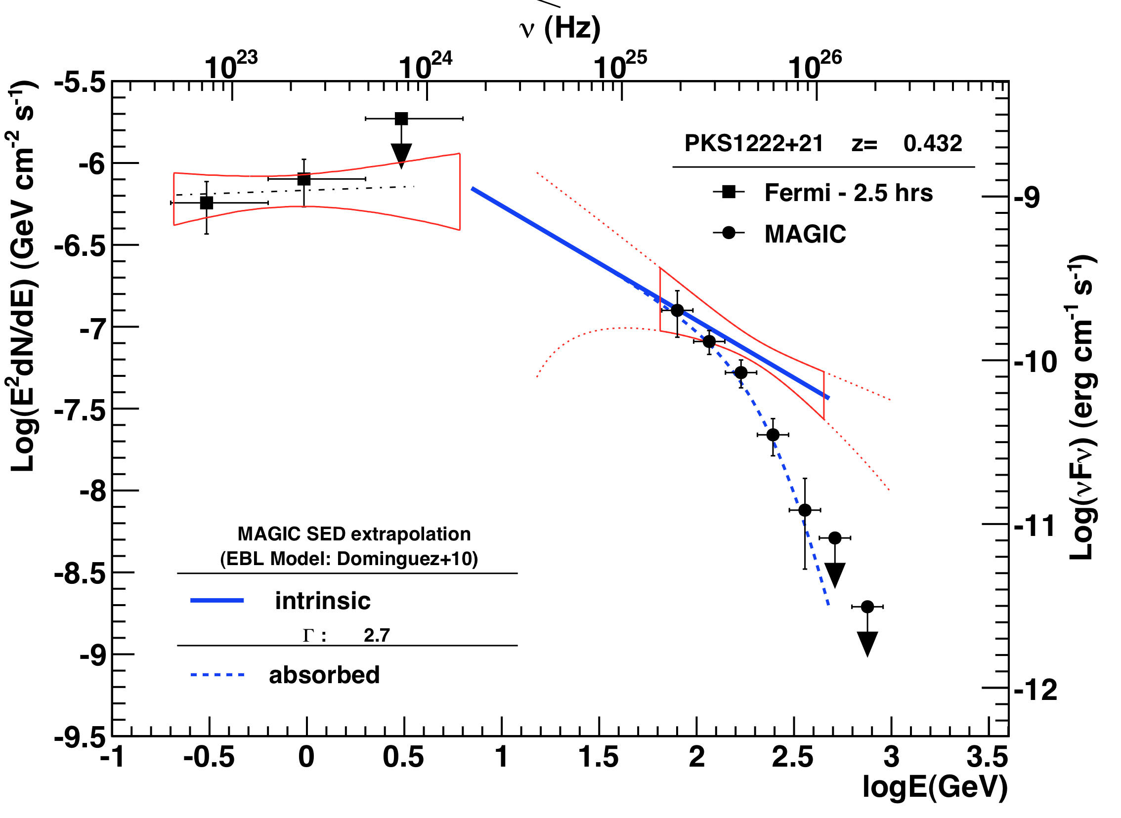
Constraints on emission zone
PKS 1222+216 (z=0.435)
MAGIC detection (2010) during high activity
Simultaneous Fermi/LAT 2.5 hrs encompassing MAGIC obs.
deabsorbed/intrinsic
observed
MAGIC Coll. ApJL 730 (2011)
  Single component from 2 to 400 GeV
  cutoff excluded at E < ~130 GeV

Slide 19
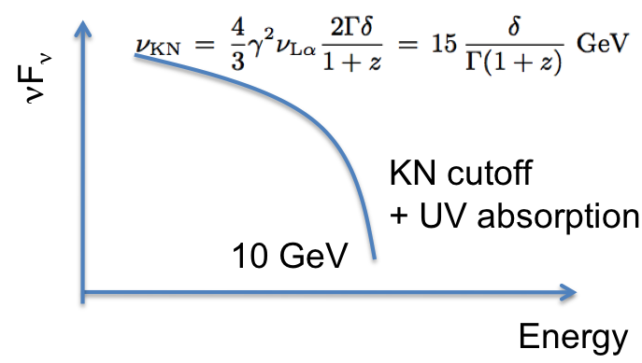
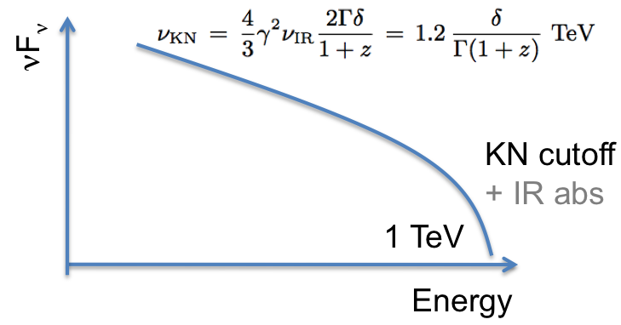
Constraints on emission zone
Internal absorption
Klein-Nishina break
Ghisellini&Tavecchio 2009
Inside BLR
Liu&Bai 2006
Outside BLR

Slide 20
Constraints on emission zone
Internal absorption
Klein-Nishina break
Ghisellini&Tavecchio 2009
Inside BLR
Liu&Bai 2006
Outside BLR
Excluded by MAGIC data

Slide 21
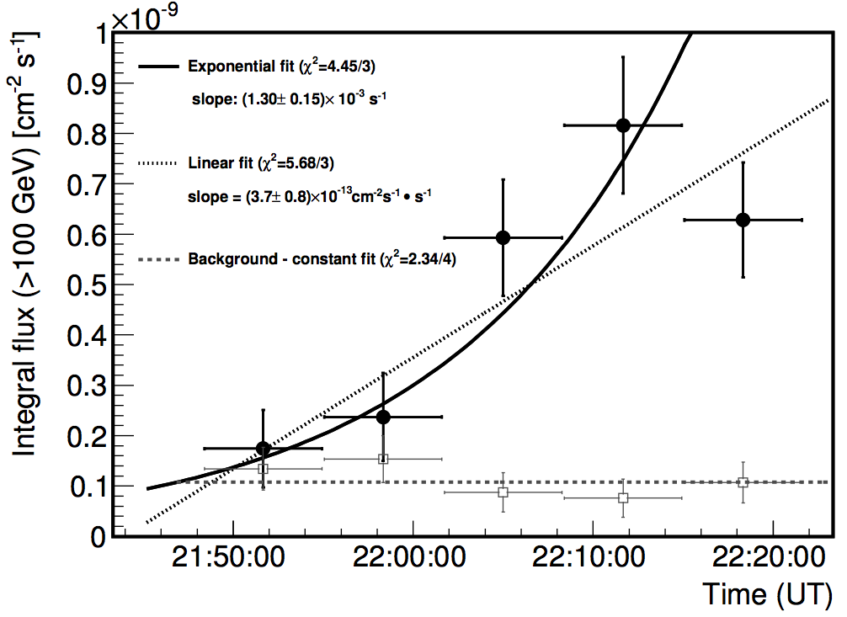
Light curve
Very fast variability
Doubling flux scale 9 minutes approx.
Size emission region:
MAGIC Coll. ApJL 730 (2011)

Slide 22
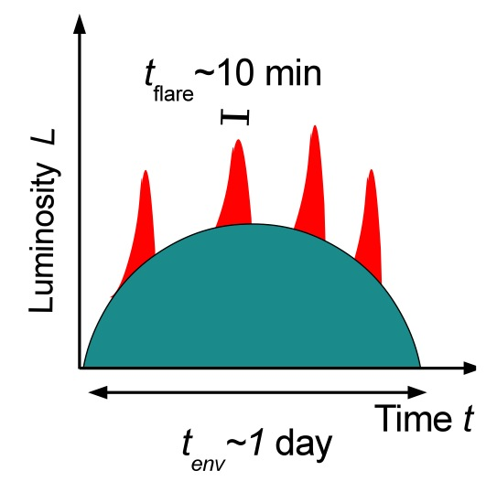
Collimation
small emitting regions (-> fast variability) over a bigger jet producing the quiescent emission?
collimation?
suggested solutions:
Giannios 2012
Needle/Jet model (Ghisellini, Tavecchio 2008MNRAS.386L..28G)
Jets in a jet (Giannios, Uzdensky, Begelman 2009)
Relativistic turbulence (Narayan, Piran 2012MNRAS.420..604N)
Kinetic beaming (Cerruti, Werner, Uzdensky, Begelman 2012)
Hydrodynamic collimation (Bromberg & Levinson 2009)
UHE neutral beams (Dermer et al 2012)
Magnetic reconnection (Nalewajko&Sikora 2009, Stawarz 2006
Plasmoids (Giannios 2012)
Notes:
Solutions triggered by AGN variability, expecially TeV variability and by PKS1222 observation

Slide 23
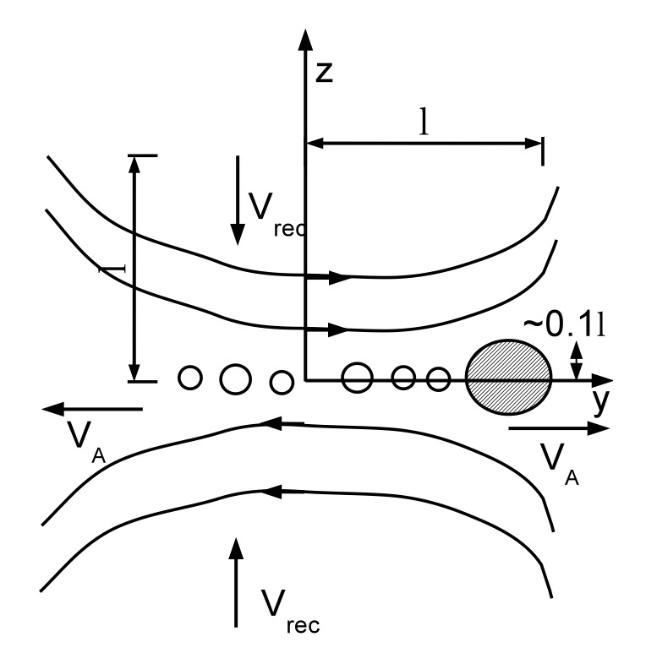
Collimation
plasmoids in magnetic reconnection:
Giannios 2012

Slide 24
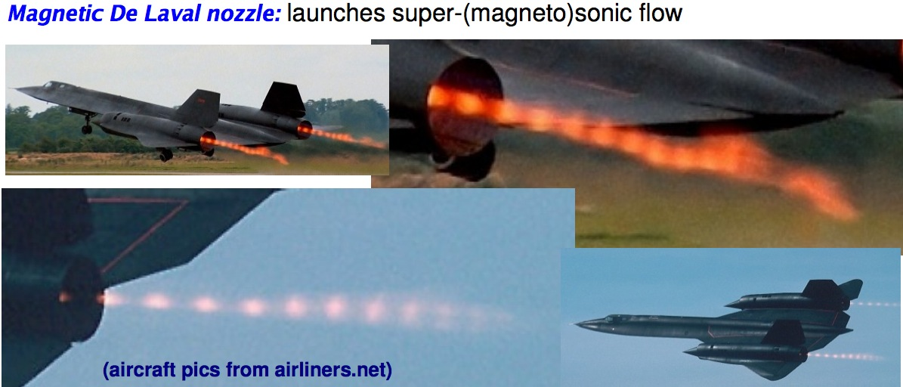
Collimation
plasmoids in magnetic reconnection:
Credits Beuther & Fendt (lectures 2009)

Slide 25
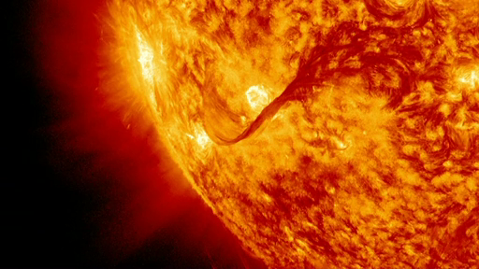
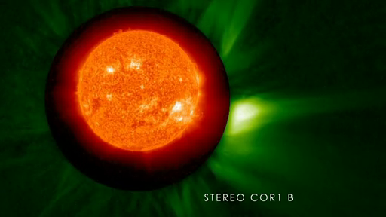

Slide 26
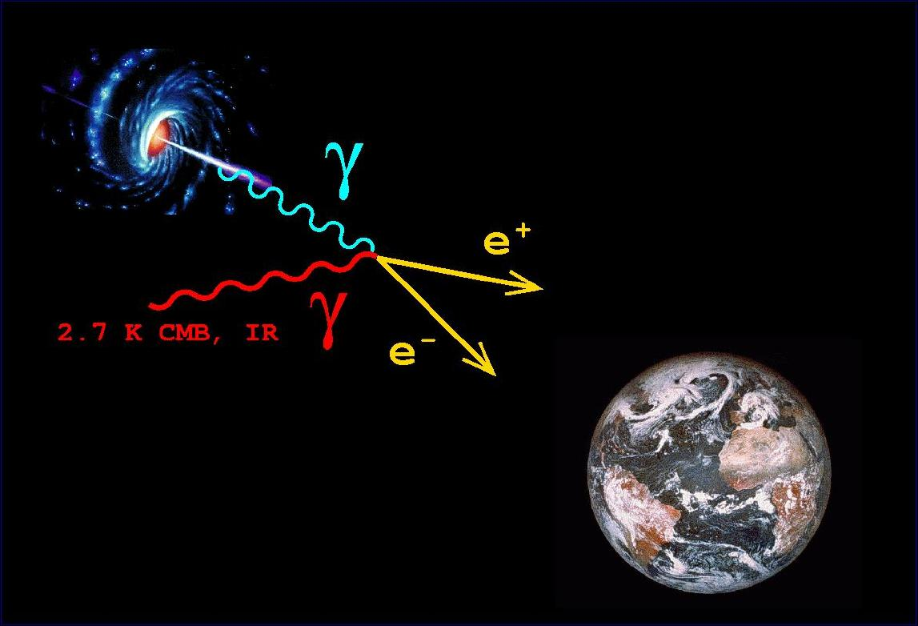
Energy flux
Emitted
spectrum
Energy
High absorption
Energy
observed spect.
Low absorption
Energy
Interaction with Extragalactic Background Light (EBL)
energy dependent γ-ray “absorption”
modification of original spectrum depending on the EBL density
Notes:
Gli AGN sono sorgenti extragalattiche quindi distanti e per raggiungerci devono attraversare lo spazio intergalattico, che non e’ vuoto. Lungo il tragitto I gamma interagiscono producendo una coppia e+e-, con il fondo presnete, deominato EBL, dovuto tanto alla onnipresente radiazione di fondo a 2K, cosi come alla luce stellare ottica, IR etc. La conclusione e’ che il flusso osservato non sara’ uguale a quello emesso, am conterra’ un termine di assorbimento, di cut-off, descritto da una esponenziale. E dipendente da un parametroo, tau, la profondita’ ottica. Questo dipende dall’energia del fotone energetico e dalal densita’ dei fotoni del fondo, ovvero dalla distanza (maggiore e’ la distanza, maggiore la quantita’ di materia che dovra’ attraversare). Quando si hanno distanze elevate questa non si misura in km, neanche in anniluce, ma tramite il redshift, lo spostamento delle righe spettrali verso il rosso dovuto all’espansione dell’universo. Quando tau=1 si definisce il cosidetto orizzonte cosmologico, ovvero la distanza oltre la quale l’assorbimento dei gamma diventa predominante, e la sorgente quindi sara’ difficilmente osservabile a quell’energia.

Slide 27
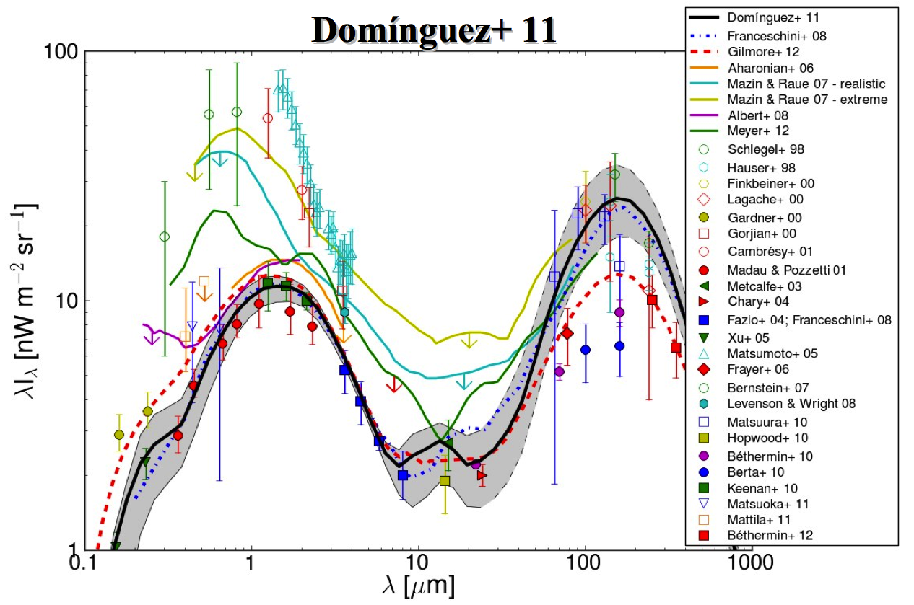
EBL density
100 GeV 1 TeV 10 TeV 100 TeV
UV – OPT IR

Slide 28
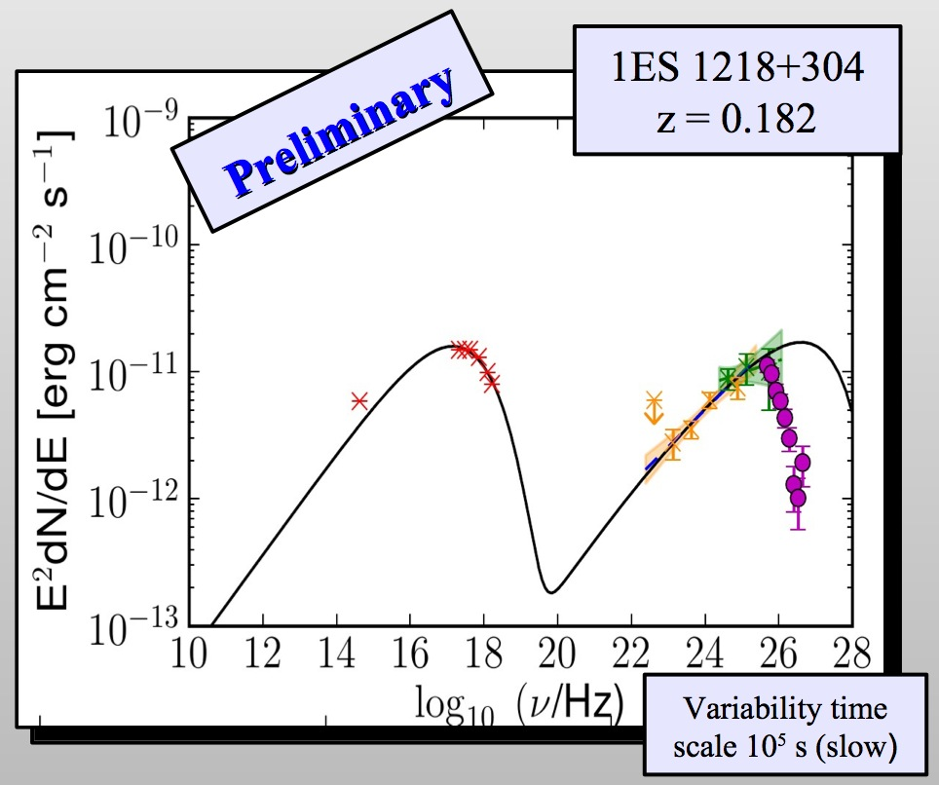
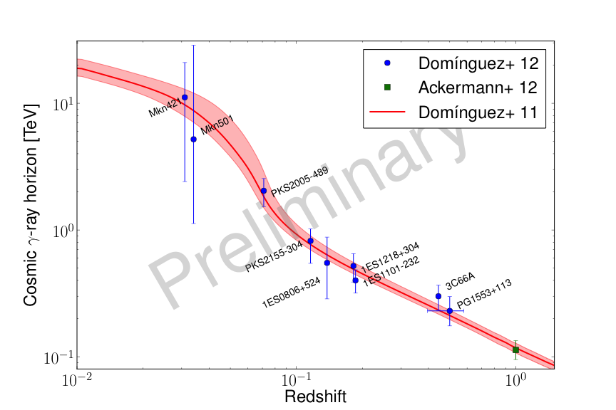
EBL density
Similar measurement in the TeV range (opt-IR EBL)
  SED extrapolation from modeling
Dominguez+12
see also Mankuzhiyil 2010

Slide 29
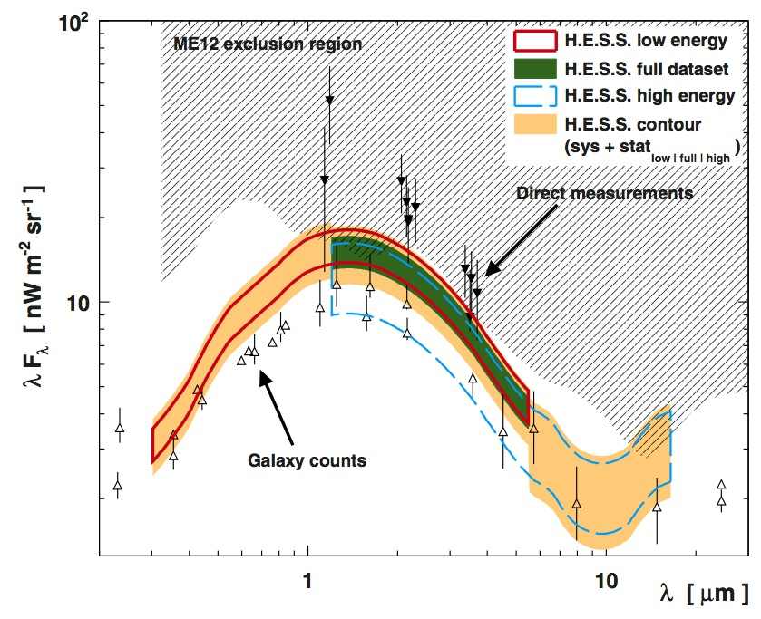
EBL density
Similar measurement in the TeV range (opt-IR EBL)
  simultaneous fit intrinsic spectrum + EBL
HESS coll. A&A 2013

Slide 30
Limits on IGMF
Reprocess of TeV photons in the GeV band
spectral features
Extended emission
CMB
EBL
γ_{GeV}
γ_{TeV}
e⁺ e⁻
γ_{TeV}
IGMF

Slide 31
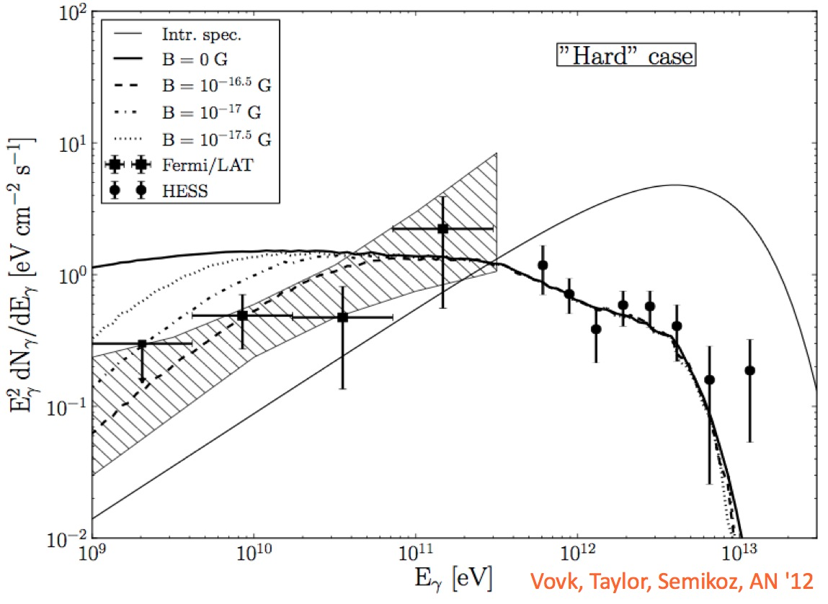
Limits on IGMF
Reprocessing of TeV photons in the GeV range:
intrinsic
see also Tavecchio et al. 2010, Neronov&Semikoz 2009
B
1ES0229+200

Slide 32
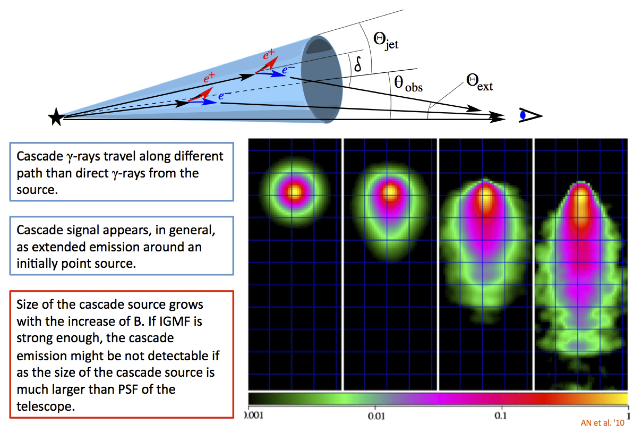
Limits on IGMF
IGMF deflects pairs → extended emission around the point source.
PSF critical...
Extracted from Neronov talk at IUA

Slide 33
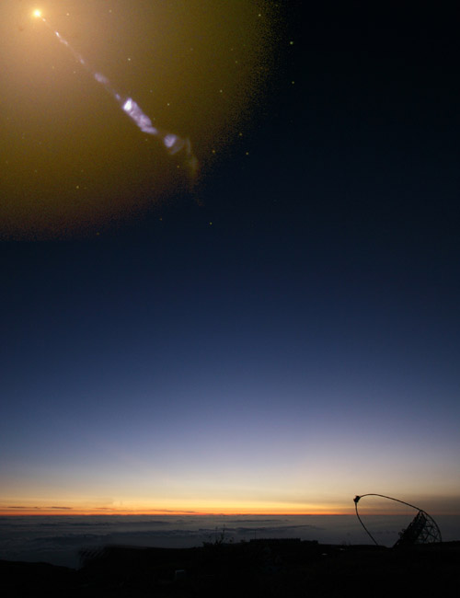
IACT systems
Imaging Air Cherenkov Telescopes

Slide 34

Cherenkov light from EAS

Slide 35
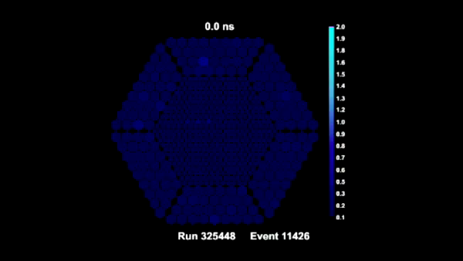
Cherenkov light from EAS
Short light pulse (few ns)
Time evolution of the shower development: Fast sampling (~GHz)

Slide 36
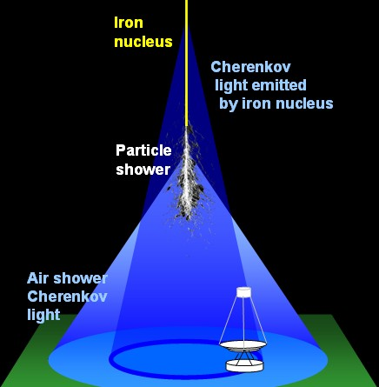
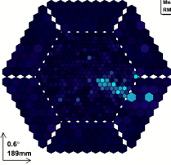
The IACT Technique
IACT detector
=
Atmosphere + telescope
Shower top
N₁ ,θ_{C1}
γ-ray
direction
Shower
top
Shower tail
n₂>n₁ ⇒ θ_{C2}> θ_{C1}
×
Shower
tail
Direction reconstruction
Particle-id
Energy reconstruction

Slide 37
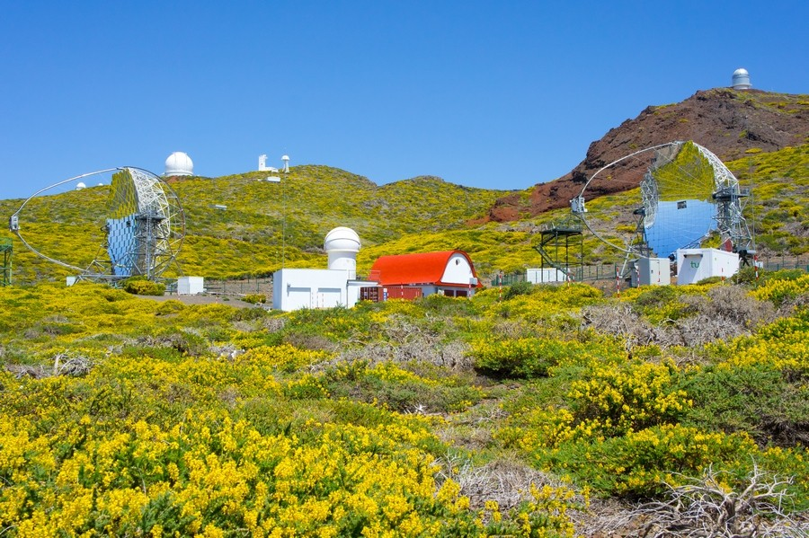
The MAGIC telescopes
VHE range - Energy threshold ~50 GeV (up to 10 TeV)
Energy Resolution ~20%
FOV: 3.5º
Angular Resolution ~0.1º
Sensitivity (5 σ in 50 hours): ~1% Crab Nebula flux (@~200 GeV)
2009
2004
MAGIC performance paper:
Aleksic et al. (MAGIC) APh, 2012, 35, 435A

Slide 38
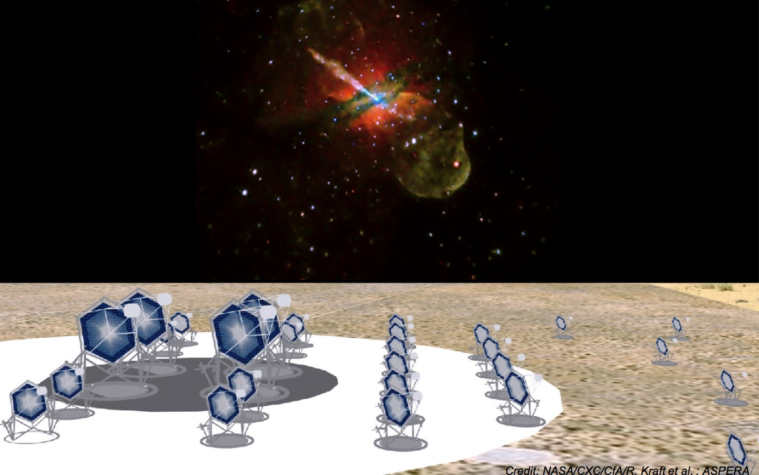
AGN: Prospects with CTA

Slide 39
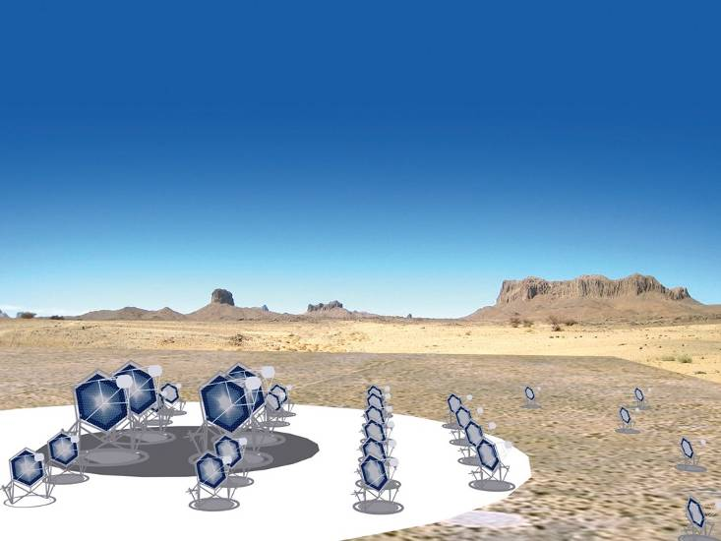
The CTA concept
2 arrays: north+south
→ all-sky coverage
core array
100 GeV-10 TeV
~ 40 ø=12 m telescopes
low energy section
E_{thresh} ~ 10 GeV
a few ø=23 m telescopes
high energy section
~ 40 ø=6 m tel.
on 10 km² area

Slide 40
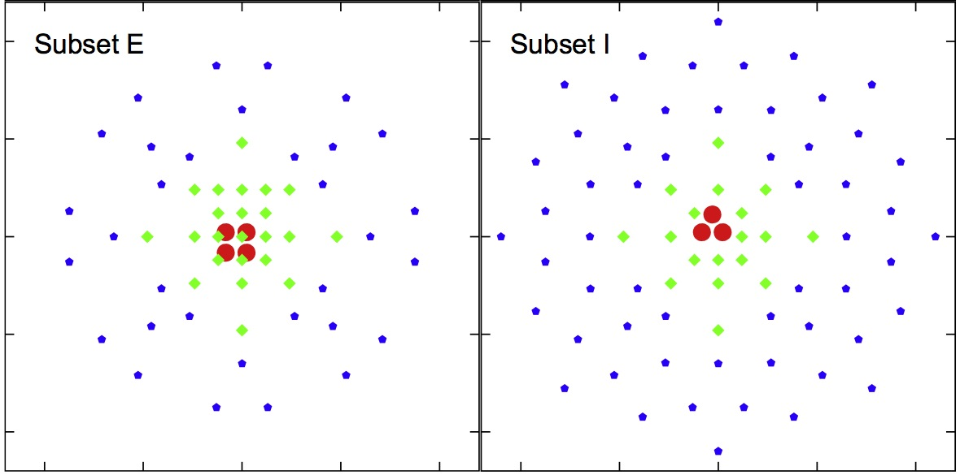
The CTA array
two possible configurations
• LST
◆ MST
★ SST
2000 m

Slide 41
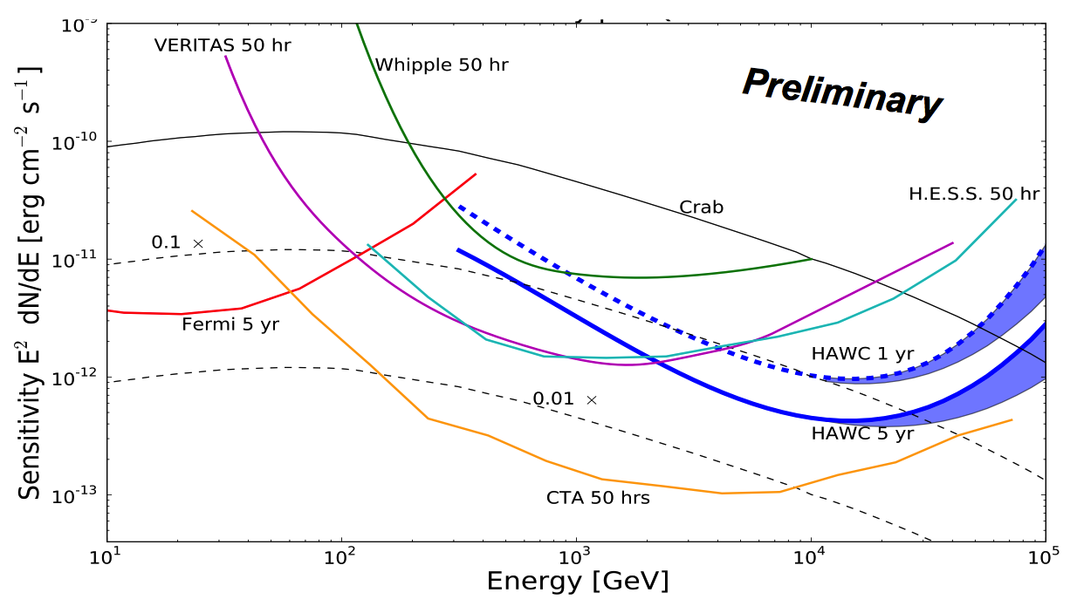
Performances
Sensitivity x10
  higher dynamic range -> quiescent states
  higher statistics: lower uncertainties in SED
  fast variability

Slide 42
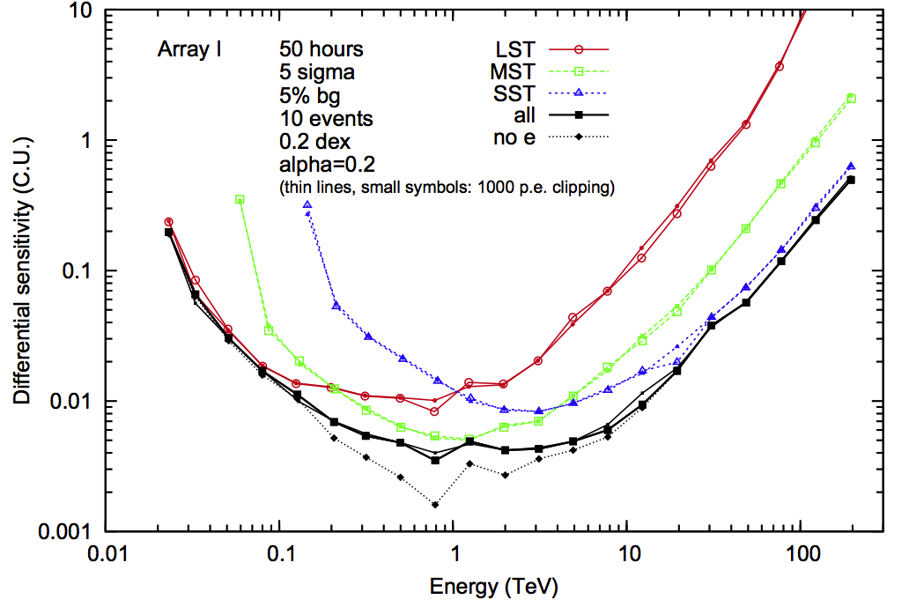
Three different instruments...
LST
MST
SST

Slide 43
Performances
Wider energy range (20 GeV – 100 TeV)
  Low energy:
  study cutoff in 10-100 GeV range
  cover gap with Fermi/LAT
  new populations (e.g. NLSy1)
  High energy:
  EBL studies: cover near-IR/IR region (~50μm)
  New gamma-emitters (e.g. FR0)
  Hadronic emission (e.g. starburst)

Slide 44
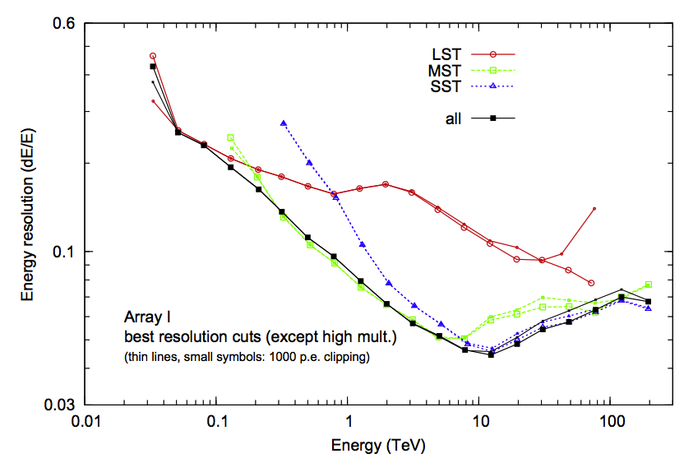
Performances
Energy resolution x3-x5
  spectral features
    absorption, cut-off
    EBL signatures
  Better EBL correction

Slide 45
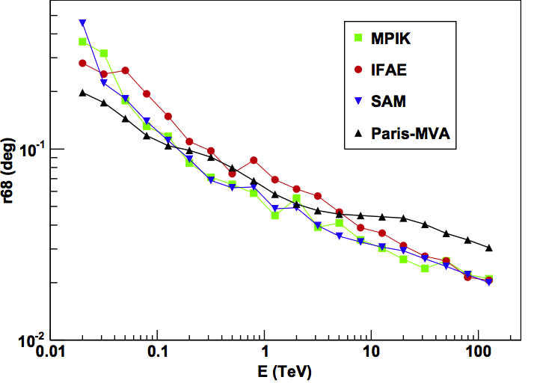
Performances
Angular resolution x2-x5
  extended emission (e.g. lobes)
  counterpart identification
  study of IGMF (diffuse AGN emission)
Wide F.o.V. (8-10 deg)
  Survey: 0.5 hr -> 10% Crab
0.1 deg
1’

Slide 46
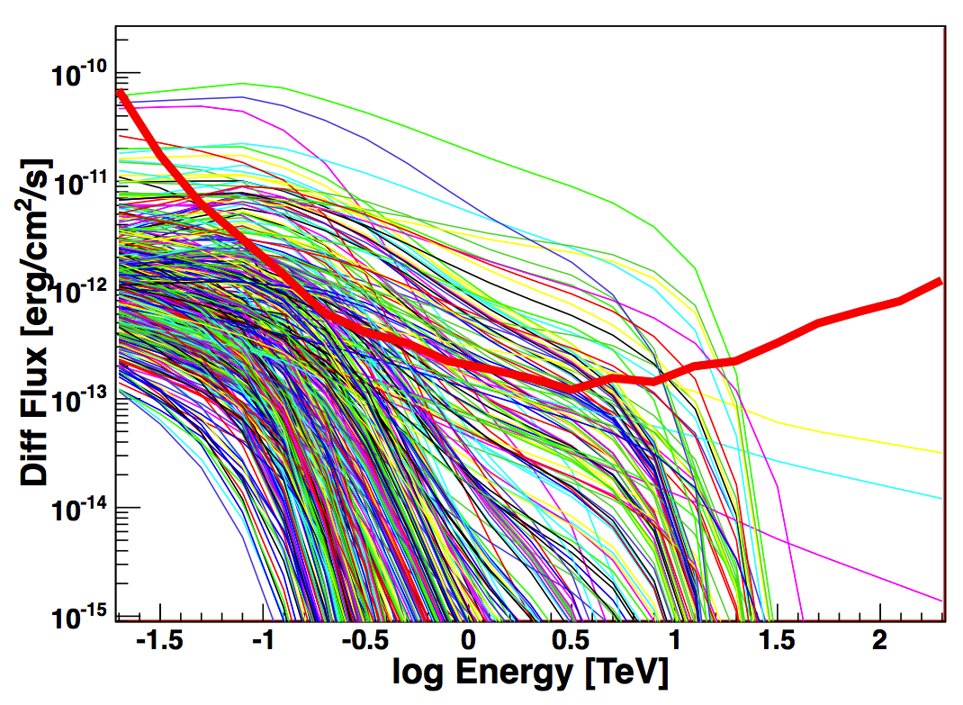
New sources
120/400 AGN detectable in 50 hrs
z_{max}~1.8
see also Sol et al. 2013 (Astrop.Phys. special issue)
1FGL extrapolated AGNs
CTA sensitivity
Hassan et al. 2011

Slide 47
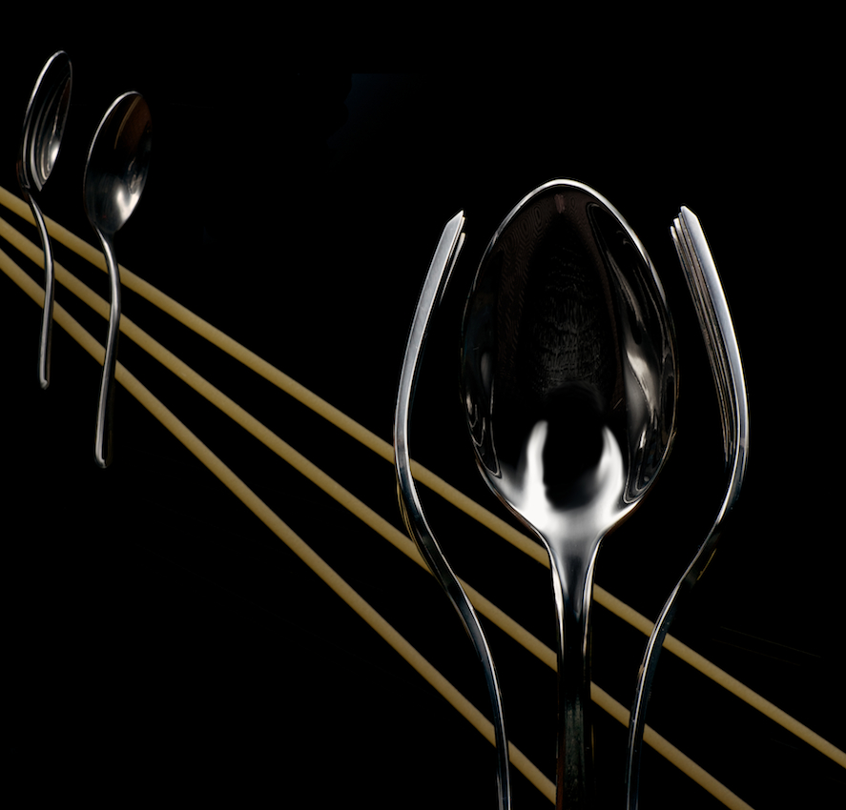
Thanks!

Slide 48
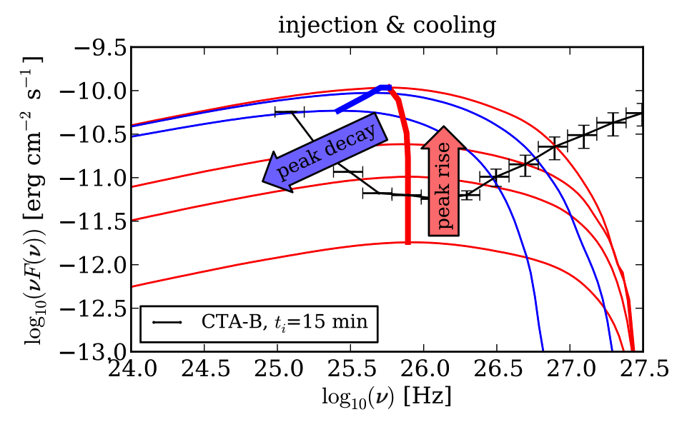
Flares - variability
Identify the emission process

Slide 49
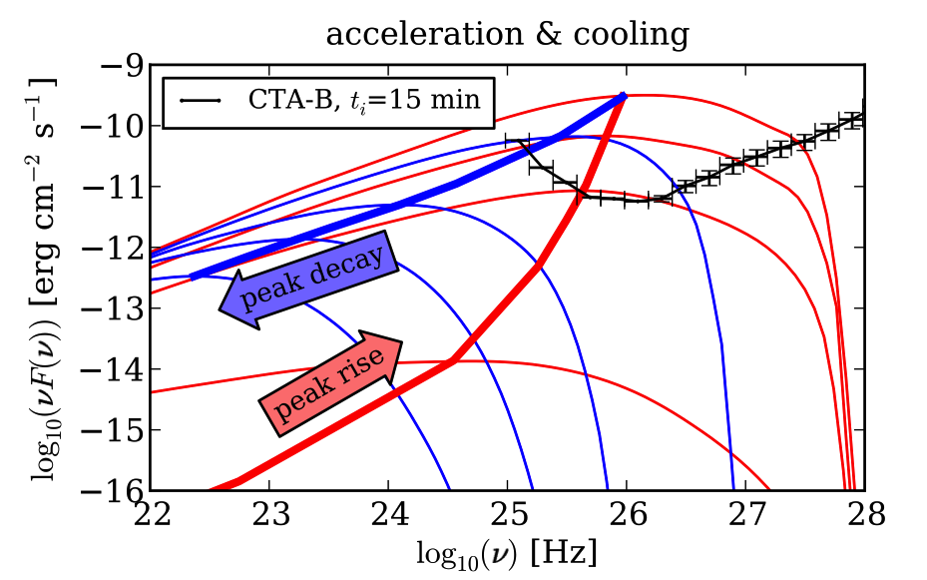
Flares - variability
Identify the emission process

Slide 50

Flares - variability
Identify the emission process

Slide 51

it can be done...
UV-HST on S5 0716+714 (z=0.3) Danforth et al. 2012
rise time ~ 7 min !!

Slide 52

it can be done...
UV-HST on S5 0716+714 (z=0.3) Danforth et al. 2012

