Slide 1
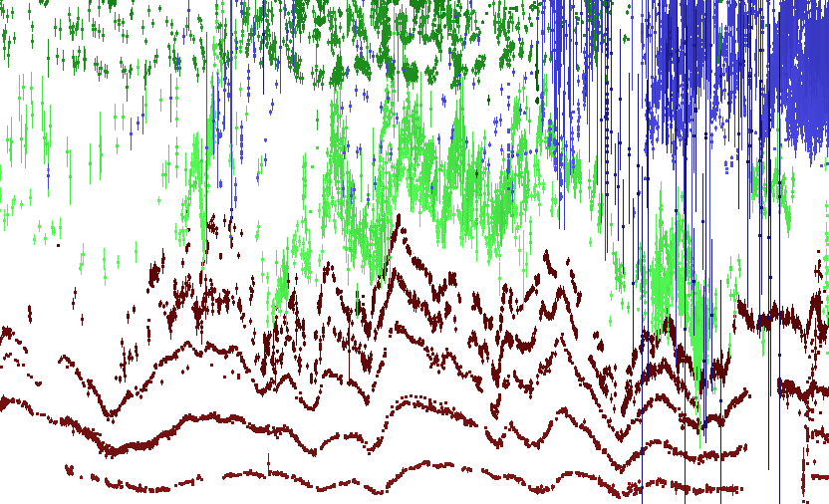
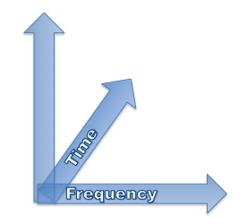
Blazars multi-wavelength
multi-temporal data analysis
Paolo Giommi

Slide 2

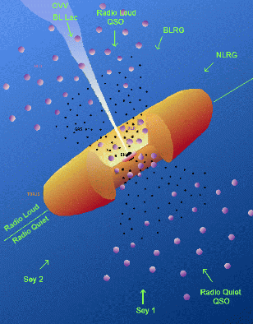
AGN : Two main categories
  Dominated by (mostly) thermal emission from accretion disk -
  Radio quiet AGN (>~90 %)
  (normal QSO powered by accretion onto a SM black hole)
  Dominated by Non-Thermal radiation –
  Jet dominated AGN (< 10%)
When Θ < θ_{blazar}
Blazar
As of today, about 3,150 blazars are known (Bzcat, edition 4.1, Massaro et al. 2012).
This number is increasing rapidly but it remains a small percentage
of the over one million AGN known
Flesch, E. The Million Quasars (MILLIQUAS) Catalog, Version 3.1
(22 October 2012) http://quasars.org/milliquas.htm

Slide 3
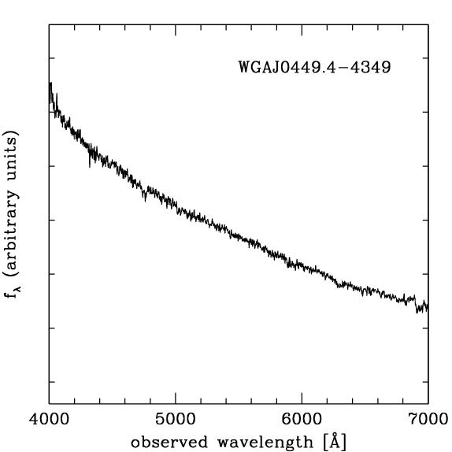
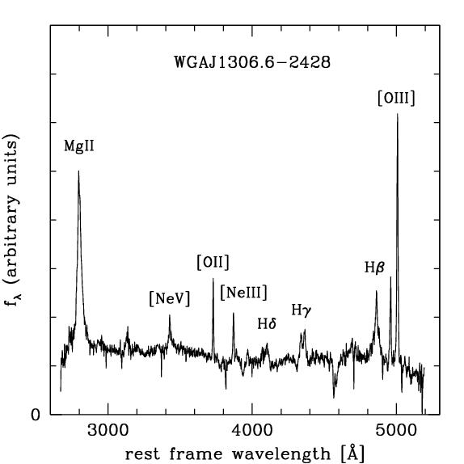
The two blazar classes
BL Lac object
Flat spectrum radio quasar

Slide 4
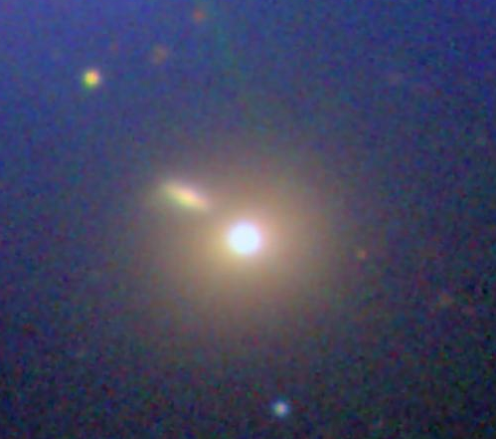

Slide 5
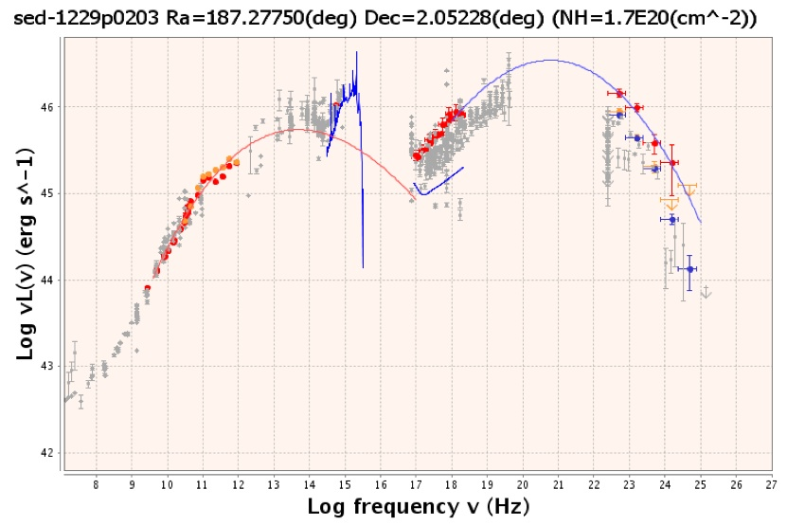

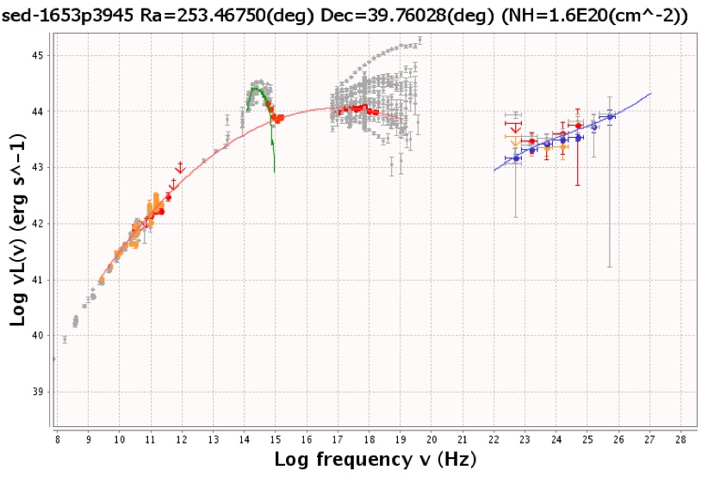
3C 273
MKN 501

Slide 6
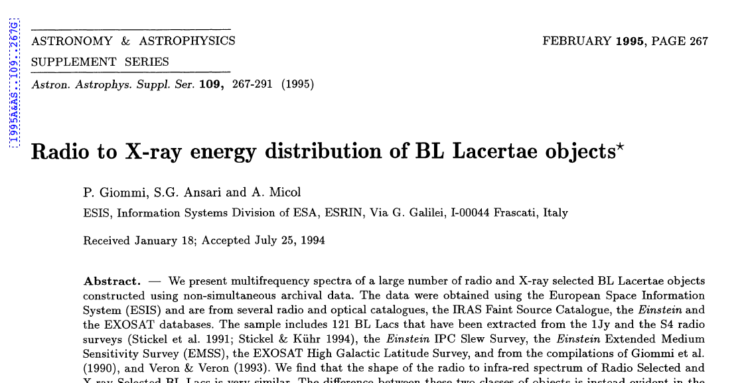

Slide 7
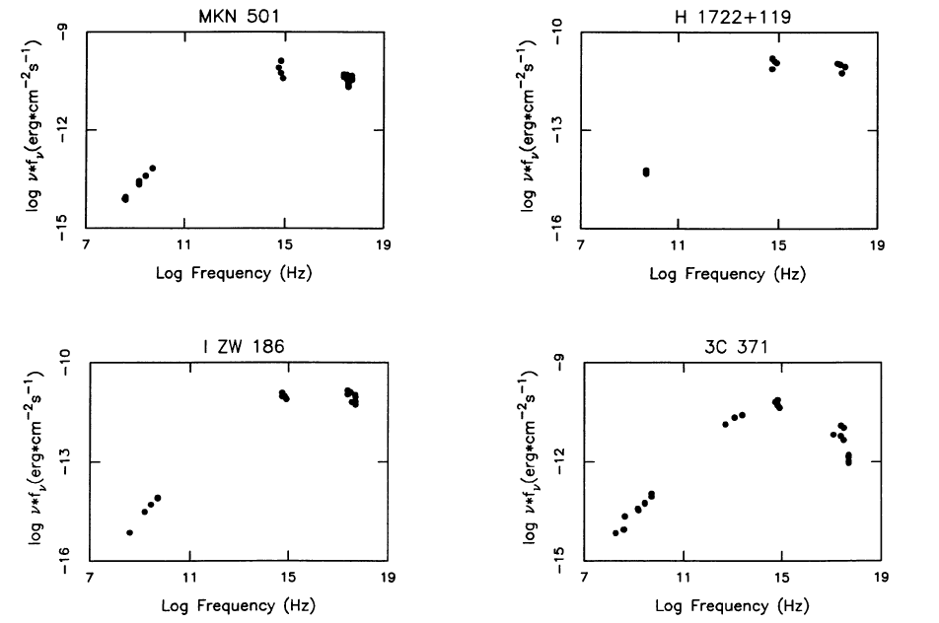

Slide 8
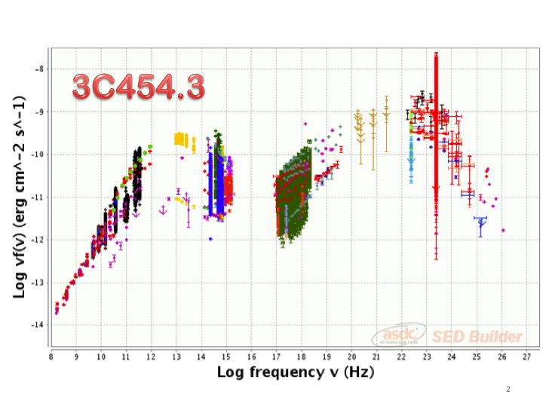

Slide 9
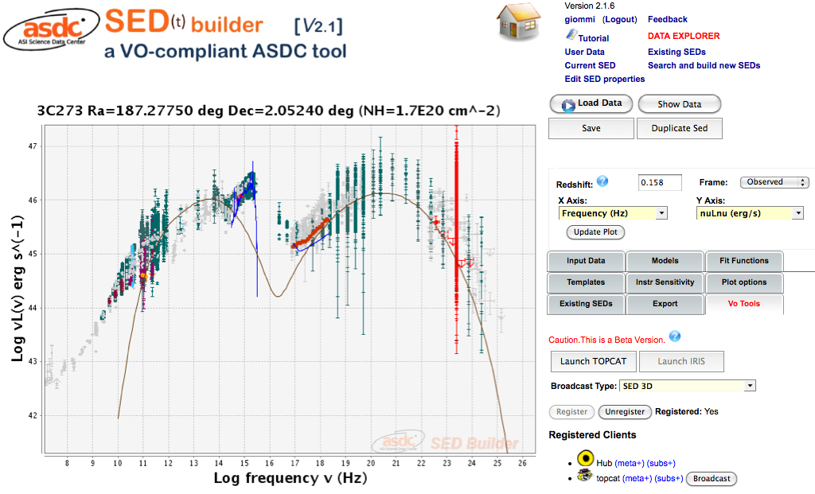
Fermi adattive bin 1GeV light-curve
Courtesiy of B. Lott
Preliminary
Accretion onto SMBH

Slide 11
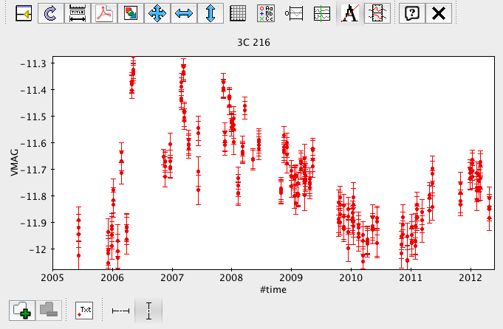

Slide 12
<3C273> rescaled

Slide 13
<3C279> rescaled

Slide 14
<PKS 0106+01>
rescaled

Slide 15
<3C345> rescaled

Slide 16
<3C454.3> rescaled

Slide 17
<3C446> rescaled

Slide 18
<BL Lac> rescaled

Slide 19
<AP Lib> rescaled

Slide 20
<PKS2155-304>
rescaled

Slide 21
<MKN501> rescaled

Slide 22
<MKN421> rescaled

Slide 23
<Centaurus-A> rescaled

Slide 24
<Crab Nebula> rescaled

Slide 26
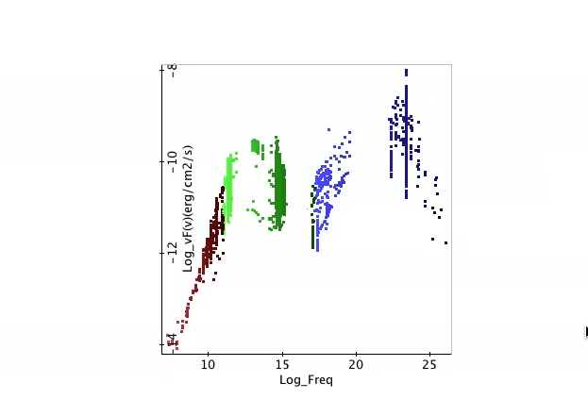

Slide 29
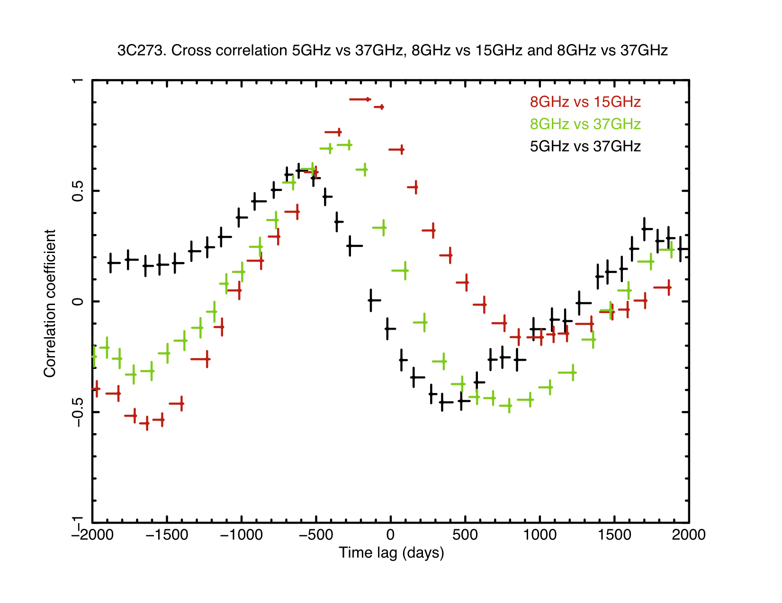

Slide 30
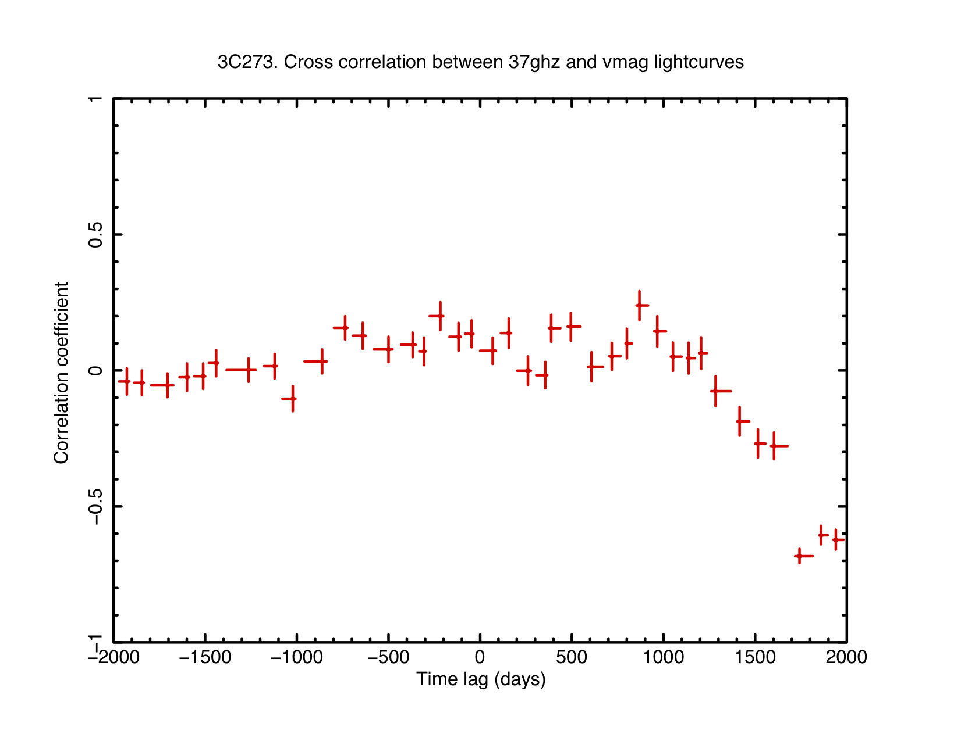

Slide 32
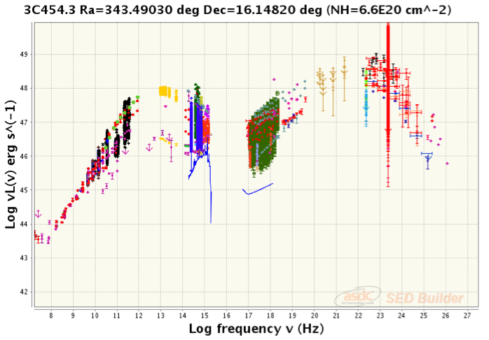

Slide 33
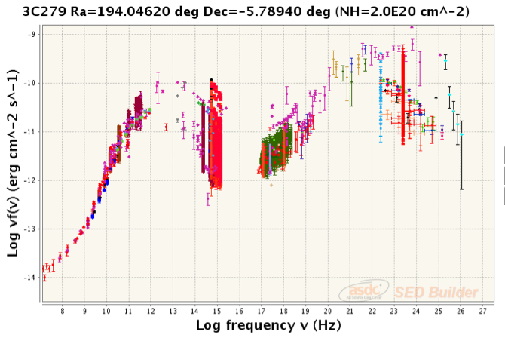

Slide 35
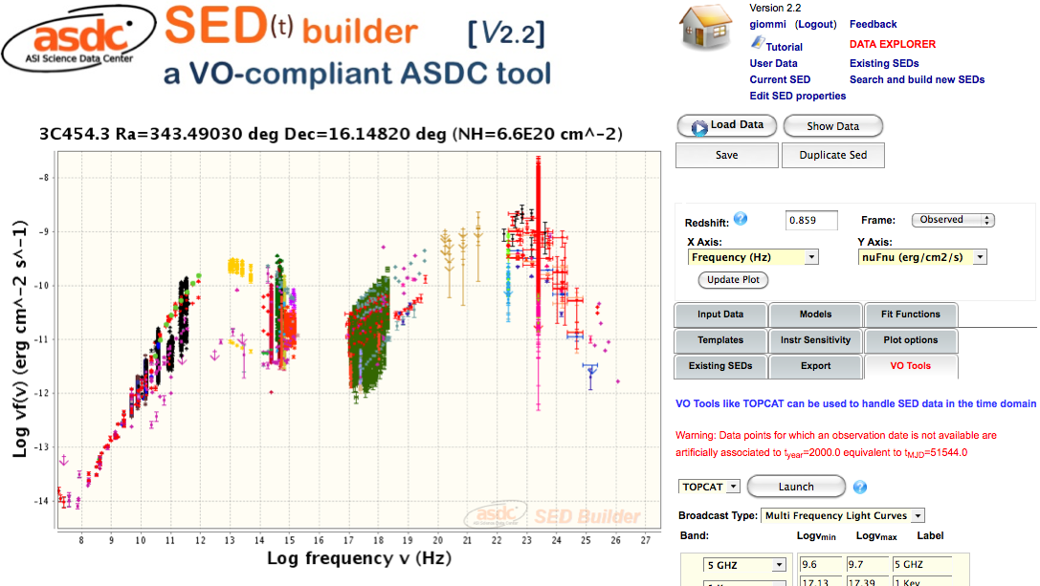
http://tools.asdc.asi.it/SED

Slide 36
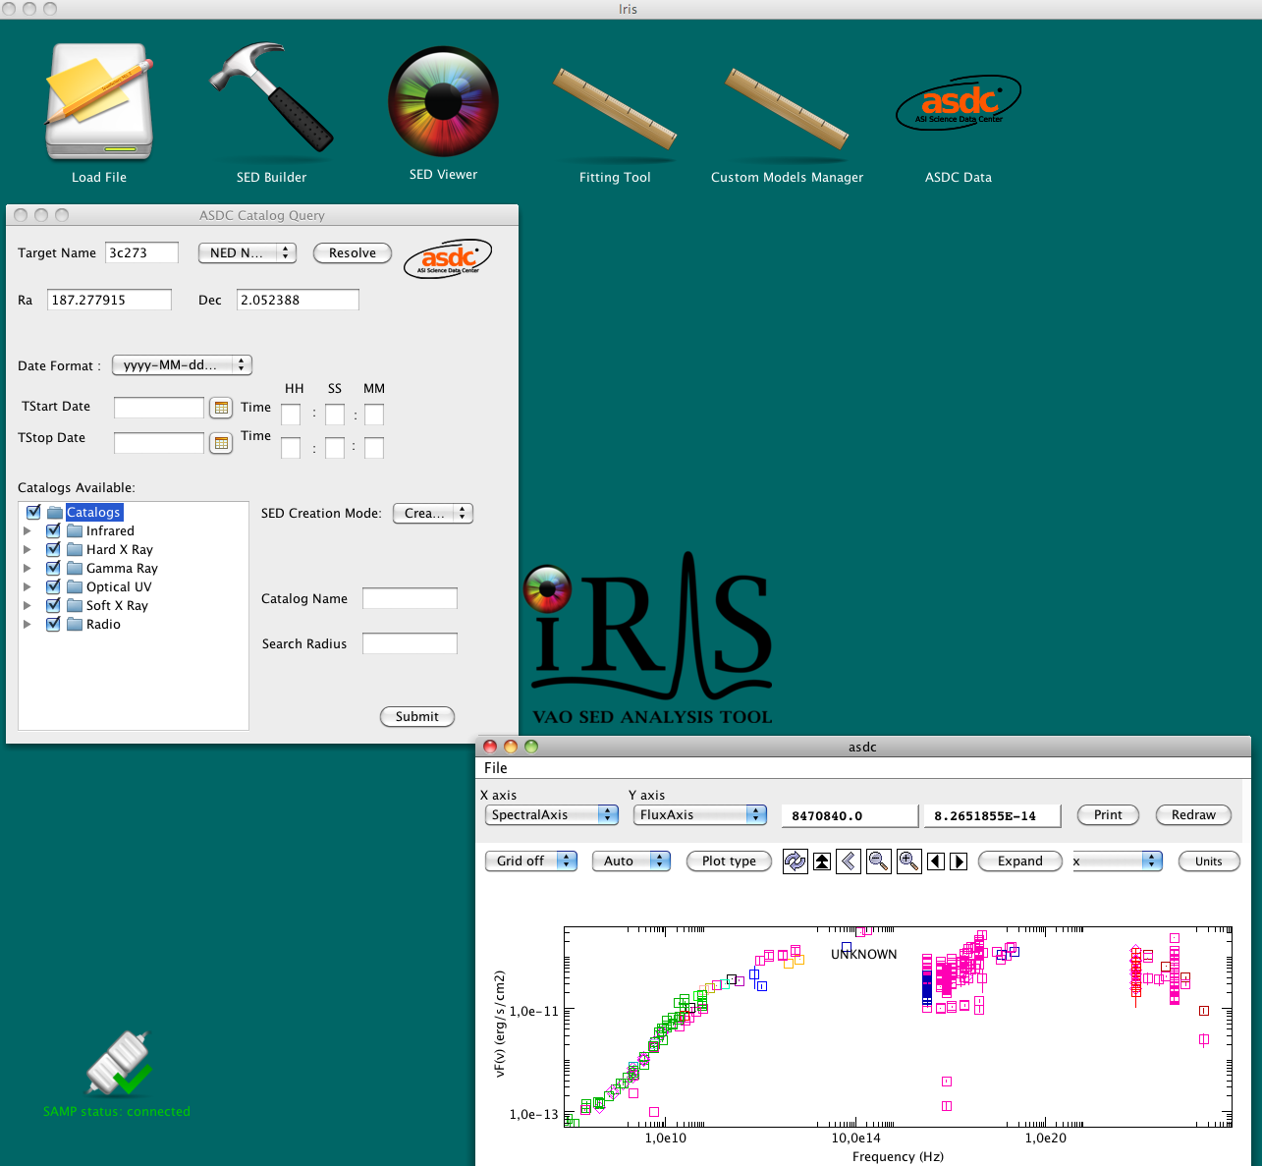

Slide 37
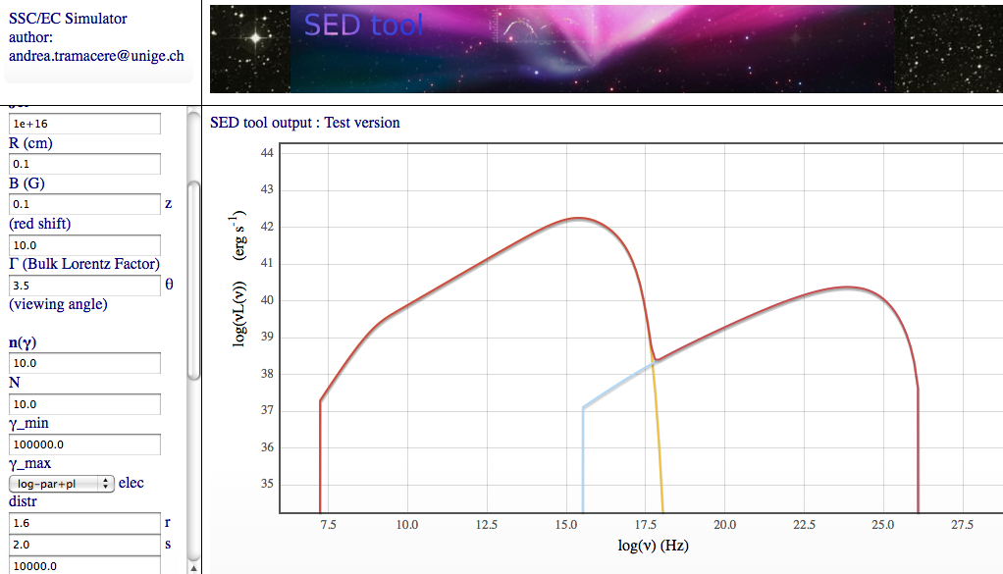
Polynomial + physical model fitting tool
Courtesy of Andrea Tramacere, ISDC

Slide 38

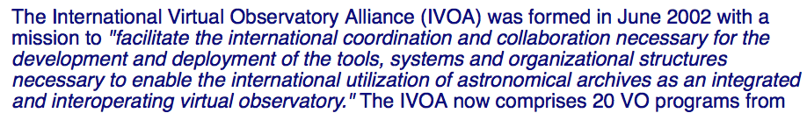
Multi-frequency astronomy is now a lot easier than in the past
thanks to the many data centers that provide data, software
and calibration for most existing observational facilities
AND

