Slide 1
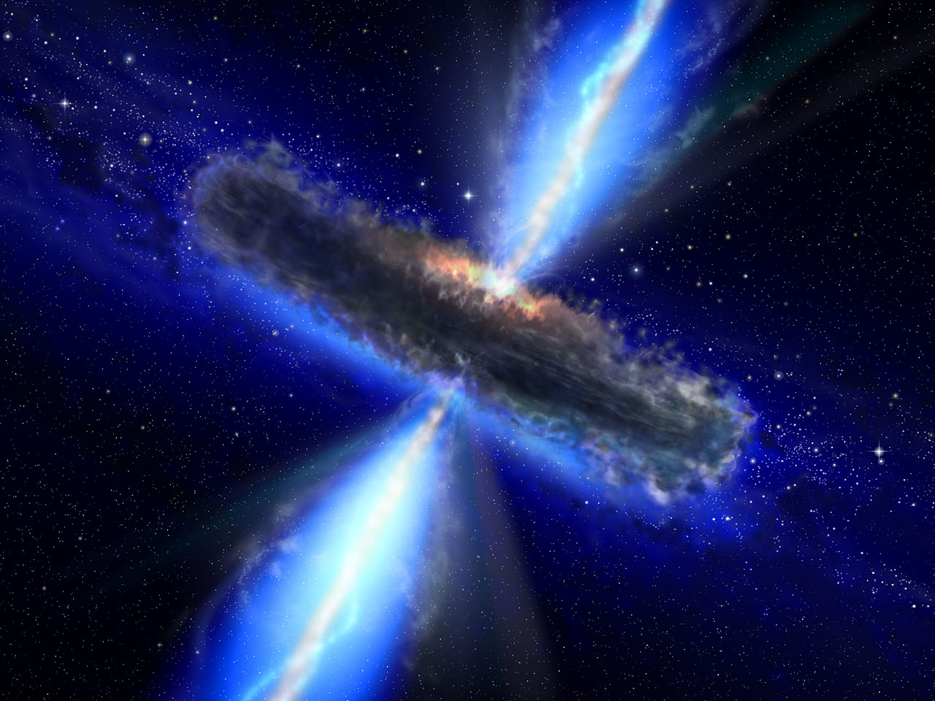
L’ accrescimento sui buchi neri super massivi:
la varieta' degli AGN
… NHXM prospects
Roberto Maiolino (Oss. Roma)
Guido Risaliti (Oss. Arcetri)
Marco Salvati (Oss. Arcetri)

Slide 2
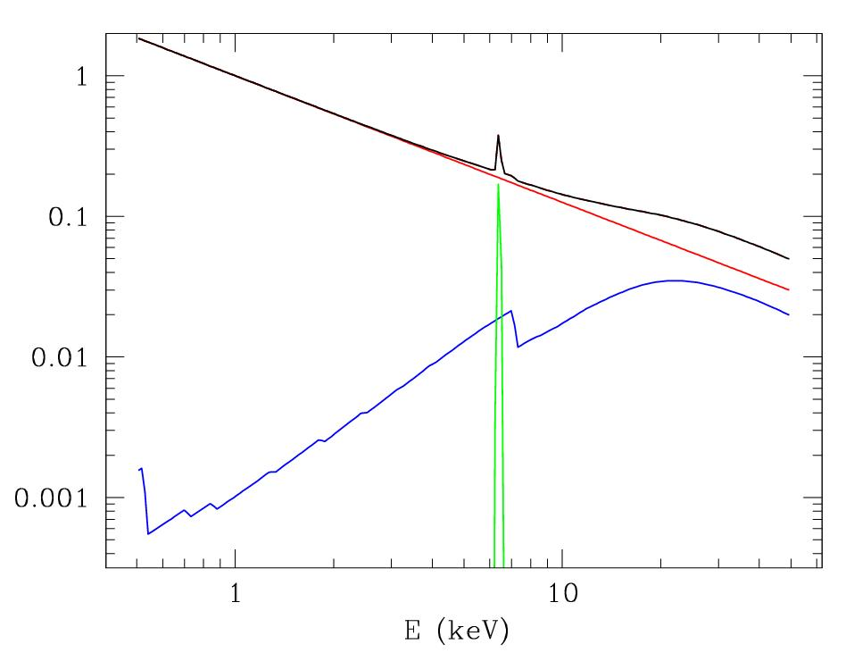
Emission components
power law
FeK
cold reflection
circumnuclear
“torus”
disk+corona

Slide 3
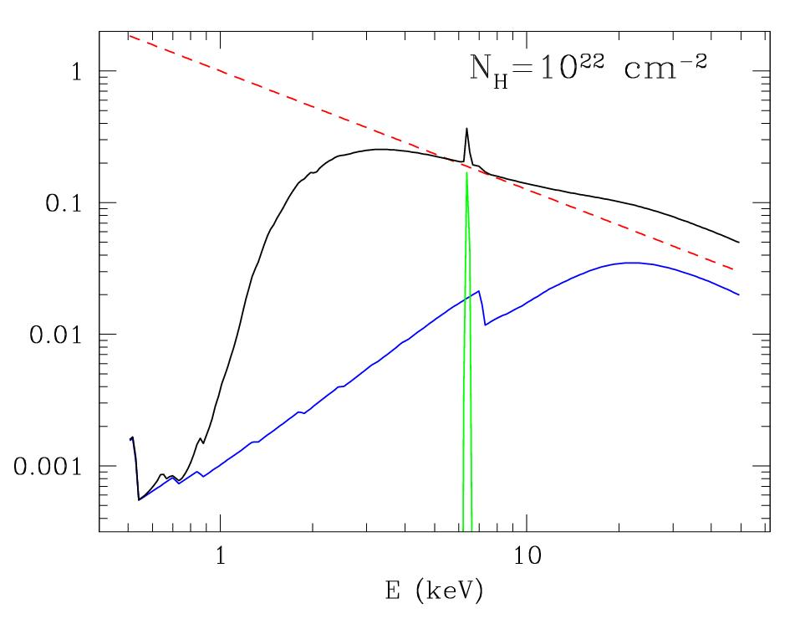
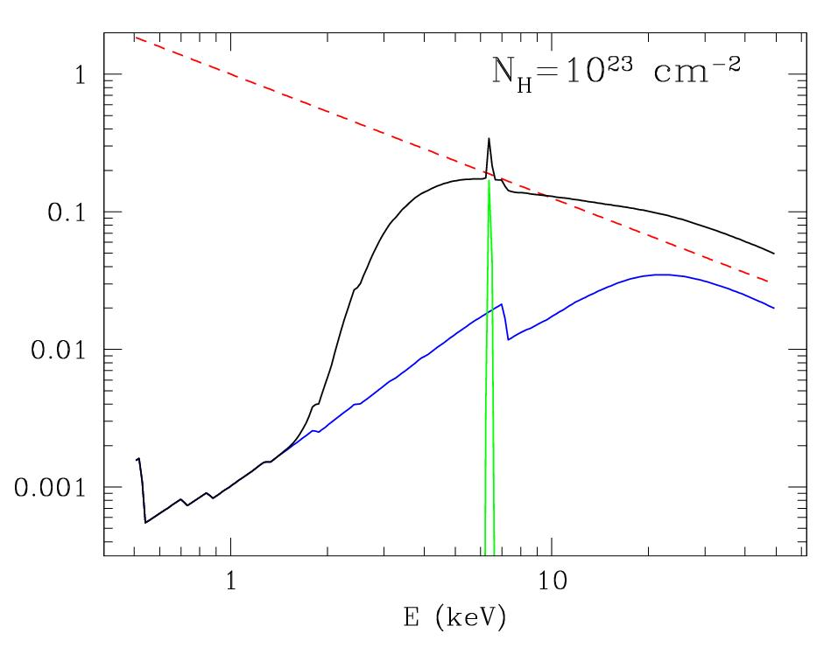
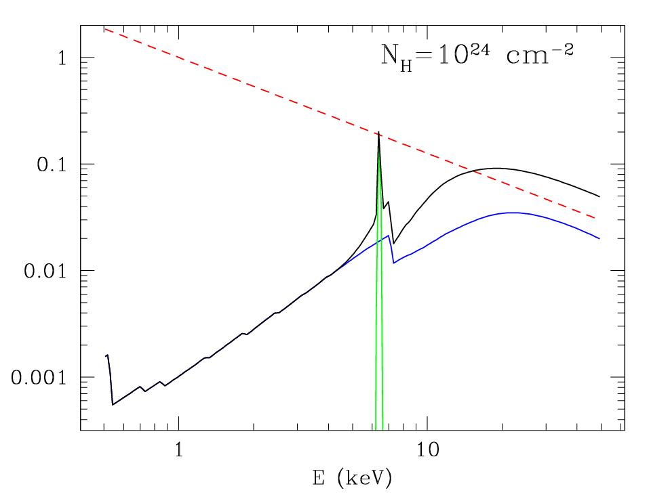
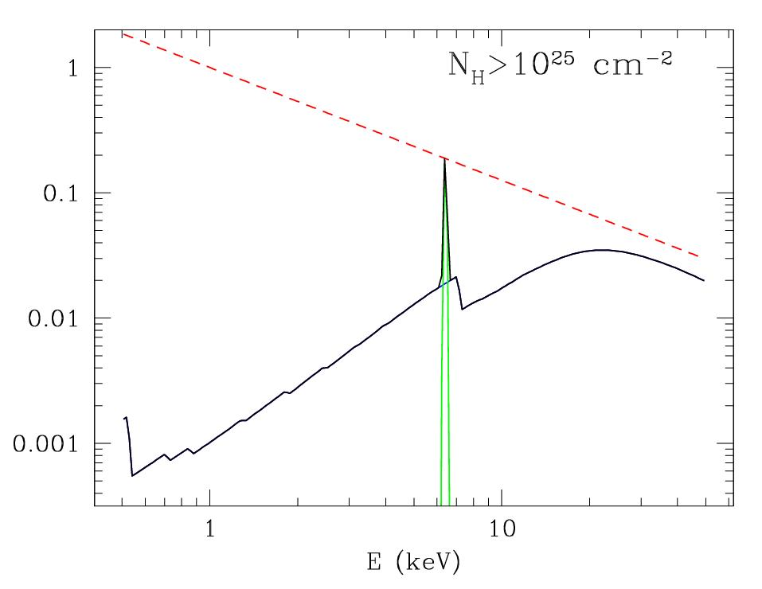
Cold absorbtion
obscuring
“torus”
disk+corona

Slide 4
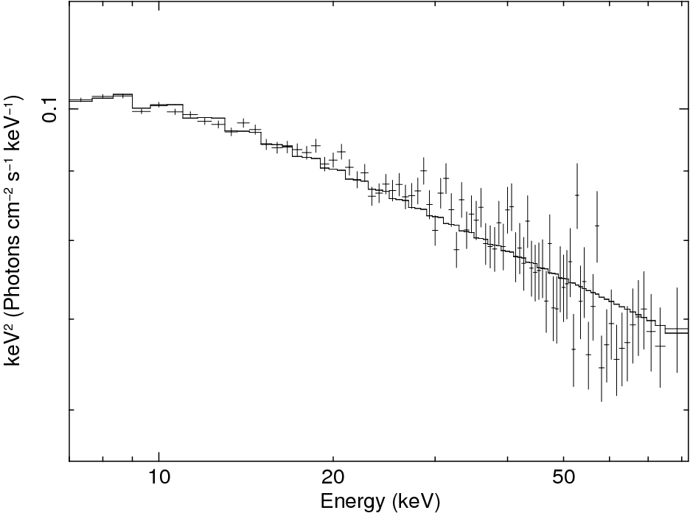
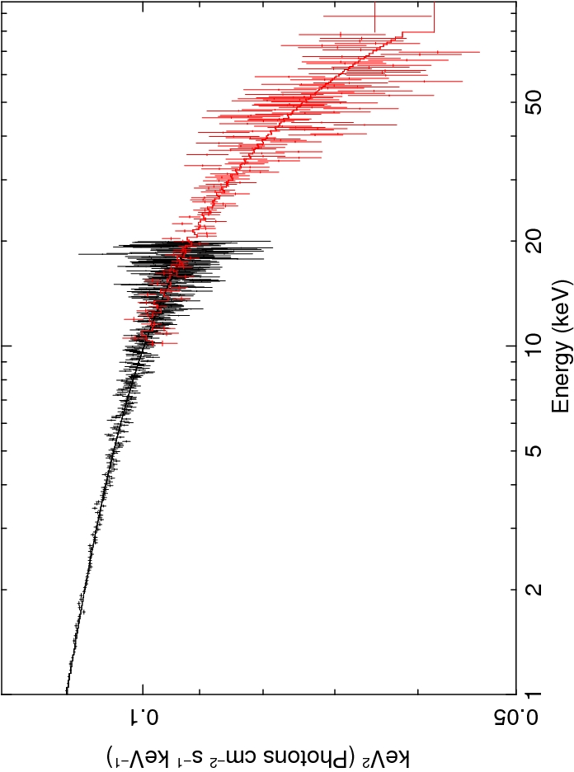
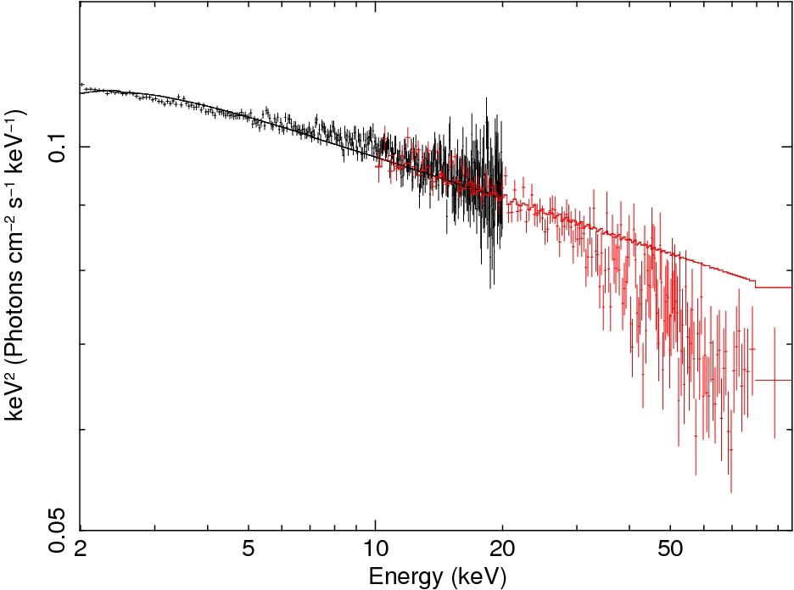
Continuum emission
Disk + Corona model:
Open questions: - Is the model correct ? (Comptonization spectra)
- Geometry of the hot corona (Disc? Sphere?)
- Electron temperature (→ Cut-off energy)
Componization
Model:
kT=100 keV
Opt.depth=0.1
NuStar
Red. χ²=1.01
No cut off!
NHXM

Slide 5
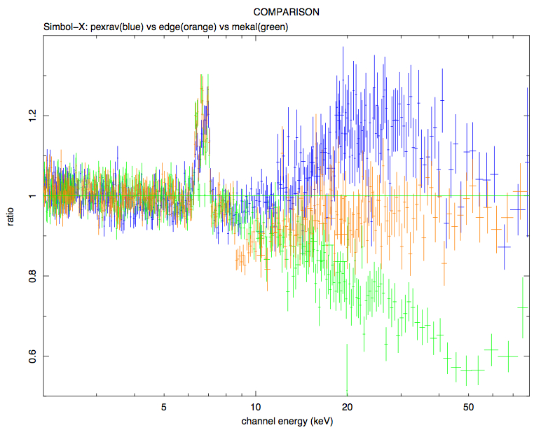
Continuum emission: low luminosity AGN
Soft+Hard band: distinction between ADAF, reflection, photoionization
reflection
phot.
ADAF
De Cia et al. 2008

Slide 6
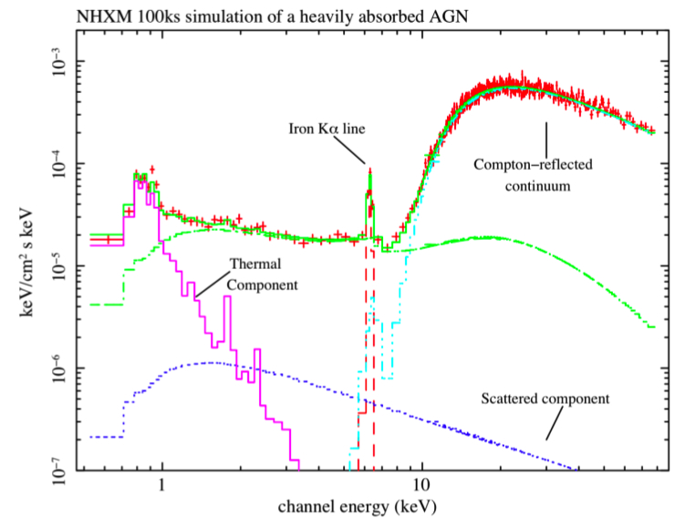
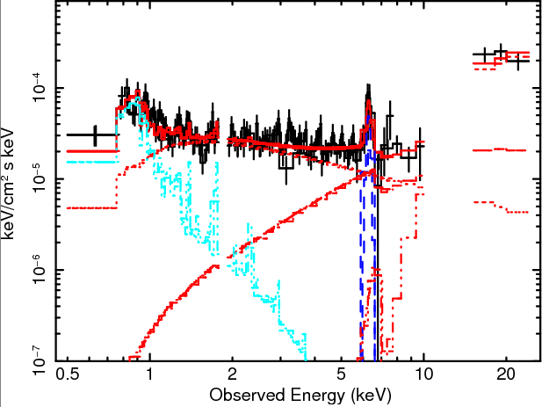
Absorption
Detection of heavily obscured AGN (e.g. in ULIRGs)
Superantennae:
(Braito et al. 09)
Suzaku
NHXM
Note: Even for AGN-dominated ULIRGs with N_{H}~10²⁴ cm⁻², detection today possible only for ~3-5 objects!!

Slide 7
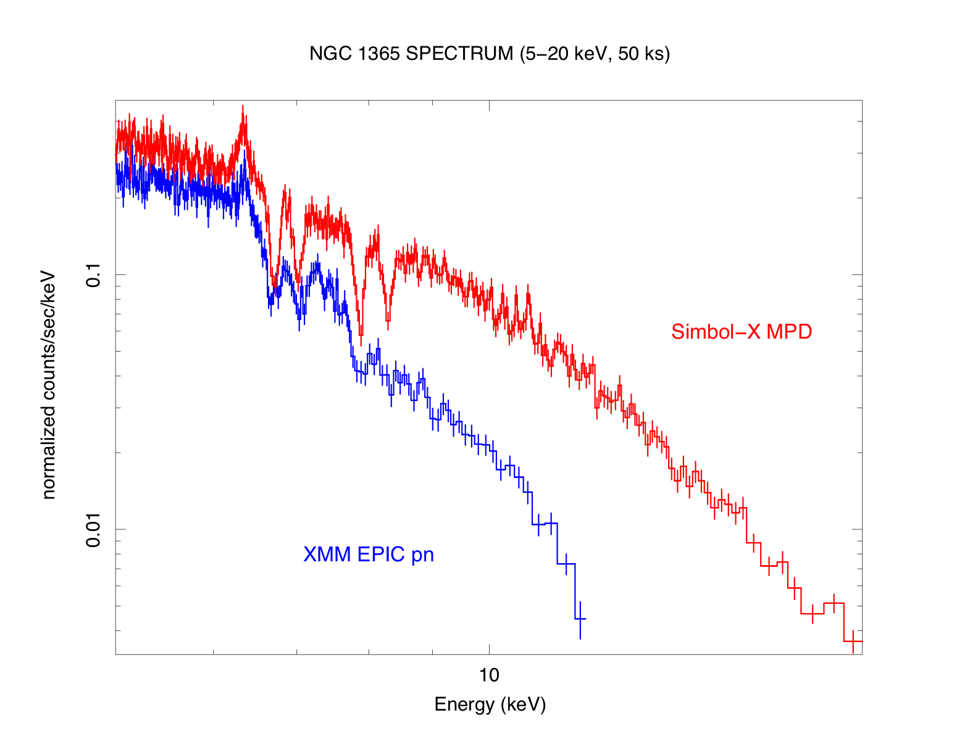
Absorption
Absorption lines: wind/outflows in AGN:
Requirements: High area in the 6-15 keV range to detect lines;
Spectrum up to 100 keV to determine continuum
1st Case: Bright Seyferts, low-velocity outflows → physics of the gas
Fe XXVI Kα
Fe XXV Kα
Fe XXV Kβ
V_{out}~ 3000 km/s
NGC 1365
Fe XXVI Kβ
NHXM
(Cappi et al. 2008)

Slide 8
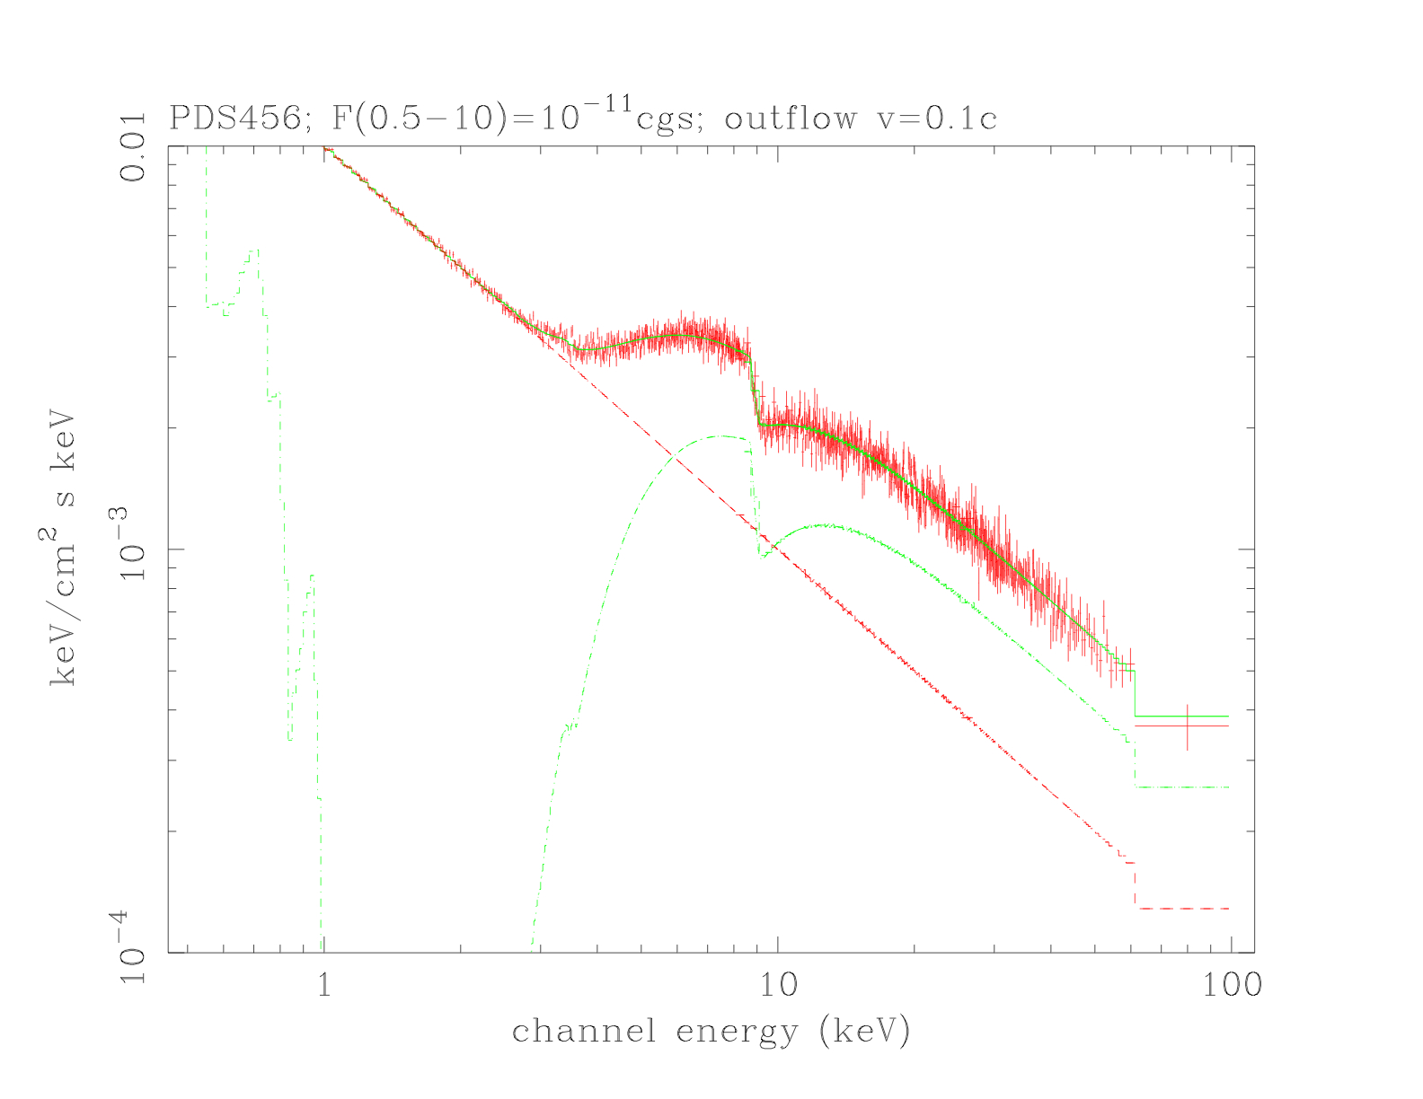
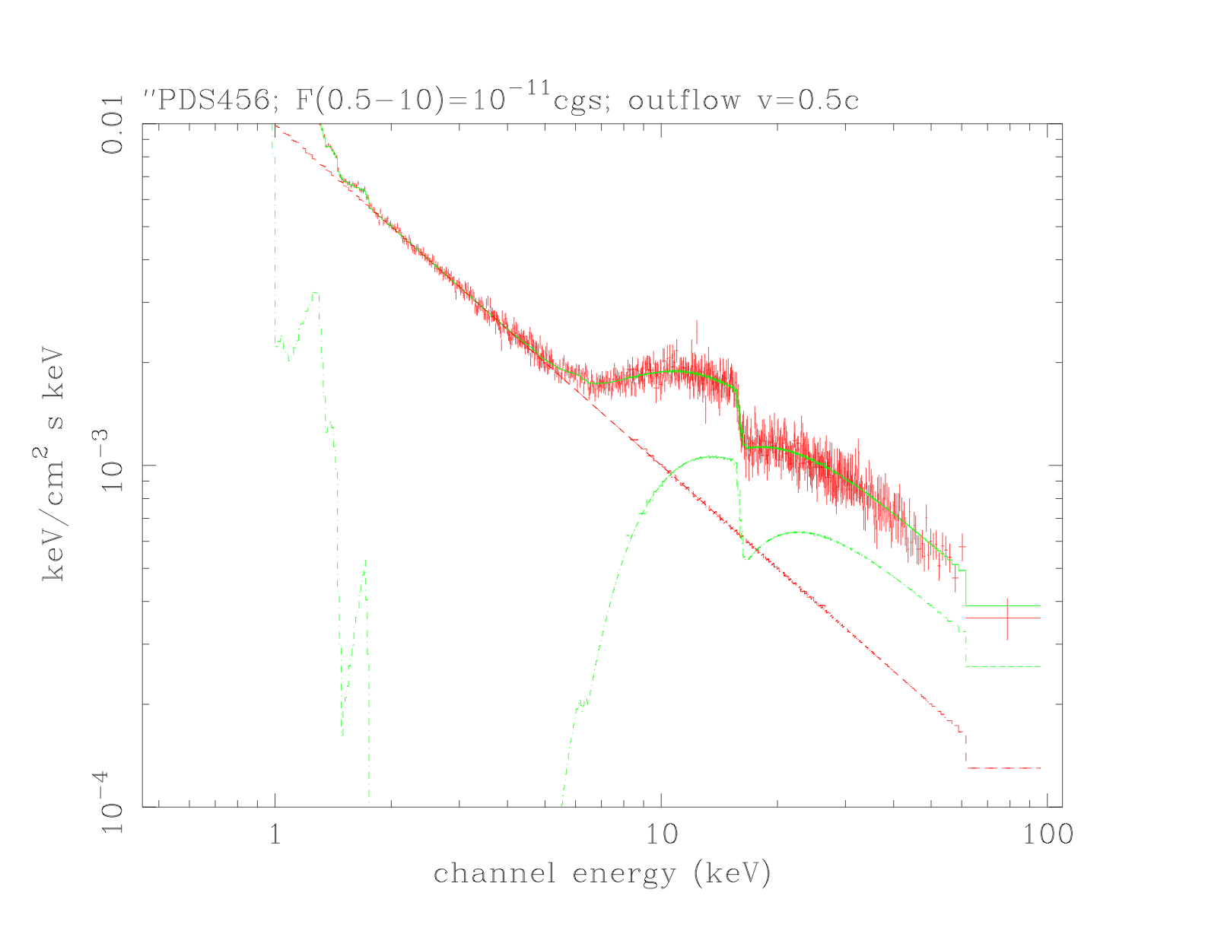
Absorption
2nd Case: High-velocity outflows (feedback) in quasars

Slide 9
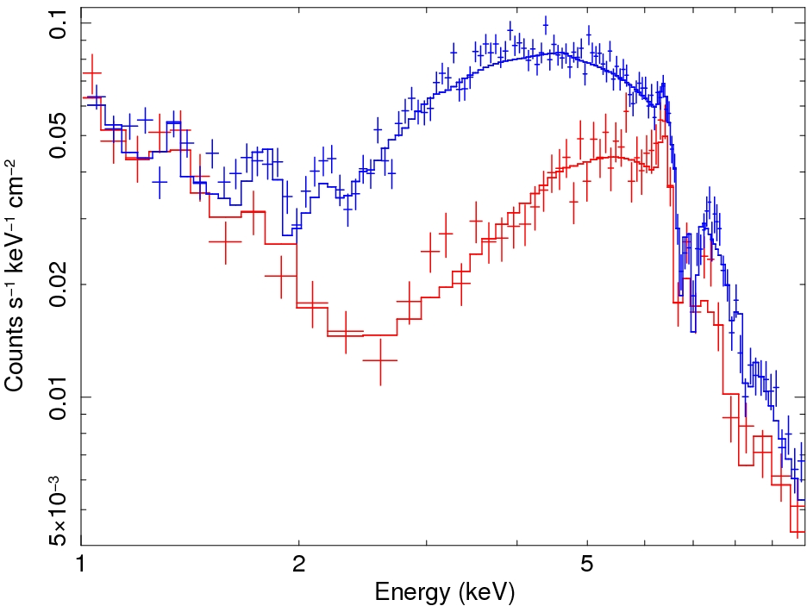
Absorption
X-ray source
Variability:
- Common (now seen in several Seyferts)
Powerful tool to study circumnuclear absorber
Need to consider it in any complete spectral analysis
cloud
NGC 1365:
ΔΤ=30 ks
ΔN_{H}=2x10²³cm⁻²
Δ(Cov.Fact.)=50%
Risaliti et al. 2002,05,07,08,09
Elvis et al. 2004
Puccetti et al. 2007
Maiolino et al. 2009

Slide 10
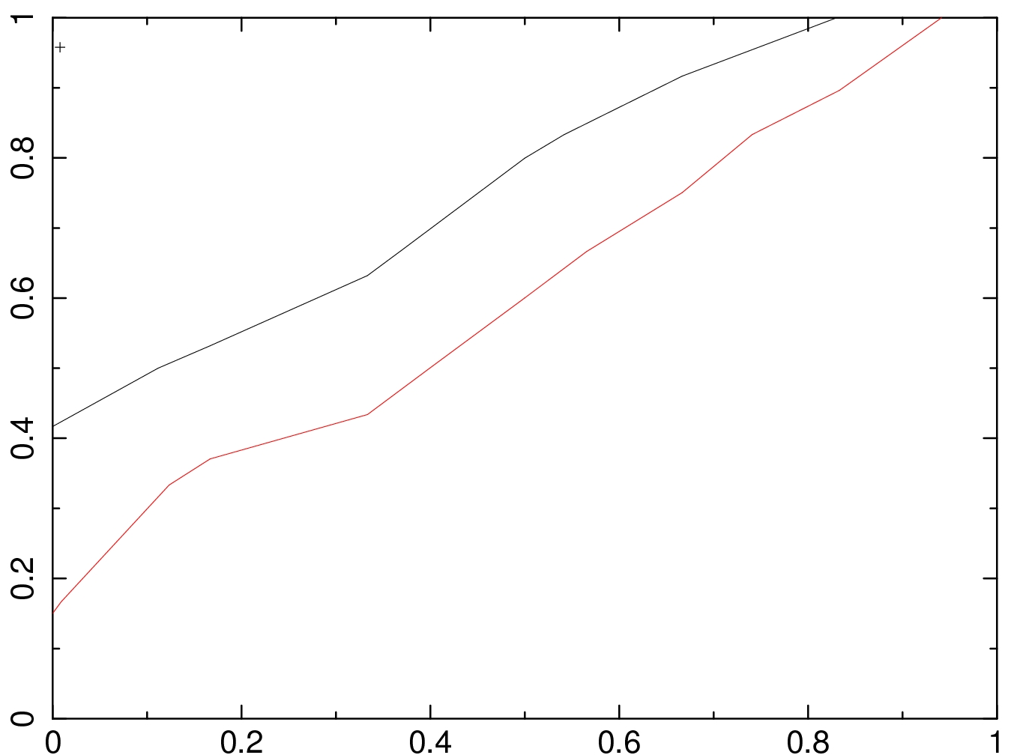
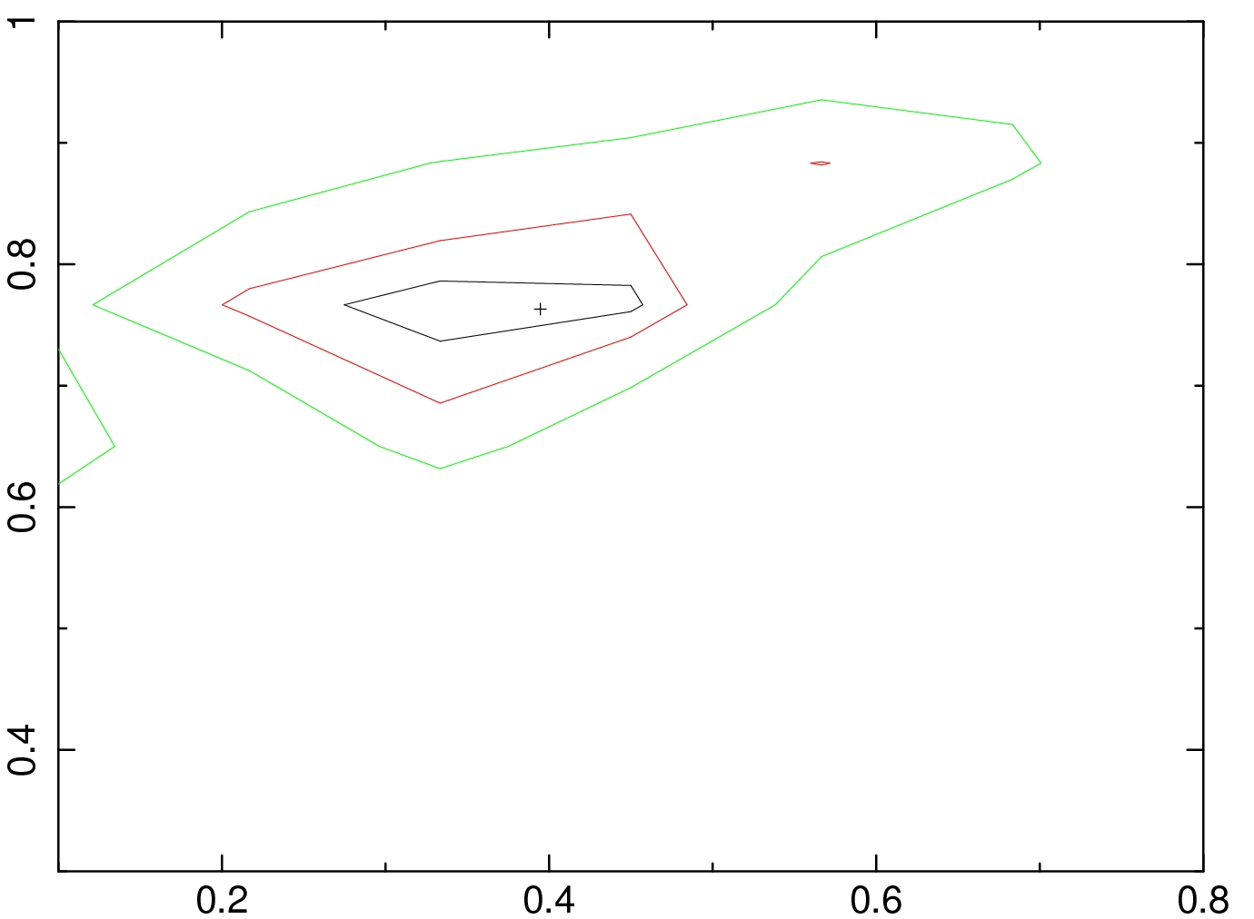
Absorption
Simulation with a realistic model: reflection, rel. line, soft exc., part. cov.
2 intervals, 10 ksec each.
N_{H1}=2x10²³cm⁻², complete covering,
N_{H2}=2x10²³cm⁻², Partial covering: CF1=40% ➔ CF2=80%
Cov. Fact. 2
Cov. Fact. 2
XMM: No C.F. variation
NHXM: C.F. variation detected
Cov. Fact. 1
Cov. Fact. 1

Slide 11
Absorption
Compton thick partial covering:
- Warped disk?
- Very dense and very small clouds at the base of the disk driven wind?
Only two cases known
so far…
N_{H} ~ 3 10²⁴ cm⁻²
Cov. Fact ~ 80%
transmitted
component
Risaliti et al. 2009
Turner et al. 2009
intrinsic
component
…but may be much
more common: their
identification is limited
by current
sensitivities at E>10 keV
(along with E <10 keV)

Slide 12
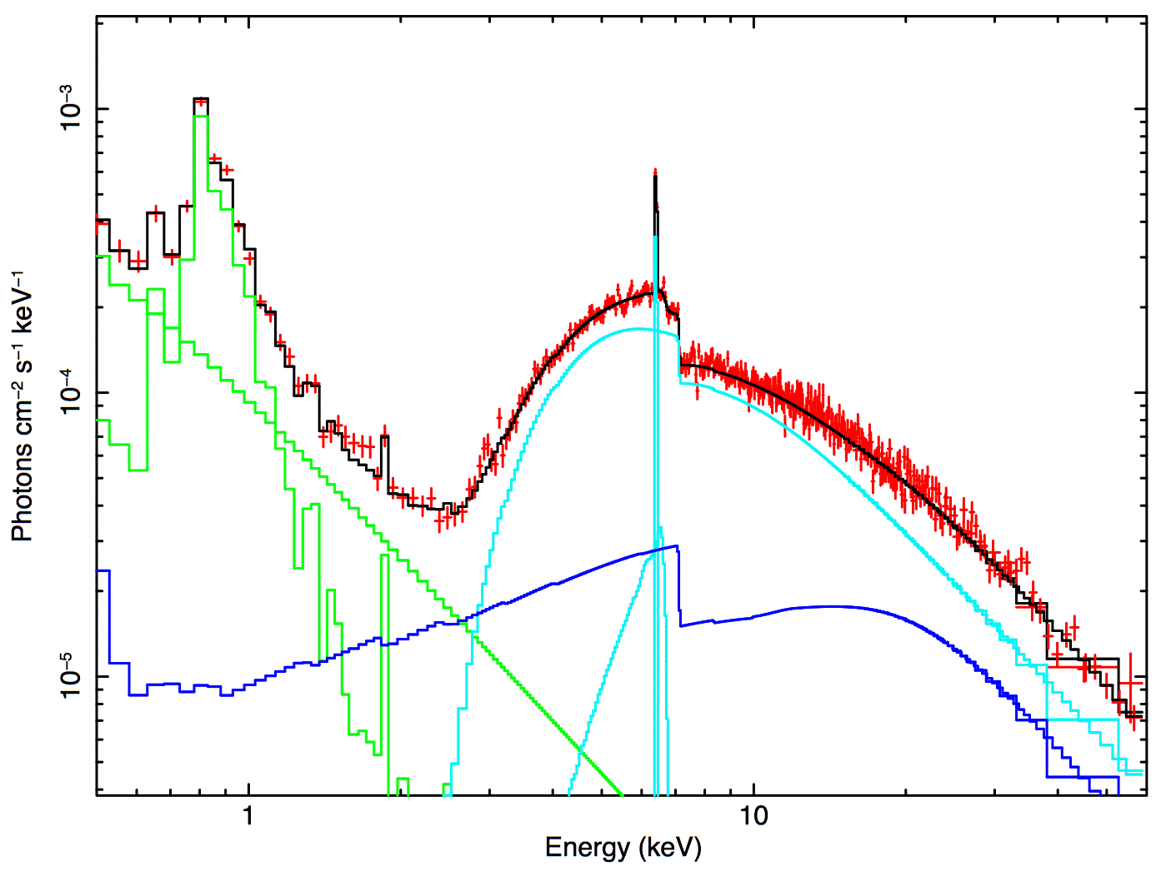
Reflection
Determination of continuum reflection component in bright AGNs
Currently uncertain by ~50% even in the brightest AGN
Needed to understand the structure & geometry of the circumnuclear medium
cold
reflection

Slide 13
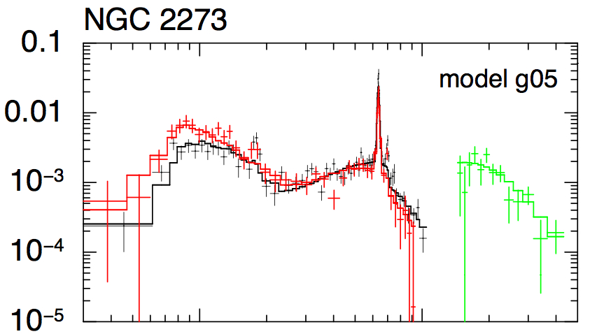
Reflection
2) Study of reflection-dominated objects: Compton hump
Only NGC 1068 in bright catalogs (BAT, Integral)
Very few other spectra, NO ONE with good spectrum
NGC2273
Awaki et al. 2009
1
10
Energy (keV)

Slide 14
Reflection
3) Reflection-dominated objects. Expected strong polarization: - energy-dependent: function of inclination angle wrt line of sight;
polarization angle: orientation of “reflector” on the sky
➔ how does it compare with the other nuclear components?
ionization
cone
2-5.6 keV
16-45 keV
126-355 keV
mid-IR
(dusty torus)
cos i
Ghisellini et al. 1994
Raban et al. 2009

Slide 15
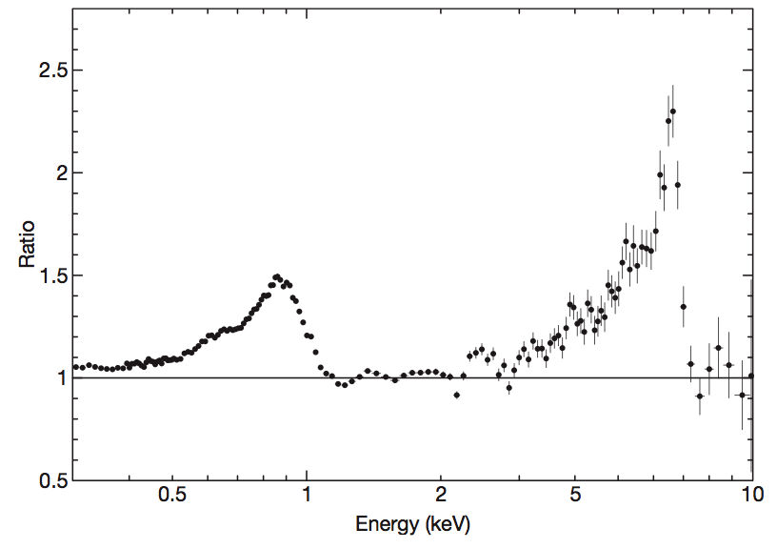
Probing Strong Gravity
Probing GR effects in AGN spectra:
Iron (K, L) relativistic lines:
shape & delays
2) Continuum polarization (NHXM):
rotation of polarization angle
Both methods provide independent
measurements of the disk geometry
and BH spin
1H0707-495
Fabian et al. 2009
Dovciak et al. 2004

Slide 16
“Old” XMM-Newton science
At least 3 times more area @ 6 keV
Future of bigger mission uncertain (and very long time scales)
Broad Iron lines in bright objects (variability, profile)
Broad Iron lines in fainter objects (increasing the sample, are they ubiquitous?
Short time scale continuum variability (power spectra etc..)

Slide 17
Conclusions
1) High Energy spectra and X-ray polarimetry key to solve many outstanding open issues in AGN physics.
2) In many cases, soft (1-10 keV) + hard (>10 keV) needed to solve problems: hard spectra alone would not suffice.
3) More generally, the majority of AGN-related fields will enormously benefit of the unprecedented capabilities of NHXM
→ Key role as “observatory” available to the community
(in contrast to PI missions such as NuStar)

